Slide 1
slot Machine game
CSC 4370 Web Programming Project 2
Matt AuGSBURGER
SHAMARI SOUTHWELL
VIRAJ SHAH
Mounica DaTla

Slide 2
WHY SLOTS?
We created an interactive slot machine game using HTML, CSS, and PHP.
HTML and CSS were used to develop the front end and the game logic was created using PHP.
http://codd.cs.gsu.edu/~maugsburger1/Project2/slotmachine.php
https://github.com/youngvz/SlotMachine

Slide 3
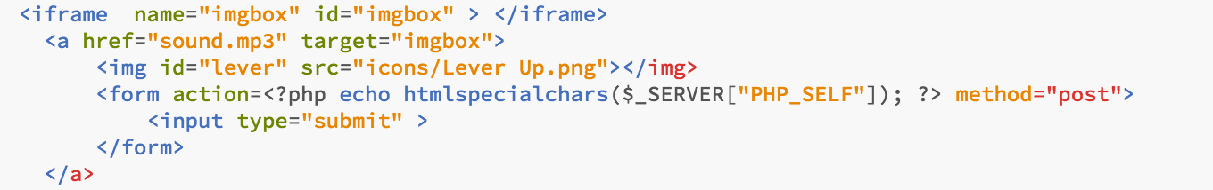
Playing sound using An iframe

Slide 4
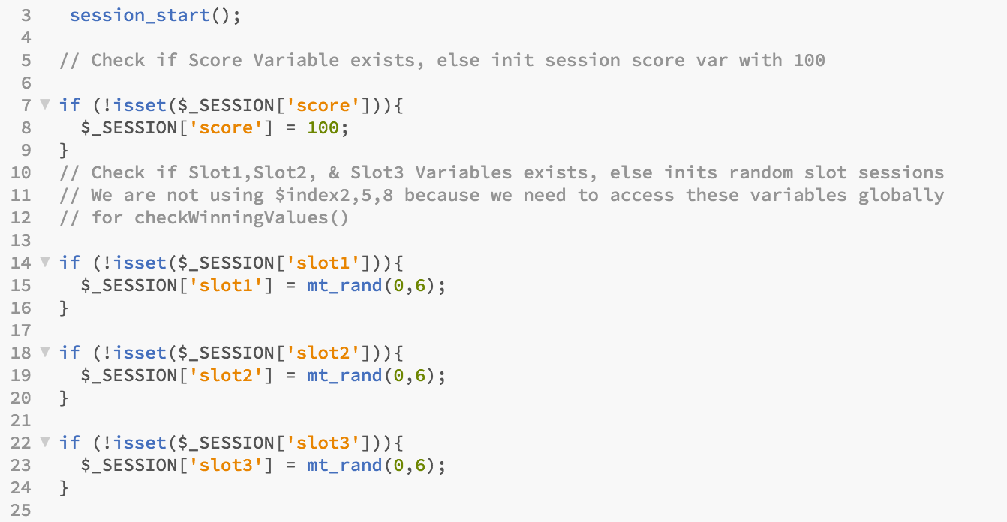
PHP SESSIONS

Slide 5
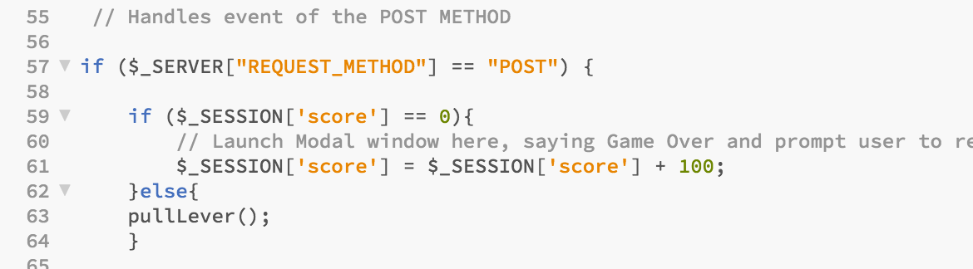
PHP POST METHOD

Slide 6
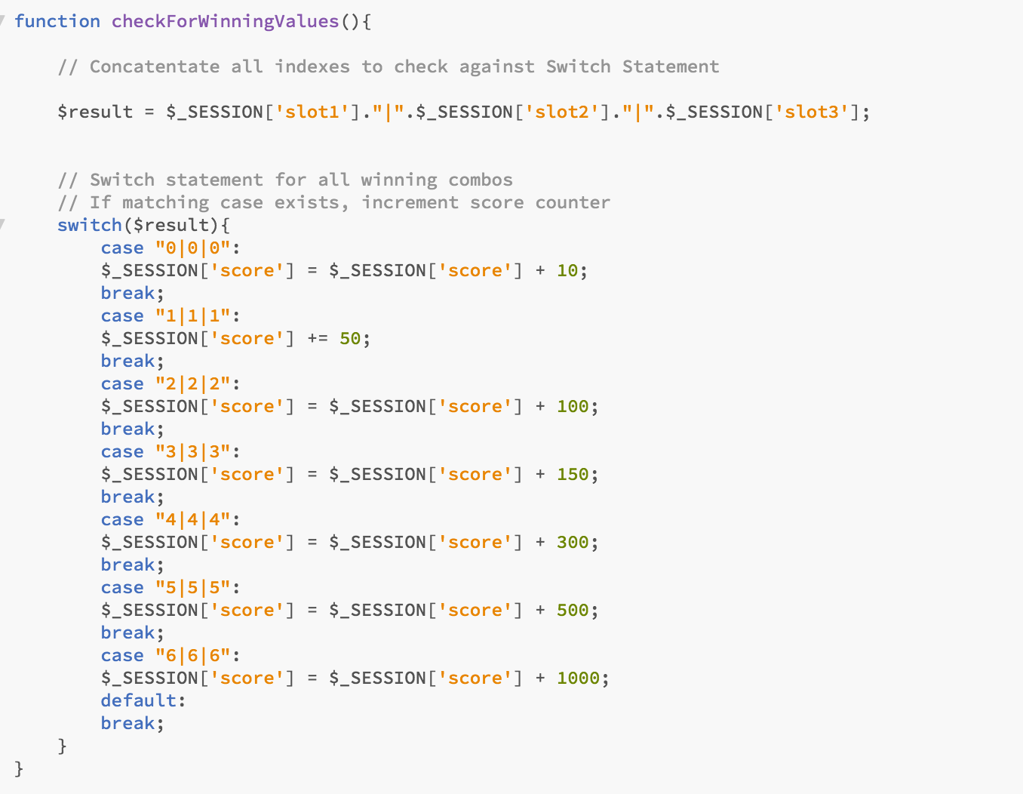
SLOT MACHINE LOGIC

