Slide 1
Android Phone with IoTivity

Slide 2





Android things with IoTivity Environment
Host computer
OS: windows 10 pro 64
Memory: 16GB
CPU: Intel® Core™ i5-8500
Software: JDK 8, IoTivity 1.3.1.aar, Android Studio

Slide 3
Development of IoTivity Client
Start Android Studio
Import IoTivity Base Android API Binary
Programming
Execute Application

Slide 4
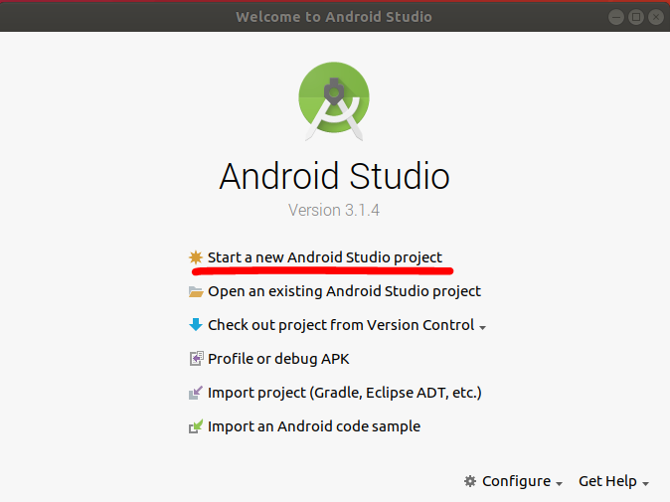
Development of IoTivity Client
Start Android Studio
Start a new Android Studio project
Import IoTivity Base Android API Binary
Programming
Execute Application

Slide 5
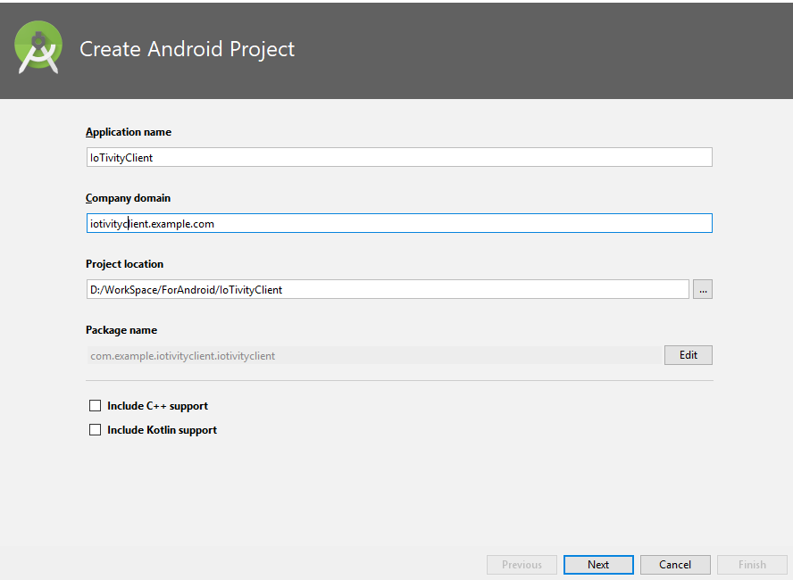
Development of IoTivity Client
Start Android Studio
Start a new Android Studio project
Set information
Import IoTivity Base Android API Binary
Programming
Execute Application

Slide 6
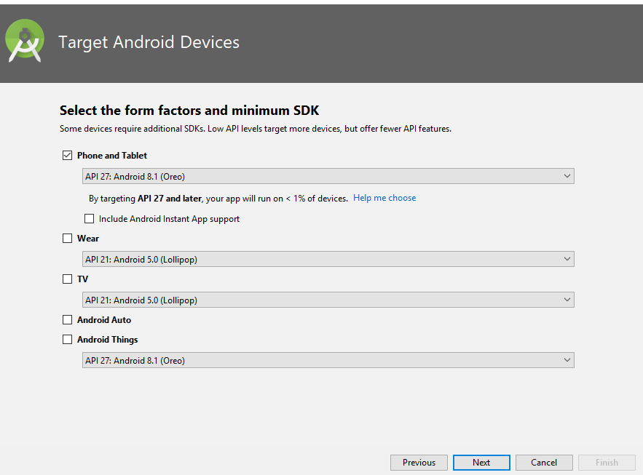
Development of IoTivity Client
Start Android Studio
Start a new Android Studio project
Set information
Choose device and Android version
Import IoTivity Base Android API Binary
Programming
Execute Application

Slide 7
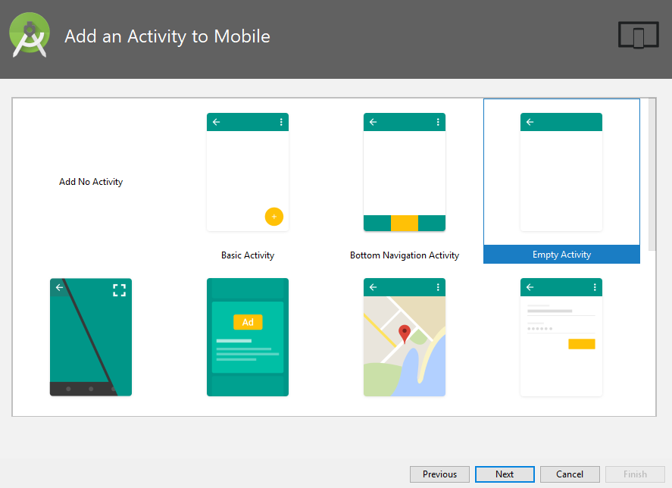
Development of IoTivity Client
Start Android Studio
Start a new Android Studio project
Set information
Choose device and Android things version
Add Activity: default
Import IoTivity Base Android API Binary
Programming
Execute Application

Slide 8
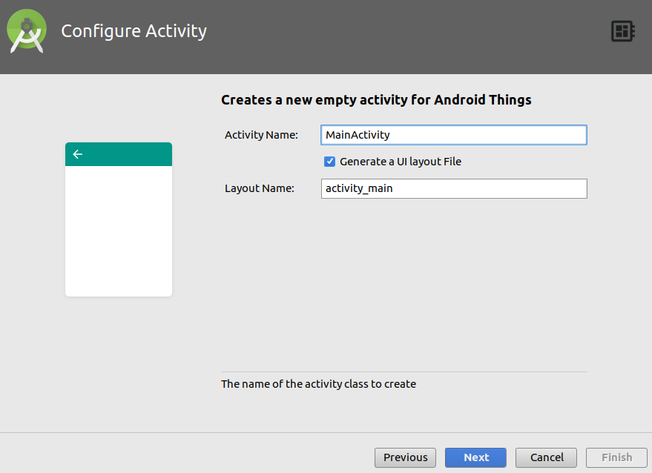
Development of IoTivity Client
Start Android Studio
Start a new Android Studio project
Set information
Choose device and Android things version
Add Activity: default
Configure Activity: default
Import IoTivity Base Android API Binary
Programming
Execute Application

Slide 9
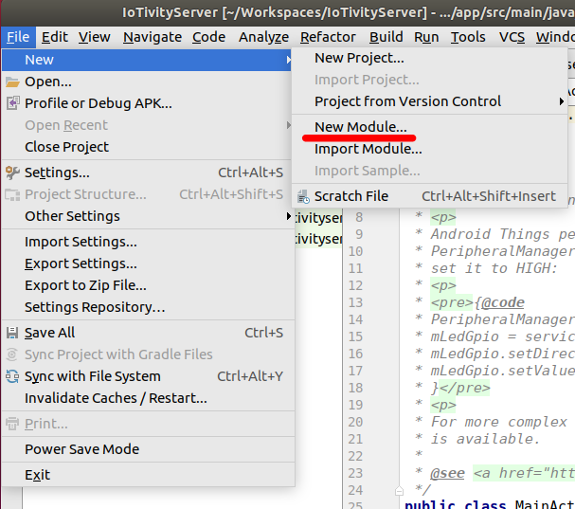
Development of IoTivity Client
Start Android Studio
Import IoTivity Base Android API Binary
Add module of android iotivity release
From the file menu, select New Module
Programming
Execute Application

Slide 10
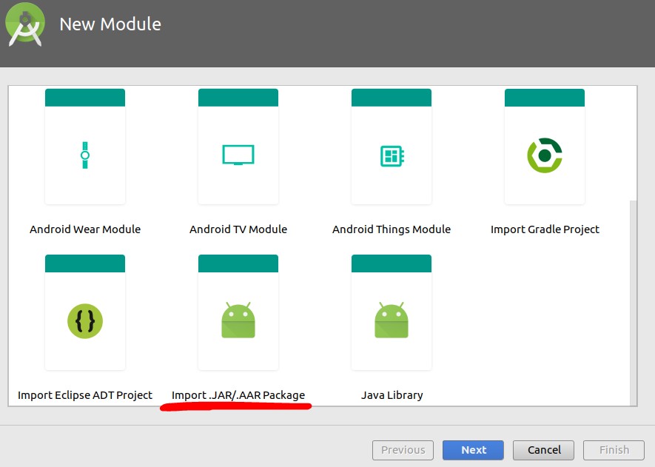
Development of IoTivity Client
Start Android Studio
Import IoTivity Base Android API Binary
Add module of android iotivity release
From the file menu, select New Module
Select Import .JAR/.ARR package
Programming
Execute Application

Slide 11
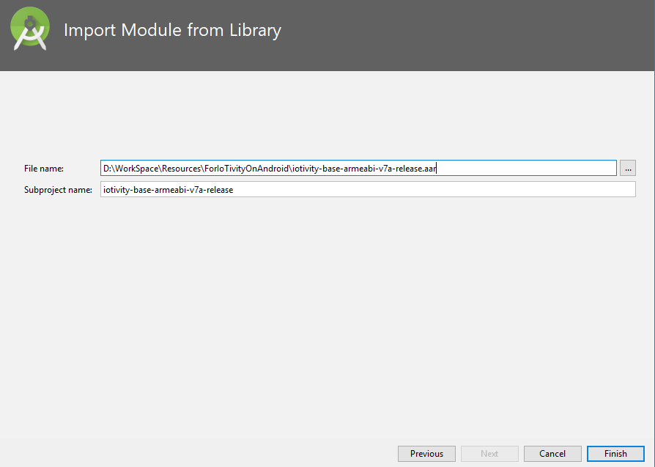
Development of IoTivity Client
Start Android Studio
Import IoTivity Base Android API Binary
Add module of android iotivity release
From the file menu, select New Module
Select Import .jar/.arr package
Locate to ARR file
Programming
Execute Application

Slide 12
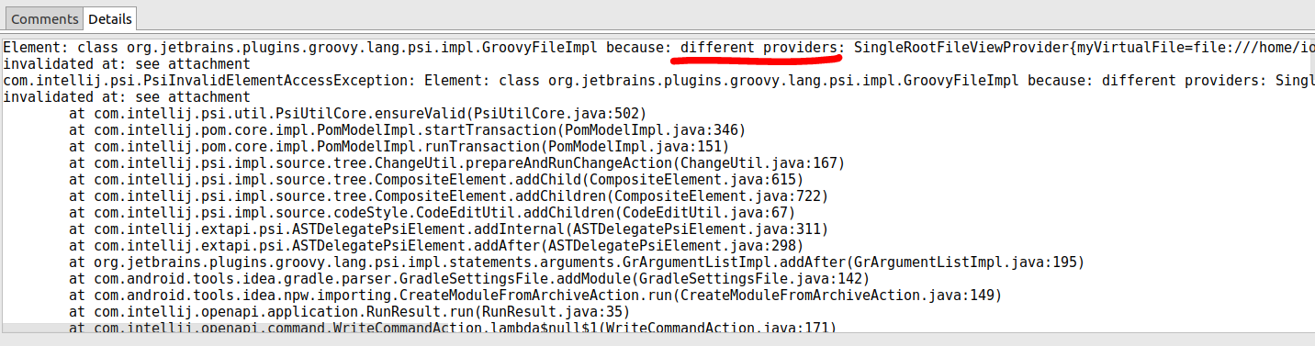
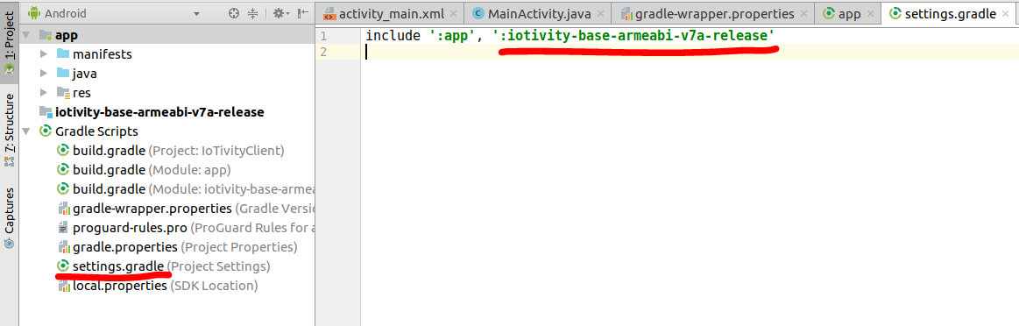
Development of IoTivity Client
Start Android Studio
Import IoTivity Base Android API Binary
Add module of android iotivity release
Manually add when there is an error occurred
In settings gradle file
Include ‘:app’, ‘:your_module_name’
Programming
Execute Application

Slide 13
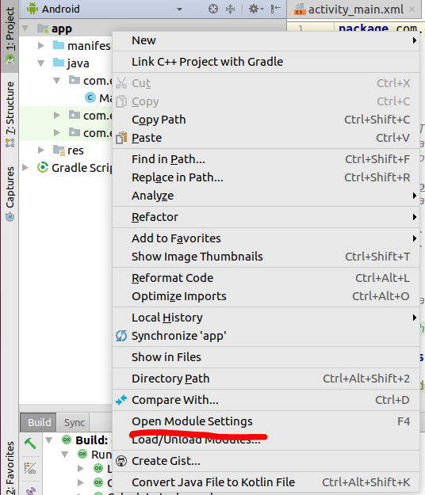
Development of IoTivity Client
Start Android Studio
Import IoTivity Base Android API Binary
Add module of android iotivity release
Settings dependency
Add module dependency
right click on app
Programming
Execute Application

Slide 14
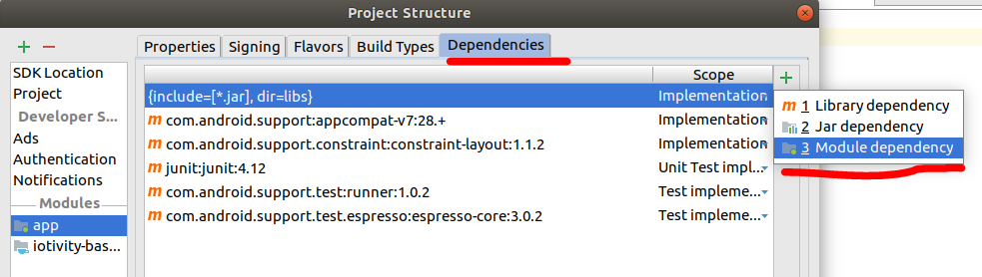
Development of IoTivity Client
Start Android Studio
Import IoTivity Base Android API Binary
Add module of android iotivity release
Settings dependency
Add module dependency
right click on app
Click module dependency
Programming
Execute Application

Slide 15
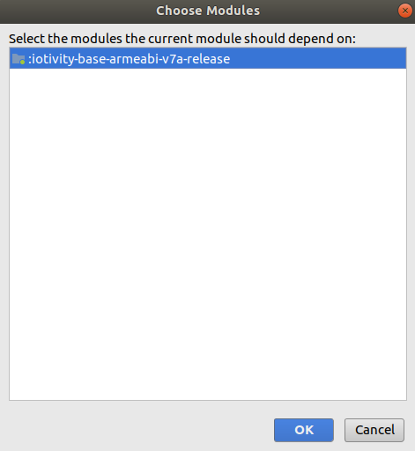
Development of IoTivity Client
Start Android Studio
Import IoTivity Base Android API Binary
Add module of android iotivity release
Settings dependency
From the file menu, select New Module
Select Import .jar/.arr package
Locate to ARR file
Add module dependency
right click on app
Click module dependency
Choose expect dependency
Programming
Execute Application

Slide 16
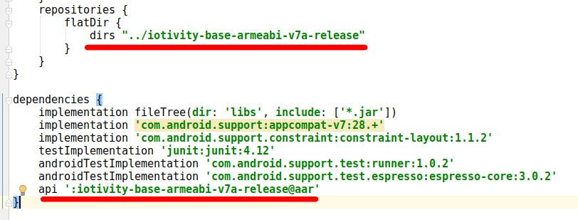
Development of IoTivity Client
Start Android Studio
Import IoTivity Base Android API Binary
Add module of android iotivity release
Settings dependency
Another function to Add module dependency
Programming
Execute Application
Directory path:
assume that in top of project folder create directory for android release iotivity and copy to there.
Build.Gradle file is under top of the project folder so the path is ../<name of you created directory>
Android release name: name + @ + arr

Slide 17
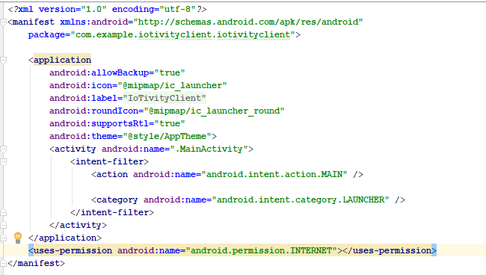
Development of IoTivity Client
Start Android Studio
Import IoTivity Base Android API Binary
Programming
Set permissions
Execute Application
Notes:
Open interconnect consortium = open connectivity foundation

Slide 18
Development of IoTivity Client
Start Android Studio
Import IoTivity Base Android API Binary
Programming
Set permissions
In MainActivity Create StartClient function
PlatformConfig
Find resource
Execute Application
public void startIoTivityClient(){ Log.d(TAG, "initialize IoTivity Client"); PlatformConfig platformConfig = new PlatformConfig(this, ServiceType.IN_PROC, ModeType.CLIENT, "0.0.0.0", 0, QualityOfService.LOW); OcPlatform.Configure(platformConfig); Log.d(TAG, "find resource use transport ip"); String uri = "coap://"+ IP +OcPlatform.WELL_KNOWN_QUERY + "?rt=core.temperature"; try{ OcPlatform.findResource("", uri, EnumSet.of(OcConnectivityType.CT_DEFAULT), this); } catch (OcException e){ Log.d(TAG,"error for resource find :" + e.toString()); } }
Notes:
Open interconnect consortium = open connectivity foundation

Slide 19
Development of IoTivity Client
Start Android Studio
Import IoTivity Base Android API Binary
Programming
Set permissions
In MainActivity Create StartClient function
PlatformConfig
Find resource (call back OcPlatform.OnResourceFoundListener)
onResourceFound
onFindRsourceFailed
Execute Application
@Override public synchronized
void onResourceFound(OcResource ocResource) { if (null == ocResource){ Log.d(TAG, "Found resource is invalid"); return; } String resourceName = "/t/temperature"; if(ocResource.getUri().equals(resourceName)){ HashMap<String,String> queryResults = new HashMap<>(); try{ ocResource.get(queryResults, this); }catch (OcException e){ Log.d(TAG, "get resource data error :" + e.toString()); } } else { Log.d(TAG, "no resource :" + resourceName); } } @Override public void onFindResourceFailed(Throwable throwable, String s) { Log.d(TAG, "find resource request has failed" + throwable.toString()); }
Notes:
Open interconnect consortium = open connectivity foundation

Slide 20
Development of IoTivity Client
Start Android Studio
Import IoTivity Base Android API Binary
Programming
Set permissions
In MainActivity Create StartClient function
PlatformConfig
Find resource (call back OcPlatform.OnResourceFoundListener)
OcResource.get(call back OcResource.OnGetListener)
onGetCompleted
onGetFailed
Execute Application
@Override public synchronized
void onGetCompleted(List<OcHeaderOption> list, OcRepresentation ocRepresentation) { Log.d(TAG, "get temperature"); try{ String temp = ocRepresentation.getValue("temperature");
msg(temp); }catch (OcException e) { Log.d(TAG,"error for get temperature :" + e.toString()); } } @Override public void onGetFailed(Throwable throwable) { Log.d(TAG, "GET request has failed" + throwable.toString()); }
Notes:
Open interconnect consortium = open connectivity foundation

Slide 21
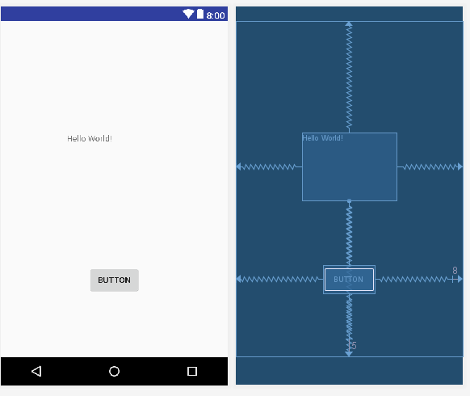
Development of IoTivity Client
Start Android Studio
Import IoTivity Base Android API Binary
Programming
Set permissions
In MainActivity Create StartClient function
Layout configuration
Execute Application
Notes:
Problem:
Android studio rendering problems: in styles.xml file
<style name="AppTheme" parent="Theme.AppCompat.Light.DarkActionBar"> to <style name="AppTheme" parent="Base.Theme.AppCompat.Light.DarkActionBar">
Missing constraint : click infer constraint icon above your design look like wand type tool.

Slide 22
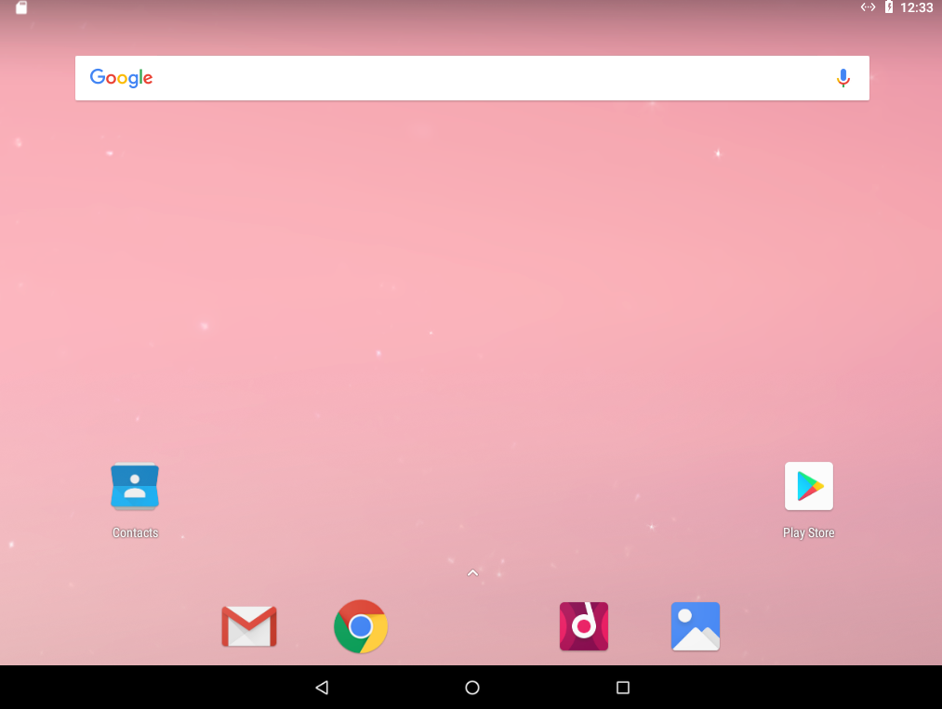
Development of IoTivity Client
Start Android Studio
Import IoTivity Base Android API Binary
Programming
Execute Application
Start Android test bed on virtual box
Notes:
Error
Didn't find class "android.view.View$OnUnhandledKeyEventListener“
Add to build.gradle
// 处理support版本和build tools版本的问题，如果运行没有问题则无需配置
configurations.all {
resolutionStrategy.eachDependency { DependencyResolveDetails details ->
def requested = details.requested
if (requested.group == "com.android.support") {
if (!requested.name.startsWith("multidex")) {
details.useVersion "26.+"
}
}
}
}

Slide 23
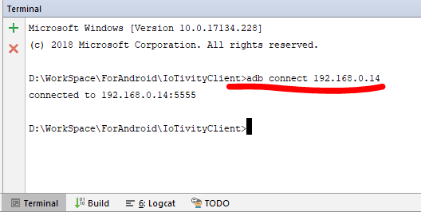
Development of IoTivity Client
Start Android Studio
Import IoTivity Base Android API Binary
Programming
Execute Application
Start Android test bed on virtual box
Adb connection

Slide 24
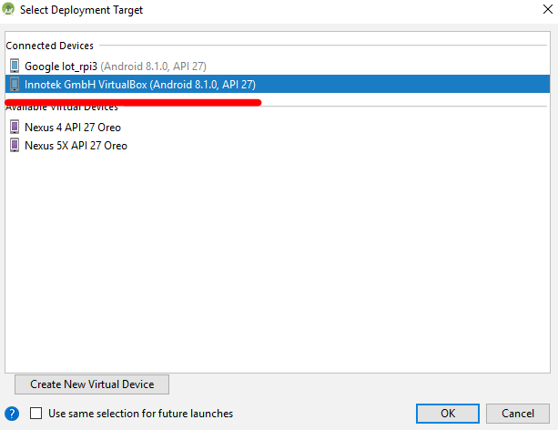
Development of IoTivity Client
Start Android Studio
Import IoTivity Base Android API Binary
Programming
Execute Application
Start Android test bed on virtual box
Adb connection
Start with android test bed

Slide 25
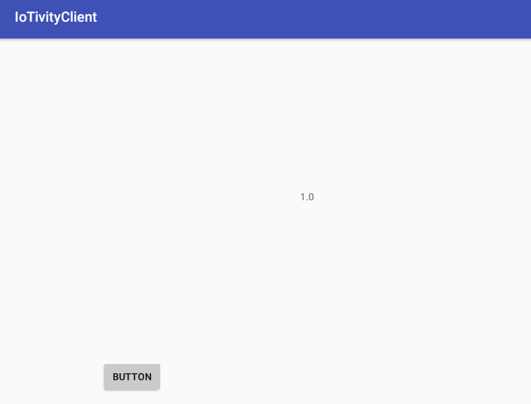
Development of IoTivity Client
Start Android Studio
Import IoTivity Base Android API Binary
Programming
Execute Application
Start Android test bed on virtual box
Adb connection
Start with android test bed

Slide 26
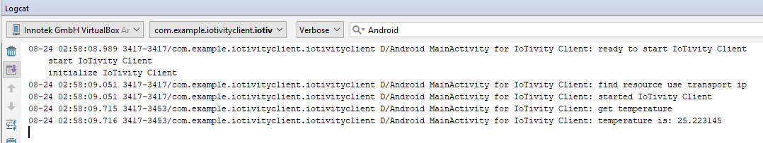
Development of IoTivity Client
Start Android Studio
Import IoTivity Base Android API Binary
Programming
Execute Application
Start Android test bed on virtual box
Adb connection
Start with android test bed

Slide 27
Reference
https://wiki.iotivity.org/android_build_instructions
https://github.com/runtimeco/android_sensor
https://openconnectivity.org/wp-content/uploads/2016/01/IoTivity-101_Vijay-Joey.pdf on 8 page
https://github.com/iotivity/iotivity/blob/master/java/examples-android/simpleclient/src/main/java/org/iotivity/base/examples/SimpleClient.java
https://github.com/kaka120011/AndroidThingsIoTivityClient/blob/master/app/src/main/java/com/kmk/iotivityclient/MainActivity.java
https://gist.github.com/tianzhijiexian/2853c097762a203cd1d024c1f846dcc3

