Slide 1
Android things with IoTivity

Slide 2








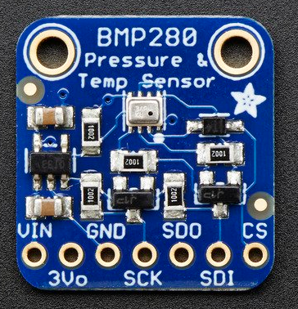
Android things with IoTivity Environment
Host computer
OS: windows 10 pro 64
Memory: 16GB
CPU: Intel® Core™ i5-8500
Guest computer
OS: Ubuntu 18. 04 desktop 64
Memory: 6GB=6144MB
Hard disk: 100GB
Network: bridge
Core: 4
Software: JDK 8, IoTivity 1.3.1, Android Studio
Environment For Raspberry pi 3 Model B
Devices
Raspberry pi 3 model B
BMP 280
Platform
Android things
Android Debug Bridge (ADB)
Guest
Host

Slide 3
Development of IoTivity server
Start Android Studio
Import IoTivity Base Android API Binary
Programming
Connect with Android Things Through ADB(Android Debug Bridge)
Execute Application

Slide 4
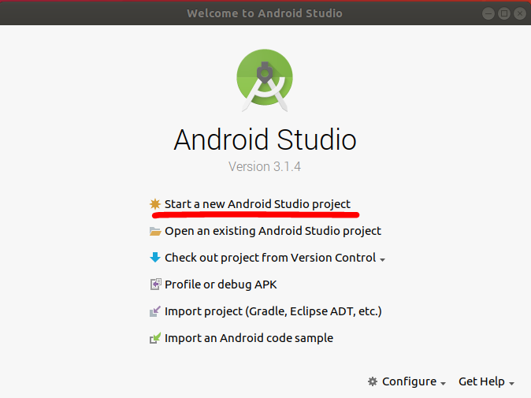
Development of IoTivity server
Start Android Studio
Start a new Android Studio project
Import IoTivity Base Android API Binary
Programming
Connect with Android Things Through ADB(Android Debug Bridge)
Execute Application

Slide 5
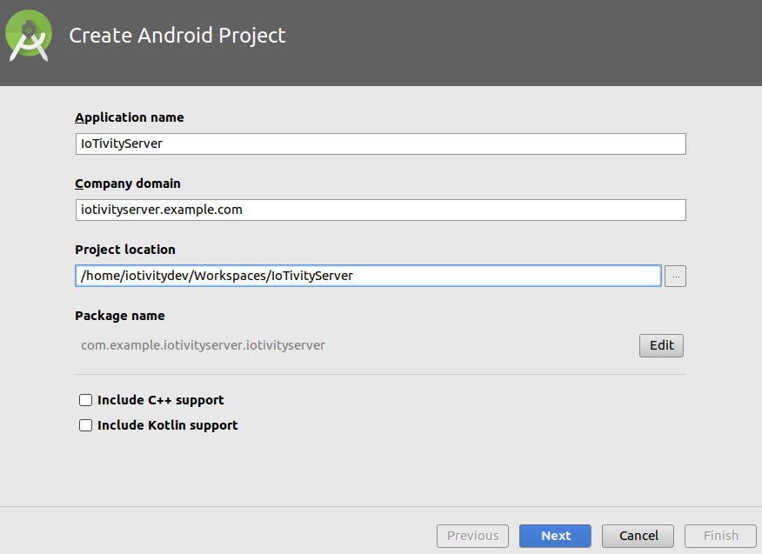
Development of IoTivity server
Start Android Studio
Start a new Android Studio project
Set information
Import IoTivity Base Android API Binary
Programming
Connect with Android Things Through ADB(Android Debug Bridge)
Execute Application

Slide 6
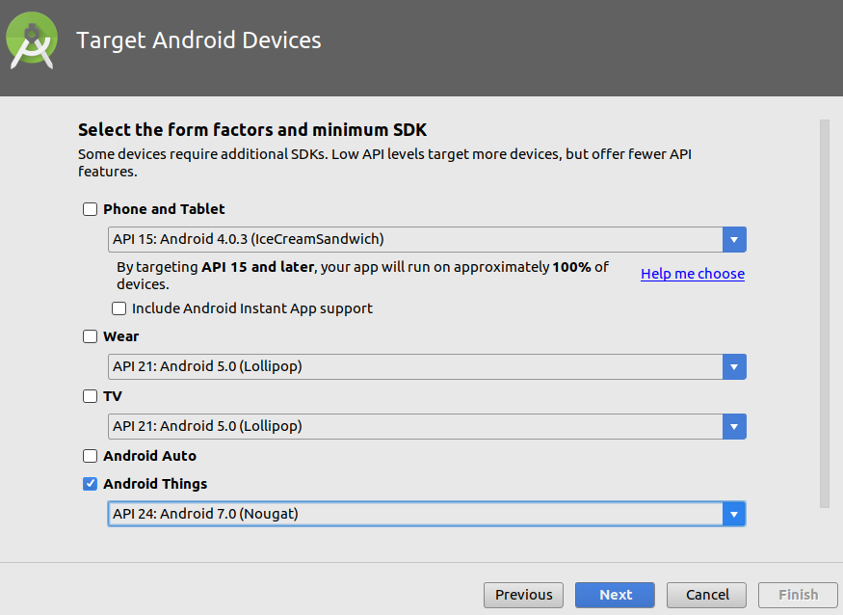
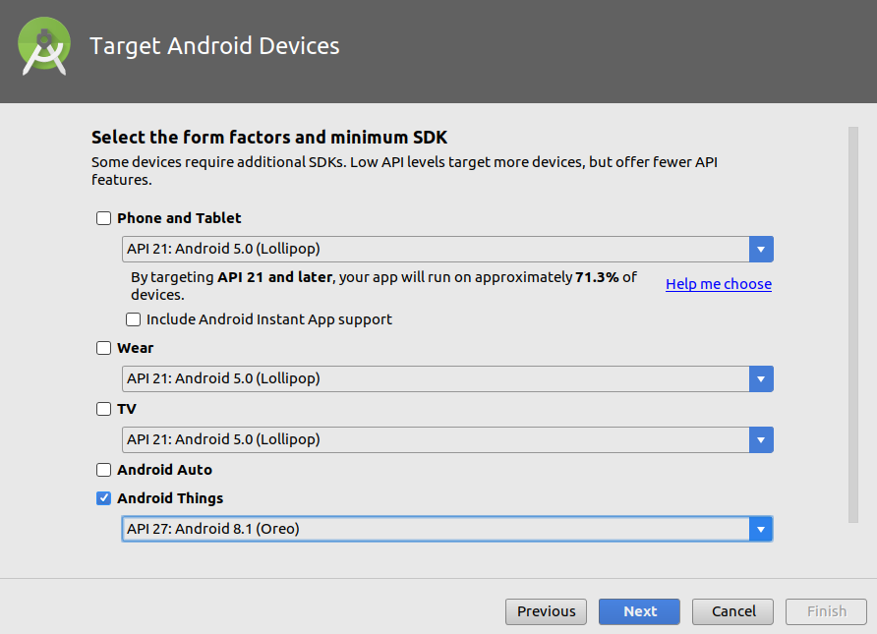
Development of IoTivity server
Start Android Studio
Start a new Android Studio project
Set information
Choose device and Android things version
Import IoTivity Base Android API Binary
Programming
Connect with Android Things Through ADB(Android Debug Bridge)
Execute Application

Slide 7
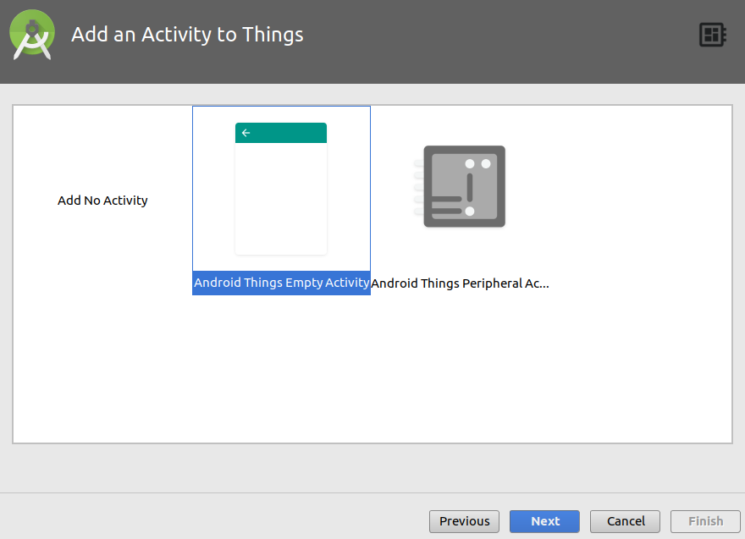
Development of IoTivity server
Start Android Studio
Start a new Android Studio project
Set information
Choose device and Android things version
Add Activity: default
Import IoTivity Base Android API Binary
Programming
Connect with Android Things Through ADB(Android Debug Bridge)
Execute Application

Slide 8
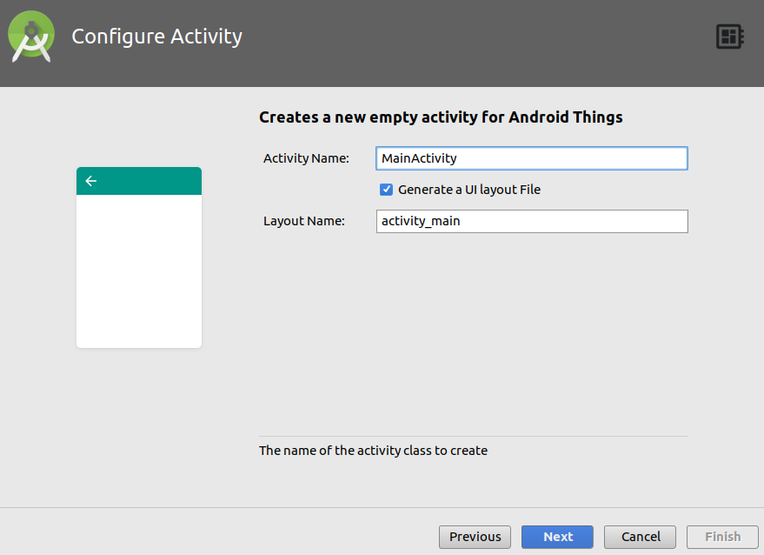
Development of IoTivity server
Start Android Studio
Start a new Android Studio project
Set information
Choose device and Android things version
Add Activity: default
Configure Activity: default
Import IoTivity Base Android API Binary
Programming
Connect with Android Things Through ADB(Android Debug Bridge)
Execute Application

Slide 9
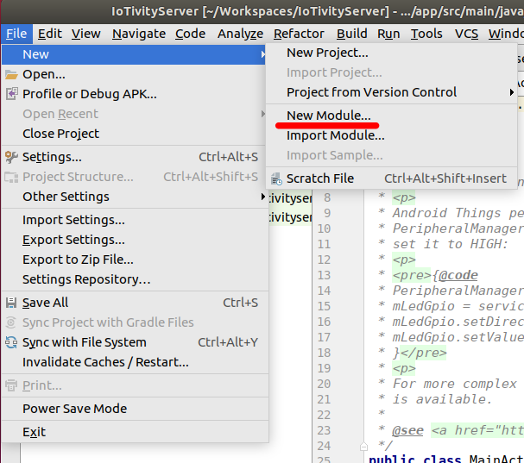
Development of IoTivity server
Start Android Studio
Import IoTivity Base Android API Binary
Add module of android iotivity release
From the file menu, select New Module
Programming
Connect with Android Things Through ADB(Android Debug Bridge)
Execute Application

Slide 10
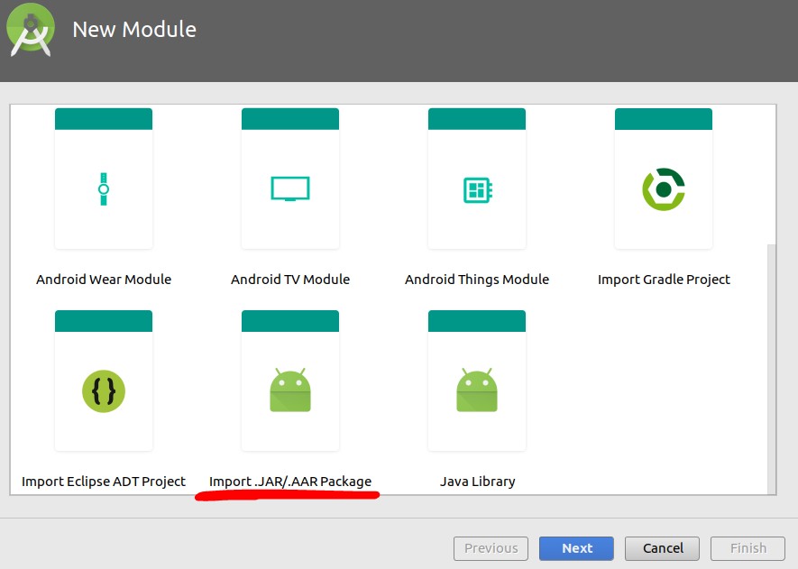
Development of IoTivity server
Start Android Studio
Import IoTivity Base Android API Binary
Add module of android iotivity release
From the file menu, select New Module
Select Import .JAR/.ARR package
Programming
Connect with Android Things Through ADB(Android Debug Bridge)
Execute Application

Slide 11
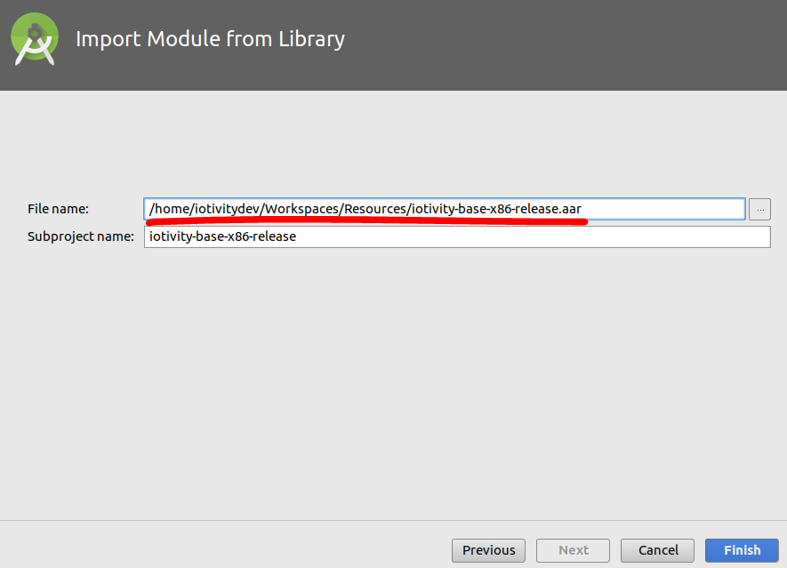
Development of IoTivity server
Start Android Studio
Import IoTivity Base Android API Binary
Add module of android iotivity release
From the file menu, select New Module
Select Import .jar/.arr package
Locate to ARR file
Programming
Connect with Android Things Through ADB(Android Debug Bridge)
Execute Application

Slide 12
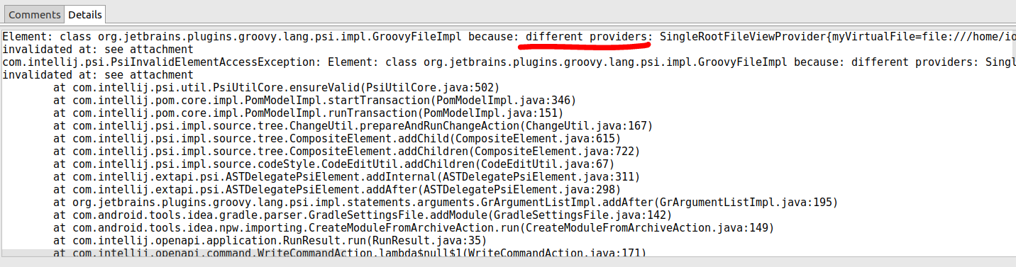
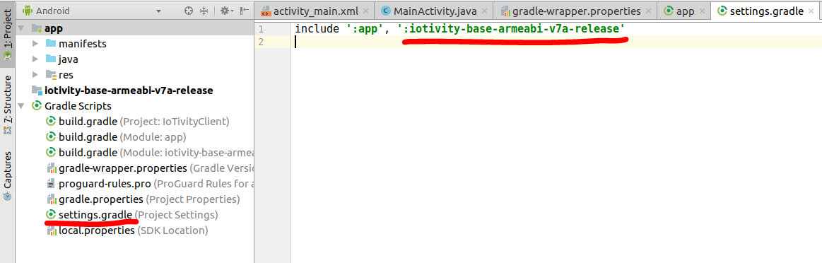
Development of IoTivity server
Start Android Studio
Import IoTivity Base Android API Binary
Add module of android iotivity release
Manually add when there is an error occurred
In settings gradle file
Include ‘:app’, ‘:your_module_name’
Programming
Connect with Android Things Through ADB(Android Debug Bridge)
Execute Application

Slide 13
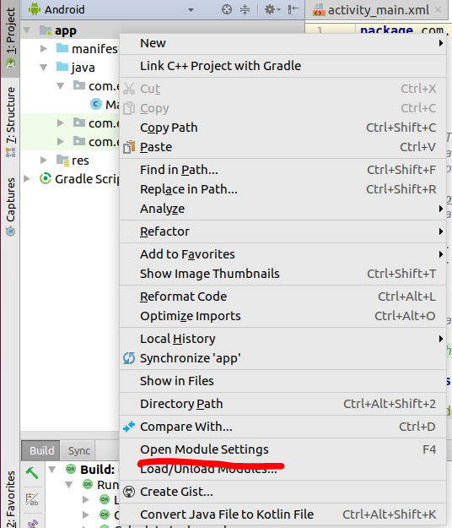
Development of IoTivity server
Start Android Studio
Import IoTivity Base Android API Binary
Add module of android iotivity release
Settings dependency
Add module dependency
right click on app
Programming
Connect with Android Things Through ADB(Android Debug Bridge)
Execute Application

Slide 14
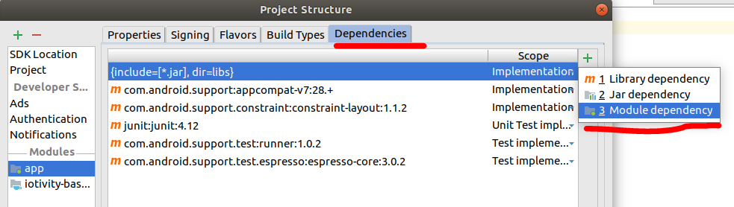
Development of IoTivity server
Start Android Studio
Import IoTivity Base Android API Binary
Add module of android iotivity release
Settings dependency
Add module dependency
right click on app
Click module dependency
Programming
Connect with Android Things Through ADB(Android Debug Bridge)
Execute Application

Slide 15
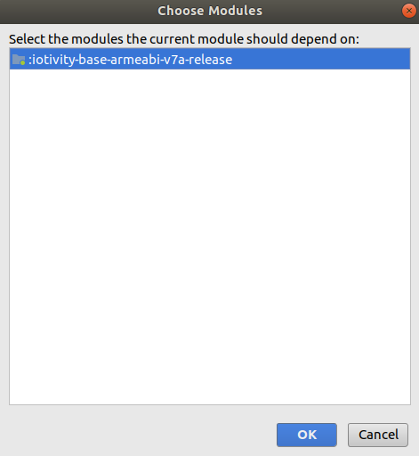
Development of IoTivity server
Start Android Studio
Import IoTivity Base Android API Binary
Add module of android iotivity release
Settings dependency
From the file menu, select New Module
Select Import .jar/.arr package
Locate to ARR file
Add module dependency
right click on app
Click module dependency
Choose expect dependency
Programming
Connect with Android Things Through ADB(Android Debug Bridge)
Execute Application

Slide 16
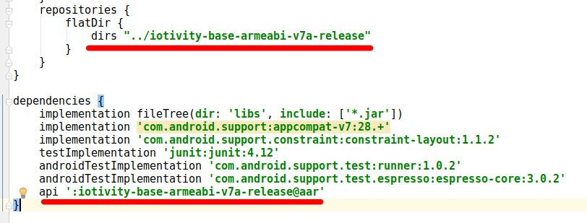
Development of IoTivity server
Start Android Studio
Import IoTivity Base Android API Binary
Add module of android iotivity release
Settings dependency
Another function to Add module dependency
Programming
Connect with Android Things Through ADB(Android Debug Bridge)
Execute Application
Directory path:
assume that in top of project folder create directory for android release iotivity and copy to there.
Build.Gradle file is under top of the project folder so the path is ../<name of you created directory>
Android release name: name + @ + arr

Slide 17
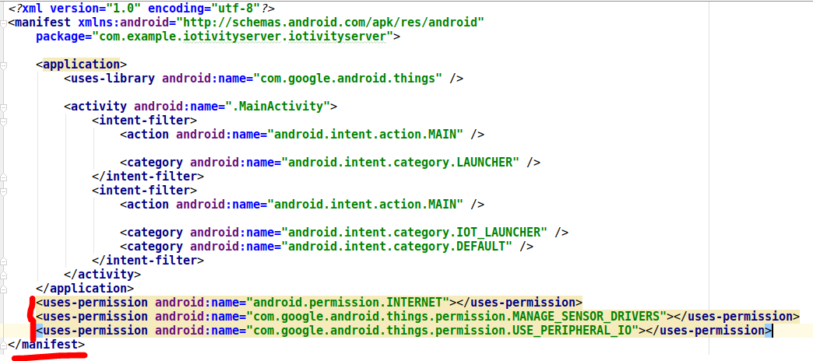
Development of IoTivity server
Start Android Studio
Import IoTivity Base Android API Binary
Programming
Set permissions
Connect with Android Things Through ADB(Android Debug Bridge)
Execute Application
Notes:
Open interconnect consortium = open connectivity foundation

Slide 18
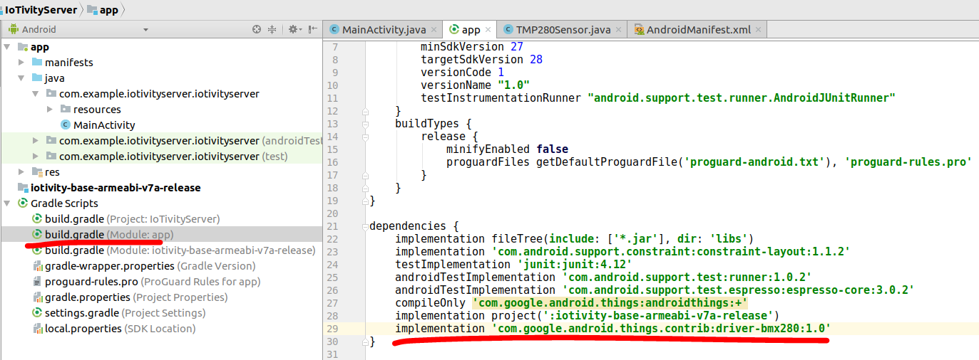
Development of IoTivity server
Start Android Studio
Import IoTivity Base Android API Binary
Programming
Set permissions
Add dependencies
Connect with Android Things Through ADB(Android Debug Bridge)
Execute Application
Notes:
Open interconnect consortium = open connectivity foundation

Slide 19
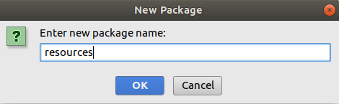
Development of IoTivity server
Start Android Studio
Import IoTivity Base Android API Binary
Programming
Set permissions
Add dependencies
Create package ‘resources’
Connect with Android Things Through ADB(Android Debug Bridge)
Execute Application
Notes:
Open interconnect consortium = open connectivity foundation

Slide 20
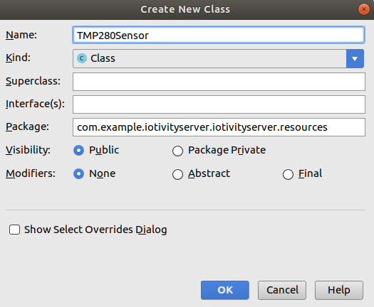
Development of IoTivity server
Start Android Studio
Import IoTivity Base Android API Binary
Programming
Set permissions
Add dependencies
Create package ‘resources’
Create ‘TMP280Sensor’ Class
Connect with Android Things Through ADB(Android Debug Bridge)
Execute Application
Notes:
Open interconnect consortium = open connectivity foundation

Slide 21
Development of IoTivity server
Start Android Studio
Import IoTivity Base Android API Binary
Programming
Set permissions
Add dependencies
Create package ‘resources’
Create ‘TMP280Sensor’ Class
Implements OcPlatform.EntityHandler
Connect with Android Things Through ADB(Android Debug Bridge)
Execute Application
@Override public EntityHandlerResult handleEntity(OcResourceRequest ocResourceRequest) { EntityHandlerResult entityHandlerResult = EntityHandlerResult.ERROR; if (null == ocResourceRequest) { Log.d(TAG,"Server request is invalid"); return entityHandlerResult; } EnumSet<RequestHandlerFlag> requestHandlerFlags = ocResourceRequest.getRequestHandlerFlagSet(); if(requestHandlerFlags.contains(RequestHandlerFlag.INIT)){ Log.d(TAG, "\t\tRequest Flag: Init"); entityHandlerResult = EntityHandlerResult.OK; } if(requestHandlerFlags.contains(RequestHandlerFlag.REQUEST)){ Log.d(TAG, "\t\tRequest Flag: Request"); entityHandlerResult = handleRequest(ocResourceRequest); } if(requestHandlerFlags.contains(RequestHandlerFlag.OBSERVER)){ Log.d(TAG, "\t\tRequest Flag: Observer"); entityHandlerResult = handleObserver(ocResourceRequest); } return entityHandlerResult; }
Notes:
Open interconnect consortium = open connectivity foundation

Slide 22
Development of IoTivity server
Start Android Studio
Import IoTivity Base Android API Binary
Programming
Set permissions
Add dependencies
Create package ‘resources’
Create ‘TMP280Sensor’ Class
Implements OcPlatform.EntityHandler
Handle Flag of REQUEST
Handle GET type request
Connect with Android Things Through ADB(Android Debug Bridge)
Execute Application
private EntityHandlerResult handleRequest(OcResourceRequest request) { EntityHandlerResult entityHandlerResult = EntityHandlerResult.ERROR; Map<String, String> queries = request.getQueryParameters(); if(!queries.isEmpty()){ Log.d(TAG, ""); } else { Log.d(TAG, "No query parameters in this request"); } for(Map.Entry<String, String> entry : queries.entrySet()){ Log.d(TAG, "query is " + entry.getKey() +", "+ entry.getValue()); } RequestType requestType = request.getRequestType(); switch(requestType){ case GET: Log.d(TAG, "\t\t\tRequest Type is GET"); entityHandlerResult = handleGetRequest(request); break; case PUT: Log.d(TAG, "\t\t\tRequest Type is PUT"); break; case POST: Log.d(TAG, "\t\t\tRequest Type is POST"); break; case DELETE: Log.d(TAG, "\t\t\tRequest Type is DELETE"); break; } return entityHandlerResult; }
Notes:
Open interconnect consortium = open connectivity foundation

Slide 23
Development of IoTivity server
Start Android Studio
Import IoTivity Base Android API Binary
Programming
Set permissions
Add dependencies
Create package ‘resources’
Create ‘TMP280Sensor’ Class
Implements OcPlatform.EntityHandler
Handle Flag of REQUEST
Handle GET type request
Set Resource Representation
Connect with Android Things Through ADB(Android Debug Bridge)
Execute Application
private EntityHandlerResult handleGetRequest(final OcResourceRequest request){ EntityHandlerResult entityHandlerResult; OcResourceResponse response = new OcResourceResponse(); response.setRequestHandle(request.getRequestHandle()); response.setResourceHandle(request.getResourceHandle()); response.setResponseResult(EntityHandlerResult.OK); response.setResourceRepresentation(getOcRepresentation()); entityHandlerResult = sendResponse(response); return entityHandlerResult; }
Notes:
Open interconnect consortium = open connectivity foundation

Slide 24
Development of IoTivity server
Start Android Studio
Import IoTivity Base Android API Binary
Programming
Set permissions
Add dependencies
Create package ‘resources’
Create ‘TMP280Sensor’ Class
Implements OcPlatform.EntityHandler
Handle Flag of REQUEST
Handle GET type request
Set Resource Representation
Set temperature results to OcRepresentation
Connect with Android Things Through ADB(Android Debug Bridge)
Execute Application
public OcRepresentation getOcRepresentation() { OcRepresentation rep = new OcRepresentation(); Log.d(TAG, "get temperature form sensor"); try{ float temp = bmx280.readTemperature(); rep.setValue(NAME_KEY, mName); rep.setValue("temperature",temp); // set temperature results Log.d(TAG, "the temperature is :" + String.valueOf(temp)); }catch (OcException e) { Log.d(TAG, e.toString()); }catch (IOException e){
Log.d(TAG, e.toString());
} return rep; }
Notes:
Open interconnect consortium = open connectivity foundation

Slide 25
Development of IoTivity server
Start Android Studio
Import IoTivity Base Android API Binary
Programming
Set permissions
Add dependencies
Create package ‘resources’
Create ‘TMP280Sensor’ Class
In MainActivity Create StartServer function
Start sensor
PlatformConfig
RegisterResource
Connect with Android Things Through ADB(Android Debug Bridge)
Execute Application
public void startIoTivityServer(){ Log.d(TAG,"start bmp280 sensor"); try{ bmx280 = new Bmx280("I2C1"); bmx280.setTemperatureOversampling(Bmx280.OVERSAMPLING_1X); bmx280.setMode(Bmx280.MODE_NORMAL); }catch (IOException e){ Log.d(TAG, "failed start sensor"); } Log.d(TAG, "initialize server"); PlatformConfig servercfg = new PlatformConfig(this, ServiceType.IN_PROC, ModeType.SERVER,"0.0.0.0",5683, QualityOfService.LOW); OcPlatform.Configure(servercfg); bmp280Sensor = new BMP280Sensor("/t/temperature", "test", bmx280); try { bmp280Sensor.registerResource(); } catch (OcException e) { Log.d(TAG, e.toString()); } }
Notes:
Open interconnect consortium = open connectivity foundation

Slide 26
Development of IoTivity server
Start Android Studio
Import IoTivity Base Android API Binary
Programming
Set permissions
Add dependencies
Create package ‘resources’
Create ‘TMP280Sensor’ Class
In MainActivity Create StartServer function
onDestroy function
Unregister resource
Close sensor
Connect with Android Things Through ADB(Android Debug Bridge)
Execute Application
protected void onDestroy(){ super.onDestroy(); Log.d(TAG, "unregister resource"); try { bmp280Sensor.unregisterResource(); } catch (OcException e) { Log.d(TAG, "unrigister error :" + e.toString()); } Log.d(TAG, "disconnect with sensor"); if(bmx280 != null){ try{ bmx280.setMode(Bmx280.MODE_SLEEP); bmx280.close(); }catch (IOException e){ Log.d(TAG, "failed stop sensor"); } } }
Notes:
Open interconnect consortium = open connectivity foundation

Slide 27
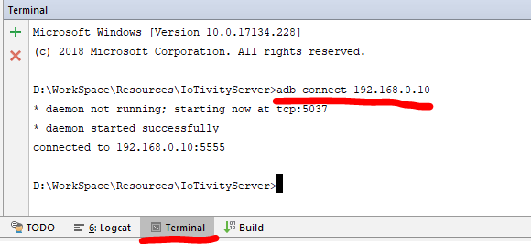
Development of IoTivity server
Start Android Studio
Import IoTivity Base Android API Binary
Programming
Connect with Android Things Through ADB(Android Debug Bridge)
Execute Application
Notes:
Open interconnect consortium = open connectivity foundation

Slide 28
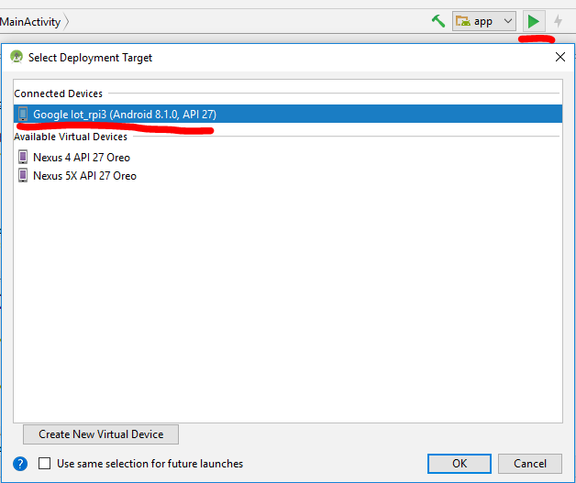
Development of IoTivity server
Start Android Studio
Import IoTivity Base Android API Binary
Programming
Connect with Android Things Through ADB(Android Debug Bridge)
Execute Application
Notes:
Open interconnect consortium = open connectivity foundation

Slide 29
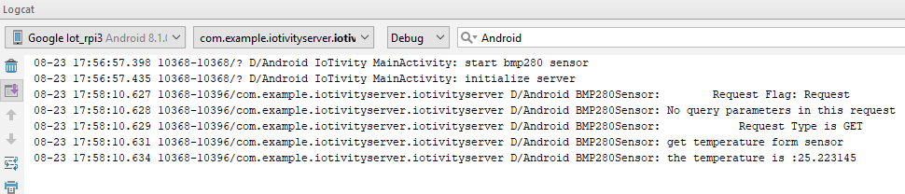
Development of IoTivity server
Start Android Studio
Import IoTivity Base Android API Binary
Programming
Connect with Android Things Through ADB(Android Debug Bridge)
Execute Application
Notes:
Open interconnect consortium = open connectivity foundation

Slide 30
Reference
https://wiki.iotivity.org/android_build_instructions
https://github.com/runtimeco/android_sensor
https://github.com/iotivity/iotivity/blob/master/java/examples-android/simpleserver/src/main/java/org/iotivity/base/examples/Light.java
https://github.com/iotivity/iotivity/blob/master/java/examples-android/simpleserver/src/main/java/org/iotivity/base/examples/SimpleServer.java
https://openconnectivity.org/wp-content/uploads/2016/01/IoTivity-101_Vijay-Joey.pdf on 8 page

