Slide 1
IoTivity

Slide 2
IoTivity
IoTivity:
is an open source software project
Is an open source reference implementation of the OCF(Open Connectivity Foundation) specification
Enabling device to device connectivity
Devices can securely connect to each other and to the internet.
Building blocks:
Discovery: supporting multiple mechanisms for discovering devices and resources in proximity and remotely
Data transmission: supporting information exchange and control based on a messaging and streaming model.
Data management: supporting the collection, storage and analysis of data from various resources.
Device management: supporting configuration, provisioning and diagnostics of devices.
Notes:
Form factor
is an aspect of hardware design
Is the specification of a motherboard.
Defines and prescribes the size, shape, and physical specifications of components.

Slide 3
IoTivity
Terminologies
Resources
Sensors, Actuators, Appliances
Client
Finds resources
Sends CRUDN requests
Server
Register Sensors
Handles the CRUDN requests
Notes:
Form factor
is an aspect of hardware design
Is the specification of a motherboard.
Defines and prescribes the size, shape, and physical specifications of components.

Slide 4





Develop Environment
Host computer
OS: windows 10 pro 64
Memory: 16GB
CPU: Intel® Core™ i5-8500
Guest computer
OS: Ubuntu 18. 04 desktop 64
Memory: 6GB=6144MB
Hard disk: 100GB
Network: bridge
Core: 4
Software: JDK 8, IoTivity 1.3.1, Android Studio
Guest
Host

Slide 5

Environment Network
Internet
Router
Public IP
DHCP Server
Private Network
Bridge
IP: DHCP
HOST
eth0
IP: DHCP
GUEST
VM
Notes:
Gigabytes(GB) 1 = 1000 Magabytes (MB) decimal = 1000 Magabytes (MB) binary

Slide 6
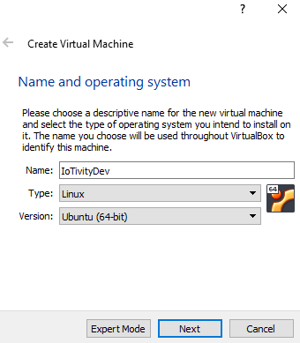
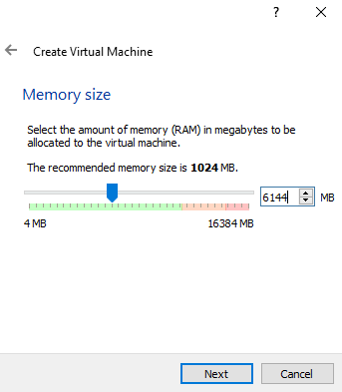
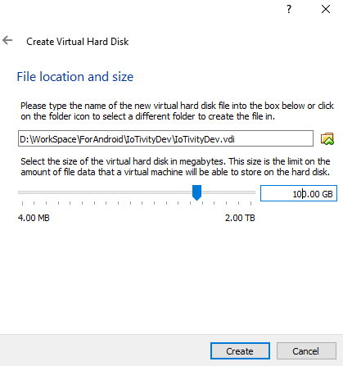
Guest Computer Generation
Guest computer generation
OS: Ubuntu 18. 04 desktop 64
http://releases.ubuntu.com/18.04/
Choose: 64bit PC(AMD64) desktop image
Memory: 6GB=6144MB
Hard disk: 100GB

Slide 7
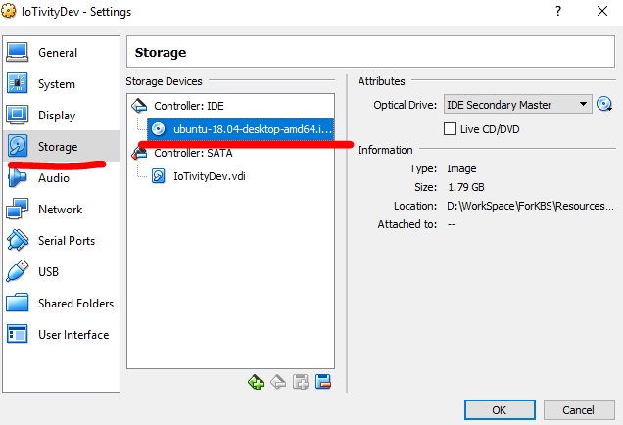
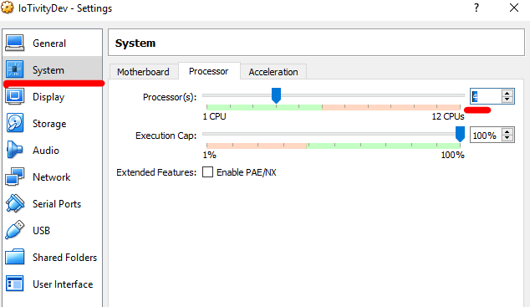
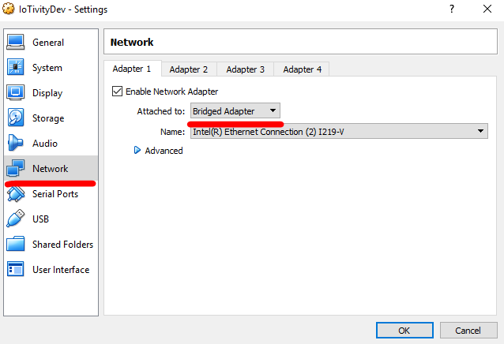
Guest Computer Generation
Guest computer settings
System: processor 4
Storage: image selection
Network: bridge

Slide 8
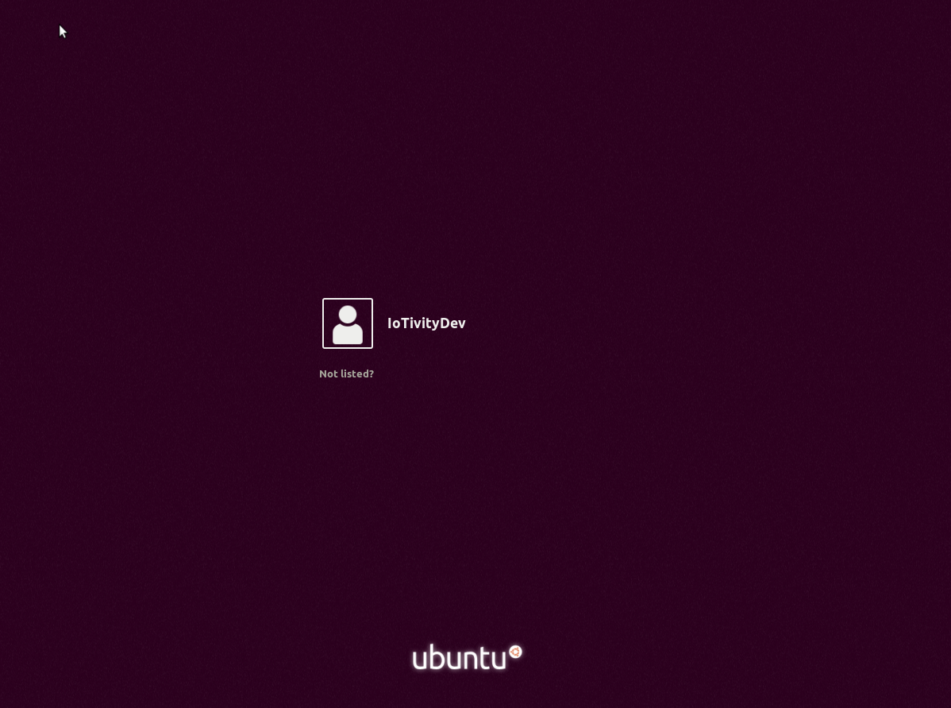
Guest Computer Generation
Guest computer OS installation: just default install

Slide 9
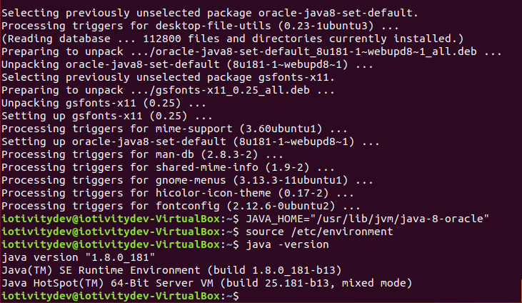
JDK 8 install
Java-8-oracle install
$ sudo add-apt-repository ppa:webupd8team/java
$ sudo apt-get update
$ sudo apt-get install oracle-java8-installer
$ JAVA_HOME="/usr/lib/jvm/java-8-oracle"
$ source /etc/environment
Verify $java -version

Slide 10
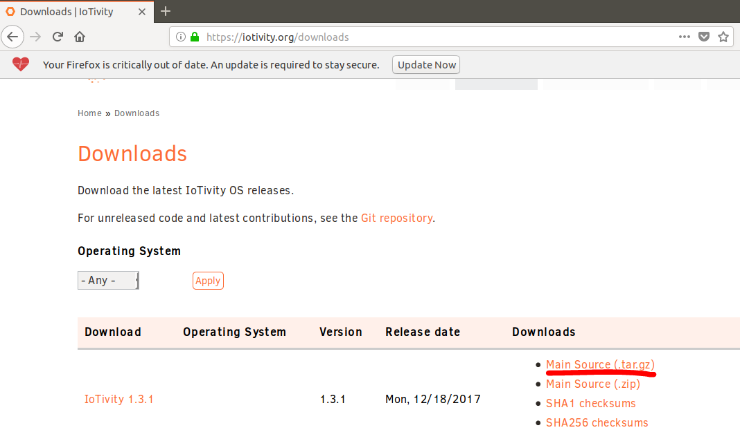
IoTivity 1.3.1 installation
Download source
From browser: https://iotivity.org/downloads/iotivity-1.3.1
Extract
$cd Dwonload
$tar zxvf iotivity-1.3.1.tar.gz -C /home/iotplatform/
Notes:
Scons
Is a cross-platform build tool

Slide 11
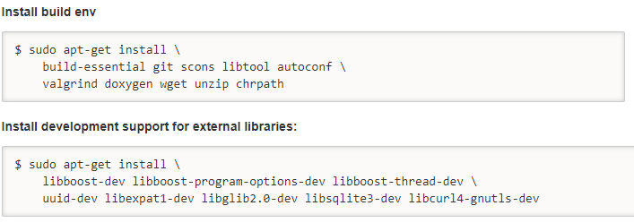
IoTivity 1.3.1 installation
Install required libraries
External libraries
$sudo apt-get install lib32stdc++6 lib32z1
Notes:
Scons
Is a cross-platform build tool

Slide 12
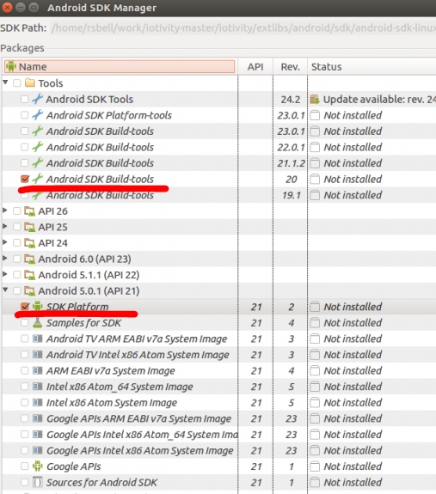
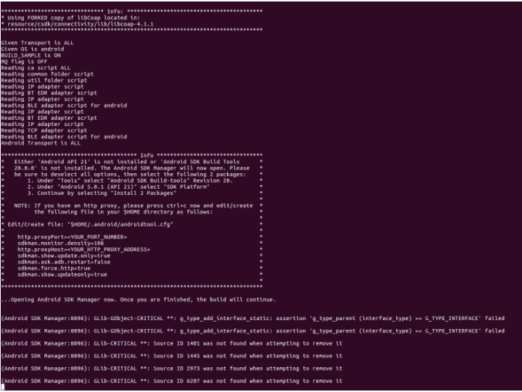
Build IoTivity for Android things
Build IoTivity
$cd iotivity-1.3.1
$scons TARGET_OS=android TARGET_ARCH=armeabi-v7a SECURED=0
In Android SDK manager just install red lined packages
※while building some libraries are required. Install them follows the recommend in terminal and rebuild
Notes:
Scons
Is a cross-platform build tool

Slide 13
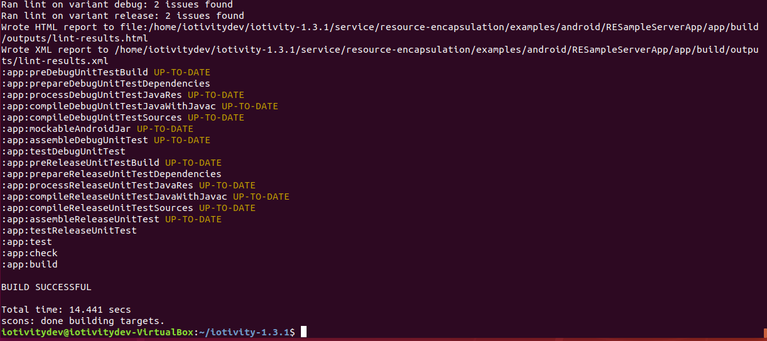
Build IoTivity for Android
Build results
$cd iotivity-1.3.1/java/iotivity-android/build/outputs/aar/
Notes:
Scons
Is a cross-platform build tool

Slide 14
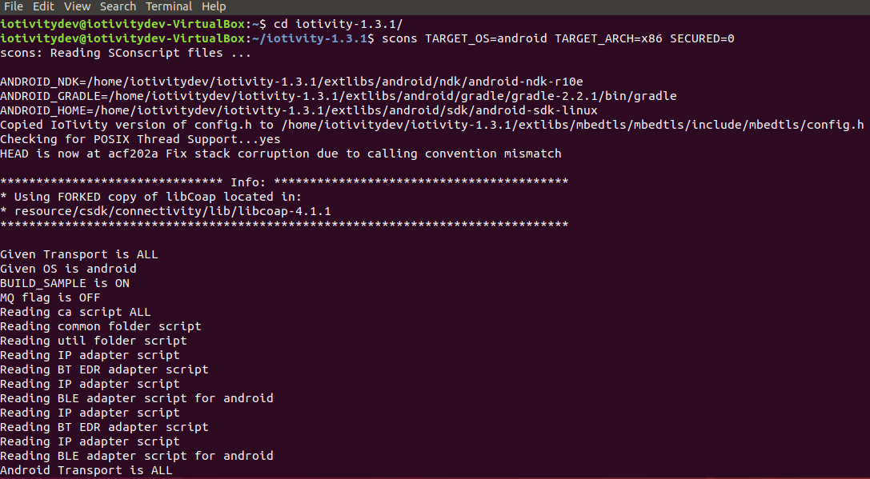
Build IoTivity for Android Phone
Build IoTivity
$cd iotivity-1.3.1
$scons TARGET_OS=android TARGET_ARCH=x86 SECURED=0
※while building some libraries are required. Install them follows the recommend in terminal and rebuild
Notes:
Scons
Is a cross-platform build tool

Slide 15
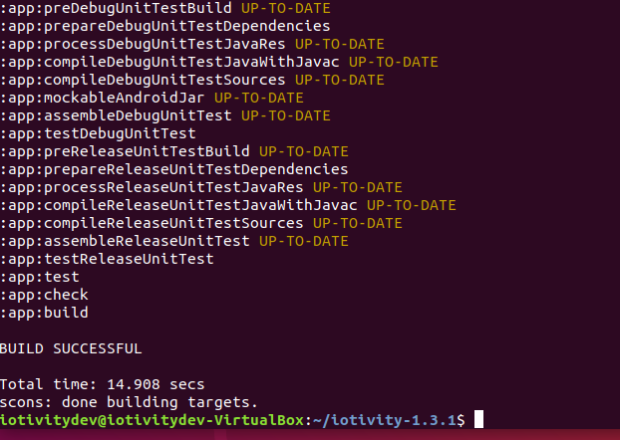
Build IoTivity for Android Phone
Build IoTivity
$cd iotivity-1.3.1
$scons TARGET_OS=android TARGET_ARCH=x86 SECURED=0
※while building some libraries are required. Install them follows the recommend in terminal and rebuild
Notes:
Scons
Is a cross-platform build tool

Slide 16
Reference
https://openconnectivity.org/developer-kit
https://wiki.iotivity.org/build_iotivity_with_ubuntu_build_machine
https://wiki.iotivity.org/android_build_instructions#prerequisites_for_building_iotivity_for_android

