Slide 1
Domain Generalization

Slide 2
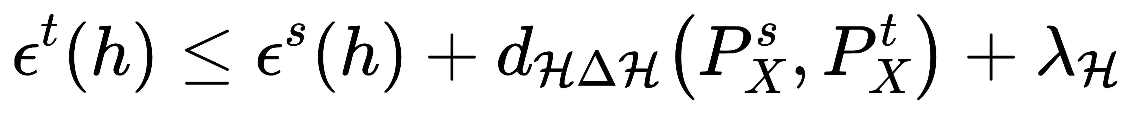
Domain adaptation
Basic theory of DA [Ben-David et al’07]
Target risk
Source risk
Complexity of ℋ
Source-target distribution divergence
To solve DA, we need to:
Reweight instances to select a subset of two domains where their 𝑑(⋅,⋅) is small
Tradaboost [Dai et al’07], KMM [Sugiyama et al’08], Distant TL [Tan et al’17]
Learn domain-invariant feature representations to reduce 𝑑(⋅,⋅)
TCA [Pan et al’11], DANN [Ganin et al’15], DDC[Tzeng et al’14] and their extensions as of today
How about testing phase? Model selection?
DA requires direct access to target domain in training!
Notes:
DG部分的参考文献https://arxiv.org/abs/2103.03097
Domain adaptation error bound

Slide 3



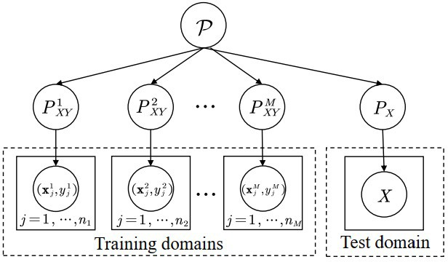
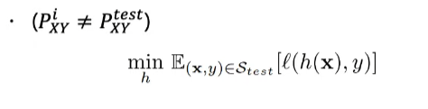
Domain generalization
Definition
Given: 𝑀 training domains , where
Condition:
Joint distributions are different
Test domain cannot be accessed in training
Goal:
Achieve minimum test error on test domain

Slide 4
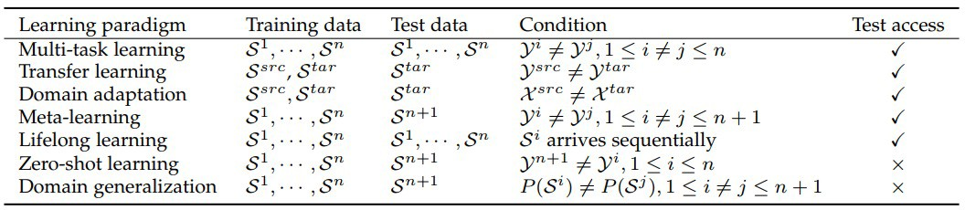
Related area

Slide 5
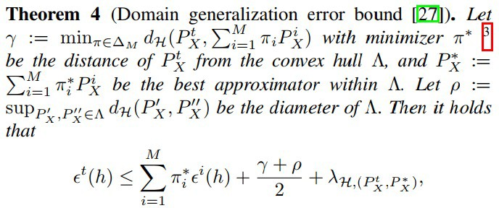

Theory
Domain generalization error bound

Slide 6
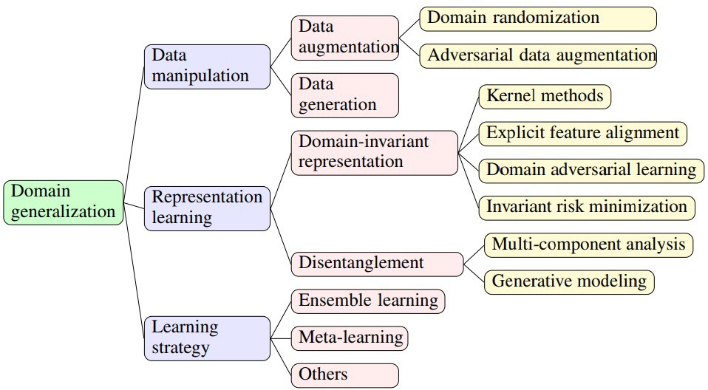
Methodology

Slide 7


Data manipulation
Data quantity and quality are key factors of generalization
Increase quality and quantity
Data augmentation
Data generation

Slide 8
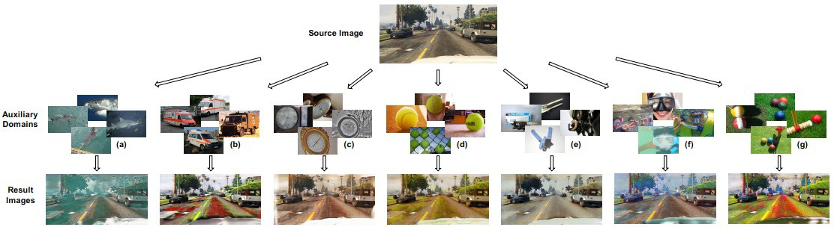
Data augmentation
Typical augmentation
Rotation, noise, color…
Domain randomization (DR)
Shape, position, texture, viewpoint, lighting condition, noise…
Yue et al. Domain Randomization and Pyramid Consistency: Simulation-to-Real Generalization without Accessing Target Domain Data. 2019.

Slide 9
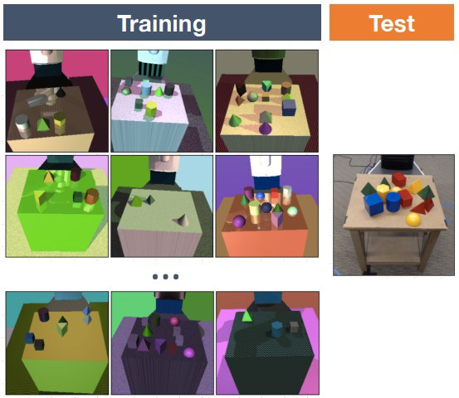
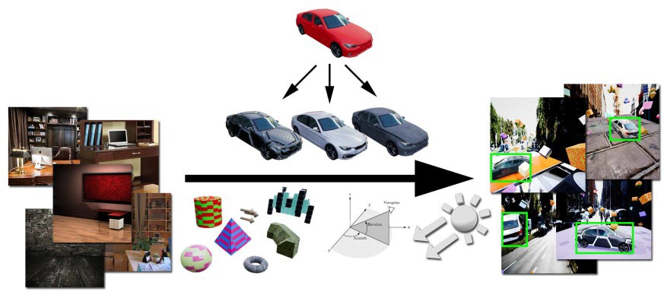
Domain randomization
Sim->Real robot control
Synthetic images -> Real images
Tobin, et al. Domain Randomization for Transferring Deep Neural Networks from Simulation to the Real World. IROS 2017.
Tremblay et al. Training Deep Networks with Synthetic Data: Bridging the Reality Gap by Domain Randomization. CVPR workshop 2018.

Slide 10
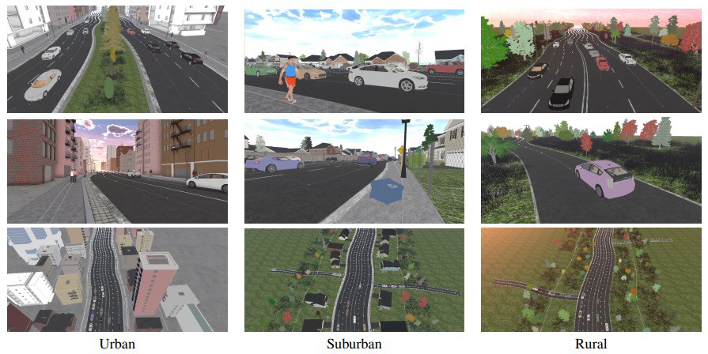
Context-aware randomization
Prakash et al. Structured Domain Randomization: Bridging the Reality Gap by Context-Aware Synthetic Data. 2018.

Slide 11

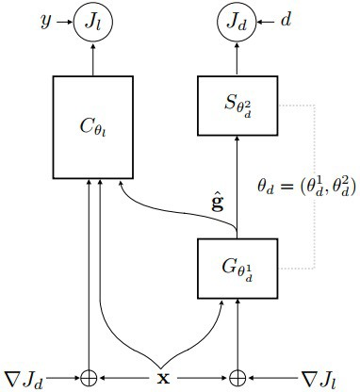
Adversarial data augmentation
CrossGrad: Adversarially augment data via gradient training
Generate data that are with same label 𝑦, but different domain label 𝑑
ADV augmentation
Learning the worse-case distribution to enable generalization
Shankar et al. Generalizing across Domains via Cross-Gradient Training. ICLR 2018.
Volpi, et al. Generalizing to Unseen Domains via Adversarial Data Augmentation. NeurIPS 2018.

Slide 12
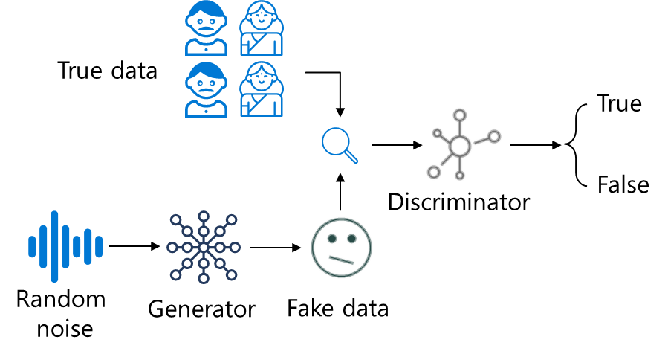
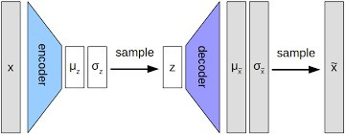
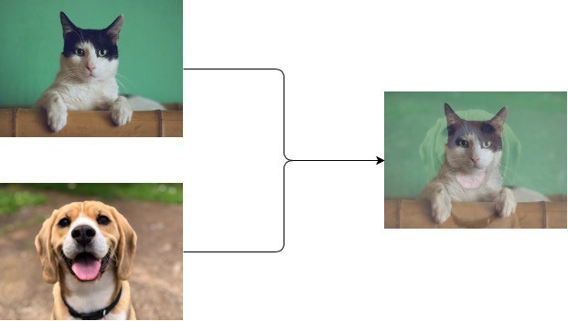
Data generation
Directly generate data
Learning to generate, instead of randomization / adversarial augmentation (Fixed scheme)
Variational auto-encoder (VAE)
Generative adversarial net (GAN)
Mixup
Kingma D P, Welling M. Auto-encoding variational bayes[J]. arXiv preprint arXiv:1312.6114, 2013.
Goodfellow I, Pouget-Abadie J, Mirza M, et al. Generative adversarial nets[J]. Advances in neural information processing systems, 2014, 27.
Zhang H, Cisse M, Dauphin Y N, et al. Mixup: Beyond empirical risk minimization[J]. arXiv preprint arXiv:1710.09412, 2017.

Slide 13
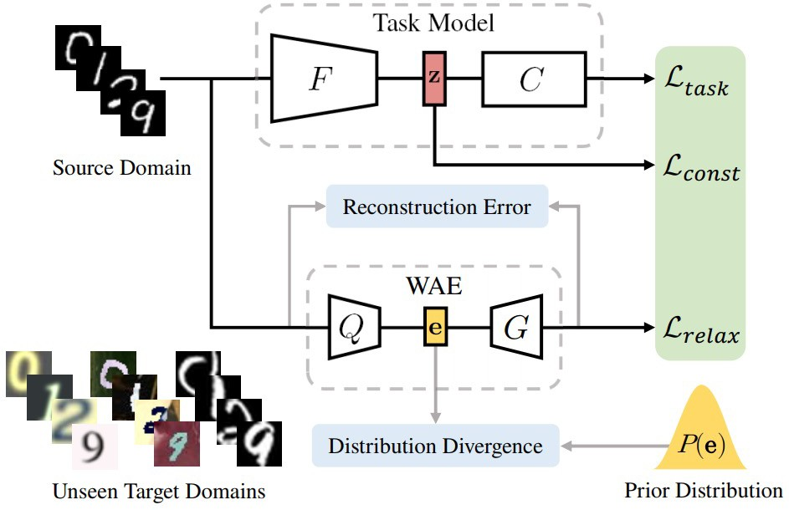
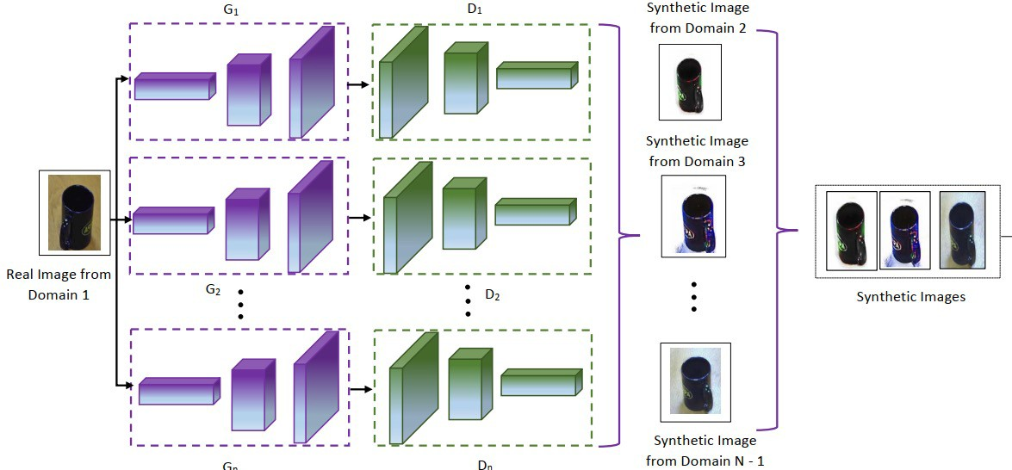
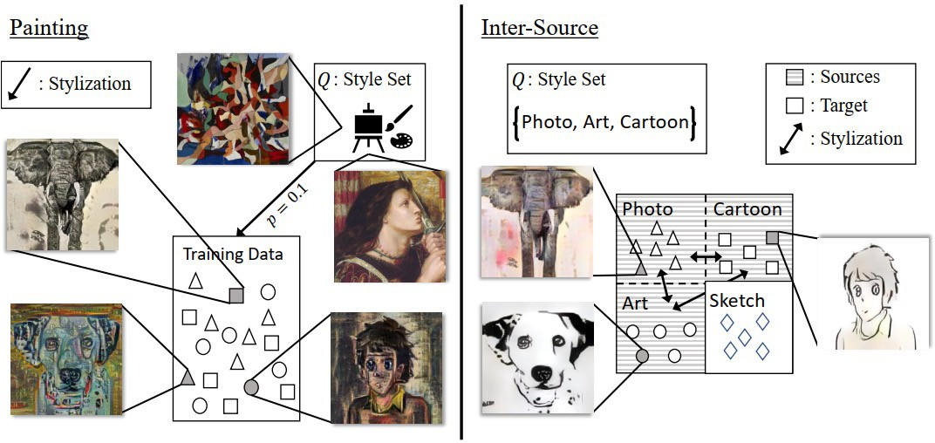
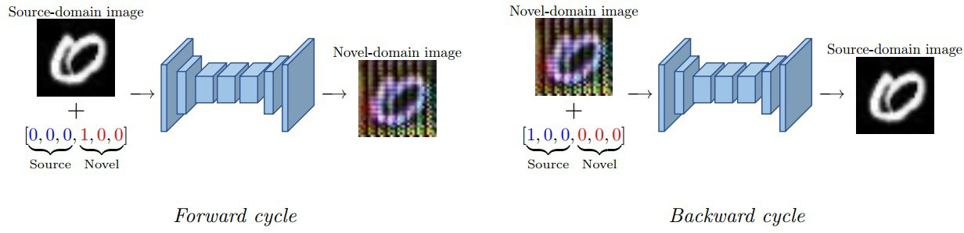
Data generation
VAE for generation
Multi-component generation
Conditional GAN for generation
Qiao et al. Learning to Learn Single Domain Generalization. CVPR 2020.
Rahman et al. Multi-component Image Translation for Deep Domain Generalization. 2020.
Zhou et al. Learning to Generate Novel Domains for Domain Generalization. ECCV 2020.
Somavarapu et al. Frustratingly Simple Domain Generalization via Image Stylization. 2020.
Image stylization

Slide 14
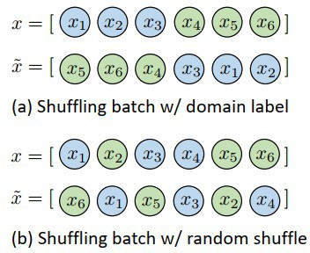
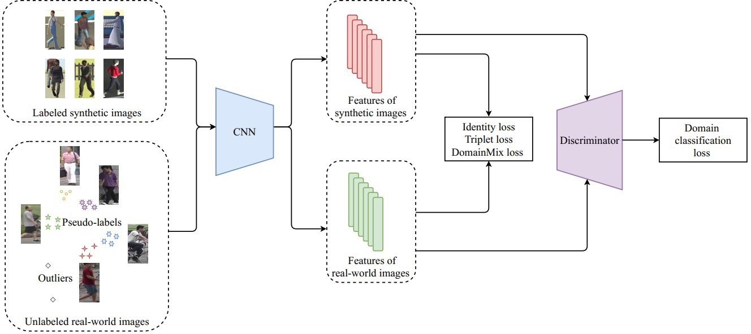

Mixup
DomainMix
Style mixup
Wang et al. DomainMix: Learning Generalizable Person Re-Identification Without Human Annotations. 2020.
Wang et al. Heterogeneous domain generalization via domain mixup. ICASSP 2021.
Zhou et al. Domain generalization with mixstyle. ICLR 2021.

Slide 15

Representation Learning
Learning domain-invariant representations
Classifier
Feature
Regularization
How to learn representations?
Kernel-based methods
Domain adversarial learning
Explicit feature alignment
Invariant risk minimization

Slide 16


Kernel-based methods
Using kernel methods to learn domain-invariant features
DICA: domain-invariant component analysis
TCA: Transfer Component Analysis
SCA: Scatter Component Analysis
Blanchard et al. Generalizing from Several Related Classification Tasks to a New Unlabeled Sample. NeurIPS 2011.
Muandet et al. Domain Generalization via Invariant Feature Representation. ICML 2013.
Grubinger et al. Domain Generalization Based on Transfer Component Analysis. IWANN 2015.
Ghifary et al. Scatter Component Analysis: A Unified Framework for Domain Adaptation and Domain Generalization. TPAMI 2017.

Slide 17
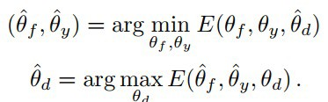
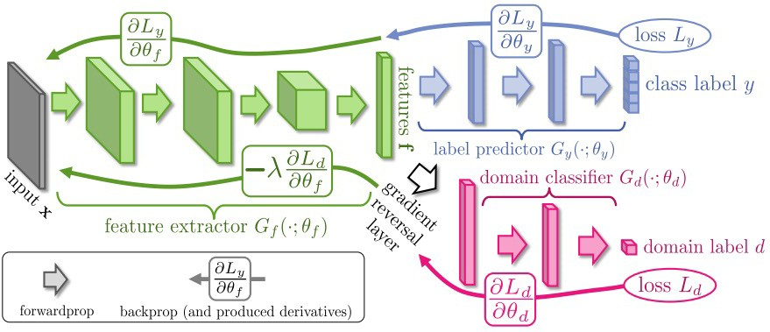
Domain adversarial learning
Adversarial training
Ganin et al. Unsupervised Domain Adaptation by Backpropagation. ICML 2015.

Slide 18
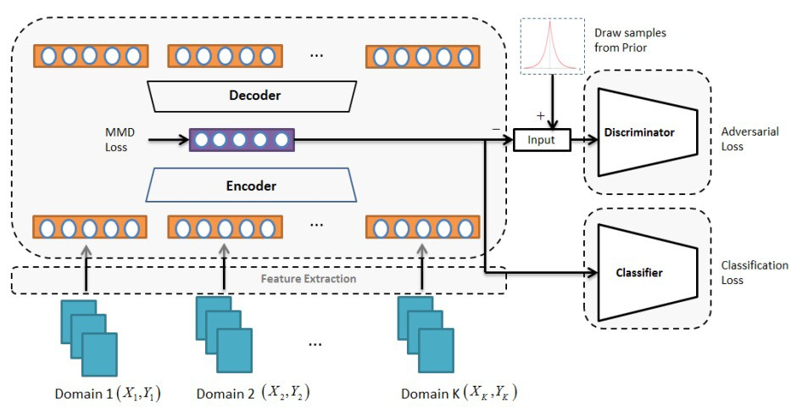
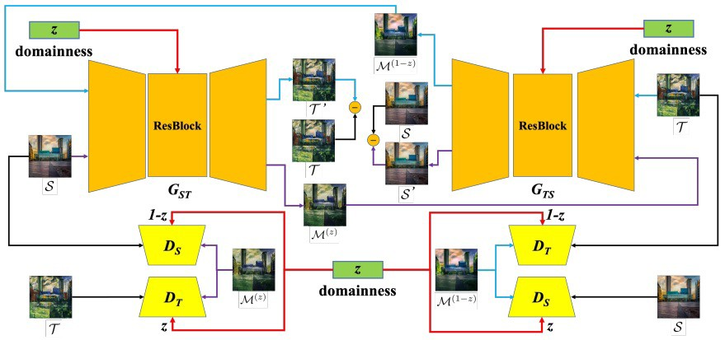


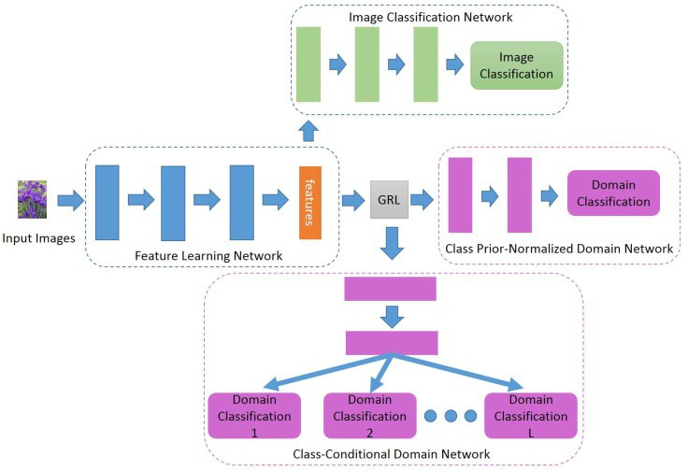
Domain adversarial learning
MMD-AAE
DLOW
Li et al. Domain Generalization with Adversarial Feature Learning. CVPR 2018.
Gong et al. DLOW: Domain Flow for Adaptation and Generalization. CVPR 2019.
Li et al. Deep Domain Generalization via Conditional
Invariant Adversarial Networks. ECCV 2018.
Conditional GAN

Slide 19


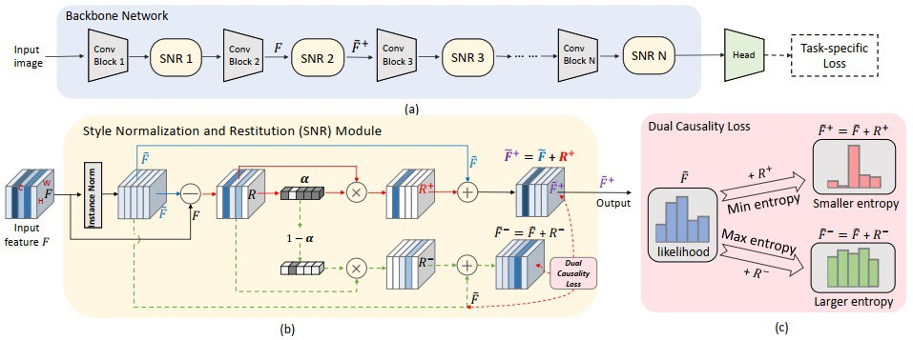
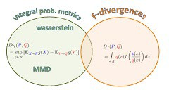
Explicit feature alignment
Distance
Maximum mean discrepancy:
Correlation alignment:
Jin X, Lan C, Zeng W, et al. Style Normalization and Restitution for Domain Generalization and Adaptation[J]. arXiv preprint arXiv:2101.00588, 2021.

Slide 20
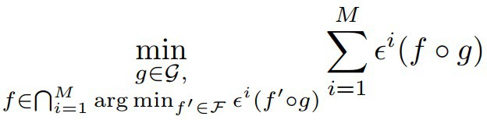

Invariant risk minimization
IRM
Do not match distributions; enforce optimal classifier on top of the representation space to be the same across all domains
Arjovsky et al. Invariant risk minimization. arXiv preprint arXiv:1907.02893, 2019

Slide 21
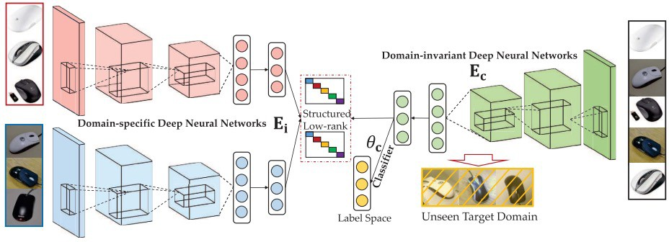
Feature disentanglement
Formulation
Multi-component analysis
Generative modeling
UndoBias
Structure low-rank DG
Khosla A, Zhou T, Malisiewicz T, et al. Undoing the damage of dataset bias[C]//European Conference on Computer Vision. Springer, Berlin, Heidelberg, 2012: 158-171.
Ding Z, Fu Y. Deep domain generalization with structured low-rank constraint[J]. IEEE Transactions on Image Processing,
2017, 27(1): 304-313.

Slide 22
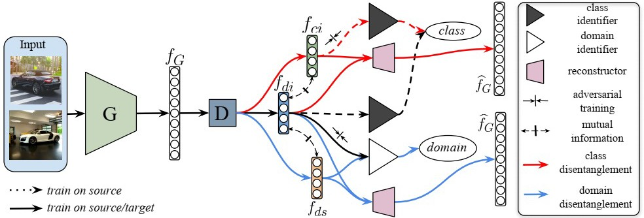
Generative modeling
DIVA: domain-invariant variational-autoencoder
DAL: domain-agnostic learning
X. Peng, Z. Huang, X. Sun, and K. Saenko, “Domain agnostic learning with disentangled representations,” in ICML, 2019
Ilse M, Tomczak J M, Louizos C, et al. Diva: Domain invariant variational autoencoders[C]//Medical Imaging with Deep Learning. PMLR, 2020: 322-348.

Slide 23
Learning strategy
Meta-learning
Divide domains into several tasks, then use meta-learning to learn general knowledge
Ensemble learning
Design ensemble models

Slide 24
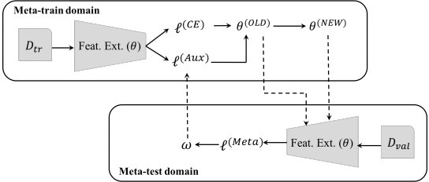
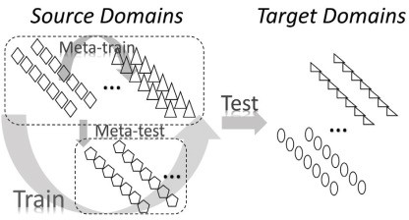



Meta-learning
Feature Critic training
MLDG
Li D, Yang Y, Song Y Z, et al. Learning to generalize: Meta-learning for domain generalization. AAAI 2018.
Li Y, Yang Y, Zhou W, et al. Feature-critic networks for heterogeneous domain generalization. ICML 2019.

Slide 25
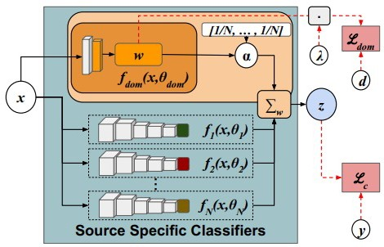
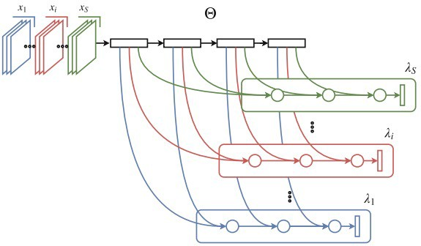

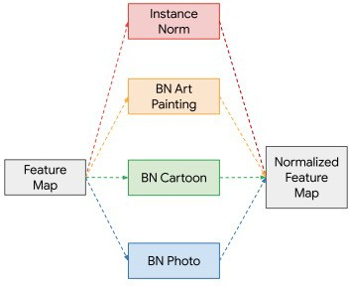
Ensemble learning
Mancini M, Bulo S R, Caputo B, et al. Best sources forward: domain generalization through source-specific nets. ICIP 2018.
Segu M, Tonioni A, Tombari F. Batch normalization embeddings for deep domain generalization[J]. arXiv preprint arXiv:2011.12672, 2020.
D’Innocente A, Caputo B. Domain generalization with domain-specific
aggregation modules[C]//German Conference on Pattern Recognition. Springer, Cham, 2018: 187-198.

Slide 26
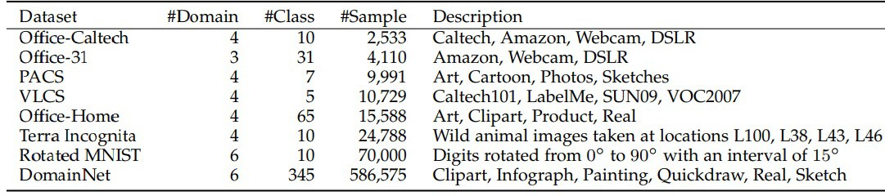
Datasets and applications
Datasets
Application
Image classification / segmentation / detection / ReID
Reinforcement learning
Parkinson’s disease
Activity recognition
Fault diagnosis

Slide 27
Challenges
Continuous domain generalization
Continuous / online learning
Generalize to novel categories
New categories instead of closed set
Interpretable domain generalization
Learning to interpret: why it can generalize?
Large-scale pre-training / self-learning and DG
The role of pre-training and self-learning with DG
Performance evaluation
Develop more fair and application-driven evaluation standards

