Slide 1
Domain Adaptation

Slide 2



Domain Shift
Training
Data
Testing
Data
99.5%
57.5%
Domain shift: Training and testing data have different
distributions.
Domain adaptation
A method of Transfer learning

Slide 3

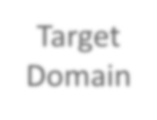




Domain Shift
Training Data
Testing Data
Source
Domain
Target Domain
1 2 3 4 5
1 2 3 4 5
This is “0”.
This is “1”.
Notes:
输入的分布有变化（只针对1来讲后续内容）
输出的分布可能也有变化（偏向某一类）
标签改变

Slide 4
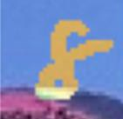
Domain Adaptation
Source Domain (with labeled data)
“4” “0” “1”
Knowledge of target domain
“8”
Little but labeled
Idea: training a model by source data,
then fine-tune the model by target data
Challenge: only limited target data, so be
careful about overfitting
Notes:
根据我们对目标域数据了解的程度，有不同的方法
当目标域有大量带标签数据时，直接在目标域训练
当目标域只有少量带标签数据时，微调

Slide 5
Domain Adaptation
Source Domain (with labeled data)
“4” “0” “1”
Knowledge of target domain
Large amount of
unlabeled data
“8”
Little but labeled

Slide 6





Basic Idea
Learn to ignore colors
Feature Extractor (network)
feature
Source
The same
distribution
Different
Target
Feature Extractor (network)
feature

Slide 7

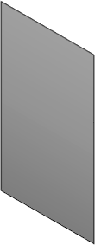







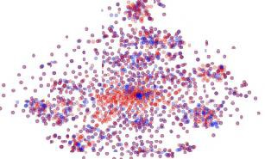


Domain Adversarial Training
image class distribution
Feature
Extractor
Label
Predictor
“4”
Source
(labeled)
blue points
Target
(unlabeled)
red points
Notes:
把source和target数据都丢入网络，使输出特征相似，（判断不出来是来自哪个域）

Slide 8





Domain Adversarial Training
𝜃∗ = min 𝐿 − 𝐿_{𝑑}
always zero?
𝑓
𝜃_{𝑓}
𝜃_{𝑓}
Feature
Extractor
𝜃_{𝑝}
Label
“4”
Predictor
𝐿
Generator
𝜃∗ = min 𝐿
𝑝
𝜃_{𝑝}
Feature extractor: Learn
to “fool” domain classifier
𝜃∗ = min 𝐿_{𝑑}
𝑑
𝜃_{𝑑}
𝐿
𝜃_{𝑑}
𝑑
Domain
Source?
Target?
Also need to support label predictor
Classifier
Discriminator
Notes:
L: 交叉熵损失
Ld：二分类损失

Slide 9
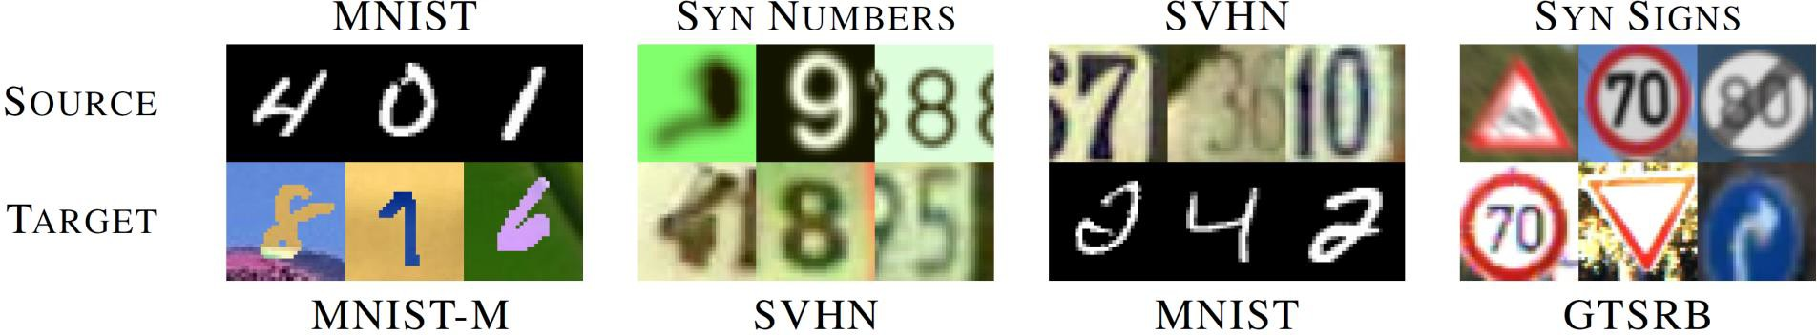
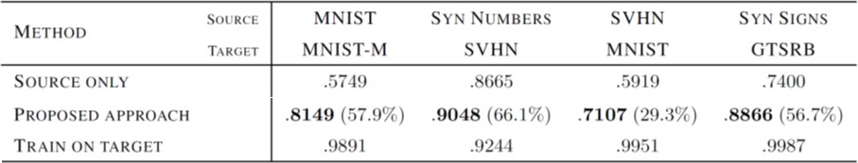
Domain Adversarial Training
Yaroslav Ganin, Victor Lempitsky, Unsupervised Domain Adaptation by Backpropagation,
ICML, 2015
Hana Ajakan, Pascal Germain, Hugo Larochelle, François Laviolette, Mario Marchand,
Domain-Adversarial Training of Neural Networks, JMLR, 2016
Notes:
原论文的结果（表格第二行）

Slide 10




































































class 1 (source)
class 2 (source)
Target data (class unknown)
Limitation
Decision boundaries learned
from source domain
Source and target data
are aligned, but ……
Target data (unlabeled far from boundary)

Slide 11

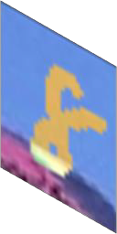







Considering Decision Boundary
unlabeled
Small entropy
Feature
Extractor
Label
Predictor
1 2 3 4 5
unlabeled
Large entropy
Feature Extractor
Label Predictor
1 2 3 4 5
Used in Decision-boundary Iterative Refinement Training with
a Teacher (DIRT-T)
Maximum Classifier Discrepancy
https://arxiv.org/abs/1802.08735
https://arxiv.org/abs/1712.02560
Notes:
最简单的方式是让输出都趋向于某一类（or 熵更小），这样离决策边界最远（这里只是一种方法，更多方法可以参考下面的论文）

Slide 12
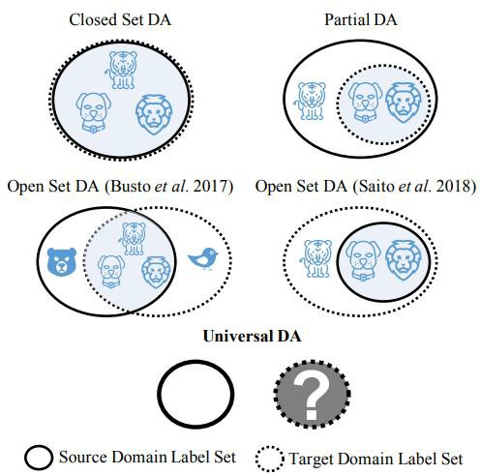
Outlook
Universal domain adaptation
https://openaccess.thecvf.com
/content_CVPR_2019/html/Yo u_Universal_Domain_Adaptati on_CVPR_2019_paper.html
Notes:
还有类别不同的情况 这里列举了4种
如何解决这类问题，可以参考论文

Slide 13
Domain Adaptation
Source Domain (with labeled data)
“4” “0” “1”
Knowledge of target domain
little & unlabeled
Large amount of
unlabeled data
“8”
Little but labeled
Testing Time Training (TTT)
https://arxiv.org/
abs/1909.13231
Notes:
目标域没有标签且数量很少的时候（如只有一张）
可以参考TTT和TTA方法。

Slide 14

Domain Adaptation
Source Domain (with labeled data)
“4” “0” “1”
Knowledge of target domain
little & unlabeled
Large amount of
unlabeled data
“8”
Little but labeled

Slide 15
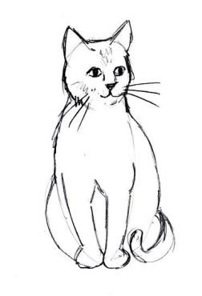
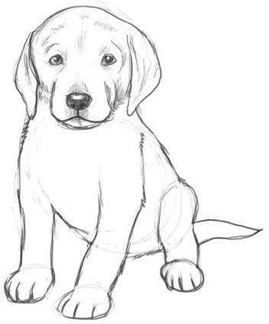
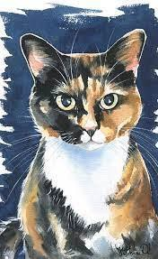
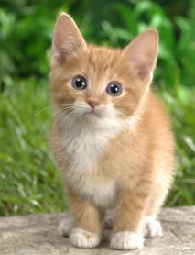

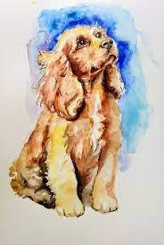


Domain Generalization
https://ieeexplore.ieee.org/document/8578664
cat
dog
cat
dog
cat
dog
cat dog
Testing
Training
cat dog
Training
cat
dog
cat
dog
cat dog
Testing
https://arxiv.org/abs/2003.13216
Notes:
对目标域什么都不知道的问题————称为domain generalization
分两种状况，训练数据有多个域 or 训练数据单个域

