Slide 1


YoUnicam-AI
Course of Data Analytics A.A 2020/21
Yuri Paoloni 115554
Matteo Leonesi 115548

Slide 2

Description & Objectives
YoUnicam-AI is a PySpark application that uses the data collected from the “detect presence” feature of the YoUnicam mobile application to predict the number of people in a certain building at a given time interval.
Of course, the predictions are done using a Machine Learning model that in our case is a Regression Model.

Slide 3
Technologies
PySpark
Jupyter
TPOT
Pandas
Scikit-learn
GIT and GitHub

Slide 4
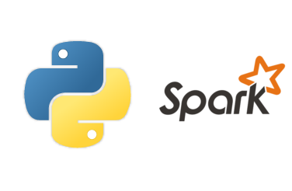
PySpark
PySpark is the Python API written in Python to support Apache Spark. The latter is a fast and general engine for large-scale data processing both for batch and a distributed general-purpose cluster computing framework.
PySpark is the core of the application and the executor of each activity.

Slide 5

Jupyter
The Jupyter Notebook is an open-source web application that allows you to create and share documents that contain live code, equations, visualizations and narrative text.
Thanks to Jupyter, we were able to try again and again operations on the data but always relying on a checkpoint from which we could re-start.

Slide 6
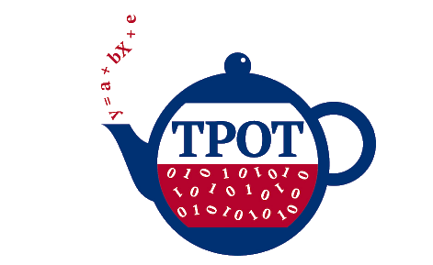
TPOT
TPOT is a Python Automated Machine Learning tool that optimizes machine learning pipelines using genetic programming.
We decided to use TPOT because is the auto-ML framework that works better with Regression problems.

Slide 7

Pandas
Pandas is a fast, powerful, flexible and easy to use open source data analysis and manipulation tool,
built on top of the Python programming language.
Pandas allowed us to work with dataframe with a lot of flexibility and ease.

Slide 8

Scikit-learn
Scikit-learn is a Python library that support the ML phases providing API for classification, regression, model segregation and evaluation.
Scikit-learn was basically used to evaluate the skills of the selected model.

Slide 9
Technical implementation
As usual, we divided the project based on the Machine Learning pipeline phases. We stopped at the Evaluation phase without Deployment (could be a future implementation).
The Model Training phase was executed with the assistance of TPOT in order to find the best tuning between the ML model and hyperparameters.

Slide 10
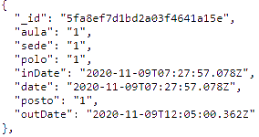
Data collection
We started by collecting the data from the MongoDB database of the YoUnicam mobile app.
Since the data contained some sensible information we applied some mapping functions on Excel in order to anonymize the data without losing the real values.
After that, we imported the data into the PySpark application.

Slide 11
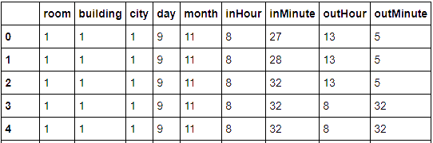
Data preparation
After some exploratory operations to check the shape of the data, we started with some cleaning operations.
We deleted null values and removed unnecessary data.
Furthermore, we destructed the date in different parts in order to gain the time interval needed for the training phase.

Slide 12
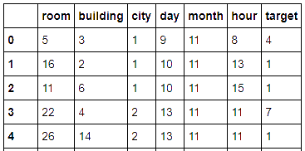
Feature Engineering
In this phase, we applied an explode function to obtain the target value and the features.
The target value is the number of people in a certain building during a time interval (hour column).
The features are the other values: room, building, city, day, month, hour (time interval).

Slide 13
Model Training
With the data prepared we can now move in the Training phase.
Here we applied the TPOT pipeline to get the best combination of ML model and hyperparameters.
Then we applied the exported algorithm to the engineered data.

Slide 14
TPOT pipeline
The TPOT pipeline takes in input the engineered data and apply on it a series of algorithm (and hyperparameters) until it gets a reasonable results.
It can take several hours but it returns a .py file with the ML model to execute.

Slide 15
Model Evaluation
In the Model Evaluation phase we applied the three main metrics to evaluate a regression model:
R Square
Mean Square Error (MSE) and Root Mean Square Error (RMSE)
Mean Absolute Error (MAE)

Slide 16

Model Evaluation
Once the TPOT pipeline has ended we took the code of the exported file and placed it into a Jupyter Notebook in order to execute it along with other operations (e.g. save intermediate results)
After some tentative we found that the best splitting was 80% training and 20% testing, the following are the results.

Slide 17
Achieved Results
As you can see from the metrics’ values we didn’t achieve really good results because of the weak quality of data.
The data in the model is related to presences from late November to February so we have a big gap in between.
We tried some over-sampling techniques but most of them are related to Classification.
Anyway, we are confident about the fact that with data that cover the whole year, the model would perform significantly better.

Slide 18
Future Work
Execute the pipeline in the future with a larger amount of records.
Moreover, this ML pipeline can be deployed and improved to be used by the University of Camerino to estimate the people in a room for different courses.
A use case could be the assignment of rooms for each course based on the model prediction to better suit the affluence of lessons.
The same work can be applied to the other data produced by the mobile application.

Slide 19
Conclusion
We would like to thank the Dr. Massimo Callisto De Donato for the help during the project development since this was our first experience in Data Science field.
We was really impressed and fascinated by this field and for sure we will continue to work on application like this in the future.
Repo: https://github.com/younicam/younicam-AI

