Slide 1

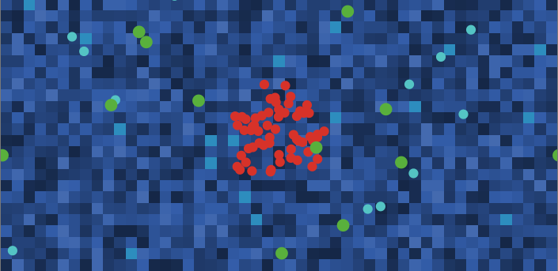
MAS / MASL · ASSIGNMENT 1
Tumor–immune
microenvironment
A multi-agent simulation in NetLogo
Andrea Biondini
Pietro Villa
Younes Rabeh
Emanuela Merelli · UNICAM
3 November 2026
Notes:
Source: Assignment-1.pdf, p. 1. Original simulation image from the report. This is a simplified computational model of tumor–immune interactions.

Slide 2
Introduction
Context
Study of a tumor-immune microenvironment and simulation
This simulation is carried out by a multiagent system in which the actors interacting with the tumor-immune microenvironment are modelled as agents of this system as we will see in the next slide.
Agents
Environment
Environment provides resources to agents; environment is perceived by agents
Two main questions:
How does oxygen deprivation affect cell growth and death rate? How does it affect the immune response?
How does high immunity strength affect the properties already cited above?
Research questions
01

Slide 3
Model components and agent roles
Tumor cells
Consume resources, adapt resistance, divide or die.
Cytotoxic T cells
Seek tumors and attack; activation and exhaustion affect behavior.
Macrophages
Switch M1/M2 phenotype; regulate T cells and support tumors.
Environment agents
Detect hypoxia and notify nearby biological agents.
Environment: vessels supply oxygen and nutrients; resources diffuse, and cytokines decay.
02
Notes:
Source: Assignment-1.pdf, MAS/MASL Assignment 1, 20 October 2026. Pages 3–5. Patch-owned variables are oxygen, nutrients, cytokine and vessel. Agents have local perception, internal state and message inboxes.

Slide 4
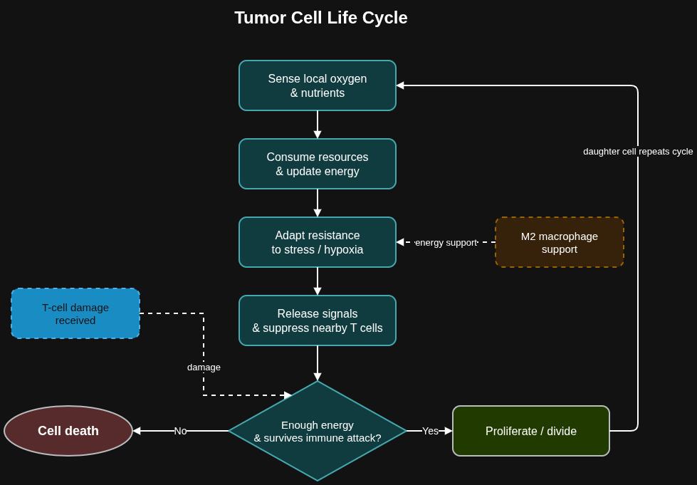
Tumor cell life cycle
Local resources
Oxygen and nutrients change the cell’s energy.
Adaptation
Hypoxia can increase resistance in surviving cells.
Immune pressure
T-cell damage competes with tumor survival and division.
03
Notes:
Source: Assignment-1.pdf, MAS/MASL Assignment 1, 20 October 2026. Pages 4–5, Chart 1. Original life-cycle diagram is preserved as a source image. Tumor state includes energy, resistance and message inbox.

Slide 5
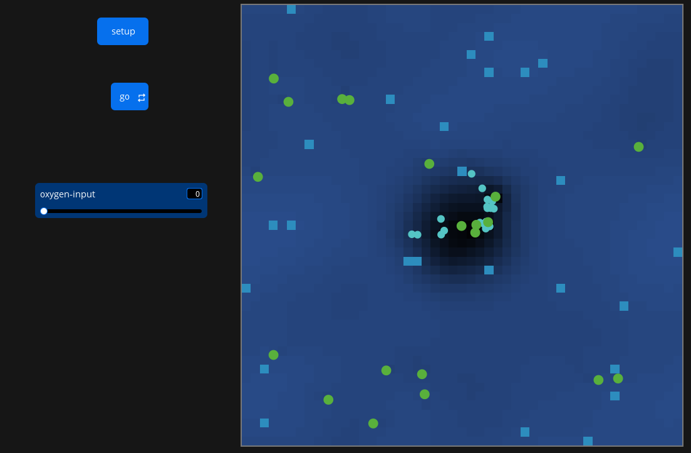
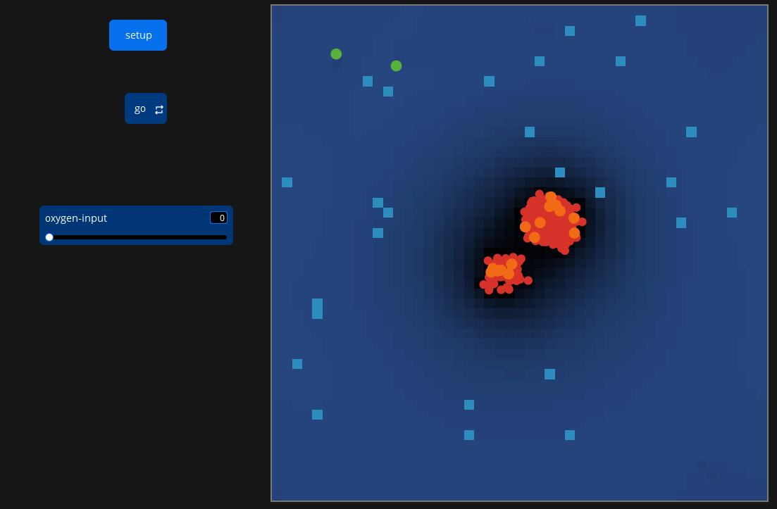
Oxygen deprivation
two possible outcomes
Hypothesis: Immune cells respond more negatively to Low Oxygen levels than tumors
Results:
Tumors exhibit increased metabolic demands, leading to excessive oxygen consumption and the development of a hypoxic microenvironment, which can suppress the effectiveness of the immune response.
04
Notes:
Source: Assignment-1.pdf, MAS/MASL Assignment 1, 20 October 2026. Pages 2, 5–6; Figures 1–4. Hypothesis: oxygen input 0 rather than 0.15 reduces tumor population. Setup: 60 tumor cells, mean tumor resistance 0.0499. The report describes both eradication and adaptation. It supplies no replicate count, distribution or uncertainty estimate.

Slide 6
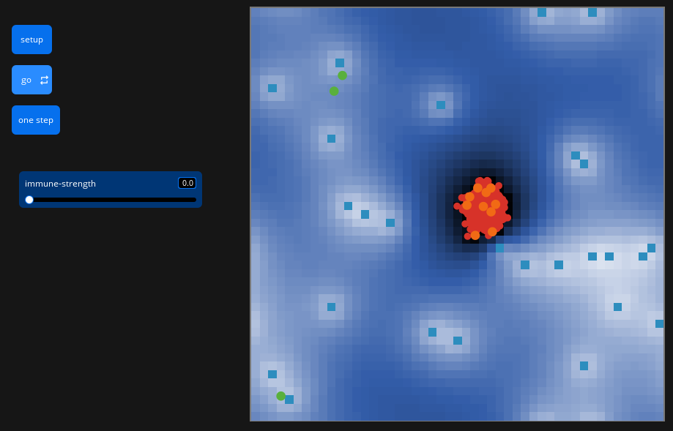
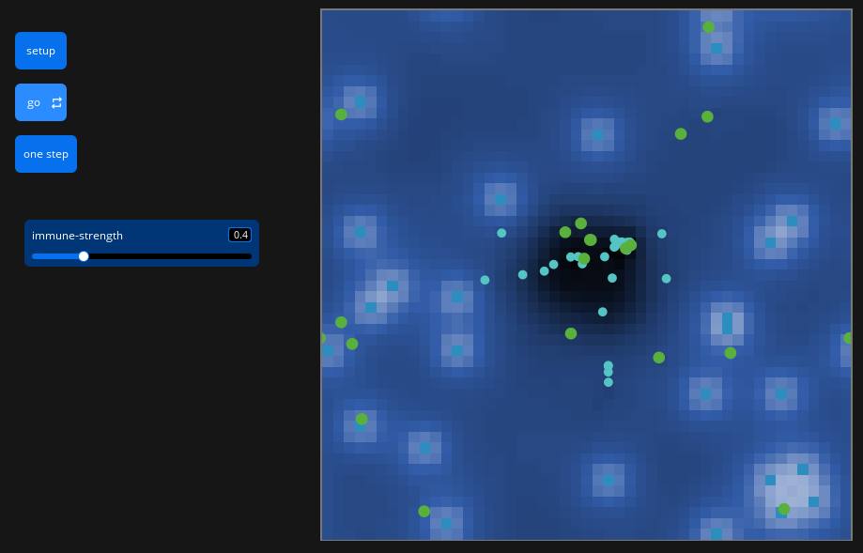
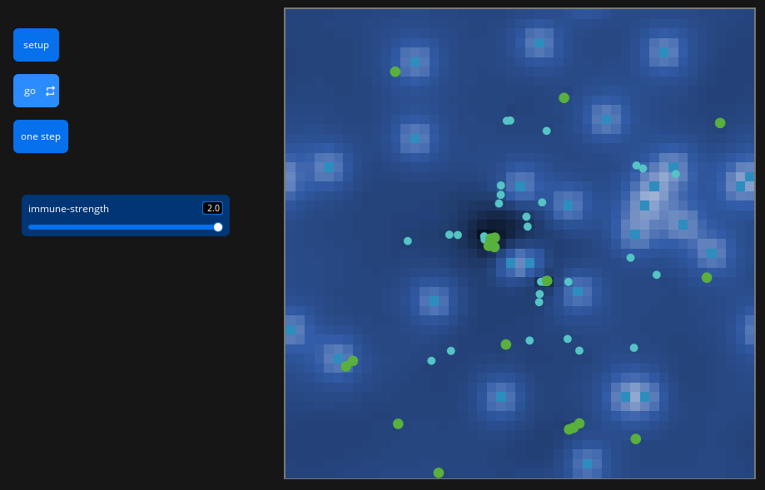
II. Immune Strength
three possible outcomes
Hypothesis: stronger immune attacks reduce the tumor population
Minimum · 0.0
Baseline · 0.4
Maximum · 2.0
Results:
Higher strength increases immune damage and tumor-cell killing.
The report describes eradication in simulations with strength > 1.
05
Notes:
Source: Assignment-1.pdf, MAS/MASL Assignment 1, 20 October 2026. Pages 2, 6–7; Figures 5–10. Screenshot settings are minimum 0.0, baseline 0.4, maximum 2.0. Immune strength multiplies damage. Report states faster tumor-cell death and more immune kills than baseline, and eradication in reported simulations with strength >1. Replicate counts and statistical comparisons are not provided. Snapshots are illustrative, not a controlled time-matched comparison.

Slide 7
Conclusions
Main findings
Oxygen deprivation can eliminate both immune cells & tumors, but surviving cells may adapt and becomes more adapted to the new environment.
Greater immune strength improves tumor control, with high enough values … the tumor is almost certain to be eradicated
The results are consistent with the hypothesis
06
Notes:
Source: Assignment-1.pdf, MAS/MASL Assignment 1, 20 October 2026. Pages 5–7. Experiments are marked WIP. Findings apply to the simplified simulation. Suggested next steps are presentation recommendations, not completed experiments: repeated runs, matched seeds and controls, report distributions and uncertainty, clarify plot-axis labels.

