Slide 1
Empirical Research Methods for Software Engineering

Slide 2
Agenda
1. Introduction to Empirical and Experimental Software Engineering
2. Empirical Research Methods
2.1 Case Study
2.2 Experimental Reserach
2.4 Survey
2.4 Post Mortem Analysis
3. Guidelines for Empirical Research in Software Engineering
3. Conclusion

Slide 3
Experimental & Empirical Software Engineering
Experimental software engineering is a sub-domain of software engineering focusing on experiments on software systems (software products, processes, and resources).
Text
Text
Text
Text
Empirical software engineering is a field of research that emphasizes the use of empirical studies of all kinds to accumulate knowledge. Methods used include experiments, variety of case studies, surveys, and statistical analyses.

Slide 4
Why Empirical Study for Software Engineering
Empirical studies (use of experience, observation) have become important for software engineering
research.
Too many methods and tools exist to allow each programmer or software house to determine the best choice of tools and methods by trial and error.
Empirical studies determine the differences among alternative software techniques.
For example experiment on quality and cost of a software product.

Slide 5
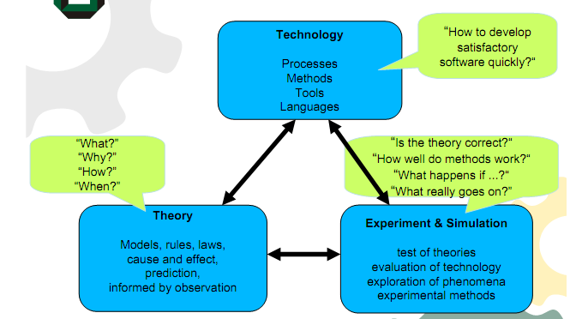
How Empirical study helps software engineering Research

Slide 6
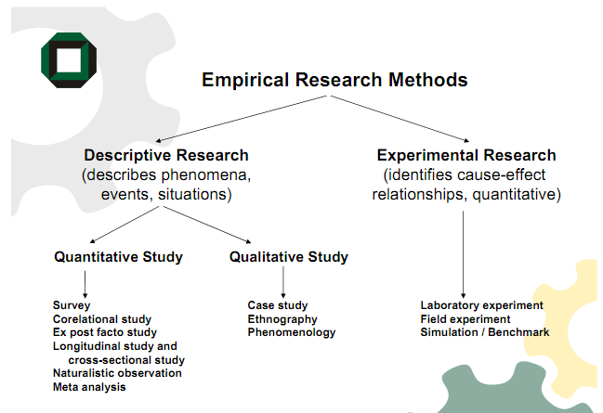
Empirical Research Methods

Slide 7
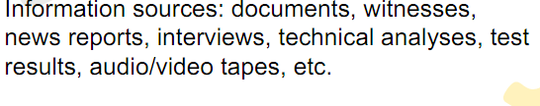

Case Study
A case study is systematic description and analysis of an event organization or individual.

Slide 8
Case Study
A case study determined the cause of the crash:
An overflow occurred when converting a 64-bit integer into a 16-bit integer in a program called the Inertial Reference System.
This overflow wasn’t monitored and therefore caused the entire control system to stop, and …boom!
The program causing the overflow wasn’t needed during flight, but only during initialization (up to -9s launch time).
It was kept running for 50 s into the flight to avoid re-initialization time of several hours in case of an aborted launch.
The software was designed for the Ariane 4 rocket, where this particular overflow could not happen.
So the error was a software-reuse error, caused by missing specifications of the conditions under which the software worked correctly.

Slide 9
Software engineering Case Study on Ariane 5 crash
In software research, case studies are often used to demonstrate the functionality or capability of a new tool (existence proof).
Case studies are also useful for describing and understanding rare events (such as disasters caused by software failures).
Case studies are limited, because the cause of a specific event cannot be determined with any degree of certainty. To establish cause and events reliably, we need experiments.

Slide 10

Experimental Research
Objective is to prove software engineering theory, hypothesis or product.
Experimental are also referred to as research-in-small because their scope is limited.
When experimenting random tests are conducted.
For- Example comparison between various processors.

Slide 11
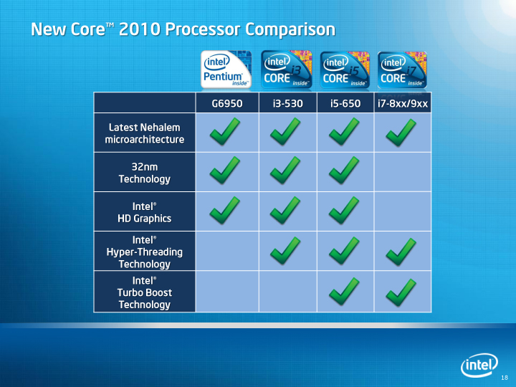
Experimental Research

Slide 12
Survey
A survey collects data about some state of affairs querying a representative sample of some population.
Example: “If the president were elected tomorrow, whom would you vote?”
Surveys collect frequency data, but also information about reasons and preferences.
Example: “Why do you prefer a certain brand of car Surveys also test who holds certain preferences (male/female, age, ethnicity, income, location, etc
Surveys help understand why a certain phenomenon occurred and increase our ability to predict it.
Question: „What has caused the most difficulty when trying to understand object-oriented software?“
1. Missing or inadequate design documentation
(16.8%)
2. Inheritance (15.5%)
3. Poor or inappropriate design (12.9%).

Slide 13
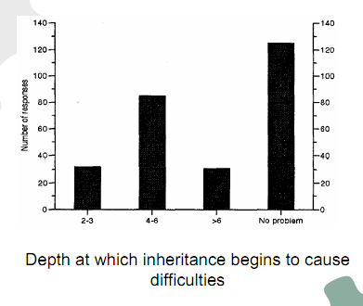
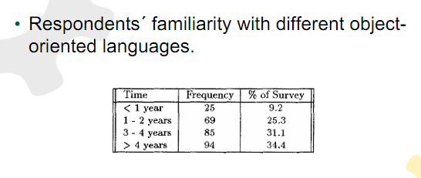
Survey

Slide 14
Post-mortem Analysis
Post-mortem analysis is a research method studying the past.
The basic idea behind post-mortem analysis is to capture the knowledge and experience from a specific case or activity after it has been finished.
Two types of postmortem analysis:
a general post-mortem analysis capturing all available information from an activity .
focused post-mortem analysis for a specific activity, for example, cost estimation.

Slide 15
Guidelines for Empirical Research in Software Engineering
Guidelines for empirical research will be useful for following cases:
The reader of a published paper.
The reviewer of a paper prior to its publication.
The authors of a paper.
Researchers planning an empirical study.
A meta-analyst wanting to combine information from different studies of the same
phenomenon.
A journal editorial board.

Slide 16
Guidelines for Empirical Research in Software Engineering
Kitchenham, B.A have categorized the guidelines according to the following sections:
Experimental context
Experimental design
Conduct of the experiment and Data collection
Analysis
Presentation of results
Interpretation of results

Slide 17
Guidelines for Experimental Context
Guidelines for experimental context are as listed below:
Be sure to specify as much of the industrial context as possible. In particular, clearly define the entities, attributes and measures that are capturing the contextual information.
If a specific hypothesis is being tested, state it clearly prior to performing the study,
and discuss the theory from which it is derived, so that its implications are apparent.
If the research is exploratory, state clearly and, prior to data analysis, what
questions the investigation is intended to address, and how it will address them.
Describe research that is similar to, or has a bearing on, the current research and
how current work relates to it.

Slide 18
Guidelines for Experimental Design
Guidelines for experimental design are as listed below:
Identify the population from which the subjects and objects are drawn.
Define the process by which the subjects and objects were selected.
Define the process by which subjects and objects are assigned to treatments.
Restrict yourself to simple study designs or, at least, to designs that are fully analyzed in the literature.
Define the experimental unit.
For formal experiments, perform a pre-experiment or pre-calculation to identify or estimate the minimum required sample size.
Use appropriate levels of blinding.
If you cannot avoid evaluating your own work, then make explicit any vested interests (including your sources of support), and report what you have done to minimize bias.

Slide 19
Guidelines for Experimental Design
Avoid the use of controls unless you are sure the control situation can be unambiguously defined.
Fully define all treatments (interventions).
Justify the choice of outcome measures in terms of their relevance to the objectives of the empirical study.

Slide 20
Guidelines for Conduct of the experiment and Data collection
Define all software measures fully, including the entity, attribute, unit and counting
rules.
For subjective measures, present a measure of inter-rater agreement, such as the
kappa statistic or the intra-class correlation coefficient for continuous measures.
Describe any quality control method used to ensure completeness and accuracy of
data collection.
For surveys, monitor and report the response rate, and discuss the representativeness of the responses and the impact of non-response.
For observational studies and experiments, record data about subjects who drop
out from the studies.
For observational studies and experiments, record data about other performance
measures that may be adversely affected by the treatment, even if they are not the main focus of the study.

Slide 21
Guidelines for Analysis
Specify any procedures used to control for multiple testing.
Consider using blind analysis.
Perform sensitivity analyses.
Ensure that the data do not violate the assumptions of the tests used on them.
Apply appropriate quality control procedures to verify your results

Slide 22
Guidelines for Presentation of results
Describe or cite a reference for all statistical procedures used.
Report the statistical package used.
Present quantitative results as well as significance levels. Quantitative results should
show the magnitude of effects and the confidence limits.
Present the raw data whenever possible. Otherwise, confirm that they are available
for confidential review by the reviewers and independent auditors.
Provide appropriate descriptive statistics.
Make appropriate use of graphics.

Slide 23
Guidelines for Interpretation of Results
Define the population to which inferential statistics and predictive models apply.
Differentiate between statistical significance and practical importance.
Define the type of study.
Specify any limitations of the study.

Slide 24
Conclusion
These Guidelines will be useful to improve the quality of conducting empirical research in software engineering.

