Slide 1
Punching above your weight:
Sentiment analysis through BOW
Younus Ahmed

Slide 2
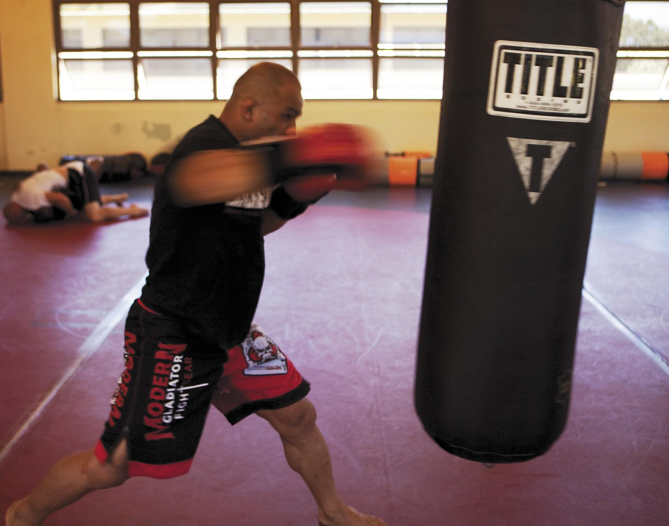
Background
Tackling the Poor Assumptions of Naive Bayes Text Classifiers
Baselines and Bigrams: Simple, Good Sentiment and Topic Classification
Reproduced results:
Ensemble of Generative And Discriminative Techniques for Sentiment Analysis of Movie Reviews
Data scientist
NB & SVM
Models

Slide 3
4 Major Hypothesis
Bigrams increase accuracy
NB performs better than SVM on short reviews
NBSVM model can outperform either underlying model
Simple BOW can outperform state-of-the-art

Slide 4
Game Plan
Use a different dataset (Yelp)
Build and Optimize a NB and SVM Model
Combine both into a NBSVM Model
Build a Neural BOW as the comparative ‘state-of-the-art’
Test 4 hypothesis:
Bigrams increase accuracy
NB performs better than SVM on short reviews
NBSVM model can outperform either underlying model
Simple BOW can outperform state-of-the-art

Slide 5

Data
Started with 8GB of Yelp Data from Kaggle
Collapsed to binary classification (0 and 1)
Subsetted to only use AZ reviews
Final data set = 1.15M Reviews and Ratings

Slide 6
NB & SVM Optimization
Developed Base: Filtered stopwords (conversational nature), TF-IDF (indicators different for types of business ex plumber vs restaurant), Max_DF = 5 (TF-IDF lead to ‘yasssss’) [NB Base 90.8% / SVM Base 91.96%]
NB + Bigrams: +1.1% Accuracy
SVM + Bigrams: +0.17% Accuracy
SVM + Modified Huber Loss: +1.1% Accuracy
SVM + Regularization Tuning: +1.8% Accuracy

Slide 7
Neural BOW
-Utilized a continuous BOW framework
-Used GloVe embeddings for each word in yelp review. Averaged embeddings for each review.
-Developed Base: embed_dim=60 [NB Base 87.8%]
-Filtered stopwords (conversational nature) Max_DF = 5 Increased embed_dim to 300 [+2.75% accuracy to base]
-Used lemmatizer for preprocessing [+3.38%accuracy to base]
-Used word2vec with lemmatizer preprocessing and filtered stop words[best model [4.34%]
-Used TF-IDF on the embeddings with weighted average for each review [+1.5% to base]

Slide 8
Results
Model | Precision | Recall | F1
NB (optimized) | 0.9454 | 0.9461 | 0.9454
SVM (optimized) | 0.9543 | 0.9516 | 0.9523
NBSVM (optimized) | 0.9547 | 0.9549 | 0.9548
Neural BOW | 0.9320 | 0.9523 | 0.9420

Slide 9

Hypothesis validated?
Bigrams increase accuracy NB: 1.1%+ SVM: 0.27%+
NB performs better than SVM on short reviews (117 words for both) ¯\_(ツ)_/¯
NBSVM model can outperform either underlying model
Simple BOW can outperform state-of-the-art

