Slide 1
Modelibra Software Family
Dzenan Ridjanovic

Slide 2
About Modelibra
Open Source Software
Domain Models
Dynamic Web Applications

Slide 3
Open Source Software
Team Work
Software Repository
Quality Assurance

Slide 4
Domain Models
Software Backbone
User Concepts
Concept Properties
Concept Neighbors

Slide 5
Dynamic Web Applications
Client Software vs. Server Software
Java, XHTML & CSS
Web Components

Slide 6
Modelibra Software Family
ModelibraModeler
ModelibraWicketSkeleton
Modelibra
ModelibraWicket

Slide 7
ModelibraModeler
Graphical Design Tool
Code Generation
Domain Model XML Configuration
Relational Database Schema

Slide 8
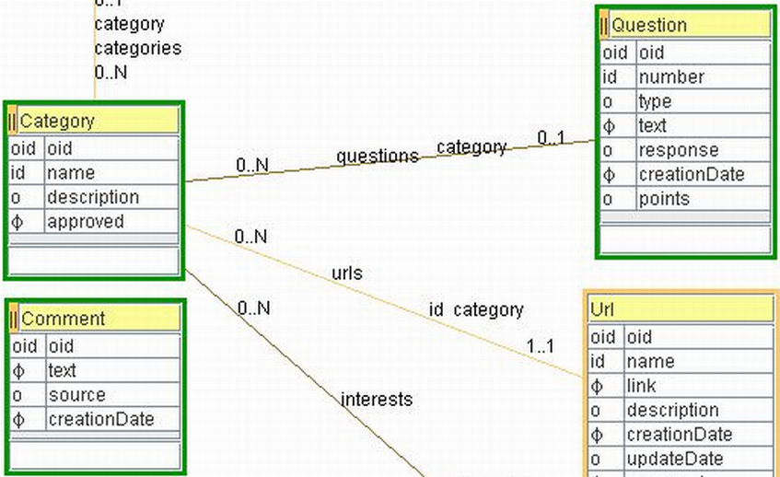
Graphical Model

Slide 9
ModelibraWicketSkeleton
Eclipse Project
Modelibra & ModelibraWicket Libraries
CSS
Code Generation Templates
Domain Model Configuration
Code Generation Context

Slide 10
Modelibra
Java 6
Domain Classes
Model Classes
Concept Classes
Generic vs. Specific Classes
Configuration Classes

Slide 11
Modelibra Model
Domain Model Configuration
Meta Model
Model Entry Points
Entities vs. Entity
Retrieval, Selection & Order
Add, Update, Remove

Slide 12
Modelibra Persistency
Main Memory Restriction
Persistency Layer
XML Data Files
JDBC Relational Database
db4o Object Database

Slide 13
Modelibra Performance
Load vs. Save
Main Memory Indexes
Add, Update, Remove
Retrieval & Selection
Actions vs. Transactions
PolePosition Benchmark
Session & Undo
Export & Synchronization

Slide 14
ModelibraWicket
Wicket Web Framework
Wicket Model
ModelibraWicket Component Framework
ModelibraWicket Knows Domain Model
Generic Programming
Default Web Application
Web Component Model
Web Component View
XHTML Code

Slide 15
Web Component Context
Web Page:
DmEducApp dmEducApp =
(DmEducApp) getApplication();
DmEduc dmEduc =
dmEducApp.getDmEduc();
WebLink webLink =
dmEduc.getWebLink();

Slide 16
Web Component Model
ViewModel commentsModel =
new ViewModel(webLink);
Comments comments =
webLink.getComments();
commentsModel.setEntities(comments);

Slide 17
Web Component View
View commentsView = new View();
commentsView.
setWicketId(“commentTable”);

Slide 18
Web Component HTML
<div wicket:id = “commentTable”>
Dynamic data.
</div>

Slide 19
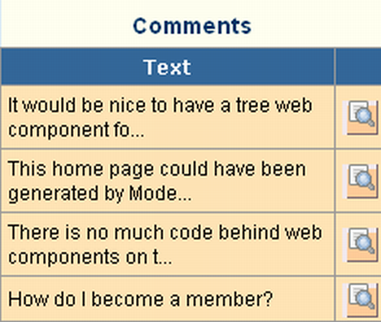
Web Component

Slide 20
Modelibra Productivity
Graphical Domain Model
Code Generation
Generic vs. Specific Code
Default XML Data File Persistency
No Installation
No Changes For Relational and Object Db
Rich API
Default Web Application
Model Validation by Use
Web Components Know Domain Model
Modelibra Performance

Slide 21
Modelibra Future
ModelibraSwing
Modelibra & JHotDraw for ModelibraModeler
Performance Benchmarking with p-unit
Lazy Loading
Hibernate Persistency
Distributed Model with Terracotta
Catalog of Concepts
Catalog of Web Components
Catalog of Web Applications
AJAX Web Components
View XML Configuration

