Slide 1

Building Age from Space
A model that learns on Madrid and maps building age in any city from a few labelled pixels
Potato Team
Sara S. Ali & Mostafa Mohammed
Hack4Dev · November 2026
Notes:
Welcome. We are the Potato Team, Sara S. Ali and Mostafa Mohammed. In the next minutes: how a satellite can tell how old a building is, how we built a model on Madrid, and how it adapts to Amsterdam from just a handful of labelled pixels.

Slide 2
Abstract
Can a satellite tell how old a building is, even in a city it has never seen? We use 42 years of Landsat imagery (1984–2025) over 76,263 building pixels in Madrid. Each pixel's yearly spectral history is turned into a fingerprint by an ensemble of 5 one-dimensional convolutional networks trained with supervised contrastive learning. Tested honestly on unseen Madrid neighbourhoods (10-fold spatial cross-validation), it reaches macro-F1 0.649 ± 0.038. Our function modelCreate adapts it to a new city from n labelled pixels per class: up to 20 it uses the backbone as it is; above that it recalibrates on the city's own pixels, fine-tunes the top layers when cross-validation supports it, and lets uncertain pixels follow their labelled neighbours. In Amsterdam, macro-F1 rises from 0.651 (n = 5) to 0.760 (n = 200), and every pixel comes with a confidence level.
0.649
Madrid macro-F1, unseen neighbourhoods
0.685
Amsterdam, 25 labelled pixels per class
0.760
Amsterdam, 200 labelled pixels per class
Notes:
The abstract in one sentence: we learn how building age shows up in 42 years of satellite data in Madrid, then adapt to a new city with very few labels. Three numbers to remember: Madrid score on neighbourhoods the model never saw, and Amsterdam with 25 and with 200 labelled pixels per class.

Slide 3
How old is every building in a city?
1
Energy
We predict one of four periods for every building pixel (30 m × 30 m)
Older buildings lose more heat: retrofit programmes need to know where they are
Before 1960
2
Safety
before 1945 in Amsterdam
Building codes changed over time: age is a proxy for structural risk
1960 – 1984
1945 – 1984 in Amsterdam
3
Planning
1984 – 2004
Many cities have no complete building register, but every city has satellite images
first 20 years of satellite
2004 – 2024
second 20 years
Satellite record used: Landsat 5, 7, 8, 9 — one value per year, 1984 – 2025
Notes:
Why care? Energy retrofits, structural safety and planning all depend on building age, and many cities lack a complete register. Satellites cover every city. We classify each 30 metre pixel into four construction periods; the oldest boundary is city-specific: 1960 in Madrid, 1945 in Amsterdam.

Slide 4
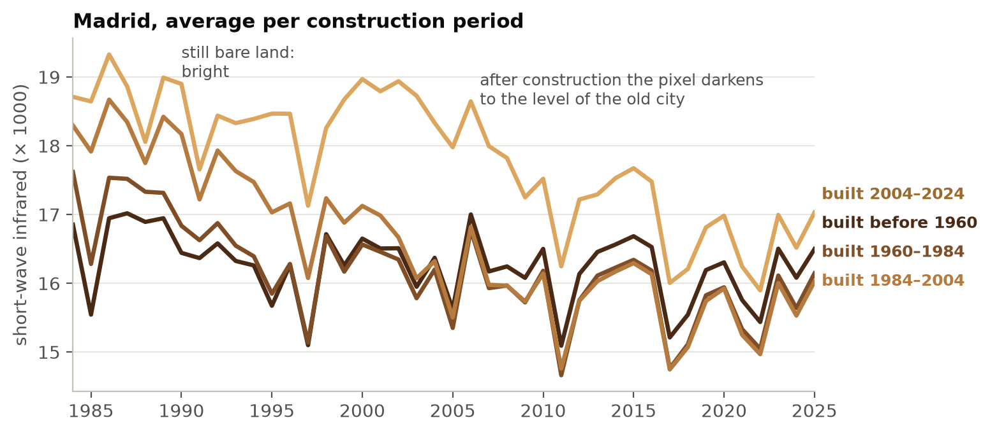
A satellite remembers when the land was built on
Bare land is bright in short-wave infrared; buildings are darker
When a pixel gets built on, its 42-year history shows a drop
The year of the drop tells the age; old buildings are dark from the start
Our model reads the whole 42-year history of 32 measurements per pixel
Average of all Madrid building pixels per construction period
Notes:
This is the signal. Each line is the average over all Madrid building pixels of one period. Newer periods start bright because the land was bare, then fall to the level of the old city once buildings appear. The timing of that fall carries the age. The model sees 32 such measurements per year for 42 years.

Slide 5
Our solution in one picture
Raw satellite data
Clean & prepare
Backbone
modelCreate
Age map
1984–2025, up to 3 images a year
best observation per band, quality flags
5 networks trained on Madrid only
adapts to a new city from a few labels
4 periods + confidence per pixel
Stage 1 — learn on Madrid
Stage 2 — adapt to any city
Turn every pixel's 42-year history into a short fingerprint so that buildings of the same age end up close together.
Show the model a few labelled buildings of the new city; it builds that city's own map and says how sure it is.
Notes:
Two stages. Stage one is done once, on Madrid: a backbone that turns every pixel's history into a fingerprint where same-age buildings sit close together. Stage two runs for each new city: modelCreate takes a few labelled pixels and produces a map with a confidence level per pixel.

Slide 6
Choosing the model: 13 candidates
Why TempCNN
Tied for best (0.640) with a bigger hybrid model
Simplest of the top group, fastest to train
Keeps the year order: a 5-year sliding window over 42 years
Tree models (Random Forest, XGBoost) memorised Madrid: big train/test gap
Notes:
We compared 13 model families, from logistic regression to transformers, on the same honest blocks. A one-dimensional convolutional network, TempCNN, tied for first place with a bigger hybrid; we chose it because it is simpler and faster, and it reads the years in order. Tree models scored well on training data but generalised worst.

Slide 7
Then we pushed it further and checked every step
5 networks
averaged: +0.008 over a single network, better on 10 of 10 blocks
31
alternative designs and losses tested: none beat our model
~1,000
networks trained to make these decisions
We keep 5: the smallest number that is as good as 10 and clearly better than one
Notes:
After choosing TempCNN we improved it in measured steps. Averaging several networks trained with different random starts adds about one point and wins on every block. We then tried 27 architecture changes and 4 different training losses, about a thousand networks in total; none beat the current design, so we kept it. The number of averaged networks is chosen by a fixed rule: the smallest ensemble that matches ten.

Slide 8
Madrid: 0.649 macro-F1 on unseen neighbourhoods
0.649
true \ predicted | Before 1960 | 1960–1984 | 1984–2004 | 2004–2024
Before 1960 | 61% | 31% | 5% | 3%
1960–1984 | 18% | 69% | 9% | 5%
1984–2004 | 5% | 17% | 67% | 11%
2004–2024 | 3% | 12% | 16% | 68%
macro-F1 ± 0.038 (sd over 10 spatial folds)
67%
of pixels in the right period (4 classes; chance = 25%)
Read across a row: of all buildings truly from that period, the share predicted in each period. Most mistakes are with the neighbouring period.
F1 per period
before 1960: 0.55 1960–84: 0.68 1984–2004: 0.68 2004–24: 0.70
The hardest case: 31% of pre-1960 buildings are taken for 1960–1984. Both were built before the satellite record starts, so their histories look alike.
Notes:
On Madrid neighbourhoods the model never saw, the macro-F1 is 0.649 with a spread across the ten test folds. About two thirds of pixels get the right period out of four. Errors are almost always the neighbouring period; the hardest is telling pre-1960 from 1960 to 1984, because both were built before the first satellite image of 1984.

Slide 9
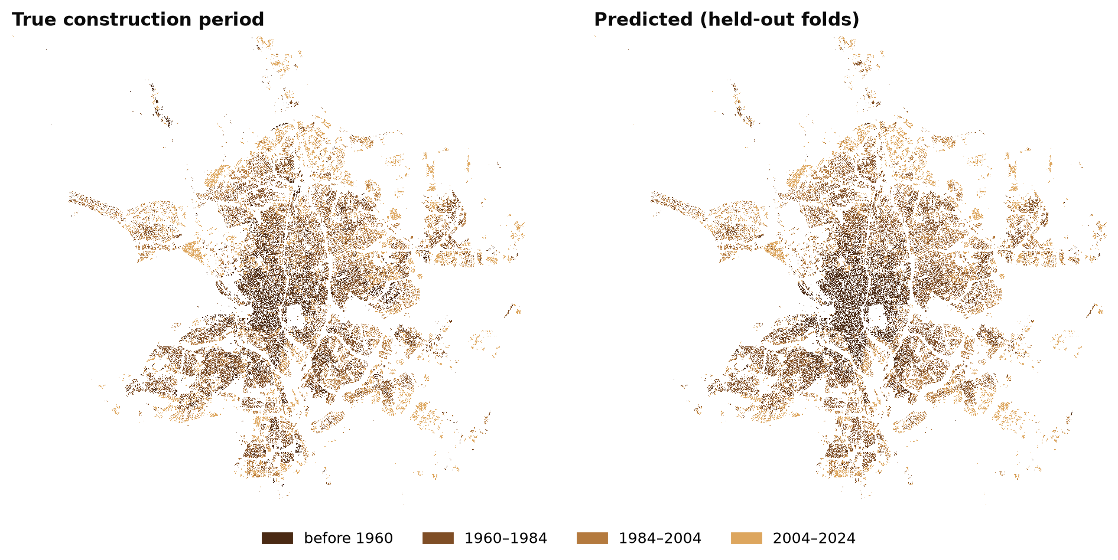
Madrid: the true map vs the model's map
Every pixel is predicted by a network that never saw its 1 km block during training
Notes:
Left: the truth. Right: the model's prediction, where each block was predicted by a model that never trained on it. The historic centre, the 1960s to 80s ring and the newer outskirts are all recognisable.

Slide 10
modelCreate: adapting to a new city
Input: n labelled pixels per period from the new city
n ≤ 20: bare backbone
n > 20: full pipeline
Average the fingerprints of each period's labelled pixels (one 'prototype' per period). Every other pixel takes the period of the closest prototype.
1
Recalibrate
re-measure the network's internal averages on the new city's own (unlabelled) pixels
2
Fine-tune if it helps
Too few labels to change the network safely, so we don't.
cross-validation on the labels decides how many top layers to retrain (often just the last ones)
3
Confidence rule
clear winner between the two closest periods: keep it (high). Unclear: ask the labelled and high-confidence neighbours (moderate-high)
Nothing is tuned by hand for a city: thresholds, neighbourhood size and hemisphere are measured from the city's own data.
Notes:
This is the function the challenge asks for. With twenty or fewer labels per period we keep the Madrid network untouched and classify by distance to the average fingerprint of each period. With more labels we recalibrate the network on the new city's pixels, fine-tune its top layers only if cross-validation on those labels says it helps, and add a confidence rule: when the two closest periods are almost tied, the pixel follows its labelled and confident neighbours.

Slide 11
Amsterdam: more labels, better maps
 | n per period | Method | Macro-F1 (mean ± sd)
Madrid | 10-fold CV | backbone | 0.649 ± 0.038
Amsterdam | n = 5 | bare backbone | 0.651 ± 0.017
Amsterdam | n = 25 | full pipeline | 0.685 ± 0.028
Amsterdam | n = 50 | full pipeline | 0.703 ± 0.022
Amsterdam | n = 100 | full pipeline | 0.738 ± 0.007
Amsterdam | n = 200 | full pipeline | 0.760 ± 0.006
0.707
0.760
0.685
average, 5 sizes
peak (n = 200)
low data (n = 25)
Notes:
The required table: Madrid, and Amsterdam for each number of labels per period, ten random draws each with a fixed seed. Five labels use the untouched backbone; from 25 on, the full pipeline. The score grows steadily with labels. Bottom left: the three prize metrics, the average over all five sample sizes, the peak, and the low-data score at 25 labels.

Slide 12
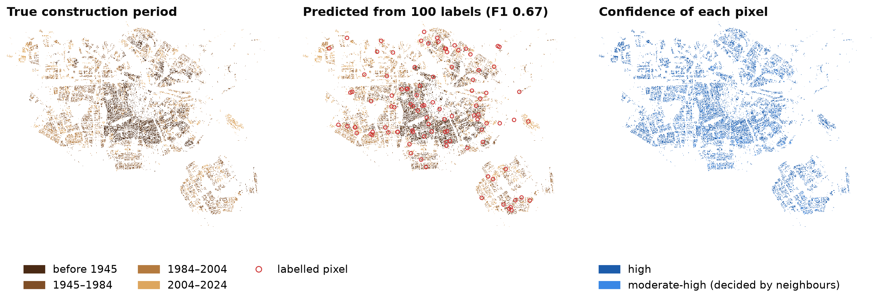
Amsterdam from 100 labelled pixels (25 per period)
One random draw (seed 0): macro-F1 0.67 on the other 25,892 pixels. The canal-ring centre (oldest) and the newer districts are recovered from only 100 examples.
Notes:
One example run: the red circles are the only 100 labelled pixels the model got from Amsterdam. The middle map is its prediction for all twenty-six thousand building pixels; the right map shows which pixels it is sure about and which were settled by their neighbours.

Slide 13
Every pixel comes with an honest confidence
65%
of pixels are 'high' at n = 100, and 79% of those are right
35%
are 'moderate-high': decided by their neighbours, 65% right
Users can trust 'high' pixels directly and send 'moderate-high' ones for a field check first.
Notes:
The confidence level is useful in practice. Pixels marked high are right about three times in four or better; moderate-high pixels, which were decided by their neighbours, are right about two times in three. A city could accept the high ones and check the others on the ground.

Slide 14
Thank you
Sara S. Ali & Mostafa Mohammed · Potato Team
0.649
0.685
0.760
Madrid
Amsterdam, n = 25
Amsterdam, n = 200
Notes:
Thank you. Questions are welcome; the code runs end to end from the raw parquet files with one command and a fixed seed.

