Slide 1
Ab initio Session 3
Ab Initio Components
Ab Initio Training
Notes:
CapGemini
Ab Initio Training

Slide 2
Filter by expression
Sort
Sort within Group
DeDup Sorted
Reformat: Example showing multiple output
CapGemini
Ab Initio Training

Slide 3

Filter by Expression
Filter by Expression filters data records according to a DML expression.
CapGemini
Ab Initio Training

Slide 4
The Filter by Expression Component
For each record on the input port the ‘select_expr’ parameter is evaluated. If ‘select_expr’ evaluates true (non-zero), the input record is written to the ‘out’ port exactly as the input was read.
If the ‘select_expr’ evaluates false (zero), the record is written to the ‘deselect’ port.
The ‘out’ port must be connected downstream, those records meeting the ‘select_expr’ criteria
The ‘deselect’ output may be optionally used
CapGemini
Ab Initio Training

Slide 5
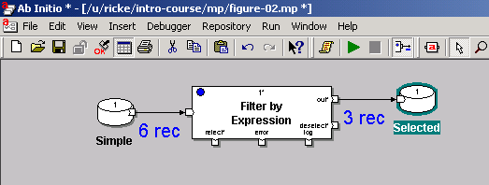
Filter Data
1. Push “Run” button.
2. View monitoring information.
3. View output data.
CapGemini
Ab Initio Training

Slide 6
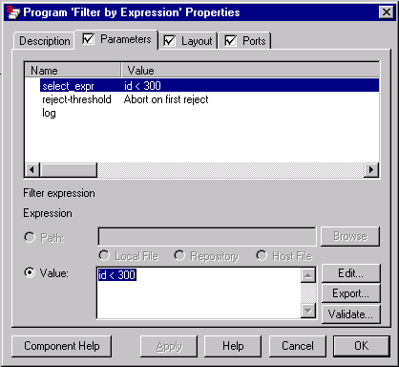
Expression Parameter
CapGemini
Ab Initio Training

Slide 7
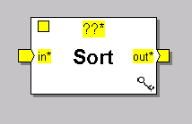
The Sort Component
Reads records from input port, sorts them by key, and writes the result on the output port.
CapGemini
Ab Initio Training

Slide 8
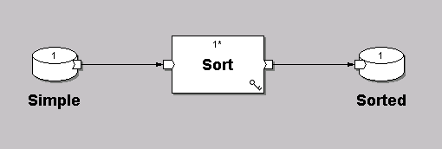
Sorting
CapGemini
Ab Initio Training

Slide 9
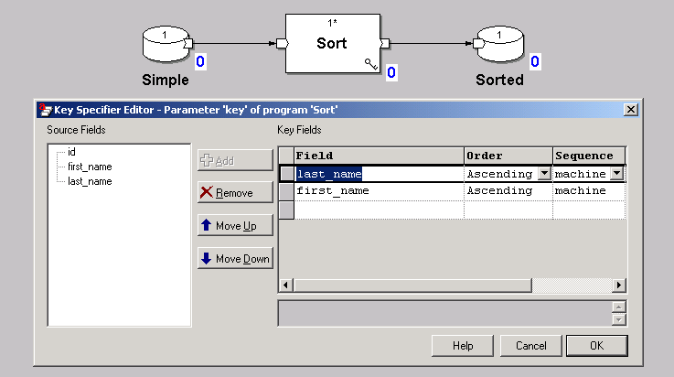
Sorting - The Key Specifier Editor
CapGemini
Ab Initio Training

Slide 10
Parameters for Sort
key
(key specifier, required)
Name(s) of the key field(s) and the sequence specifier(s) you want Sort to use when it orders data records.
max-core
(integer, required)
Maximum memory usage in bytes. The default value of max-core is 100663296 (100 megabytes). When Sort reaches the number of bytes specified in the max-core parameter, it sorts the records it has read and writes a temporary file to disk.
CapGemini
Ab Initio Training

Slide 11
Runtime Behavior of Sort
The Sort component:
Reads the records from all the flows connected to the in port until it reaches the number of bytes specified in the max-core parameter.
Sorts the records and writes the results to a temporary file on disk.
Repeats this procedure until it has read all records.
Merges all the temporary files, maintaining the sort order
Writes the result to the out port Sort stores temporary files in the working directories specified by its layout.
CapGemini
Ab Initio Training

Slide 12
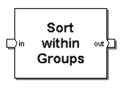
Sort within Groups
Sort within Groups refines the sorting of data records already sorted according to one key specifier: it sorts the records within the groups formed by the first sort according to a second key specifier.
CapGemini
Ab Initio Training

Slide 13
Parameters for Sort within Groups
major-key
(key specifier, required) :Name(s) of the key field(s) and the sequence specifier(s) by which Sort within Groups assumes input is ordered.
minor-key
(key specifier, required) :Name(s) of the key field(s) and the sequence specifier(s) you want Sort within Groups to use when it orders data records.
max-core
(integer, required) :Maximum memory usage in bytes before Sort within Groups stops the execution of the graph. The default value of max-core is 10485760 (10 megabytes).
CapGemini
Ab Initio Training

Slide 14
Runtime Behavior of Sort within Groups
Sort within Groups assumes input records are sorted according to the major-key parameter. Sort within Groups reads data records from all the flows connected to the in port until it either reaches the end of a group or reaches the number of bytes specified in the max-core parameter. When Sort within Groups reaches the end of a group, it does the following:
Sorts the records in the group according to the minor-key parameter
Writes the results to the out port
Repeats this procedure with the next group
CapGemini
Ab Initio Training

Slide 15
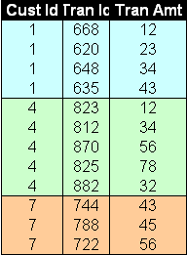
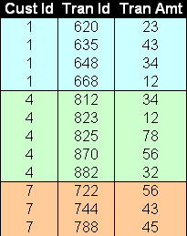
Sort Within Groups : Example
Minor Key
Major Key
Input data sorted by Cust Id
Output data Sorted by Cust Id
And Tran Id
CapGemini
Ab Initio Training

Slide 16
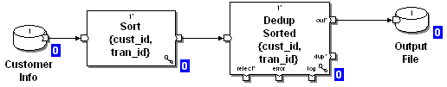
Sort Within Group
Major Key : class
Minor Key : roll_nbr
CapGemini
Ab Initio Training

Slide 17
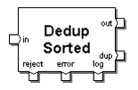
Dedup Sorted
Dedup Sorted separates one specified data record in each group of data records from the rest of the records in the group.
Dedup Sorted requires grouped input
CapGemini
Ab Initio Training

Slide 18
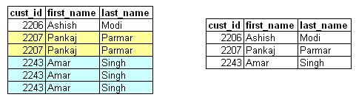
Removing Duplicates
Input
Output
Occurrence of Duplicate
Records in Customer Info
file
CapGemini
Ab Initio Training

Slide 19
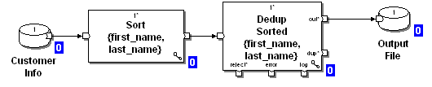
Delete Duplicates
Deletes duplicates from a group of records based on the key/s
Data should be sorted on the same key/s before using Dedup
“keep” property can be used to select either first, last or unique
record from within the group
CapGemini
Ab Initio Training

Slide 20
Runtime Behavior of Dedup Sorted
The Dedup Sorted component:
Reads a grouped flow of records from the in port. If your records are not already grouped, use Sort to group them.
Applies the expression in the select parameter to the records, if you have defined the select parameter
CapGemini
Ab Initio Training

Slide 21
Runtime Behavior of Dedup Sorted
If the expression evaluates to 0 for a particular record, Dedup Sorted does not process the record (that is, the record does not appear on any output port).
If the expression produces NULL for a particular record, Dedup Sorted writes the record to the reject port and writes a descriptive error message to the error port. Dedup Sorted discards the information if you do not connect flows to the reject or error ports.
If the expression evaluates to anything other than 0 or NULL for a particular record, Dedup Sorted processes the record. If you do not supply an expression for the select parameter, Dedup Sorted processes all the records on the in port.
CapGemini
Ab Initio Training

Slide 22
Runtime Behavior of Dedup Sorted
Dedup Sorted considers any consecutive records with the same key value to be in the same group:
If a group consists of one record, Dedup Sorted writes that record to the out port.
If a group consists of more than one record, Dedup Sorted uses the value of the keep parameter to determine:
  Which record — if any — to write to the out port.
  Which record or records to write to the dup port.
CapGemini
Ab Initio Training

Slide 23
Runtime Behavior of Dedup Sorted
If you have chosen unique-only for the keep parameter, Dedup Sorted does not write records to the out port from any groups consisting of more than one record.
Both the out and dup ports are optional; if you do not connect flows to them, Dedup Sorted discards the records.
CapGemini
Ab Initio Training

Slide 24
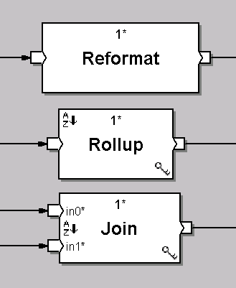
More Complex Components
In these components the record format metadata typically changes (goes through a transformation) from input to output
CapGemini
Ab Initio Training

Slide 25
Reformat-Transform Component
Transform components modify or manipulate data records by using one or more transform functions.
Reformat: Changes the record format of your data by dropping fields or by using DML expressions to add fields, combine fields, or modify the data.
CapGemini
Ab Initio Training

Slide 26
Data Transformation
0345,090263John,Smith;
Input record format:
record
decimal(”,”) id;
date(”MMDDYY”) bday;
string(”,”)first_name;
string(”;”) last_name;
end
Drop
Reformat
Reformat
Reorder
id+1000000
Output record format:
record
decimal(7) id;
string(8) last_name;
date(”YYYY.MM.DD”) bday;
end
1000345Smith 1963.09.02
CapGemini
Ab Initio Training

Slide 27
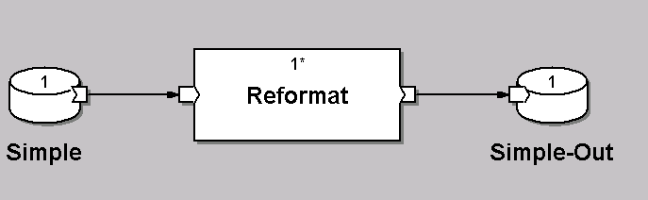
The Reformat Component
Reads records from input port, reformats each according to a transform function (optional in the case of the Reformat Component), and writes the result records to the output (out0) port.
Additional output ports (out1, ...) can be created by adjusting the count parameter.
CapGemini
Ab Initio Training

Slide 28
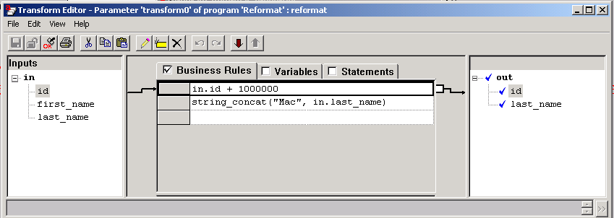
The Transform Function Editor
CapGemini
Ab Initio Training

Slide 29
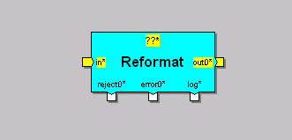
Reformat
Reformat with 5 ports
CapGemini
Ab Initio Training

Slide 30
About Transform Functions
A transform function (or transform) is the logic that drives data transformation — most commonly, transform functions express record reformatting logic. In general, however, you can use transform functions in data cleansing, record merging, and record aggregation.
CapGemini
Ab Initio Training

Slide 31
About Transform Functions
To be more specific, a transform function is a collection of business rules, local variables, and statements. The transform expresses the connections between the rules, variables, and statements, as well as the connections between these elements and the input and output fields.
Transform functions are always associated with transform components; these are components that have a transform parameter: the Aggregate, Denormalize Sorted, Fuse, Join, Match Sorted, MultiReformat, Normalize, Reformat, Rollup, and Scan components.
CapGemini
Ab Initio Training

Slide 32
About Transform Functions
Each component that has a transform parameter:
Determines the values that are passed to the transform function
Interprets the results of the transform function
CapGemini
Ab Initio Training

Slide 33
Runtime Behavior of Reformat
The n in outn gives each out port a unique number. Each outn port has a corresponding rejectn and errorn port.
The Reformat component:
Reads records from the in port.
If you supply an expression for the select parameter, the expression filters the records on the in port:
  If the expression evaluates to 0 for a particular record, Reformat does not process the record, which means that the record does not appear on any output port.
  If the expression produces NULL for any record, Reformat writes a descriptive error message and stops execution of the graph.
CapGemini
Ab Initio Training

Slide 34
Runtime Behavior of Reformat
If the expression evaluates to anything other than 0 or NULL for a particular record, Reformat processes the record. If you do not supply an expression for the select parameter, Reformat processes all the records on the in port.
Passes the records to the transform functions, calling the transform function on each port, in order, for each record, beginning with out port 0 and progressing through out port count - 1.
Writes the results to the out ports.
CapGemini
Ab Initio Training

Slide 35
Parameters for Reformat
Reformat :Parameters
count
limit
log
ramp
reject-threshold
select
Transform n
CapGemini
Ab Initio Training

Slide 36
Parameters for Reformat
count :(integer, required)
Integer from 1 to 20 that sets the number of each of the following. The default is 1.
  out ports
  reject ports
  error ports
  transform parameters
CapGemini
Ab Initio Training

Slide 37
Parameters for Reformat
Transform: (filename or string, optional)
Either the name of the file, or a transform string, containing a transform function corresponding to an out port; n represents the number of an out port .Transform functions for Reformat should have one input and one output.
select :(expression, optional)
Filter for data records before reformatting.
CapGemini
Ab Initio Training

Slide 38
Parameters for Reformat
limit : (integer, required)
A number representing reject events .When the reject-threshold parameter is set to Use ramp/limit, the component uses the values of the ramp and limit parameters in a formula to determine the component's tolerance for reject events. Default is 0.
CapGemini
Ab Initio Training

Slide 39

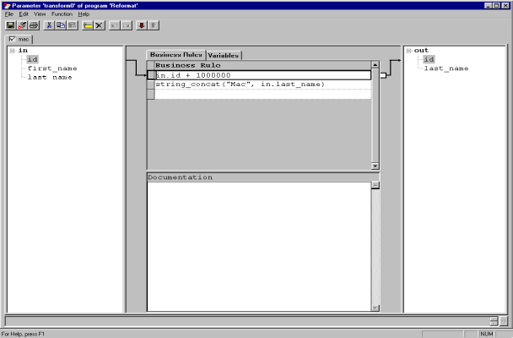
A Look Inside the Reformat Component
a
b
c
x
y
z
CapGemini
Ab Initio Training

Slide 40
A Record arrives at the input port
9
45
QF
out :: trans(in) =
begin
out.x :: in.b - 1;
out.y :: in.a;
out.z :: fn(in.c);
end;
CapGemini
Ab Initio Training

Slide 41
The Transformation Function is evaluated
9
45
QF
out :: trans(in) =
begin
out.x :: in.b - 1;
out.y :: in.a;
out.z :: fn(in.c);
end;
CapGemini
Ab Initio Training

Slide 42
The result record is written to the output port of the component
out :: trans(in) =
begin
out.x :: in.b - 1;
out.y :: in.a;
out.z :: fn(in.c);
end;
44
9
RG
CapGemini
Ab Initio Training

Slide 43
Exercise 1
CapGemini
Ab Initio Training

Slide 44
Exercise 2
CapGemini
Ab Initio Training

Slide 45
Thank You
End of Session 3
CapGemini
Ab Initio Training

