Slide 1
Ab initio Session 4
Introduction to Ab Initio
Ab Initio Training
Notes:
CapGemini
Ab Initio Training

Slide 2
Join
CapGemini
Ab Initio Training

Slide 3
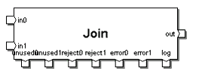
Join Basic Definition
Join performs inner, outer, and semi-joins with multiple flows of data records.
CapGemini
Ab Initio Training

Slide 4
JOIN
Join reads data from two or more input ports, combines records with matching keys according to the transform you specify, and sends the transformed records to the output port. Additional ports allow you to collect rejected and unused records. There can be as many as 20 input ports.
CapGemini
Ab Initio Training

Slide 5
Alphabetical List of Join Parameters
count maintain-order
dedupn max-core
driving max-memory
join-type override- keyn
key ramp
limit record- requiredn
logging reject-threshold
log_input selectn
log_intermediate sorted-input
log_output transform
log_reject
CapGemini
Ab Initio Training

Slide 6
Parameter Descriptions for Join
count : (integer, required)
An integer n from 2 to 20 specifying the total number of inputs (in ports) to Join. This in turn determines the number of the following ports and parameters:
  unused ports
  reject ports
  error ports
  record-required parameters
  dedup parameters
  select parameters
  override-key parameters Default is 2.
Each in port (always 2 or more) has a number n appended. There can be as many as 20 in ports altogether. Each outn, unusedn, rejectn, and errorn port corresponds to an inn port.
CapGemini
Ab Initio Training

Slide 7
Parameter Descriptions for Join
sorted-input : (choice, required)
When set to In memory: Input need not be sorted, Join accepts unsorted input, and permits the use of the maintain-order parameter.
When set to Inputs must be sorted, Join requires sorted input, and the maintain-order parameter is not available.
Default is Inputs must be sorted.
CapGemini
Ab Initio Training

Slide 8
Parameter Descriptions for Join
key : (key specifier, required)
Name(s) of the field(s) in the input records that must have matching values for Join to call the transform function.
CapGemini
Ab Initio Training

Slide 9
Parameter Descriptions for Join
transform : (filename or string, required)
Either the name of the file containing the transform function, or a transform string. In the file specified in the transform parameter or in the transform string, create a transform function that has the following characteristics:
  The transform function takes the number of input arguments specified in the count parameter.
  The first argument is a data record with the record format of the in0 port. The second argument is a data record with the record format of the in1 port, and so on.
  The transform function has an explicit or implicit rule that assigns a value to every field in the output record.
CapGemini
Ab Initio Training

Slide 10
Parameter Descriptions for Join
join-type : (choice, required)
Choose from the following:
  Inner join — sets the record-requiredn parameters for all ports to True. Inner join is the default. The GDE does not display the record-requiredn parameters because they all have the same value.
  Outer join — sets the record-requiredn parameters for all ports to False. The GDE does not display the record-requiredn parameters because they all have the same value.
  Explicit — allows you to set the record-requiredn parameter for each port individually. If you set the dedupn parameter to True on the driving input, set the join-type parameter to Inner join. (The driving input is the largest input, as specified by the driving parameter.)
CapGemini
Ab Initio Training

Slide 11
Parameter Descriptions for Join
dedupn : (boolean, required)
Set the dedupn parameter to True to remove duplicates from the corresponding inn port before joining. This allows you to choose only one record from a group with matching key values as the argument to the transform function. Default is False, which does not remove duplicates.
If you remove duplicates on this input port before joining it to the driving input, set the record-requiredn parameter to True on all other ports. (The driving input is the largest input, as specified by the driving parameter.)
There is one dedupn parameter associated with each inn port.
CapGemini
Ab Initio Training

Slide 12
Parameter Descriptions for Join
selectn : (expression, optional)
Filter for records before join function. One per inn port; n represents the number of an in port.
CapGemini
Ab Initio Training

Slide 13
Parameter Descriptions for Join
override-keyn : (key specifier, optional)
Alternative name(s) for the key field(s) for a particular inn port.
Supported for Co>Operating System Version:
  2.1 and higher with the sorted-input parameter set to In memory: Input need not be sorted
  2.2.2 and higher with the sorted-input parameter set to Inputs must be sorted There is one override-keyn parameter per inn port. The n corresponds to the number of an in port.
To use key field(s) other than the key field(s) specified in the key parameter for a particular inn port, specify the key field(s) you want to use in the corresponding override-keyn parameter. Default is 0.0.
CapGemini
Ab Initio Training

Slide 14
Parameter Descriptions for Join
max-memory : (integer, required)
Maximum memory usage in bytes before Join writes temporary files to disk. Only available when the sorted-input parameter is set to Inputs must be sorted.
The default value is 8388608 bytes (8 megabytes). Start by using this default, and then adjust to higher or lower values as necessary if you encounter performance difficulties. It is very unlikely you will ever need to change the value of this parameter.
CapGemini
Ab Initio Training

Slide 15
Parameter Descriptions for Join
driving : (integer, required)
Number of the port to which you connect the driving input. The driving input is the largest input. All other inputs are read into memory.
The driving parameter is only available when the sorted-input parameter is set to In memory: Input need not be sorted. For example, suppose the largest input to be joined is on the in1 port. Specify a port number of 1 as the value of the driving parameter. The Join component reads all other inputs to the join, for example, in0, and in2, into memory.
Default is 0, which specifies that the driving input is on port in0.
CapGemini
Ab Initio Training

Slide 16
Parameter Descriptions for Join
maintain-order : (boolean, required)
Set to True to ensure that records remain in the original order of the driving input. (The driving input is the largest input, as specified by the driving parameter.) Default is False.
Only available when the sorted-input parameter is set to In memory: Input need not be sorted. If the sorted-input parameter is set to Inputs must be sorted, and all inputs are sorted on the fields given in the key parameter, then the output maintains the sort order on that key without the use of this parameter.
CapGemini
Ab Initio Training

Slide 17
Parameter Descriptions for Join
maintain-order : (boolean, required)
If any inputs, other than the driving input, are too large to fit within the memory limit specified by max-core, and you set maintain-order to
False — Join stores some of its intermediate results in temporary files on disk. This alters the order of records in the driving input.
True — Join stops execution of the graph. Even if you leave maintain-order set to False, Join groups together all output records for a given driving input record. If the driving input is grouped by key value, you can still use components downstream that require records grouped by key value.
CapGemini
Ab Initio Training

Slide 18
Parameter Descriptions for Join
max-core : (integer, required)
Maximum memory usage in bytes. Only available when the sorted-input parameter is set to In memory: Input need not be sorted. The default value is 67108864 bytes (64 megabytes).
If the total size of the intermediate results Join holds in memory exceeds the number of bytes specified in the max-core parameter, Join writes temporary files to disk
CapGemini
Ab Initio Training

Slide 19
Runtime Behavior of Join
The Join component:
Reads data records from multiple inn ports.
Applies the expression in any defined selectn parameter to the records on the corresponding inn port.
  If the expression evaluates to 0 for a record, Join does not process the record, and it does not appear on any output port.
  If the expression produces NULL for a particular record, Join writes a descriptive error message and stops graph execution.
  If the expression evaluates to anything other than 0 or NULL for a particular record, Join processes the record.
CapGemini
Ab Initio Training

Slide 20
Runtime Behavior of Join
If you do not supply an expression for a selectn parameter, Join processes all the records on the corresponding inn port.
Operates on the records that have matching key values using a multi-input transform function.
Writes the result to the out port. If you connect a flow to an unusedn port, Join writes to the unusedn port, from the corresponding inn port, any of the selected records that it does not pass through the transform function. In other words, Join writes the following records to unusedn ports:
For an inner join — all unmatched records
For an outer join — no records, since Join passes all records through the transform function
For an explicit join — records for which the transform is not called
For an input port with the dedupn parameter set to True — records with duplicate key values
CapGemini
Ab Initio Training

Slide 21
Runtime Behavior of Join
Thus, the set of records that Join passes through the transform function is mutually exclusive with the set of records that come out the unusedn port, and the two sets are also collectively exhaustive. The result is that all selected records are accounted for exactly once.
If the transform function returns NULL, Join writes:
Each input record to the corresponding rejectn port.
CapGemini
Ab Initio Training

Slide 22
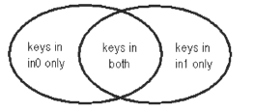
Join Types
Inner Join (Equi-Join)
Full Outer Join (Cartesian Product)
Explicit Join (Left or Right Outer Join
CapGemini
Ab Initio Training

Slide 23
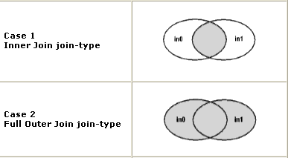
Join Types : Inner & Outer
CapGemini
Ab Initio Training

Slide 24
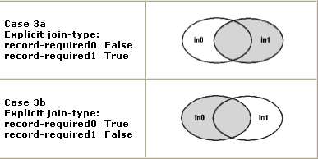
Join Types : Explicit
CapGemini
Ab Initio Training

Slide 25
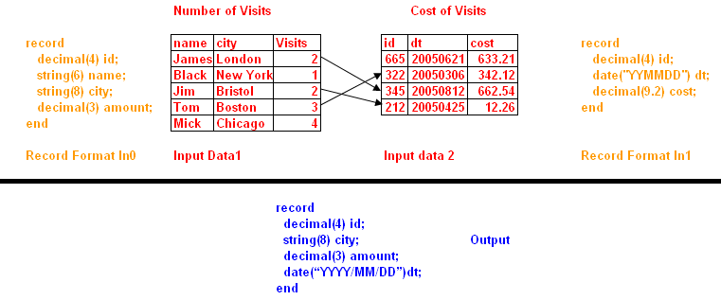
Joining of Data
CapGemini
Ab Initio Training

Slide 26
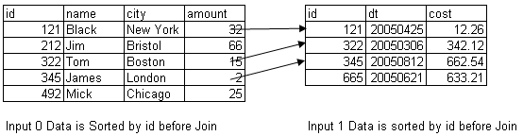
Input data sorted before Join
CapGemini
Ab Initio Training

Slide 27

The Join Component
Join performs a join of inputs. By default, the inputs to join must be sorted and an inner join is computed.
Note: The following slides and the on-line example assume the join-type parameter is set to ‘Outer’, and thus compute an outer join.
CapGemini
Ab Initio Training

Slide 28
Building the Output Record
in0:
record
decimal(4) id;
string(6) name;
string(8) city;
decimal(3) amount;
end
in1:
record
decimal(4) id;
date(”YYMMDD”) dt;
decimal(9.2) cost;
end
out:
record
decimal(4) id;
string(8) city;
decimal(3) amount;
date(“YYYY/MM/DD”)dt;
end
CapGemini
Ab Initio Training

Slide 29
What if the in1 record is missing?
in0:
record
decimal(4) id;
string(6) name;
string(8) city;
decimal(3) amount;
end
in1:
record
decimal(4) id;
date(”YYMMDD”) dt; ???
decimal(9.2) cost;
end
out:
record
decimal(4) id;
string(8) city;
decimal(3) amount;
date(“YYYY/MM/DD”)dt;
end
CapGemini
Ab Initio Training

Slide 30
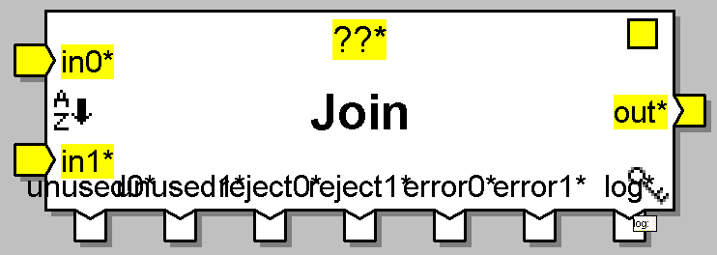
Ports of Join Component
reject0
error0
unused0
error1
Log Port
reject1
unused1
CapGemini
Ab Initio Training

Slide 31
Join Type : Scenario
Transaction
Customer
Tran Id | Cust Id | Tran Amt
T1 | C2 | 34
T2 | C1 | 45
T3 | C1 | 67
T4 | C2 | 23
T5 | C4 | 33
Cust Id | Cust Name
C1 | Name1
C2 | Name2
C3 | Name3
Key
Fields in Output of Join
Cust Id | Cust Name | Tran Amt
How many records will be generated at the output of Join
CapGemini
Ab Initio Training

Slide 32
Join Type : Scenario
Transaction
Customer
Tran Id | Cust Id | Tran Amt
T1 | C2 | 34
T2 | C1 | 45
T3 | C1 | 67
T4 | C2 | 23
T5 |  | 33
Cust Id | Cust Name
C1 | Name1
C2 | Name2
C3 | Name3
Key
Fields in Output of Join
Cust Id | Cust Name | Tran Amt
How many records will be generated at the output of Join
CapGemini
Ab Initio Training

Slide 33
Join Type : Scenario
Transaction
Customer
Tran Id | Cust Id | Tran Amt
T1 | C2 | 34
T2 | C1 | 45
T3 | C1 | 67
T4 | C2 | 23
T5 | C4 | 33
Cust Id | Cust Name
C1 | Name1
C2 | Name2
 | Name3
Key
Fields in Output of Join
Cust Id | Cust Name | Tran Amt
How many records will be generated at the output of Join
CapGemini
Ab Initio Training

Slide 34
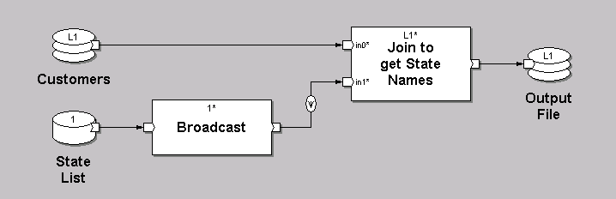
Minimize operations on large data
When joining a very small dataset to a very large dataset, it may be more efficient to broadcast the small dataset or use it as a lookup file rather than repartition and re-sort the large dataset.
CapGemini
Ab Initio Training

Slide 35
Minimize sorted join component and if possible replace them by in-memory join/hash join.
If the two inputs are huge then use sorted join, otherwise use hash join with proper driving port.
CapGemini
Ab Initio Training

Slide 36
Exercise 3
CapGemini
Ab Initio Training

Slide 37
Thank You
End of Session 4
CapGemini
Ab Initio Training

