Slide 1
Ab initio Session 5
Introduction to
Ab Initio
Ab Initio Training
Notes:
CapGemini
Ab Initio Training

Slide 2
Rollup
Scan
CapGemini
Ab Initio Training

Slide 3
Rollup
Rollup evaluates a group of input records that have the same key and then generates data records that either summarize each group or select certain information from each group.
Rollup gives you more control over record selection, grouping, and aggregation than Aggregate . Rollup does not produce intermediate summary records. If you want intermediate summary records, use Scan.
CapGemini
Ab Initio Training

Slide 4
Alphabetical List of Rollup Parameters
check-sort
key
key-method
limit
logging
log_input
log_intermediate
log_output
log_reject
max-core
ramp
reject-threshold
sorted-input
transform
CapGemini
Ab Initio Training

Slide 5
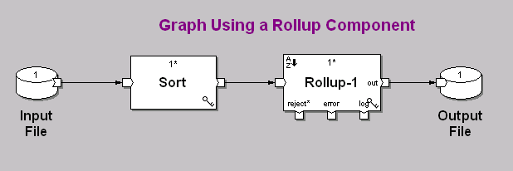
CapGemini
Ab Initio Training

Slide 6
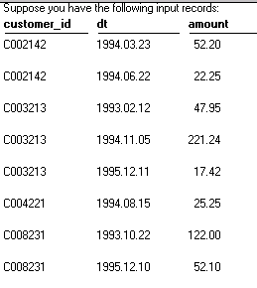
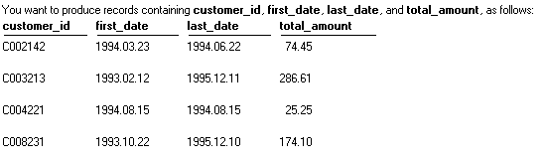
CapGemini
Ab Initio Training

Slide 7
Parameter Descriptions for Rollup
sorted-input :(boolean, required)
When set to In memory: Input need not be sorted, Rollup accepts ungrouped input, and requires the use of the max-core parameter.
When set to Input must be sorted or grouped, Rollup requires grouped input, and the max-core parameter is not available.
Default is Input must be sorted or grouped.
CapGemini
Ab Initio Training

Slide 8
Parameter Descriptions for Rollup
key-method :(choice, optional)
Method by which the component groups records. Choose one of the following:
  Use key specifier — the component uses a key specifier.
  Use key_change function — the component uses the key_change transform function.
CapGemini
Ab Initio Training

Slide 9
Parameter Descriptions for Rollup
key :(key specifier, optional)
Names(s) of the key field(s) Rollup can use to group or define groups of data records. If the value of the key-method parameter is Use key specifier, you must specify a value for the key parameter.
If you specify Use key_change function for the key-method parameter, the key parameter is not available.
For an alternate method Rollup can use to define groups, see the key-method parameter
CapGemini
Ab Initio Training

Slide 10
Parameter Descriptions for Rollup
max-core :(integer, required)
Maximum memory usage in bytes.
Only available when the sorted-input parameter is set to In memory: Input need not be sorted.
The default value of max-core is 67108864 (64 megabytes).
If the total size of the intermediate results Rollup holds in memory exceeds the number of bytes specified in the max-core parameter, Rollup writes temporary files to disk.
CapGemini
Ab Initio Training

Slide 11
More on :The sorted-input parameter
Rollup can process either grouped or ungrouped input, depending on the setting of the sorted-input parameter .There are two choices for the sorted-input parameter:
Input must be sorted or grouped (default)
In memory: Input need not be sorted
CapGemini
Ab Initio Training

Slide 12
Input must be sorted or grouped
When you leave the sorted-input parameter set to this default, Rollup requires data records grouped according to the key parameter . If you need to group the records, use Sort with the same key specifier that you use for Rollup.
CapGemini
Ab Initio Training
Notes:
CapGemini
Ab Initio Training

Slide 13
Input must be sorted or grouped
With sorted-input set to Input must be sorted or grouped, Rollup defines groups of data records in one of the following ways:
According to the key parameter.
By the key_change transform function , if you set the key-method parameter to Use key_change function.
Rollup only supports the key_change transform function when the sorted-input parameter is set to Input must be sorted or grouped.
Rollup considers records as belonging to the same group if they have the same key value, or if the key_change transform function returns 0 (false).
CapGemini
Ab Initio Training

Slide 14
Input must be sorted or grouped
The key_change transform function takes two arguments:
A previous input record
The current input record
The key_change transform function should return 0 (false) if the key values in these two records are the same, or non-0
(true) if they are not the same.
If you want Rollup to treat all records as one group, specify the value in the key parameter as {}.
CapGemini
Ab Initio Training

Slide 15
In memory: Input need not be sorted
When you set the sorted-input parameter to this choice, Rollup accepts ungrouped input, and groups all records according to the key parameter .With sorted-input set to In memory: Input need not be sorted, Rollup maximizes performance by holding intermediate results in main memory.
The size of the table of intermediate results (until it reaches the number of bytes specified in the max-core parameter) depends on:
The number of distinct key values
The size of the input record format
The size of temporary_type
CapGemini
Ab Initio Training

Slide 16
Built-in Functions for Rollup
The following aggregation functions are predefined and are only available in the rollup component:
avg max
count min
first product
last sum
CapGemini
Ab Initio Training

Slide 17
Modes of Roll up
Template Mode
Use of functions such as sum() ,count() ,min() ,max()
Expanded Mode
To find other details about min or max value record.
Example : you want to determine the price of the largest single purchase and the item that was purchased
CapGemini
Ab Initio Training

Slide 18
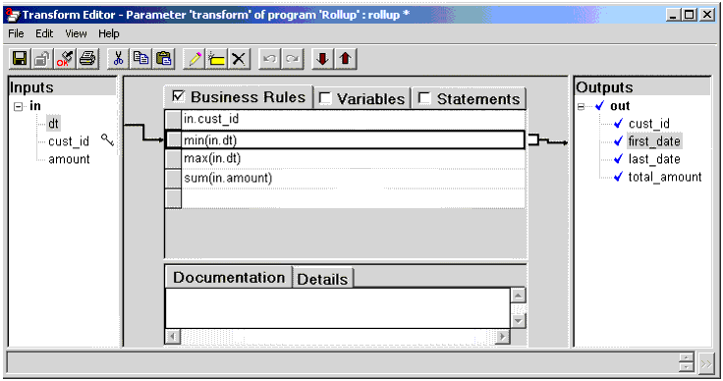
Rollup : Template Mode
(Grid View)
CapGemini
Ab Initio Training

Slide 19
Rollup : Template Mode
(Text View)
Out ::rollup(in) =
begin
out.cust_id :: in.cust_id;
out.first_date :: min(in.dt);
out.last_date :: max(in.dt);
out.total_amount :: sum(in.amount);
end;
CapGemini
Ab Initio Training

Slide 20
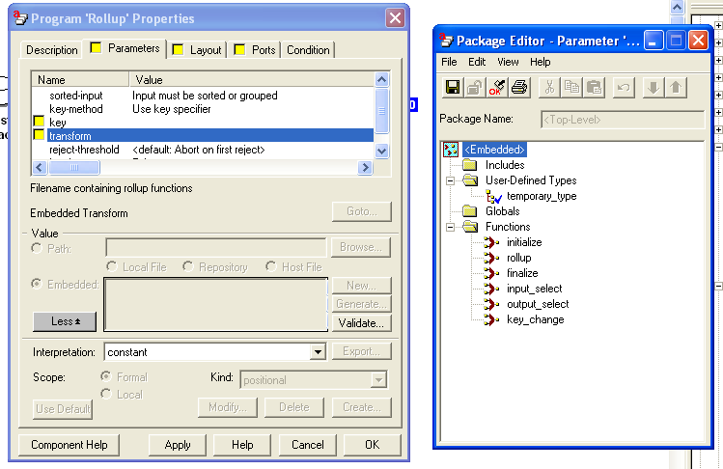
Rollup Properties & Package Editor
CapGemini
Ab Initio Training

Slide 21
Runtime behavior of Rollup
Rollup reduces each group of data records to a single aggregate output record, using a series of transform functions as follows:
With the first data record of each group, Rollup creates a temporary aggregate record.
With each following data record of the same group, Rollup updates the temporary aggregate record.
CapGemini
Ab Initio Training

Slide 22
Runtime behavior of Rollup
When you set sorted-input to Input must be sorted or grouped, Rollup writes the temporary aggregate record to the out port after processing the last data record of each group, and repeats the preceding process with the next group.
When you set sorted-input to In memory: Input need not be sorted, Rollup processes all the data records, and then writes all the temporary aggregate records to the out port.
CapGemini
Ab Initio Training

Slide 23
At runtime, Rollup executes the following steps:
Input selection : optional
Temporary initialization :optional
Rollup
Finalization
Output selection : optional
CapGemini
Ab Initio Training

Slide 24
Runtime : Input selection
If you have defined input_select, it filters the input records.
If the expression evaluates to 0 for a particular record , Rollup does not process the record (i.e., the record does not appear on any output port).
If the expression produces NULL for a particular record , Rollup:
Writes the record to the reject port
Writes a descriptive error message to the error port
CapGemini
Ab Initio Training

Slide 25
Runtime : Input selection
If you do not connect flows to the reject or error ports, Rollup discards the information.
If the expression evaluates to anything other than 0 or NULL for a particular record, Rollup processes the record.
If you have not defined input_select, Rollup processes all records.
CapGemini
Ab Initio Training

Slide 26
Runtime : Temporary initialization
Rollup passes the first record in each group to the initialize transform function.
The initialize transform function creates a temporary record for the group, with record type temporary_type.
CapGemini
Ab Initio Training

Slide 27
Runtime :Computation
Rollup calls the rollup transform function for each record in a group, using that record and the temporary record for the group as arguments.
The rollup transform function returns a new temporary record.
CapGemini
Ab Initio Training

Slide 28
Runtime :Finalization
Rollup repeats this procedure with each group.
If you set sorted-input to In memory: Input need not be sorted:
After Rollup processes all the input records, it calls the finalize transform function with the temporary record for each group and an arbitrary input record from each group as arguments.
The finalize transform function produces an output record for each group.
CapGemini
Ab Initio Training

Slide 29
Runtime :Output selection
If you have defined the output_select transform function, it filters the output records.
The output_select transform function takes a single argument - the record produced by finalization - and returns a value of 0 (false) or non-0 (true).
Rollup ignores records for which output_select returns 0; it writes all others to the out port.
If you have not defined the output_select transform function, Rollup writes all records to the out port.
CapGemini
Ab Initio Training

Slide 30
Explanation of types and transform functions
temporary_type : Rollup requires temporary storage. The first section of the example defines temporary storage as a record with a type named temporary_type:
type temporary_type
record
date (“DDMMYYYY") first_dt;
date (“DDMMYYYY") last_dt;
decimal(4) total_amt;
end;
CapGemini
Ab Initio Training

Slide 31
Explanation of types and transform functions
initialize - The initialize transform function initializes temporary storage by setting the total_amount field of the temporary record to 0 and by saving the value from the dt field of the first input record to the first_date and last_date fields of the temporary record:
Out :: initialize(in) =
begin
out.first_dt :: in.dt;
out.last_dt :: in.dt;
out.total_amt :: 0;
end;
CapGemini
Ab Initio Training

Slide 32
Explanation of types and transform functions
rollup - The rollup transform function fills the fields in the temporary record for each group as follows:
It accumulates, in the total_amt field, a sum of the values in the amount field of the input records.
It selects the smallest value of the dt field from the group of input records, and inserts it in the first_dt field.
It selects the largest value of the dt field from the group of input records, and inserts it in the last_dt field.
CapGemini
Ab Initio Training

Slide 33
Explanation of types and transform functions
Out :: rollup (tmp, in) =
begin
out.first_dt :: if (in.dt < tmp.first_dt)
in.dt
else
tmp.first_dt;
out.last_dt :: if (in.dt > tmp.last_dt)
in.dt
else
tmp.last_dt;
out.total_amount :: tmp.total_amt + in.amount;
end;
CapGemini
Ab Initio Training

Slide 34
Explanation of types and transform functions
finalize - The finalize transform function gathers the values of the customer_id field from the last record of the group, and the value of the first_date, last_date, and calculated total_amount fields from the temporary record for the group, and produces the output record:
out :: finalize (tmp, in) =
begin
out.customer_id :: in.customer_id
out.first_date :: tmp.first_dt;
out.last_date :: tmp.last_dt;
out.total_amount :: tmp.total_amt;
end;
CapGemini
Ab Initio Training

Slide 35

SCAN
Scan generates a series of cumulative summary records - such as successive year-to-date totals - for groups of data records.
Scan produces intermediate summary records. If you do not want intermediate summary records, use Rollup .
CapGemini
Ab Initio Training

Slide 36
Alphabetical List of Scan Parameters
check-sort
key
key-method
limit
logging
log_input
log_intermediate
log_output
log_reject
max-core
ramp
reject-threshold
sorted-input
transform
CapGemini
Ab Initio Training

Slide 37
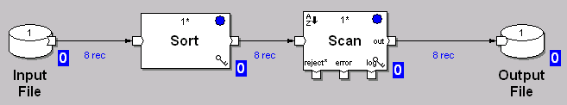
CapGemini
Ab Initio Training

Slide 38
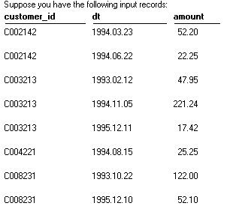
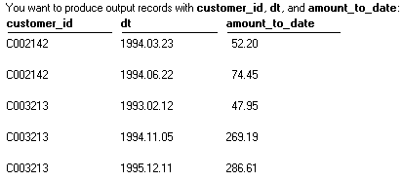
CapGemini
Ab Initio Training

Slide 39
Parameter Descriptions for Scan
sorted-input : (Boolean, required)
When set to In memory: Input need not be sorted, Scan accepts ungrouped input, and requires the use of the max-core parameter.
When set to Input must be sorted or grouped, Scan requires grouped input, and the max-core parameter is not available.
Default is Input must be sorted or grouped.
CapGemini
Ab Initio Training

Slide 40
Parameter Descriptions for Scan
key-method : (choice, optional)
Method by which the component groups records. Choose one of the following:
  Use key specifier — the component uses a key specifier.
  Use key_change function — the component uses the key_change transform function.
CapGemini
Ab Initio Training

Slide 41
Parameter Descriptions for Scan
key : (key specifier, optional)
Name(s) of the key field(s) Scan can use to group or define groups of data records.
For an alternate method Scan can use to define groups
CapGemini
Ab Initio Training

Slide 42
Parameter Descriptions for Scan
max-core : (integer, required)
Maximum memory usage in bytes. Only available when the sorted-input parameter is set to In memory: Input need not be sorted. The default value of max-core is 10485760 (10 megabytes).
If the total size of the intermediate results Scan holds in memory exceeds the number of bytes specified in the max-core parameter, Scan writes temporary files to disk.
CapGemini
Ab Initio Training

Slide 43
Specifying a Transform for Scan
Input selection : optional
Temporary initialization : optional
Rollup
Finalization
Output selection : optional
Key_change : optional
CapGemini
Ab Initio Training

Slide 44
Determining Whether to Scan Sorted or Unsorted Input
Scan can process either sorted or unsorted input, depending on the setting of the sorted-input parameter. The setting can be one of the following:
Input must be sorted or grouped (default)
In memory: Input need not be sorted
CapGemini
Ab Initio Training

Slide 45
Runtime behavior of Scan
Scan produces a series of n output records for each group of n input data records, computing each output record as an aggregation of the input records processed so far, as follows:
With the first data record of each group, Scan creates a temporary aggregate record.
With each following data record of the same group, Scan updates the temporary aggregate record, producing an aggregate record of the records processed so far for each group.
After processing each data record, Scan writes the aggregate record to the out port , using a series of transform functions.
CapGemini
Ab Initio Training

Slide 46
At runtime, Scan executes the following steps:
Input selection : optional
Temporary initialization :optional
Computation
Finalization
Output selection : optional
CapGemini
Ab Initio Training

Slide 47
Runtime : Input selection
If you have defined input_select, it filters the input records.
If the expression evaluates to 0 for a particular record , Scan does not process the record (i.e., the record does not appear on any output port).
If the expression produces NULL for a particular record , Scan :
Writes the record to the reject port
Writes a descriptive error message to the error port
CapGemini
Ab Initio Training

Slide 48
Runtime : Input selection
If you do not connect flows to the reject or error ports, Scan discards the information.
If the expression evaluates to anything other than 0 or NULL for a particular record, Scan processes the record.
If you have not defined input_select, Scan processes all records.
CapGemini
Ab Initio Training

Slide 49
Runtime : Temporary initialization
Scan passes the first record in each group to the initialize transform function.
The initialize transform function creates a temporary record for the group, with record type temporary_type.
CapGemini
Ab Initio Training

Slide 50
Runtime :Computation
Scan calls the Scan transform function for each record in a group, using that record and the temporary record for the group as arguments.
The Scan transform function returns a new temporary record.
CapGemini
Ab Initio Training

Slide 51
Runtime :Finalization
Scan can calls the finalize transform function once for every input record.
Scan passes the temporary record and the input record to the finalize transform function.
The finalize transform function produces an output record for each input record.
CapGemini
Ab Initio Training

Slide 52
Runtime :Output selection
if you have defined the output_select transform function, it filters the output records.
The output_select transform function takes a single argument - the record produced by finalization - and returns a value of 0 (false) or non-0 (true).
Scan ignores records for which output_select returns 0; it writes all others to the out port.
If you have not defined the output_select transform function, Scan writes all records to the out port.
CapGemini
Ab Initio Training

Slide 53
Explanation of types and transform functions
temporary_type : Scan requires temporary storage. The first section of the example defines temporary storage for Scan as a record with a type named temporary_type. This type contains a field named amount_to_date, which provides a place for Scan to store the running total it calculates:
type temporary_type =
record
decimal(8.2) amount_to_date;
end;
CapGemini
Ab Initio Training

Slide 54
Explanation of types and transform functions
initialize - The initialize transform function initializes temporary storage by setting the amount_to_date field of the temporary record to 0 :
temp :: initialize(in) =
begin
temp.amount_to _date :: 0;
end;
CapGemini
Ab Initio Training

Slide 55
Explanation of types and transform functions
scan - The scan transform function accumulates, in the amount_to_date field of the temporary record for each group, a running total of the values in the amount field of the input records from each group processed so far:
out :: scan(temp, in) =
begin
out.amount_to_date :: temp.amount_to_date + in.amount;
end;
CapGemini
Ab Initio Training

Slide 56
Explanation of types and transform functions
finalize - The finalize transform function gathers the values of the customer_id and dt fields from the current record, and the value of the amount_to_date field from the temporary record, and produces an output record:
out :: finalize(temp, in) =
begin
out.customer_id :: in.customer_id;
out.dt :: in.dt;
out.amount_to_date :: temp.amount_to_date;
end;
CapGemini
Ab Initio Training

Slide 57
Exercise 4
CapGemini
Ab Initio Training

Slide 58
Exercise 5
CapGemini
Ab Initio Training

Slide 59
Thank You
End of Session 5
CapGemini
Ab Initio Training

