Slide 1
Teradata is a Relational Database Management System (RDBMS):
Designed to run the world’s largest commercial databases.
Preferred solution for enterprise data warehousing (OLAP).
Executes on UNIX-MP-RAS or NT-based system platforms
Compliant with ANSI industry standards
Runs on single (SMP) or multiple (MPP) nodes
Acts as “Database server” to client applications throughout the enterprise
Uses Parallelism to manage Terabytes of data
“Shared-Nothing Architecture”

Slide 2
Advantage Teradata
Unlimited, Proven Scalability
Unlimited Parallelism - Parallel sorts/aggregations, temporary tables –
“Shared-Nothing” architecture
Mature Optimizer - Complex queries, joins per query, ad-hoc processing
It’s a “Cost Based Optimizer”.
Model the Business - 3NF, robust view processing, star schema
Lowest TCO - ease of setup & maintenance, robust parallel utilities, no re-orgs, lowest disk to data ratio, robust expansion utility
High Availability - No single point of failure, scalable data loading, parallel load utilities

Slide 3
Advantage Teradata
Enormous capacity
Billions of rows
Terabytes of data
High-performance parallel processing
Single database server for multiple clients “Single Version of the Truth”
Network and Mainframe connectivity
Industry standard access language (SQL)
Manageable growth via modularity
Fault tolerance at all levels of hardware and software
Data integrity and reliability

Slide 4
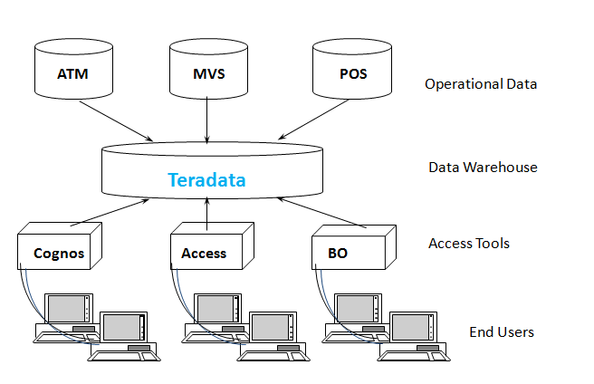
Advantage Teradata Warehouse

Slide 5
History of Teradata
Following is a quick summary of the history of Teradata, listing major milestones.
1979 – Teradata was incorporated
1984 – Release of first database computer DBC/1012
1986 – Fortune magazine names Teradata as ‘Product of the Year’
1999 – Largest database in the world using Teradata with 130 Terabytes
2002 – Teradata V2R5 released with Partition Primary Index and compression
2006 – Launch of Teradata Master Data Management solution
2008 – Teradata 13.0 released with Active Data Warehousing
2011 – Acquires Teradata Aster and enters into Advanced Analytics Space
2012 – Teradata 14.0 introduced
2014 – Teradata 15.0 introduced

Slide 6
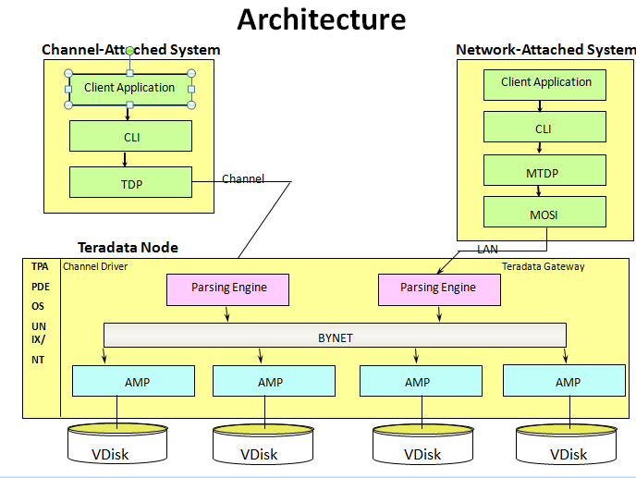

Slide 7
Understanding Node
Parsing Engine
BYNET
AMP
AMP
AMP
AMP
Vdisk
Vdisk
Vdisk
Vdisk

Slide 8
Node Components
Component | Functionality
Parsing Engine | Managing individual sessions (up to 120) Parsing and optimizing your SQL requests Dispatching the optimized plan to the AMPs ASCII / EBCDIC conversion (if necessary) Sending the answer set response back to the requesting client
AMP | Storing and retrieving rows to and from the disks Lock management Sorting rows and Aggregating columns Join processing Output conversion and formatting Creating answer sets for clients Disk space management and Accounting Special utility protocols Recovery processing
Vdisk | A vdisk (pronounced, "VEE-disk") is the logical disk space that is managed by an AMP.

Slide 9
Teradata relies on three architectural components that have set the rules for parallel processing.
PE or the Optimizer(Parse Engine
The PE is the boss and tells the AMPs exactly what to do.
When a user logon to Teradata their logon is accepted or rejected by a Parsing Engine
The Parsing Engine will accept each query from that user and come up with a plan for the AMPs to satisfy the request.
The PE‘s plan is passed to the AMPs via the BYNET
The AMPs will retrieve the data requested from their virtual disks and pass it back up the BYNET to the PE.
The PE will then deliver the data to the user
The Parsing Engines having the capability to handle up to 120 users at a time

Slide 10
The AMPs
The PE passes the PLAN to the AMPs over the BYNET. The AMPs then retrieve the rows they own from their disks and pass it back to the PE over the BYNET
The AMPs organize every table in separate blocks just like you might organize your clothes in separate dresser drawers
When a table is first created each AMP creates a table header on their disk
When the table is loaded each AMP receives rows for that table that they and only they own.

Slide 11
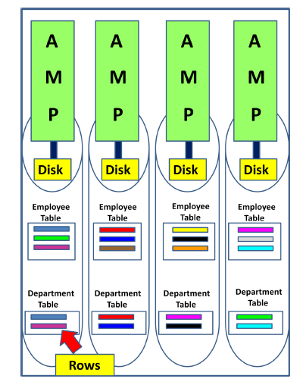

Slide 12
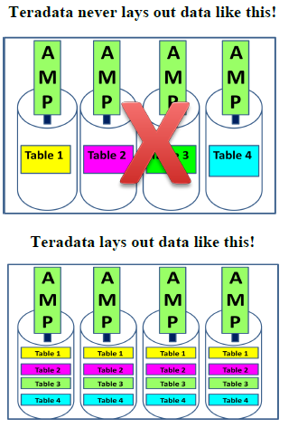

Slide 13
The BYNET
The BYNET gets its name from the Banyan tree. The Banyan tree has the ability to continually plant new roots to grow forever
The BYNET is the communication network between AMPs and PE‘s.
The AMPs then retrieve the data requested by the PE and they deliver their portion of the answer set to the PE over the BYNET.
There are always two BYNETs for redundancy and extra bandwidth.

Slide 14
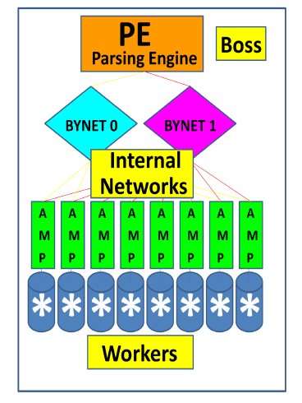

Slide 15
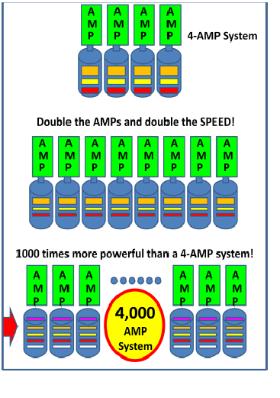

Slide 16
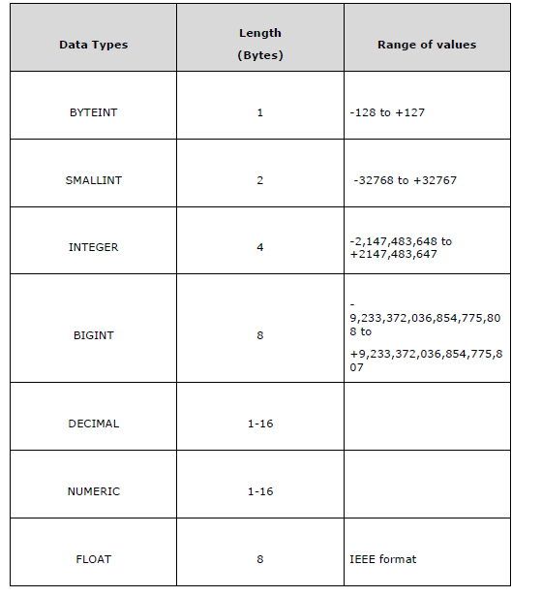
Teradata Data types

Slide 17
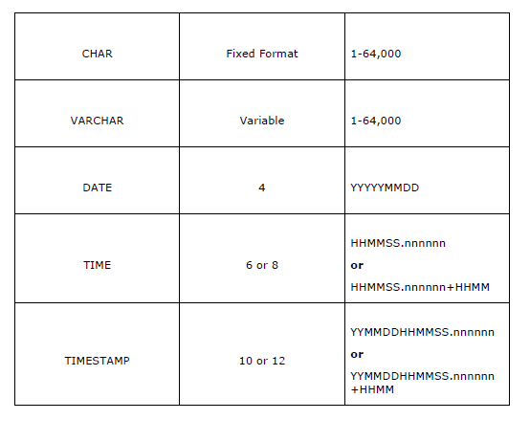

Slide 18
Determining the Release of Your Teradata System:
SELECT * FROM DBC.DBCINFO;
InfoKey InfoData
RELEASE V2R.05.01.03.00
VERSION 05.01.03.00
Teradata Table
Tables in Relational model are defined as collection of data. They are represented as rows
and columns.
Table Types
Permanent Table: This is the default table and it contains data inserted by the
user and stores the data permanently.

Slide 19
Create Table
CREATE TABLE command is used to create tables in Teradata.
Following is the generic syntax of CREATE TABLE statement.
CREATE <SET/MULTISET> TABLE <Tablename>
< Table Options>
<Column Definitions>
<Index Definitions>;
Table Options – Specifies the physical attributes of the table such as Journal and
Fallback.
Column Definition – Specifies the list of columns, data types and their attributes.
Index Definition – Additional indexing options such as Primary Index, Secondary
Index and Partitioned Primary Index.

Slide 20
CREATE TABLE EMPLOYEE
(
EmployeeNo INTEGER,
FirstName VARCHAR(30) ,
LastName VARCHAR(30) ,
DeptNo BYTEINT
)
SHOW TABLE command to view the Definition of the table.
SHOW TABLE Employee;
INSERT INTO EMPLOYEES VALUES (1,’Raja’,’Ram’,10)
SELECT * FROM EMPLOYEES;

Slide 21
Set Versus Multiset
Teradata classifies the tables as SET or MULTISET tables based on how the duplicate
records are handled. A table defined as SET table doesn’t store the duplicate records,
whereas the MULTISET table can store duplicate records.
CREATE SET TABLE EMPLOYEE_SET
(
EmployeeNo INTEGER,
FirstName VARCHAR(30) ,
LastName VARCHAR(30) ,
DeptNo BYTEINT
)
INSERT INTO EMPLOYEES VALUES (1,’Raja’,’Ram’,10)

Slide 22
Multiset table
CREATE MULTISET TABLE EMPLOYEE_SET
(
EmployeeNo INTEGER,
FirstName VARCHAR(30) ,
LastName VARCHAR(30) ,
DeptNo BYTEINT
)
Volatile Table:
The data inserted into a volatile table is retained only during the
user session. The table and data is dropped at the end of the session. These tables
are mainly used to hold the intermediate data during data transformation.

Slide 23
CREATE VOLATILE TABLE dept
(
dept_no INTEGER,
avg_salary INTEGER,
max_salary INTEGER,
min_salary INTEGER
)
INSERT INTO DEPT VALUES(1,10000,1000000,20000)
SELECT * FROM dbc.tables WHERE tablekind = 'T'

Slide 24
Global Temporary Table
The definition of Global Temporary table is stored in data dictionary and they can be used by many users/sessions.
But the data loaded into global temporary table is retained only during the session.
CREATE SET GLOBAL TEMPORARY TABLE dept_GTB
(
dept_no INTEGER,
avg_salary INTEGER,
max_salary INTEGER,
min_salary INTEGER
)
List of table in database
Select tablename from dbc.tables where tablekind=‘T’

Slide 25
CREATE SET TABLE EMP
(
EmployeeNo INTEGER,
FirstName VARCHAR(30) ,
LastName VARCHAR(30) ,
DOB DATE FORMAT 'YYYY-MM-DD',
DepartmentNo BYTEINT
)
INSERT INTO EMP VALUES(200,’Raja’,’Ram’,’2001-10-2016’,20)

Slide 26
ALTER TABLE COMMAND
ALTER TABLE emp
ADD BirthDate DATE FORMAT 'YYYY-MM-DD',
DROP DOB;
DROP TABLE COMMAND
DROP TABLE EMP
SHOW TABLE EMP

Slide 27
CREATE TABLE STUDENTS (STUDENT_ID INTEGER,LAST_NAME VARCHAR(40),FIRST_NAME VARCHAR(40),CLASS_CODE
VARCHAR(2),GRADE_PT FLOAT)
INSERT INTO STUDENTS VALUES(123250, 'Phillips' ,'Martin‘,'SR‘, 3.00)
INSERT INTO STUDENTS VALUES(125634, 'Hanson', 'Henry', 'FR‘, 2.88)
INSERT INTO STUDENTS VALUES(234121 , 'Thomas', 'Wendy', 'FR‘, 4.00)
INSERT INTO STUDENTS VALUES(231222, 'Wilson', 'Susie' ,'SO', 3.80)
INSERT INTO STUDENTS VALUES(260000, 'Johnson', 'Stanley',NULL,NULL)
INSERT INTO STUDENTS VALUES(280023, 'McRoberts', 'Richard', 'JR', 1.90)
INSERT INTO STUDENTS VALUES(322133, 'Bond', 'Jimmy', 'JR‘, 3.95)
INSERT INTO STUDENTS VALUES(324652, 'Delaney', 'Danny', 'SR', 3.35)
INSERT INTO STUDENTS VALUES(333450, 'Smith', 'Andy','SO' ,2.00)
INSERT INTO STUDENTS VALUES(423400, 'Larkins' ,'Michael', 'FR', 0.00)

Slide 28
SELECTING REQUIRED COLUMS
SELECT First_name
,Last_name
,Class_Code
,Grade_Pt
FROM Student_Table ;
WHERE Clause
By adding a WHERE clause to the SELECT, a constraint is established to potentially limit which rows are returned based on a TRUE comparison to specific criteria or set of conditions.
The following SELECT can be used to return the students with a B (3.0) average or better from the Student table:
SELECT Student_ID
,Last_Name
,Grade_Pt
FROM Student_Table
WHERE Grade_Pt >= 3.0 ;

Slide 29
Compound Comparisons (AND / OR)
SELECT Last_Name
,First_Name
FROM Student_Table
WHERE Grade_Pt = 3.0 AND Grade_Pt = 4.0;
SELECT Student_ID
,Last_Name
,First_Name
,Grade_Pt
FROM Student_Table
WHERE Grade_Pt = 3.0 OR Grade_Pt = 4.0 ;
SELECT *
FROM Student_Table
WHERE Grade_Pt = 3.0 OR Grade_Pt = 4.0 AND Class_Code = 'FR' ;

Slide 30
SELECT Last_Name
,Class_Code
,Grade_Pt
FROM Student_Table
WHERE (Grade_Pt = 3.0 OR Grade_Pt = 4.0) AND Class_Code = 'FR' ;
SELECT *
FROM Student_Table
WHERE Grade_Pt = NULL AND Class_Code = NULL ;
SELECT *
FROM Student_Table
WHERE Grade_Pt = NULL AND Class_Code = IS NULL ;

Slide 31
Using NOT in SQL Comparisons
SELECT Last_Name
,First_Name
,Class_Code
,Grade_Pt
FROM Student_Table
WHERE NOT (Grade_Pt >= 3.0 AND Class_Code <> 'SR') ;
SELECT Last_Name, First_Name
,Class_Code
,Grade_Pt
FROM Student_Table
WHERE NOT (Grade_Pt >= 3.0 AND Grade_Pt IS NOT NULL AND
Class_Code <> 'SR' AND Class_Code IS NOT NULL) ;

Slide 32
USING IN OPERATOR
SELECT Last_Name
,Class_Code
,Grade_Pt
FROM Student_Table
WHERE Grade_Pt IN (2.0, 3.0, 4.0) ;
USING NOT IN OPERATOR
SELECT Last_Name
,Class_Code
,Grade_Pt
FROM Student_Table
WHERE Grade_Pt NOTIN (2.0, 3.0, 4.0) ;

Slide 33
Using Quantifiers Versus IN
SELECT Last_Name
,Class_Code
,Grade_Pt
FROM Student_Table
WHERE Grade_Pt = ANY (2.0, 3.0, 4.0) ;
SELECT Last_Name
,Grade_Pt
FROM Student_Table
WHERE Grade_Pt NOT = ALL (2.0, 3.0, 4.0) ;
USING BETWEEN
SELECT Grade_Pt
FROM Student_Table
WHERE Grade_Pt BETWEEN 2.0 and 4.0 ;
Notes:
The ALL and ANY is quantifiers for 'LIKE' operator, these quantifiers are used to indicate how many string patterns must be found in the string expression.
CREATE TABLE t (x INTEGER);
INSERT t (1);
INSERT t (2);
INSERT t (3);
INSERT t (4);
INSERT t (5);
IF you use this query …
THEN the result is …
SELECT * FROM t WHERE x IN ANY (1,2)
1, 2
SELECT * FROM t WHERE x = SOME (1,2)
1, 2
SELECT * FROM t WHERE x NOT IN ALL (1,2)
3, 4, 5
SELECT * FROM t WHERE NOT (x IN ANY (1,2))
3, 4, 5
SELECT * FROM t WHERE NOT (x = SOME (1,2))
3, 4, 5
SELECT * FROM t WHERE x NOT IN SOME (1, 2)
1, 2, 3, 4, 5
SELECT * FROM t WHERE x NOT = ANY (1, 2)
1, 2, 3, 4, 5
SELECT * FROM t WHERE x IN ALL (1,2)
no rows
SELECT * FROM t WHERE NOT (x NOT IN SOME (1,2))
no rows
SELECT * FROM t WHERE x = ALL (1,2)
no rows
SELECT * FROM t WHERE NOT (x NOT = ANY (1,2))
no rows
ANY - one or more pattern should match in the string expression ALL - All patterns in the list should be match.
first_name like ANY ('ad%', 'w%', 'e%') will find adrian, william and eleanor first_name like ALL ('ad%', 'w%', 'e%') will not find anything because you cannot build a string which starts with AD, W and E! But first name like ALL ('%an%','%w%, '%e%') will find Andrew but not adrian, william or Eleanor.

Slide 34
Character String Search (LIKE)
SELECT *
FROM Student_Table
WHERE Last_Name LIKE 'sm%' ;
SELECT *
FROM Student_Table
WHERE Last_Name LIKE ('_a%') ;
SELECT *
FROM Student_Table
WHERE Last_Name LIKE ALL ('%S%', '%m%') ;
SELECT *
FROM Student_Table
WHERE Last_Name LIKE ALL ('%S%', '%m%') ;

Slide 35
String Functions
SELECT SUBSTR(‘warehouse’,1,4)
SELECT ‘data’ || ‘ ‘ || ‘warehouse’
SELECT UPPER(‘data’)
SELECT LOWER(‘DATA’)

Slide 36
EXTRACT- Date
EXTRACT function extracts portions of day, month and year from a DATE value.
SELECT DATE;
SELECT DATABASE;
SELECT TIME;
SELECT EXTRACT(YEAR FROM CURRENT_DATE);
SELECT EXTRACT(MONTH FROM CURRENT_DATE);
SELECT EXTRACT(DAY FROM CURRENT_DATE);
SELECT EXTRACT(HOUR FROM CURRENT_TIMESTAMP);
SELECT EXTRACT(MINUTE FROM CURRENT_TIMESTAMP);
SELECT EXTRACT(SECOND FROM CURRENT_TIMESTAMP);

Slide 37
INTERVAL
Teradata provides INTERVAL function to perform arithmetic operations on DATE and TIME values
There are two types of INTERVAL functions
Year-Month Interval
Day-Time Interval
SELECT CURRENT_DATE, CURRENT_DATE + INTERVAL '03' YEAR;
SELECT CURRENT_DATE, CURRENT_DATE + INTERVAL '03-01' YEAR TO MONTH;
SELECT CURRENT_TIMESTAMP;

Slide 38
CASE Expression
CASE expression evaluates each row against a condition or WHEN clause and returns the result of the first match.
CASE <expression>
WHEN <expression> THEN result-1
WHEN <expression> THEN result-2
ELSE
Result-n
END

Slide 39
SELECT EmployeeNo,CASE DepartmentNo
WHEN 1 THEN 'Admin'
WHEN 2 THEN 'IT'
ELSE 'Invalid Dept'
END AS Department
FROM Employee;

Slide 40
Derived Columns
SELECT 2+4*5, (2+4)*5
,2+4/5, (2+4)/5
,2+4.0/5, (2+4.0)/5
,10**9 ;
SELECT salary (format 'ZZZ,ZZ9.99')
,salary/12 (format 'Z,ZZ9.99')
FROM Pay_Table ;
SELECT salary (format 'ZZZ,ZZ9.99')
,salary/12 (format 'Z,ZZ9.99')
FROM Pay_Table
WHERE salary/12 > 1000 ;
SELECT salary AS Annual_salary
,salary/12 AS Monthly_salary
FROM Pay_Table ;
Notes:
create table pay_table (salary numeric);
insert into pay_table values(1200)
insert into pay_table values(10000);
insert into pay_table values(20000)

Slide 41
SELECT 200/100 AS Div200
,204 MOD 100 AS Last2
,2 MOD 2 AS Even
,3 MOD 2 AS Odd
,ABS(1) AS WasPositive
,ABS(-1) AS PositiveNow
,SQRT(4) AS SqRoot ;
Breaking Conventions
SELECT salary "Annual salary"
,salary/12 "Monthly salary"
FROM Pay_Table
ORDER BY "Annual Salary" ;

Slide 42
ORDER BY
SELECT *
FROM Student_Table
WHERE Grade_Pt > 3
ORDER BY Grade_Pt ;
SELECT *
FROM Student_Table
WHERE Grade_Pt > 3
ORDER BY Grade_Pt DESC;
SELECT *
FROM Student_Table
WHERE Grade_Pt > 3
ORDER BY 5 DESC ;
SELECT Last_Name
,Class_Code
,Grade_Pt
FROM Student_Table
ORDER BY 2 DESC, 1 ;

Slide 43
TOP Rows Option
TOP {decimal | integer} [PERCENT] [WITH TIES]
SELECT TOP 3 Last_Name
,Class_Code, Grade_Pt
FROM Student_Table
ORDER BY 2 DESC, 1 ;
DISTINCT
SELECT DISTINCT Class_code
FROM student_table
ORDER BY class_code;
SELECT DISTINCT class_code, grade_pt
FROM student_table
ORDER BY class_code, grade_pt;
Notes:
The TOP N function produces The top (or bottom) N rows of results based on specified criteria.
The top (or bottom) N percentage of rows based on specified criteria.
These results either with or without ties (more than one row has identical criteria values).
Sample rows arbitrarily without regard to rankings or order.
New syntax to the SQL lexicon: TOP {decimal | integer} [PERCENT] [WITH TIES]
Below are the options with TOP. TOP 10 – Return the top ten rows according to criteria
TOP 15 PERCENT – Return the top 15% of rows according to criteria
TOP 10 WITH TIES – If more that one row has the same criteria value, return all
TOP 15 PERCENT WITH TIES – If more than one row has the same criteria value, return all
Example 1: SELECT TOP 5 department_number ,budget_amount FROM department ORDER BY 2 DESC; Result department_number budget_amount ------------------------- ------------- 401 982300.00 403 932000.00 301 465600.00 100 400000.00 501 308000.00 Example 2: SELECT TOP 5 WITH TIES department_number , budget_amount FROM department ORDER BY 2 DESC; department_number budget_amount -------------------------- ------------- 401 982300.00 403 932000.00 301 465600.00 100 400000.00 501 308000.00 402 308000.00
Using the PERCENT Option The TOP N function can also produce a percentage of rows in addition to an absolute number of rows. Return employees whose salaries represent the top ten percent. SELECT TOP 10 PERCENT employee_number ,salary_amount FROM employee ORDER BY salary_amount DESC; employee_number salary_amount ------------------- ------------- 801 100000.00 1017 66000.00 1019 57700.00 Things to notice: 10% of 26 rows is 2.6 rows rounded to 3. PERCENT must be a number between 0 and 100. At least one row is always returned (if there is at least one row in the table). A percentage resulting in a fractional number of rows is always rounded up:10% of 6 rows = .6 rows = 1 row output 20% of 6 rows = 1.2 rows = 2 rows output 30% of 6 rows = 1.8 rows = 2 rows output

Slide 44
HELP commands
HELP DATABASE <database-name> ; This command is used to display the names of all the tables (T), views (V), macros (M),
and triggers (G) stored in a database and table comments
HELP USER <user-name> ; This command is used to display the names of all the tables (T), views (V), macros (M), and
triggers (G) stored in a user area and table comments
HELP 'SQL'; This command is used to display a list of all available SQL commands and functions.
HELP SESSION; This command is used to display the user name, account name, logon date and time,
current database name, collation code set and character set being used and also ,
transaction semantics, time zone and character set data.
HELP TABLE <table-name> ; This command is used to display the column names, type identifier, and any user written comments on
the columns within a table.
HELP VIEW My_View ;
HELP INDEX <table-name> ;

Slide 45
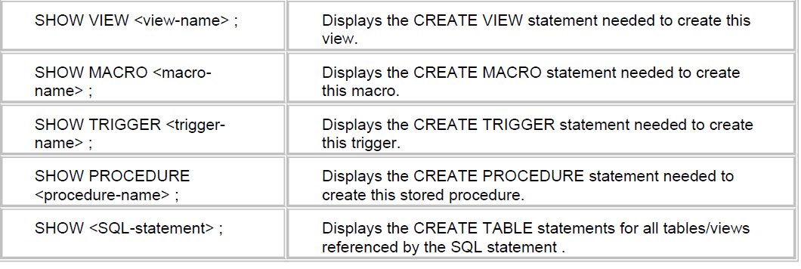
SHOW COMMAND
SHOW TABLE <TABLE-NAME> Displays the create table statement need to create table
SHOW TABLE Employee ;

Slide 46
EXPLAIN
The EXPLAIN command is a powerful tool provided with the Teradata database. It is designed to provide an English explanation of what steps the AMP must complete to satisfy the SQL request. The EXPLAIN is based on the PE's execution plan.
EXPLAIN
SELECT * FROM Student_table ;
Adding Comments
-- the double dash at the start of a single line denotes a comment is on that line
/* the slash asterisk at the start of a line denotes the beginning of a comment
*/ the asterisk slash (reversed from the start of a comment) is used to end a comment.

Slide 47
ACCOUNT Function
A user within the Teradata database has an account number. This number is used to identify the user, provide a basis for charge back, if desired and establish a basic priority.
SELECT ACCOUNT ;
SELECT SESSION;
SELECT DATABASE;

Slide 48
Data Conversions
CAST
Data can be converted from one type to another by using the CAST function.
CAST ( <smallint-data> AS CHAR(5) ) /* smallint to character */
CAST ( <decimal-data> AS INTEGER ) /* truncates decimals */
CAST ( <byteint-data> AS SMALLINT ) /* binary to smallint */
CAST ( <char-data> AS BYTE (128) ) /* character to binary */
CAST ( <byteint-data> AS VARCHAR(5) ) /* byteint to character */
CAST ( <integer-data> AS FLOAT) /* integer to float point */
SELECT CAST('ABCDE' AS CHAR(1) ) AS Trunc
,CAST(128 AS CHAR(3) ) AS OK
,CAST(127 AS INTEGER) AS Bigger
,CAST(121.53 AS SMALLINT) AS Whole
,CAST(121.53 AS DECIMAL(3,0)) AS Rounder ;

Slide 49
FORMAT
SELECT 'ABCDE' (FORMAT 'XXX') AS Shorter
,121.53 (FORMAT '99999') AS Fmt_121
,121.53
,991001(date) (FORMAT 'MM/dd/Yy') AS Fmt_NumDate
,991001(date) (FORMAT 'mmmbdd,byyyy') AS Fmt_Date ;
LOWER Function
SELECT LOWER ('ABCDE') AS Result ;
UPPER Function
SELECT UPPER('aBcDe') AS Result ;
Notes:
For formatting refer to this link
http://info.teradata.com/htmlpubs/DB_TTU_14_00/index.html#page/SQL_Reference/B035_1143_111A/ch09.051.25.html
FORMAT
Data
Display Form
X(6)
'HELLO'
'HELLO ‘
XXXXXX
'HELLO'
'HELLO ‘
X
'HELLO'
'H‘
$$9.99
.079
' $0.08‘
$$9.99
1095
******
ZZ,ZZ9.99
1095
' 1,095.00‘
9.99E99
1095
'1.09E03‘
999V99
123.456
'12346‘
$(5).9(2)
1
'$1.00‘
G--(8)D9(2)
-12345678.90
'-12 345 678,90‘
where the SDF defines the group separator as ' ' (blank) and the radix separator as ','.
Z(I)D9(F)
000000.42
',42'
where the SDF defines the radix separator as ','.
YY.DDD
85.224
'85.224‘
MMMBDD,BYY
Sep 12, 85
'Sep 12, 85'
YYYY-MM-DD
1996-02-14
'1996-02-14‘
YYYYBMMMBDD
1985 Sep 12
'1985 Sep 12'
________________________________________________________
SELECT DATE; TERADATA SQL Assistant modifies the DATE column and display in format specified in settings.To Display DATE in actual format: SELECT CAST(DATE AS VARCHAR(20)); Display date in the user specified format SELECT CAST(DATE AS DATE FORMAT ‘Y4-MM-DD’); Add 2 Days to DATE SELECT DATE + INTERVAL ‘2’ DAY; Add 2 Months to DATE SELECT DATE + INTERVAL ‘2’ MONTH; Add 2 Years to DATE SELECT DATE + INTERVAL ‘2’ YEAR; Subtract 2 DATEs SELECT DATE – (DATE -2 ); Change Date to Timestamp SELECT CAST(DATE AS TIMESTAMP(0)); Select YEAR from Date SELECT EXTRACT(YEAR FROM DATE); Select MONTH from Date SELECT EXTRACT(MONTH FROM DATE); Select DAY from Date SELECT EXTRACT(DAY FROM DATE); Select LAST DAY of LAST MONTH SELECT (DATE – EXTRACT(DAY FROM DATE)) Select FIRST day of Current Month SELECT (DATE – EXTRACT(DAY FROM DATE)) + 1; Select LAST day of Current Month SELECT (DATE + INTERVAL ‘1’ MONTH) – EXTRACT(DAY FROM ADD_MONTHS(DATE,1));
If DATE is 2013-03-13 then TERADATA will save it in integer format and value will be SEL (2013-1900)*10000 + 03*100 + 13 –> [1130313]
Example: If we have a table which has a DATE column DOA and it has some value as ‘2013-03-13’ then we can fetch records like this:
SELECT * FROM EMPLOYEE WHERE DOJ=’2013-03-13′;
OR
SELECT * FROM EMPLOYEE WHERE DOJ=1130313;

Slide 50
RANK
Syntax
RANK( ) OVER (ORDER BY sales DESC);
To display rank
SELECT S_ID,
STORENAME,
SALES,
RANK( ) OVER (ORDER BY sales DESC)
AS "Ranking"
FROM STORE
QUALIFY Ranking <= 3;
To remove duplicates
select id, name, email
from source_table
qualify count(*) over (partition by id) = 1
Notes:
http://www.teradatawiki.net/2013/10/Teradata-Ranking.html

Slide 51
Aggregation
SELECT SUM(Grade_pt)
,AVG(Grade_pt)
,MIN(Grade_pt)
,MAX(Grade_pt)
,COUNT(Grade_pt)
FROM Student_table;
SELECT SUM(Grade_Pt) AS "Total"
,AVG(Grade_Pt) AS "Average"
,MIN(Grade_Pt) AS Smallest
,MAX(Grade_Pt) AS Highest
,COUNT(Grade_Pt) AS "Count"
FROM Student_table ;

Slide 52
SELECT SUM(salary) (Title 'Salary Total', Format '$$$$,$$9.99')
,SUM(salary*1.05) (Title '+5% Raise', Format '$$$$,$$9.99')
,SUM(salary*1.10) (Title '+10% Raise', format '$$$$,$$9.99')
,AVG(salary) (Title 'Average Salary', format '$$$$,$$9.99'),
,SUM(salary) / COUNT(salary) (Title 'Computed Average Salary')
( format '$$$$,$$9.99')
SELECT SUM(Grade_Pt) AS "Total"
,AVG(Grade_Pt) AS "Average"
,MIN(Grade_Pt) AS Smallest
,MAX(Grade_Pt) AS Highest
,COUNT(Grade_Pt) AS "Count"
FROM Student_table
WHERE class_code = 'SR' ;

Slide 53
SELECT Class_code
,SUM(Grade_Pt) AS "Total"
,AVG(Grade_Pt) AS "Average"
,MIN(Grade_Pt) AS Smallest
,MAX(Grade_Pt) AS Highest
,COUNT(Grade_Pt) AS "Count"
FROM Student_table
GROUP BY Class_code ;
SELECT Last_name
,Class_code
,SUM(Grade_Pt) AS "Total"
,AVG(Grade_Pt) AS "Average"
,MIN(Grade_Pt) AS Smallest
,MAX(Grade_Pt) AS Highest
,COUNT(Grade_Pt) AS "Count"
FROM Student_table
GROUP BY 1, 2 ;

Slide 54
SELECT Class_code
,SUM(Grade_Pt) AS "Total"
,AVG(Grade_Pt) AS "Average"
,MIN(Grade_Pt) AS Smallest
,MAX(Grade_Pt) AS Highest
,COUNT(*) AS "Count"
FROM Student_table
GROUP BY 1
ORDER BY 1 ;
SELECT Class_code
,SUM(Grade_Pt) AS "Total"
,AVG(Grade_Pt) AS "Average"
,COUNT(Grade_Pt) AS "Count"
FROM Student_table
HAVING "Average" > 3.00
GROUP BY 1
ORDER BY 1;

Slide 55
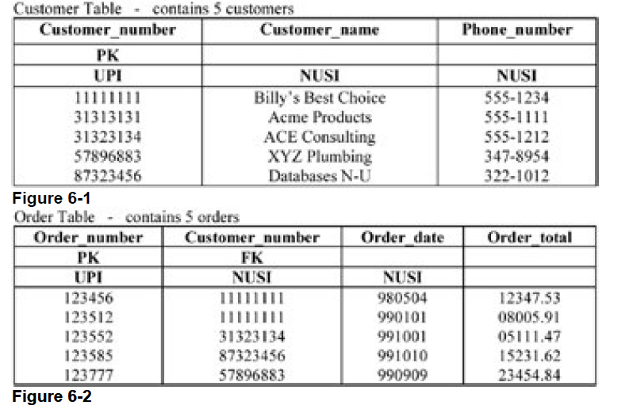
Subquery
The subquery is a commonly used technique and powerful way to select rows from one table based on
values in another table

Slide 56
find all customers that have an order of more than $10,000.00
SELECT Customer_name
,Phone_number
FROM Customer_Table
WHERE Customer_number IN ( SELECT Customer_number
FROM Order_table WHERE Order_total > 10000 ) ;
find all the orders by a specific customer:
SELECT Order_number
,Order_total
FROM Order_Table
WHERE Customer_number IN ( SELECT Customer_number
FROM Customer_table WHERE Customer_name LIKE ‘RAM%');

Slide 57
subquery to match two columns with two values in the subquery to find the highest dollar orders for each customer:
SELECT Customer_number AS Customer
,Order_number
,Order_total
FROM Order_table
WHERE (customer_number, order_total) IN
(SELECT customer_number, MAX(order_total) FROM order_table
GROUP BY 1) ;

Slide 58
find the customer who has ordered the single highest dollar amount order.
SELECT Customer_name
,Phone_number
FROM Customer_Table
WHERE customer_number IN
(SELECT customer_number FROM Order_Table
WHERE Order_total IN
(SELECT MAX(Order_total) FROM Order_Table) ) ;
find the customers without an order
SELECT Customer_name
,Phone_number
FROM Customer_Table
WHERE Customer_number NOT IN
( SELECT Customer_number FROM Order_table) ;

Slide 59
ANY
SELECT Customer_name
,Phone_number
FROM Customer_Table
WHERE customer_number = ANY
(SELECT customer_number FROM Order_Table
WHERE Order_total >
( SELECT AVG(Order_total) FROM Order_Table ) );

Slide 60
Correlated Subquery Processing
It is an excellent technique to use when there is a need to determine which rows to SELECT based on one or more values from another table
List employees max salary for each Dept
SELECT Last_name
,First_name
,Dept_no
,Salary
FROM Employee_Table AS emp
WHERE Salary =
( SELECT MAX(Salary) FROM Employee_table AS emt
WHERE emp.Dept_no = emt.Dept_no )
ORDER BY 3,1 ;

Slide 61
Correlated subquery uses the AVG function to find all employees who earn less than the average pay in their department
SELECT Last_name
,First_name
,Dept_no
,Salary ( format '$$$$,$$9.99' )
FROM Employee_Table AS emp
WHERE Salary <= ( SELECT AVG(Salary) FROM Employee_table AS e
WHERE emp.Dept_no = e.Dept_no )
ORDER BY 3,1 ;

Slide 62
Exist and Not Exist
SELECT Customer_name
FROM Customer_table AS CUST
WHERE EXISTS ( SELECT * FROM Order_table AS OT
WHERE CUST.Customer_number = OT.Customer_number ) ;
SELECT Customer_name
FROM Customer_table AS CUST
WHERE NOT EXISTS ( SELECT * FROM Order_table AS OT
WHERE CUST.Customer_number = OT.Customer_number ) ;

Slide 63
Join Processing
SELECT cust.Customer_number
,Customer_name
,Order_number
,Order_total (FORMAT '$$$,$$9.99' )
FROM Customer_table AS cust
,Order_table AS ord
WHERE cust.customer_number = ord.customer_number
ORDER BY 2 ;
Product Join
next join example uses a WHERE clause, but it only limits which rows participate in the join and does not provide a join condition
SELECT Customer_name,Order_number
,Order_total (FORMAT '$$$,$$9.99' )
FROM Customer_table AS cust
,Order_table AS ord
WHERE customer_name = 'Billy" Best Choice';

Slide 64
Date Processing
Select date
SELECT Order_date
,Order_date +60 AS Due_Date
,Order_total ,Due_date -10 (Title 'Discount Date')
,Order_total*.98 (FORMAT '$$$$,$$$.99', Title 'Discounted')
FROM Order_table
WHERE Order_date > 981231 ;
SELECT Order_date
,Order_date +365 (Title 'Year Later Date')
,Order_total (FORMAT '$$$$,$$$.99')
FROM Order_table

Slide 65
SELECT ADD_MONTHS(Order_date, 2) (Title 'Due Date')
,Order_date (FORMAT 'YYYY-MM-DD')
,Order_total (FORMAT '$$$$,$$$.99')
FROM Order_table
ORDER BY 2 ;
SELECT EXTRACT(YEAR FROM '2000-10-01') AS Yr_Part
,EXTRACT(MONTH FROM '2000-10-01') AS Mth_Part
,EXTRACT(DAY FROM '2000-10-01') AS Day_Part
,EXTRACT(HOUR FROM '10:01:30') AS Hr_Part
,EXTRACT(MINUTE FROM '10:01:30') AS Min_Part
,EXTRACT(SECOND FROM '10:01:30') AS Sec_Part ;

Slide 66
SELECT EXTRACT(Month FROM Order_date)
,COUNT(*) AS Nbr_of_rows
,AVG(Order_total) FROM Order_table GROUP BY 1 ORDER BY 1 ;
select * from sys_calendar.calendar where calendar_date=1011001 ;
SELECT Order_date
,Order_total ,Quarter_of_Year
,Week_of_Month
FROM Order_table INNER JOIN Sys_Calendar.Calendar
ON Order_date = calendar_date
WHERE Quarter_of_Year = 3
AND Week_of_Month < 2;

Slide 67
SELECT Order_date
,Order_total (FORMAT '$$$$,$$$.99')
,Day_of_Week
,Wkday_Day
FROM Order_table INNER JOIN Sys_Calendar.Calendar
ON order_date = calendar_date
INNER JOIN Week_Days
ON Day_of_Week = Wkday_no
WHERE Quarter_of_Year = 3
AND Week_of_Month < 2

Slide 68
SELECT ,CHARACTERS(First_name) AS C_length,First_name
FROM Employee_table WHERE CHARACTERS(First_name) < 7 ;
SELECT Last_name ,CHAR(Last_name) AS C_length
FROM Employee_table WHERE CHARACTERS(First_name) < 7
SELECT First_name ,CHARACTER_LENGTH(First_name) AS C_length FROM Employee_table
WHERE CHARACTER_LENGTH(First_name) < 7 ;
SELECT SUBSTRING('Partners' FROM 2 FOR 3) AS F2F3
, SUBSTRING('Partners' FROM 2) AS F2ALL
, SUBSTRING('Partners' FROM -1 FOR 6) AS BeforeF6
, SUBSTRING('Partners' FROM 6 FOR 3) AS TooFar
, SUBSTRING('Partners' FROM 6 FOR 0) AS F6None ;

Slide 69
SELECT First_name ||' '|| Last_name as "Name“ from employee_table
Cumulative Sum Using the CSUM Function
The process of creating a cumulative sum means that data values in
sequential rows are added together
SELECT EMPNO , FIRST_NAME, LAST_NAME, SALARY ,CSUM(SALARY,1) FROM EMPLOYEE_TABLE
SELECT EMPNO , FIRST_NAME, LAST_NAME, SALARY ,CSUM(SALARY,1) FROM EMPLOYEE_TABLE
GROUP BY DEPTNO
SELECT EMPNO , FIRST_NAME, LAST_NAME, SALARY ,CSUM(1, EMPNO , FIRST_NAME, LAST_NAME) FROM EMPLOYEE_TABLE

Slide 70
NULLIFZERO: it only converts a zero to a NULL
SELECT Class_code
,Grade_pt / (Grade_pt * 2 )
FROM Student_table -- Division by Zero Error
SELECT Class_code
,Grade_pt / ( NULLIFZERO(Grade_pt) * 2 )
FROM Student_table
Then with AVG(NULLIFZERO(Grade_pt):
SELECT Class_code , AVG(Grade_pt) FROM Student_table GROUP BY 1 ORDER BY 2;
Notes:
https://www.wisdomjobs.com/e-university/teradata-tutorial-212/data-interrogation-6148.html
The Teradata database software, for many years, has provided the user the ability to test for zero using the original NULLIFZERO function. The purpose of this function was to compare the data value in a column for a zero and when found, convert the zero, for the life of the SQL statement, to a NULL value.

Slide 71
NULLIF:
convert a zero to a NULL.
the SQL must pass the name of the column to compare and the value
to compare for equal.
SELECT Grade_pt / (Grade_pt * 2 )
, AVG(NULLIF(Grade_pt,0) )
FROM Student_table -- Division by Zero Error
SELECT Grade_pt / (( NULLIF(Grade_pt, 0)) * 2 ) , AVG(NULLIF(Grade_pt, 0) ) FROM Student_table
GROUP BY 1;
ZEROIFNULL
SELECT Class_code
,(Grade_pt) * 2 AS AVGGPA
FROM Student_table
--Try ZEROIFNULL(Grade_pt) * 2 AS AVGGPA

Slide 72
COALESCE: convert a NULL value to 0 or any data value
SELECT Last_name
,COALESCE(Class_code, 'Missing Class') AS Class_code
FROM Student_table
ORDER BY 2, Last_name;

Slide 73
CASE: The CASE function provides an additional level of data testing after a row is accepted by the WHERE clause
CASE <column-name>
WHEN <value1> THEN <true-result1>
WHEN <value2> THEN <true-result2>
WHEN <valueN> THEN <true-resultN>
[ ELSE <false-result> ]
END
SELECT Course_Name ,
CASE
WHEN credits = 1 THEN '1 Credit'
WHEN credits = 2 THEN '2 Credits'
WHEN credits = 3 THEN '3 Credits‘
ELSE 'More than 3 Credits'
END AS Number_of_Credits
FROM Course_table ORDER BY credits, 1 ;

Slide 74
Views
Considerations for Creating Views
An ORDER BY – rows are not ordered in a table, nor in a view
Indices – however, any index on underlying tables may be used
Aggregates must be assigned an alias due to ( )
Derived data with mathematics symbols must have an alias
Create View emp_200 AS SELECT employee_no AS Emp_No
,last_name AS LastName
,salary/12 (format '$$$$,$$9.99')
AS Monthly_Salary
FROM employee_table
WHERE dept_no = 200 ; --select * from emp_200

Slide 75
creates the same view as previous, however, it establishes the alias using this other technique
CREATE VIEW empl1_200_v (Emp_Nbr, LastName, Monthly_Salary)
AS SELECT employee_no
,last_name
,salary (format '$$$$,$$9.99')
FROM employee_table
WHERE dept_no = 200 ;
DROP VIEW empl_200_v;

Slide 76
DML Restrictions when using Views
There are a few restrictions that disallow maintenance activity on a view with an INSERT, UPDATE orDELETE request.
A view cannot be used for maintenance if it:
Performs a join operation – more than one table
Selects the same column twice – wouldn't know which one to use
Derives data – does not undo the math or calculation
Performs aggregation – eliminates detail data
Uses OLAP functions – data does not exist in a column
Uses a DISTINCT or GROUP BY – eliminate duplicate rows

Slide 77
Macros
Macros are SQL statements stored as an object in the Data Dictionary (DD).
Stored in the DD
o Can be shared by multiple users
o SQL is stored in Teradata and not sent across the network or channel
Can be secured to keep users from accessing them
Provide the access security to tables
All updates within a macro are considered a transaction
If all steps work, all work is committed
If a single step fails, all the updated rows are automatically rolled back
Although a macro can have multiple SQL statements within it, if a macro contains DDL, it must be the last statement in the macro.
Notes:
https://www.wisdomjobs.com/e-university/teradata-tutorial-212/macros-6159.html
http://www.teradatawiki.net/2013/10/Teradata-Ranking.html

Slide 78
CREATE MACRO Myfirst_macro AS
( UPDATE table2 SET column1 = column1 + 10
WHERE column2 = 14 ;
SELECT column1, column2, column3
FROM table1 INNER JOIN table2
ON table1.column4 = table2.column6
WHERE table2.column2 = 1024; ) ;

Slide 79
CREATE MACRO Mybetter_macro (invalue INTEGER) AS
( UPDATE table2 SET column1 = column1 + 10
WHERE column2 = :invalue ;
SELECT column1, column2, column3
FROM table1 INNER JOIN table2
ON table1.column4 = table2.column6
WHERE table2.column2 = :invalue ; ) ;
EXEC Myfirst_macro;
EXEC Mybetter_macro(123)

Slide 80
REPLACE MACRO Mybetter_macro (invalue1 integer, invalue2 char(3)) AS
(UPDATE mytable
SET column1 = column1 + 10
WHERE column2 = :invalue1 AND column4 = :invalue2 ;
SELECT column1, column2, column3, column4
FROM mytable AS MT RIGHT OUTER JOIN table2
ON MT.column4 = table2.column6
WHERE MT.column2 = :invalue1
AND ( table2.column4 = :invalue2 OR MT.column4 IS NULL ) ; ) ;
DROP MACRO Myfirst_macro ;

Slide 81
The Primary Index
Primary index is used to specify where the data resides in Teradata
It is used to specify which AMP gets the data row.
Each table in Teradata is required to have a primary index defined.
If the primary index is not defined, Teradata automatically assigns the primary
index.
Primary index provides the fastest way to access the data
A primary may have a maximum of 64 columns.
There are 2 types of Primary Indexes
Unique Primary Index(UPI)
Non Unique Primary Index(NUPI)
Notes:
http://www.teradatawiki.net/2013/10/Teradata-Ranking.html

Slide 82
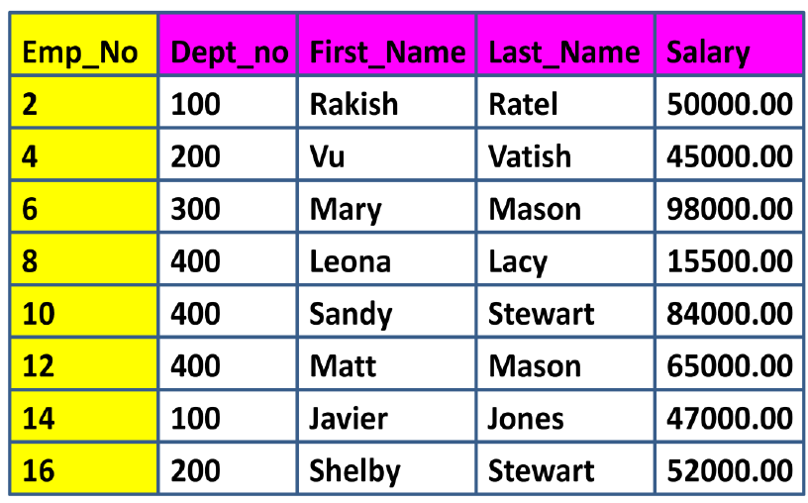
UPI OR NUPI

Slide 83
Unique Primary Index (UPI)
A Unique Primary Index (UPI) is unique and can’t have any duplicates
A Unique Primary Index means that the values for the selected column must be unique
If you try and insert a row with a Primary Index value that is already in the table,
the row will be rejected.
A Unique Primary Index will always spread the table rows evenly amongst the AMPs.

Slide 84
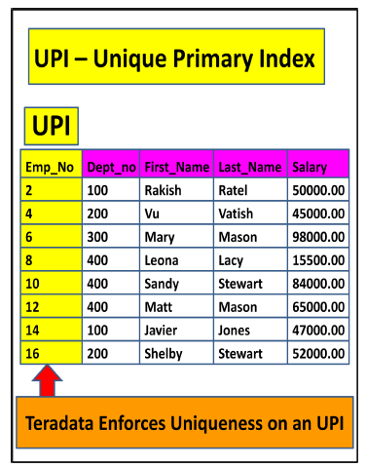

Slide 85
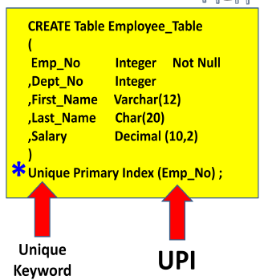

Slide 86
Non-Unique Primary Index (NUPI)
A Non-Unique Primary Index (NUPI) means that the values for the selected column can be non-unique
A Non-Unique Primary Index will almost never spread the table rows evenly
An All-AMP operation will take longer if the data is unevenly distributed
You might pick a NUPI over an UPI because the NUPI column may be more effective for query access and joins.

Slide 87
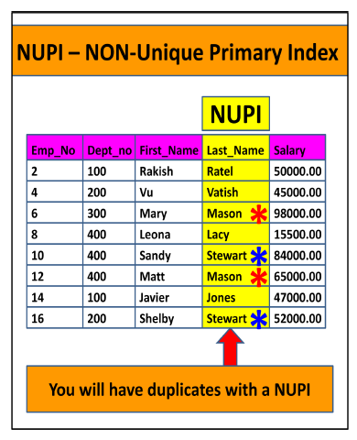

Slide 88
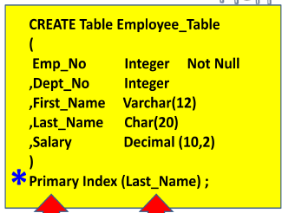

Slide 89
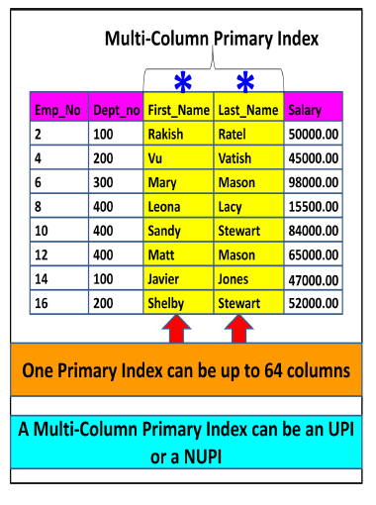
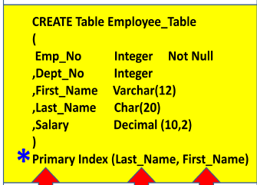
Multi-Column Primary Indexes
Teradata allows more than one column to be designated as the Primary Index.
Teradata allows up to 64 combined columns to make up the one Primary Index required for
a table.
This is often done for two reasons:
(1) To get better data distribution among the AMPs
(2) Users often use multiple keys consistently to query

Slide 90
Secondary Indexes
Secondary Indexes provide an alternate path to the data
Secondary Indexes are not as fast as the Primary Index, but they can be pretty fast, and they can be much faster than a Full Table Scan
Upto 32 secondary indexes per table
Every Secondary Index creates a Subtable on every AMP designed to point to the real Primary Index Row-ID.
two types of Secondary Index and they are
Unique Secondary Indexes, which are called USIs
Non-Unique Secondary Indexes called NUSIs.
USI is always a Two-AMP operation so it is almost as fast as a Primary Index, but a NUSI is an All-AMP operation, but not a Full Table Scan

Slide 91
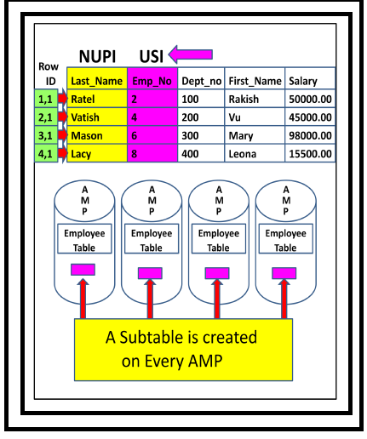
Create unique index on employees(empno)

Slide 92
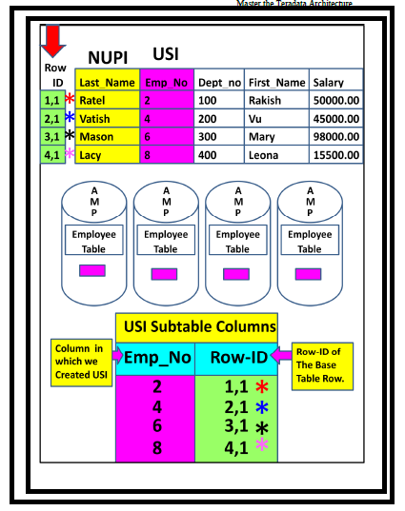

Slide 93
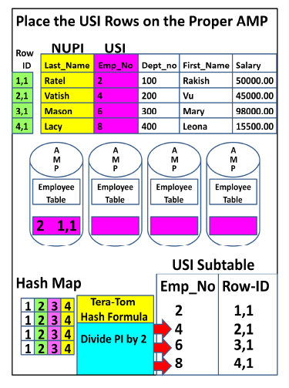

Slide 94
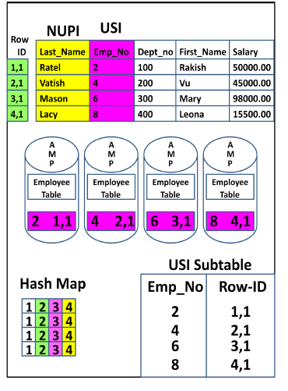

Slide 95
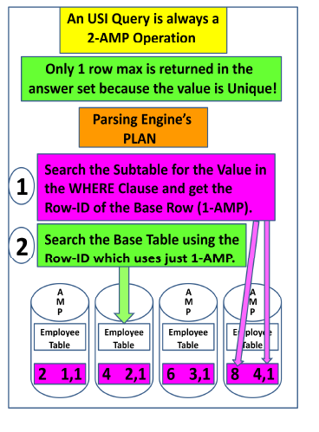

Slide 96
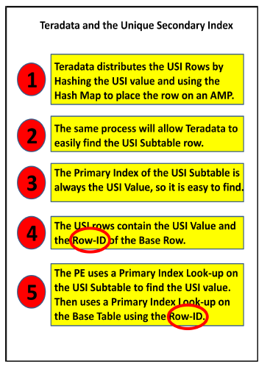

Slide 97
Teradata – Partitioned Primary Index
Partitioned Primary Index (PPI) is an indexing mechanism that is useful in improving the
performance of certain queries.
When rows are inserted into a table, they are stored in an AMP and arranged by their row id
When a table is defined with PPI, the rows are sorted by their partition number.
Advantages
Avoid full table scan for certain queries.
Avoid using secondary index that requires additional physical structure and
additional I/O maintenance.
Access a subset of a large table quickly.
Drop the old data quickly and add new data.

Slide 98
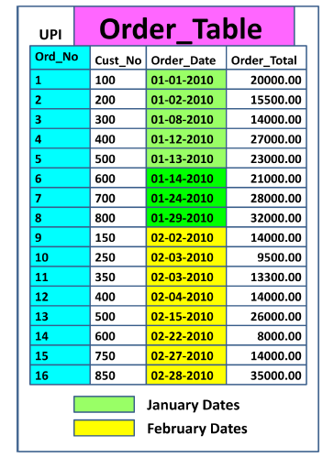

Slide 99
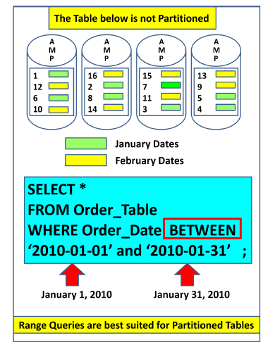

Slide 100
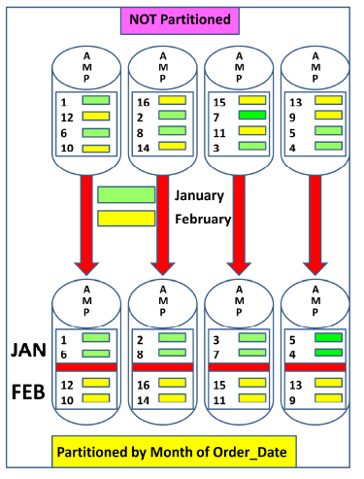

Slide 101
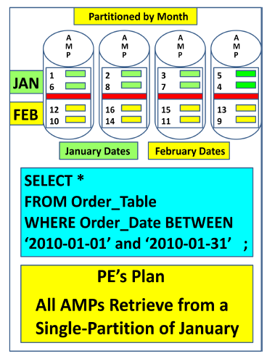

Slide 102
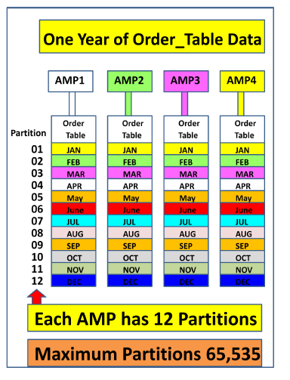

Slide 103
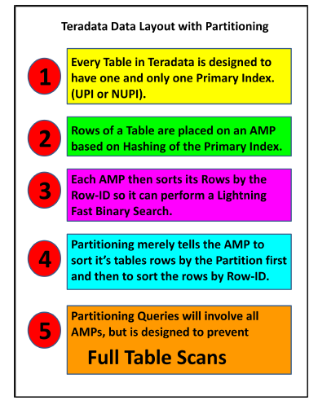

Slide 104
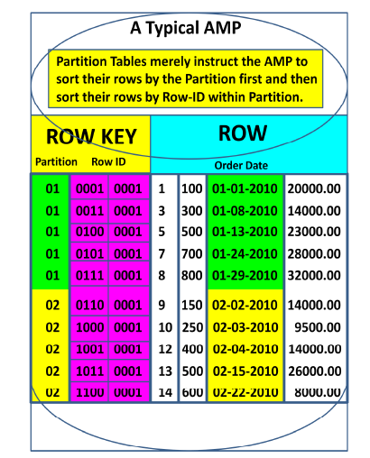

Slide 105
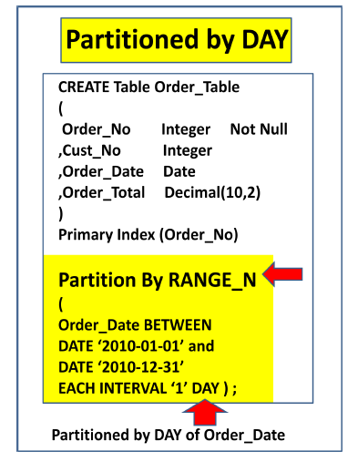

Slide 106
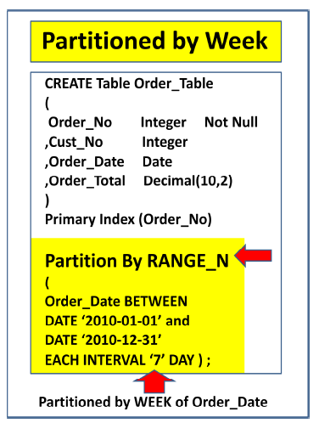

Slide 107
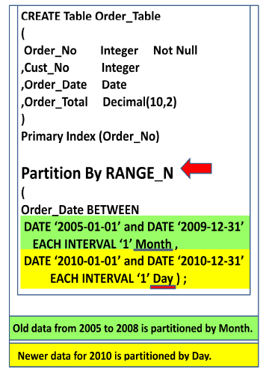

Slide 108
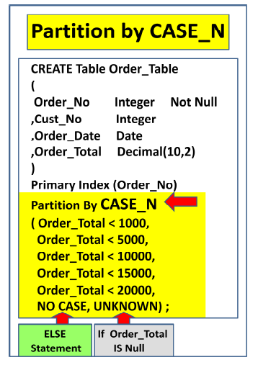

Slide 109
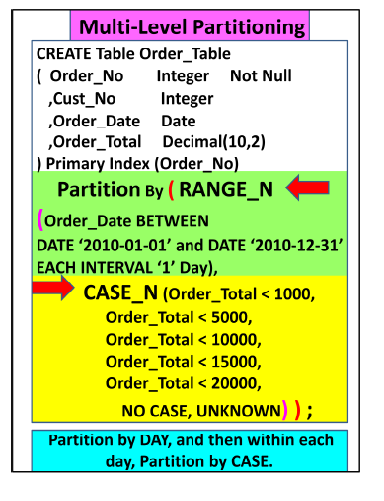

Slide 110
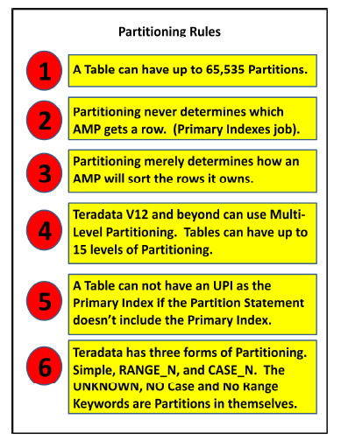

Slide 111
Teradata – JOIN INDEX
JOIN INDEX is a materialized view.
Its definition is permanently stored and the data is updated whenever the base tables referred in the join index is updated.
JOIN INDEX may contain one or more tables and also contain pre-aggregated data.
Join indexes are mainly used for improving the performance
Single Table Join Index (STJI)
Multi Table Join Index (MTJI)
Aggregated Join Index (AJI)

Slide 112
CREATE SET TABLE EMPLOYEE,FALLBACK
(
EmployeeNo INTEGER,
FirstName VARCHAR(30) ,
LastName VARCHAR(30) ,
DOB DATE FORMAT 'YYYY-MM-DD',
JoinedDate DATE FORMAT 'YYYY-MM-DD',
DepartmentNo BYTEINT
) UNIQUE PRIMARY INDEX ( EmployeeNo );
CREATE SET TABLE SALARY,FALLBACK
( EmployeeNo INTEGER,
Gross INTEGER,
Deduction INTEGER,
NetPay INTEGER )
PRIMARY INDEX ( EmployeeNo )
UNIQUE INDEX (EmployeeNo);

Slide 113
Multi Table Join Index (MTJI)
CREATE JOIN INDEX Employee_JI
AS
SELECT EmployeeNo,FirstName,LastName,
BirthDate,JoinedDate,DepartmentNo
FROM Employee
PRIMARY INDEX(FirstName);
If the user submits a query with a WHERE clause on EmployeeNo, then the system will query the Employee table using the unique primary index
If the user queries the employee
table using employee_name, then the system may access the join index Employee_JI using employee_name.
EXPLAIN SELECT * FROM EMPLOYEE WHERE FirstName='Mike';

Slide 114
CREATE JOIN INDEX Employee_Salary_JI
AS
SELECT a.EmployeeNo,a.FirstName,a.LastName,
a.BirthDate,a.JoinedDate,a.DepartmentNo,b.Gross,b.Deduction,b.NetPay FROM Employee a
INNER JOIN Salary b
ON(a.EmployeeNo=b.EmployeeNo)
PRIMARY INDEX(FirstName);
Whenever the base tables Employee or Salary are updated, then the Join index Employee_Salary_JI is also automatically updated
If you are running a query joining
Employee and Salary tables, then the optimizer may choose to access the data from Employee_Salary_JI directly instead of joining the tables.

Slide 115
Aggregate Join Index
CREATE JOIN INDEX Employee_Salary_JI
AS
SELECT a.DepartmentNo,SUM(b.NetPay) AS TotalPay
FROM Employee a INNER JOIN Salary b ON( a.EmployeeNo=b.EmployeeNo)
GROUP BY a.DepartmentNo Primary Index(DepartmentNo);

Slide 116
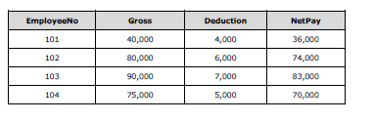
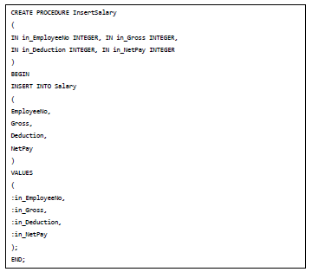
Teradata – Stored Procedure
CALL InsertSalary(105,20000,2000,18000);

Slide 117
Join Methods
Teradata uses different join methods to perform join operations. Some of the commonly
used Join methods are:
Merge Join
Nested Jon
Product Join
Merge Join
Merge Join method takes place when the join is based on the equality condition.
Merge Join requires the joining rows to be on the same AMP. Rows are joined based on their row hash.

Slide 118
Strategy #1
If the join columns are the primary indexes of the corresponding tables, then the joining
rows are already on the same AMP. In this case, no distribution is required.
Consider the following Employee and Salary Tables.
CREATE SET TABLE EMPLOYEE,FALLBACK
(
EmployeeNo INTEGER, FirstName VARCHAR(30) ,LastName VARCHAR(30) ,
DOB DATE FORMAT 'YYYY-MM-DD', JoinedDate DATE FORMAT 'YYYY-MM-DD',
DepartmentNo BYTEINT )UNIQUE PRIMARY INDEX ( EmployeeNo );
CREATE SET TABLE Salary
( EmployeeNo INTEGER, Gross INTEGER,Deduction INTEGER,
NetPay INTEGER )UNIQUE PRIMARY INDEX(EmployeeNo);
When these two tables are joined on EmployeeNo column, then no redistribution takes place since EmployeeNo is the primary index of both the tables which are being joined.

Slide 119
Strategy #2
Consider the following Employee and Department tables
CREATE SET TABLE EMPLOYEE,FALLBACK
(
EmployeeNo INTEGER, FirstName VARCHAR(30) ,
LastName VARCHAR(30) , DOB DATE FORMAT 'YYYY-MM-DD',
JoinedDate DATE FORMAT 'YYYY-MM-DD', DepartmentNo BYTEINT
) UNIQUE PRIMARY INDEX ( EmployeeNo );
CREATE SET TABLE DEPARTMENT,FALLBACK
(
DepartmentNo BYTEINT,
DepartmentName CHAR(15) )
UNIQUE PRIMARY INDEX ( DepartmentNo );
In this scenario, joining rows may not be on the same AMP. In such case,
Teradata may redistribute employee table on DepartmentNo column.

Slide 120
Nested Join
Nested Join doesn’t use all AMPs. For the Nested Join to take place, one of the condition should be equality on the unique primary index of one table and then joining this column to any index on the other table
Product Join
Product Join compares each qualifying row from one table with each qualifying row from other table. Product join may take place due to some of the following factors:
Where condition is missing.
Join condition is not based on equality condition.
Table aliases is not correct.
Multiple join conditions.

Slide 121
FastLoad utility
FastLoad utility is used to load data into empty tables. Since it does not use transient
journals, data can be loaded quickly. It doesn't load duplicate rows even if the target table
is a MULTISET table.
Phase 1
The Parsing engines read the records from the input file and sends a block to each AMP
Each AMP stores the blocks of records.
Then AMPs hash each record and redistribute them to the correct AMP.
At the end of Phase 1, each AMP has its rows but they are not in row hash sequence.
Phase 2
Phase 2 starts when FastLoad receives the END LOADING statement.
Each AMP sorts the records on row hash and writes them to the disk.
Locks on the target table is released and the error tables are dropped

Slide 122
Example
101,Mike,James,1980-01-05,2010-03-01,1
102,Robert,Williams,1983-03-05,2010-09-01,1
103,Peter,Paul,1983-04-01,2009-02-12,2
104,Alex,Stuart,1984-11-06,2014-01-01,2
105,Robert,James,1984-12-01,2015-03-09,3

Slide 123
LOGON 10.74.161.248/TD_USER24,TD_USER24;
DATABASE TD_BIM_FR_TRNG_DB;
BEGIN LOADING TD_USER24.Employee_Stg
ERRORFILES Employee_ET, Employee_UV
CHECKPOINT 10;
SET RECORD VARTEXT ",";
DEFINE
in_EmployeeNo (VARCHAR(10)) ,
in_FirstName (VARCHAR(30)) ,
in_LastName (VARCHAR(30)) ,
in_BirthDate (VARCHAR(10)) ,
in_JoinedDate (VARCHAR(10)) ,
in_DepartmentNo (VARCHAR(02)) ,
FILE=C:\Users\jayavt\Desktop\emp.txt;
INSERT INTO Employee_Stg
(EmployeeNo,FirstName,LastName,BirthDate,JoinedDate,
DepartmentNo)
VALUES (
:in_EmployeeNo ,
:in_FirstName ,
:in_LastName ,
:in_BirthDate (FORMAT 'YYYY-MM-DD'),
:in_JoinedDate (FORMAT 'YYYY-MM-DD'),
:in_DepartmentNo );
END LOADING;
LOGOFF;
FastLoad < EmployeeLoad.fl;

Slide 124
Teradata – MultiLoad
MultiLoad can load multiple tables at a time and it can also perform different types of tasks such as INSERT, DELETE, UPDATE and UPSERT. It can load up to 5 tables at a time and perform up to 20 DML operations in a script. The target table is not required for MultiLoad.
MultiLoad supports two modes:
IMPORT
DELETE
Log Table: Used to maintain the checkpoints taken during load which will be used for restart.
Error Tables: These tables are inserted during load when an error occurs. First
error table stores conversion errors whereas second error table stores duplicate
records.
Log Table: Maintains the results from each phase of MultiLoad for restart purpose.
Work table: MultiLoad script creates one work table per target table. Work table
is used to keep DML tasks and the input data.

Slide 125
Limitation
MultiLoad has some limitations.
Unique Secondary Index not supported on target table.
Referential integrity not supported.
Triggers not supported
How MultiLoad Works
MultiLoad import has five phases:
Phase 1: Preliminary Phase – Performs basic setup activities.
Phase 2: DML Transaction Phase –Verifies the syntax of DML statements and
brings them to Teradata system.
Phase 3: Acquisition Phase – Brings the input data into work tables and locks the table.
Phase 4: Application Phase – Applies all DML operations
Phase 5: Cleanup Phase – Releases the table lock.

Slide 126
.LOGTABLE TD_USER24.employee_log;
.LOGON 10.74.161.248/TD_USER24,TD_USER24;
.BEGIN MLOAD TABLES Employee_Stg;
.LAYOUT Employee;
.FIELD in_EmployeeNo * VARCHAR(10);
.FIELD in_FirstName * VARCHAR(30);
.FIELD in_LastName * VARCHAR(30);
.FIELD in_BirthDate * VARCHAR(10);
.FIELD in_JoinedDate * VARCHAR(10);
.FIELD in_DepartmentNo * VARCHAR(02);
.DML LABEL EmpLabel;
INSERT INTO Employee_Stg
( EmployeeNo,FirstName, LastName, BirthDate,JoinedDate,DepartmentNo )
VALUES ( :in_EmployeeNo,:in_FirstName, in_Lastname,:in_BirthDate,:in_JoinedDate,
:in_DepartmentNo );
.IMPORT INFILE emp.txt
FORMAT VARTEXT ','
LAYOUT Employee
APPLY EmpLabel;
.END MLOAD;
LOGOFF;
Mload < EmployeeLoad.ml;

Slide 127
Teradata – FastExport
.LOGTABLE TD_BIM_FR_TRNG_DB.employee_log;
LOGON 10.74.161.248/TD_USER24,TD_USER24;
DATABASE TD_BIM_FR_TRNG_DB;
.BEGIN EXPORT SESSIONS 2;
.EXPORT OUTFILE employeedata.txt
MODE RECORD FORMAT TEXT;
SELECT CAST(EmployeeNo AS CHAR(10)),
CAST(FirstName AS CHAR(15)),
CAST(LastName AS CHAR(15)),
CAST(BirthDate AS CHAR(10))
FROM
Employee;
.END EXPORT;
.LOGOFF;
fexp < employee.fx

Slide 128
BTEQ utility
BTEQ utility is a powerful utility in Teradata that can be used in both batch and interactive mode.
It can be used to run any DDL statement, DML statement, create Macros and stored
procedures.
BTEQ can be used to import data into Teradata tables from flat file and it can also be used to extract data from tables into files or reports

Slide 129
.LOGON 192.168.1.102/dbc,dbc;
DATABASE tduser;
CREATE TABLE employee_bkup
(
EmployeeNo INTEGER,
FirstName CHAR(30),
LastName CHAR(30),
DepartmentNo SMALLINT,
NetPay INTEGER
)
Unique Primary Index(EmployeeNo);
.IF ERRORCODE <> 0 THEN .EXIT ERRORCODE;
SELECT * FROM
Employee
Sample 1;
.IF ACTIVITYCOUNT <> 0 THEN .GOTO InsertEmployee;
DROP TABLE employee_bkup;
.IF ERRORCODE <> 0 THEN .EXIT ERRORCODE;

Slide 130
.LABEL InsertEmployee
INSERT INTO employee_bkup
SELECT a.EmployeeNo,
a.FirstName,
a.LastName,
a.DepartmentNo,
b.NetPay
FROM
Employee a INNER JOIN Salary b
ON (a.EmployeeNo=b.EmployeeNo);
.IF ERRORCODE <> 0 THEN .EXIT ERRORCODE;
.LOGOFF;

