Slide 1

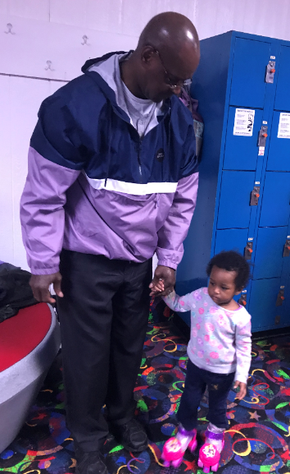
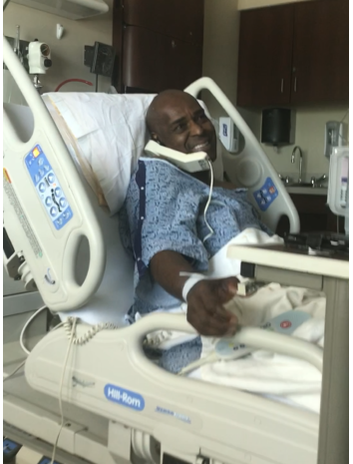
IN LOVING MEMORY <deceased Name>
Thank you for choosing Your-Exodus. Our goal is to provide a quality static web page for our customers to commemorate their loved ones that have passed on. We allow up to 2 weeks for forms submissions. After the set deadline, we are allowed up to 2 weeks to develop the page and submit the link back to the customer. If the customers is not satisfied, our policy allows 1-additional week for the customer to contact us about any corrections that need to be made. All payments are non-refundable. If you are not satisfied with your page, we will work diligently to fix the issue. Pages are available for 6 months after all changes are finalized and approved.
Pic 1
Pic 3
Pic 4
Pic 7
Pic 8
Pic 10
Pic 11
Pic 12
Pic 9

