Slide 1


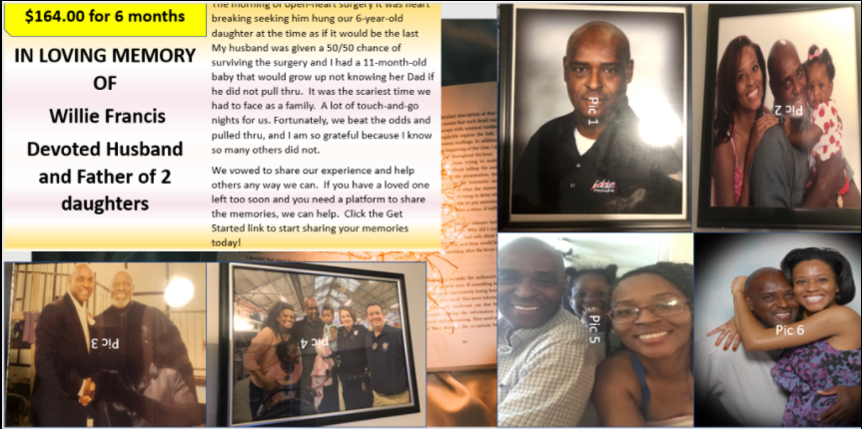
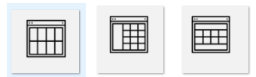


We offer our Condolences and our Services
Samples Design Templates
We Offer 5 layouts for Web Page design. Prices range from $350-$390 per 6-month post
Layout: Guiding light
We are the Francis Family. We are not strangers to sudden tragedy. In 2018, my husband was given a 50/50 chance of surviving open-heart surgery. It was the scariest time we had to face as a family. A lot of touch-and-go nights for us. Fortunately, we beat the odds and he pulled thru. I am so grateful because I know so many others did not.
We vowed to share our experience and help others any way we can. If you have a loved one that has gone home to glory too soon, we can help!
Visit https://your-exodcus.com to start sharing your memories today!
Our mission is to give you a quality page with a personal touch using images and sentiments.
You choose your Design Options
Password-protection
Allow Comments
Visit our website to Pick-a-layout that works best for you!
PAYMENT TYPES
Currently Accepting PayPal Only
Copyright © 2021 Your Exodus.com
All rights reserved
Copyright © 2021 Your Exodus.com
All rights reserved
Copyright © 2021 Your Exodus.com
All rights reserved

Slide 2
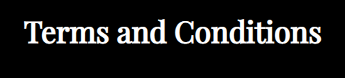

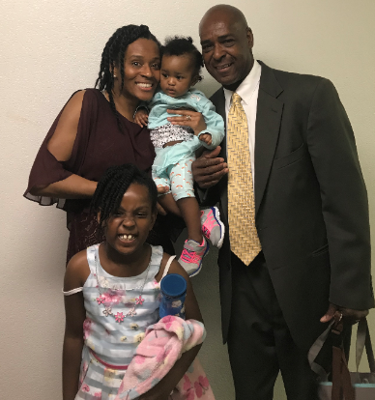
Who we are
Your-Exodus is here to give you a high-quality platform to celebrate the life of your loved ones and share it.
Our goal is to give you a personal touch using pictures and sentiments. You can select a design that includes a range of flowers to complete your final touch.
Taking time to mourn the loss of your loved ones’ is apart of healing. It is okay to hold on to fond memories and share them with surviving friends and family.
Thank you for choosing Your-Exodus. Our goal is to provide a quality web page for our customers to commemorate their loved ones that have passed on. We do require a state ID to verify the identity of the requestor. Upon payment, we allow up to 2 weeks for forms submissions. After the set deadline, we are allowed up to 2 weeks to develop the page and submit the link back to the customer.
If the customers is not satisfied, our policy allows 1-additional week for the customer to contact us about any corrections that need to be made. We do not edit content given to us by our customers including images and text. We only do placements and posts using in the layouts purchased by the customer
All payments are non-refundable
Contact US
Please visit us at
https://Your-Exodus.com
We look forward to your Feedback, Questions, Comments, and Suggestions.
If you have a loved one that has gone home to glory too soon, we can help! Visit our site to begin sharing your memories today
Copyright © 2021 Your Exodus.com
All rights reserved
Copyright © 2021 Your Exodus.com .
All rights reserved
Copyright © 2021 Your Exodus.com .
All rights reserved

