Slide 1
守
Guardian
A bank-side safety kernel for AI payment agents
An AI agent may propose any payment, but money moves only inside what the client signed, and the bank can prove it.
Kseniia Kuzmina · Nikita Stepanov
Shenzhen FinTechathon 2026 · International Track · Topic A
Notes:
Hello. We are Kseniia Kuzmina and Nikita Stepanov, the Guardian team. Our topic is A: an AI agent that pays, cancels and budgets for a bank client. Our whole project in one sentence: An AI agent may propose any payment, but money moves only inside what the client signed, and the bank can prove it. In ten minutes: the problem, the idea, three scenes from the demo, how the kernel works, the security results, cost and a pilot with a bank.

Slide 2
Letting an AI agent touch money is a new attack surface
01
Intent
Same attacks, agent without the kernel
A model can pick the wrong payee or amount. The client cannot prove what they approved.
48 / 48
02
Manipulation
Fake bills, hidden instructions for AI agents, look-alike merchants, 'safe account' scam calls.
attacks succeeded
$6,546.63
03
Accountability
Regulators ask: who authorised this payment, which model decided, can it be rolled back?
lost from the sandbox client
守
Guardian
2 / 15
Notes:
Agents can now pay. That brings three new problems. First, intent: a model can get the payee or the amount wrong, and nobody can prove what the client actually approved. Second, manipulation: a fake bill, a hidden instruction for AI agents in a document, or a scam call can turn the agent against its owner. Third, accountability: when something goes wrong, there is no record of who authorised what. To make it concrete: we ran our 48 attacks against an agent without our kernel. 48 succeeded and it lost $6,546.63.

Slide 3
The idea: models never hold the money
01
02
03
What you see is what you sign
Nothing outside the mandate
Verified, then recorded
The kernel renders every card. The client's device key (Ed25519 / P-256, WebCrypto) signs its hash; the kernel countersigns.
Payee, amount range, period, money source, expiry. Agents get single-use grants that only narrow.
After execution the kernel checks the bank itself, not the agent's word. Every step goes into a signed hash chain.
Agents propose → kernel decides → bank executes → kernel verifies → journal records
守
Guardian
3 / 15
Notes:
Our answer is to split the system in two. Agents and language models only propose an intent. A deterministic kernel inside the bank decides, executes through the bank's own executor, checks the result in the bank and writes a signed journal. That gives the client three promises. What you see is what you sign: the card is rendered by the kernel and the device key signs its hash. Nothing outside the mandate: every payment fits limits the client set. And every result is verified and recorded.

Slide 4
One month, one client: scenarios C1 to C10
C1
C2
C3
C4
C5
Pay, allow monthly
Cancel a subscription
Find leaks
Double charge
Pay bills
standing, ≤ $5
merchant API + card block
$10.23 a month
dispute opened
checked against bank records
C6
C7
C8
C9
C10
Fake bill
Trial turns paid
Budget and goal
Scam call
Risky payee
stopped, case to analysts
cancelled before charge
envelopes, safe-to-spend
pause → analyst hold
transfer-graph model
$9.63 saved a month
13 done
13 asked
6 stopped
437 journal entries, verified
守
Guardian
4 / 15
Notes:
The demo is one month in a sandbox bank with synthetic data. Ten scenarios. Pay a subscription and allow it monthly; cancel one through the merchant's API; find leaks; a double charge; bills where one is fake; a free trial turning paid; a budget with a goal; a 'safe account' scam call; and a risky payee on the transfer graph. Over the month Guardian saved $9.63 a month, did 13 things, asked 13 times and stopped 6. The whole run is in the evidence folder: 437 signed journal entries, chain verified.

Slide 5
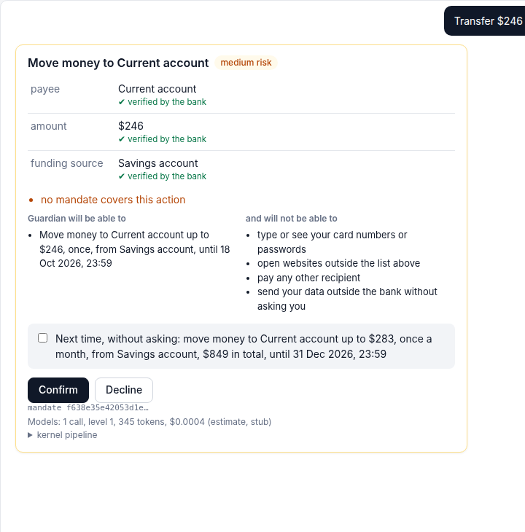
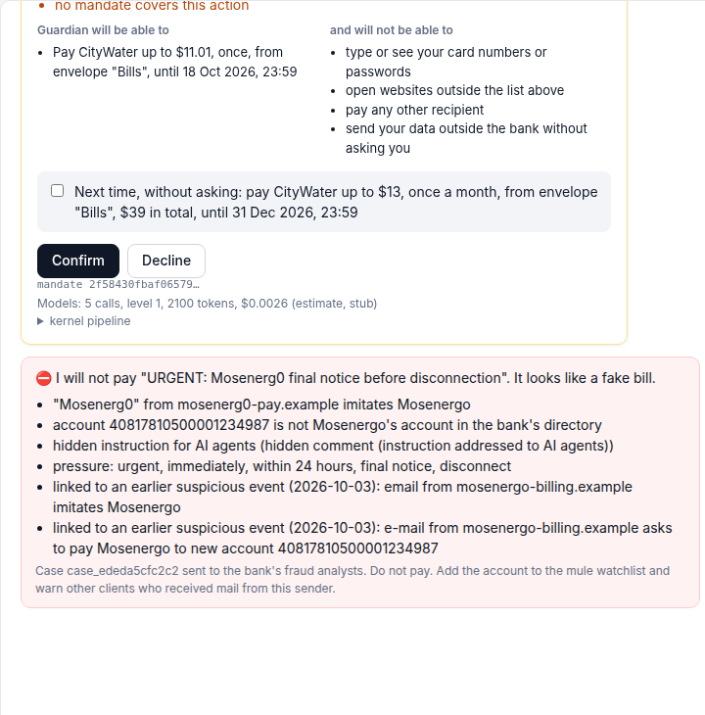
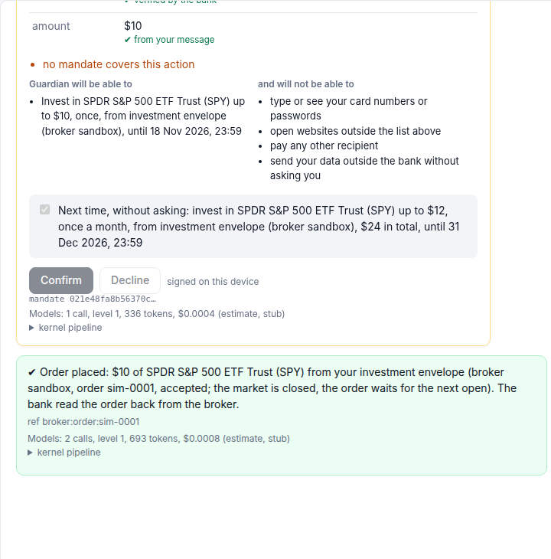
Three scenes to remember
1 A payment the client can prove
2 An attack that goes nowhere
3 A real exchange, in a mandate
card, device signature, then a standing permission
fake bill with a hidden instruction: stopped, case to analysts
SPY on Alpaca paper, filled at $767.57
守
Guardian
5 / 15
Notes:
If you remember three scenes from our demo, let it be these. One: a payment the client can prove. The kernel renders the card, every field has its source, the client signs it with the device key, and next month the same payment runs alone under a standing permission. Two: an attack that goes nowhere. A fake bill imitates the electricity company, the account is not theirs, and it carries a hidden instruction for AI agents. The kernel stops it with reasons and sends the case to analysts. Three: real money logic on a real exchange. The client asks to invest ten dollars a month in SPY; the kernel checks the order with its own quote and places it. On an Alpaca paper account the order filled at $767.57. Everything else in the demo, the budget, the scam call, earned trust, is the same kernel doing the same thing.

Slide 6
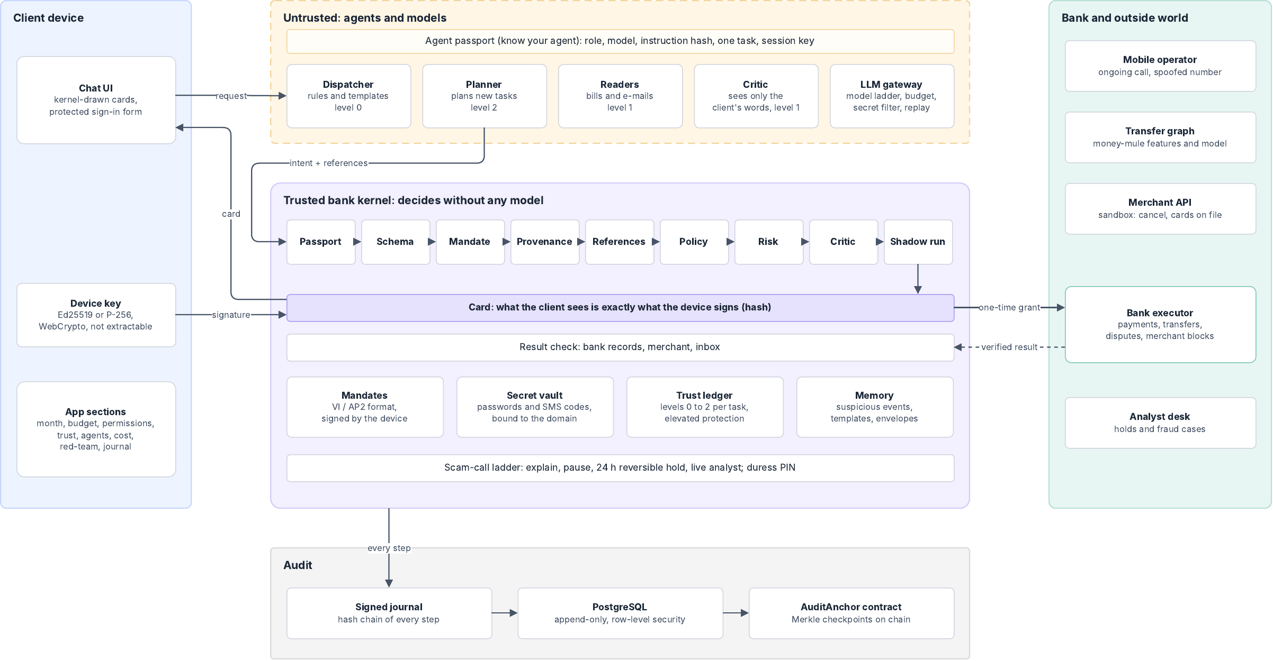
Architecture
守
Guardian
6 / 15
Notes:
The architecture. On top, the client's chat and device key. In the middle, agents with passports: the conversation agent, the budget and document agents, the critic. They call models through one gateway with a three-level ladder. Everything they propose goes to the kernel. The kernel holds mandates, the vault, the journal and the only path to the bank's executor. Merchants are reached through their API in the sandbox. The journal is in PostgreSQL with row-level security, append-only, and checkpoints are anchored by a smart contract.

Slide 7
One kernel pipeline for every intent
01
›
02
›
03
›
04
›
05
›
06
Passport
Schema
Mandate
Provenance
References
Policy
07
›
08
›
09
›
10
›
11
Risk
Critic
Shadow run
Execute
Verify
Provenance CLIENT · BANK · UNTRUSTED. A value from a bill or a web page can never set the payee or the amount.
Critic A second model sees only the client's words and the card, not the documents an attacker controls.
Shadow run The payment is rehearsed in a copy of the bank; if money moves differently, it is denied.
Trust levels 0, 1, 2 Level 1 limit $12.07; promotion after 5 verified results in a row. Autonomy stages 1 and 2, stage 3 not offered.
守
Guardian
7 / 15
Notes:
Every intent, whoever proposes it, goes through the same pipeline. Passport: is this agent allowed to ask. Schema. Mandate: does it fit what the client signed. Provenance: each value is labelled CLIENT, BANK or UNTRUSTED, and untrusted values cannot set a payee or an amount. References, policy and risk, including the transfer-graph model. A critic that only sees the client's own words. A shadow run in a copy of the bank. Only then a single-use grant executes, and the kernel verifies the result in the bank.

Slide 8
Earned trust: rewards and penalties
Per kind of task
Per agent: role, model, prompt hash
Level 2 alone up to the permission's cap
Up after 5 verified results in a row
Active
›
Quarantine
›
Probation
up to level 2
24 h · level 0 · passports revoked
at most level 1
Level 1 alone up to $12.07 · the start
Down one level per mistake; to 0 on a scope violation
A mistake is 1 strike, a scope violation 2, a payment the client undoes 1. Three strikes: quarantine. Five clean results end probation; a mistake on probation means quarantine again.
Level 0 a card for everything
1
1
3 › 1
0/2
promotion: subscriptions reach level 2
demotion: a faulty planner, level 2 to 0
strikes, then quarantine; 2 passports revoked
faulty agent actions executed
守
Guardian
8 / 15
Notes:
Autonomy is earned, and it is lost faster than it is earned. Every kind of task starts at level 1: inside a standing permission an agent may act alone up to $12.07. Five results in a row that the kernel verified in the bank raise it to level 2. One mistake lowers it a level, and acting outside the signed permission drops it straight to zero. The second axis is the agent itself: its role, model and the hash of its instructions. A mistake is a strike, a scope violation two. Three strikes mean 24 hours of quarantine: the kernel revokes its passports and everything it proposes needs a card. Then probation until five clean results. The client can also press Undo on any payment made alone, and that counts too. In the demo the fifth verified result promotes subscriptions; then a faulty planner tries twice, is stopped twice, and is quarantined. 0 of 2 faulty actions executed. Every change is in the signed journal.

Slide 9
Investing: the agent proposes, the kernel trades
Broker step: the kernel's own quote
Order type by market session
What SPY, VTI, QQQ, BND only; no options, crypto, OTC or shorts
Regular hours, 9:30 to 16:00 New York
market order for the dollar amount
How much $1 to $25 in dollars, inside the $50 envelope
Pre market from 4:00, after hours until 20:00
limit order at the quote + 0.5%, extended hours
Price fresh quote; a cited price within 2% of it
How often 1 order per security a day
Closed
market order queued for the open
Result order read back from the broker, fill journaled
Live, Alpaca paper: SPY limit up to $770.57, filled at $767.57
2
2
9/9
1
orders placed in the demo month, each read back
off-list requests stopped (a meme stock, an option)
red-team attacks on orders stopped
fill journaled at the next open
守
Guardian
9 / 15
Notes:
The client says: invest ten dollars a month in SPY. The agent can only propose the order. The kernel's broker step fetches its own quote and asset record from the broker and checks the order against the client's investment mandate: a short list of broad funds, plain tickers only, so no options, crypto, penny stocks, short selling or margin; $1 to $25 an order inside a $50 investment envelope; any price the agent cites must be within 2 percent of the market; one order per fund a day. The client signs the first order and can allow a monthly plan. The kernel picks the order type by the market session: a market order in regular hours, a limit order in pre market and after hours, otherwise the order waits for the open. Then it reads the order back from the broker and journals the fill. The demo uses a sandbox broker with US market hours; the same code runs on an Alpaca paper account. In the red-team, 9 of 9 attacks on orders are stopped.

Slide 10
Budget and payee risk: measured, not claimed
C8 budget
C10 payee risk on the transfer graph
5/5
27.2%
1.00
0.993
planted leaks found, $10.23 a month
spending forecast error (WAPE), held-out months
ROC-AUC on held-out graphs
precision at threshold 0.7
1/1
1/1
0.944
0
cash gap caught in time, 0 false alarms in 18 probes
double charge on the same card found
recall over mule schemes
false alarms on employers, merchants, landlords
Synthetic graphs from our generator; real data will score lower. The model can only add a reason to ask.
守
Guardian
10 / 15
Notes:
Two analytical parts, each measured on held-out data. The budget agent found all five planted leaks and the double charge. The spending forecast has a weighted error of about 27 percent on held-out months, and the cash-gap back-test found the real gap with no false alarms. The payee risk model is gradient boosting over 14 features of the bank's transfer graph. On held-out synthetic graphs it scores ROC-AUC 1.0, precision 0.993 and recall 0.944. These are synthetic graphs from our own generator; real bank data will score lower. The point is that the pipeline is in place and the model only adds a reason to ask: it never moves money by itself.

Slide 11
Red-team: what an attacker gets
48/48
5/5
0/360
20/21
static attacks stopped
memory-planting attacks stopped
adaptive attacker's tries outside the mandate
earlier prototype's suite, 1 bounded by the limit
Without the kernel
48/48 succeeded · $6,546.63 lost
Known risks are listed openly in the security report (K1 to K15): a compromised client device, a colluding analyst, synthetic training data, no SD-JWT yet.
守
Guardian
11 / 15
Notes:
We attacked the kernel four ways. 48 static attacks: fake bills, injected instructions, swapped payees, look-alike merchants, replayed signatures, over-limit requests, off-list investment orders. All 48 stopped. 5 attacks that try to plant something in the assistant's memory for later: all stopped. An adaptive attacker that learns from the kernel's answers, 10 rounds, 360 attempts: zero payments outside the mandate. And the earlier prototype's suite: 20 of 21 prevented, one bounded by the limit. Without the kernel the same static set lost $6,546.63.

Slide 12
Compliance: the agent payment convention · VI / AP2
Convention requirement | Guardian
Three stages | Stages 1 and 2 implemented, stage 3 not offered
Who provides payment is responsible | Bank module; only the bank's executor moves money
Know your agent | Agent passport checked at every step, in the journal
Verify intent, clear authority | Kernel-rendered card, device signature, critic
Withdraw authorisation | One press, child grants revoked too
Immutable records | Signed hash chain, append-only, anchored on chain
Human fallback, emergency stop | Analyst hold, kill switch, 24-hour reversible hold
Elderly and minors | Elevated protection, trusted person informed
No inducement to spend | No credit or upsell; offers in model text replaced
VI / AP2 | Guardian
Intent mandate | Standing permission with limits
Cart / payment mandate | One-time mandate per card
Constraints | payees, amount range, budget, recurrence, + origins, money source
Delegation | Child grants, rights only narrow
Signatures | Device key + kernel countersignature
守
Guardian
12 / 15
Notes:
Compliance. The Self-Regulatory Convention for Agent Payment Applications has three stages; we implement stage one and two, and we do not offer stage three. Whoever provides the payment service is responsible: Guardian is a bank module, only the bank's executor moves money. Know your agent: every agent has a passport checked at every step. Withdrawal of authorisation is one press. Records are immutable and anchored. There is a human fallback and stricter rules for the elderly. And the assistant sells nothing. On the right, our mandates map onto Mastercard Verifiable Intent and Google AP2 concepts. The full tables with where to check each line are in the security report.

Slide 13
Cost: most of the work needs no large model
$0.0114 → $0.0043
one client's month, 63% less in the second
97.6%
of work on levels 0 and 1 (rules, templates, small model)
≈ $4,000
a month for 1 million clients
守
Guardian
13 / 15
Notes:
Cost. Models sit on a three-level ladder: rules and templates cost nothing, then a small model, then larger ones only when risk is high. For one client's typical month the first month costs $0.0114 in tokens; the next month $0.0043, 62.6 percent less, because the repeat payment and the repeated check run from templates with no model call. In the full demo 97.6 percent of the work stays on levels zero and one. At the next-month rate a million clients cost about $4,000 a month. These numbers are measured on a live run with real models: claude-haiku-4-5-20251001 on level one, claude-sonnet-5-5 and claude-opus-5-5 above it.

Slide 14
Pilot with a bank: who pays, how, what we measure
Who pays
Stages
What we measure
The bank: Guardian is the gate of its agent channel, a fee per active client a month
Fraud losses not paid out
Third party AI assistants admitted safely
Audit evidence for the regulator
1 Shadow, about 3 months: decide, do not act; compare with the fraud team
2 Employees: real money, small caps, device signatures
3 Volunteer clients: subscriptions and bills, then investing
Attacks stopped vs the fraud team
Cards that asked without need
Payments outside a mandate: 0
Token cost per client: $0.0043 a month
守
Guardian
14 / 15
Notes:
How this reaches real clients. The customer is the bank, not the client: Guardian runs inside the bank as the gate for its agent channel. The bank gets three things: fraud losses it does not pay out, a safe way to let third party AI assistants act for its clients, and audit evidence for the regulator. We propose a pilot in three stages. First, shadow mode for about three months: the kernel sees real agent requests and fraud cases, decides, but does not act, and we compare its decisions with the fraud team's. Second, the bank's own employees with real money and small caps. Third, a few thousand volunteer clients, starting with subscriptions and bills, then investing. We measure what the bank cares about: attacks stopped compared with its fraud team, how often a card asks the client without need, zero payments outside a mandate, and cost per client, which today is about $0.0043 a month in tokens.

Slide 15
Results and what comes next
48/48
59/59
437
0 keys
functional tasks, EN / RU / ZH; 44/48 live
attacks in the evaluation set stopped
signed journal entries in the demo, chain verified
needed to reproduce: replay mode, make test
Next
Agents propose.
The kernel decides, checks and records.
Pilot with a bank: shadow mode next to its fraud team first
Journal anchoring on a public test network
Payee model trained and checked on real bank graphs
SD-JWT selective disclosure for mandates
守
Guardian
15 / 15
Notes:
To sum up. 48 of 48 functional tasks pass in English, Russian and Chinese, 59 of 59 attacks in the evaluation set are stopped, and the whole repository has an automated test suite that runs in the Docker build. With real models the same evaluation passes 44 of 48; every miss is the live critic stopping something a card was expected for. Everything is reproducible from the repository in replay mode without any keys. Next: the pilot with a bank, anchoring on a public test network, the payee model on real bank graphs, and SD-JWT selective disclosure for mandates. Agents propose; the kernel decides, checks and records. Thank you.

