Slide 1
AGENTIC AI HACKATHON 2026 · BUSINESS & PRODUCTIVITY AI
Business Listing
Consistency Agent
Listify
Matches
CityPages
Diwali shown as Closed
LocalLoop
Same facts, different format
One true record. Five listing sites. An agent that finds every mismatch, fixes only what you approve, and proves the fix went live.
NearbyNow
Someone else's listing
ShopFront
Sunday shown as Closed
Live demo zirohacksub.onrender.com demo PIN 7KQ4X-M9PHT Repo github.com/yourgrok/zirohacksub
Fictional business (Sunrise Sweets & Bakery, Pune), mock listing sites, synthetic data only.
Notes:
Opening (20 s): Every local business lives on many listing sites, and the details drift apart. We built an agent that keeps them consistent, but only ever changes something after the owner approves it, and only reports success after it has reloaded the page and seen the value. Everything you see is a real run of the deployed app on a fictional bakery with mock listing sites.

Slide 2
OVERVIEW
The seven things you asked us to show
1
2
3
4
The problem
Our solution
The agentic AI
Technical implementation
Five sites, five versions of one business.
Scan, review, apply, verify. The owner stays in charge.
A loop that reads, decides, acts, verifies and recovers.
Architecture, stack, data flow, platform integration, guardrails.
slides 3-4
slides 5-6
slides 7-8
slides 9-11
5
6
7
TRY IT YOURSELF
zirohacksub.onrender.com
PIN 7KQ4X-M9PHT
2-minute video: docs/demo/demo.mp4
The innovation
The demonstration
The impact
Why it is not a dashboard, a chatbot or a cron job.
One scenario end to end, the result on screen, and the TC1-TC8 proof.
Numbers we measured, scalability, honest limits, roadmap.
slide 12
slides 13-15
slides 16-17
Business Listing Consistency Agent · Agentic AI Hackathon 2026
2
Notes:
A map of the talk so the judges can tick their seven criteria as we go. The dark card has the live demo address and the synthetic demo PIN.

Slide 3
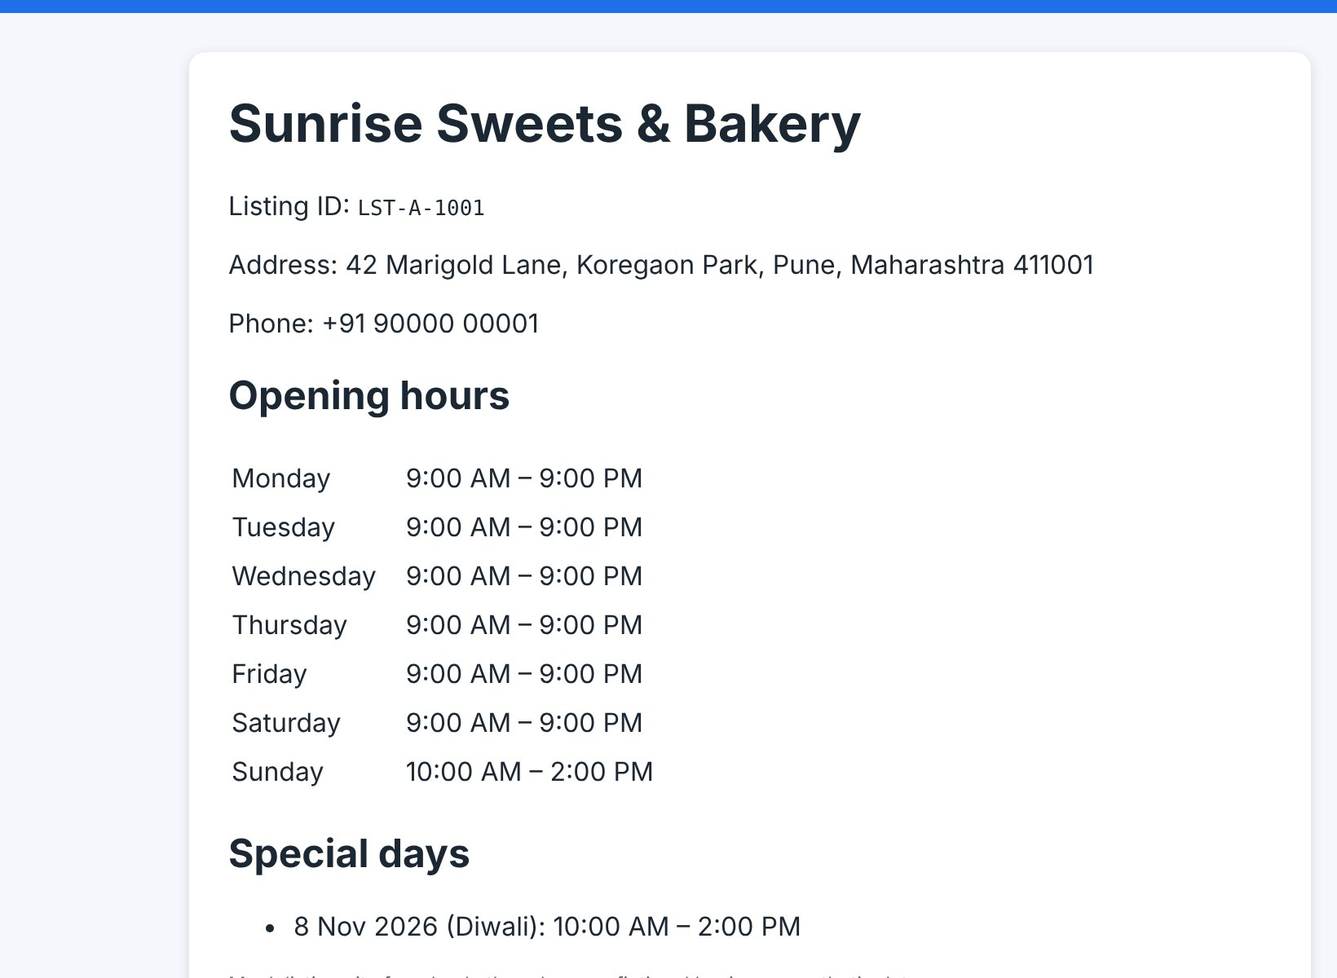
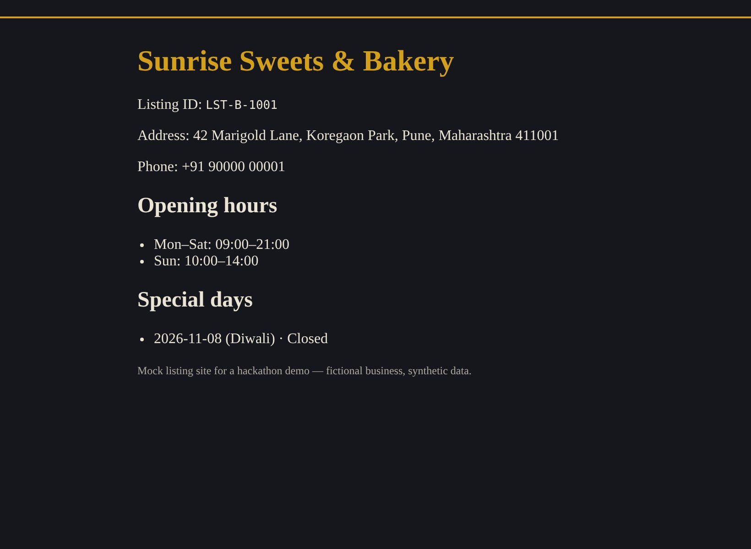
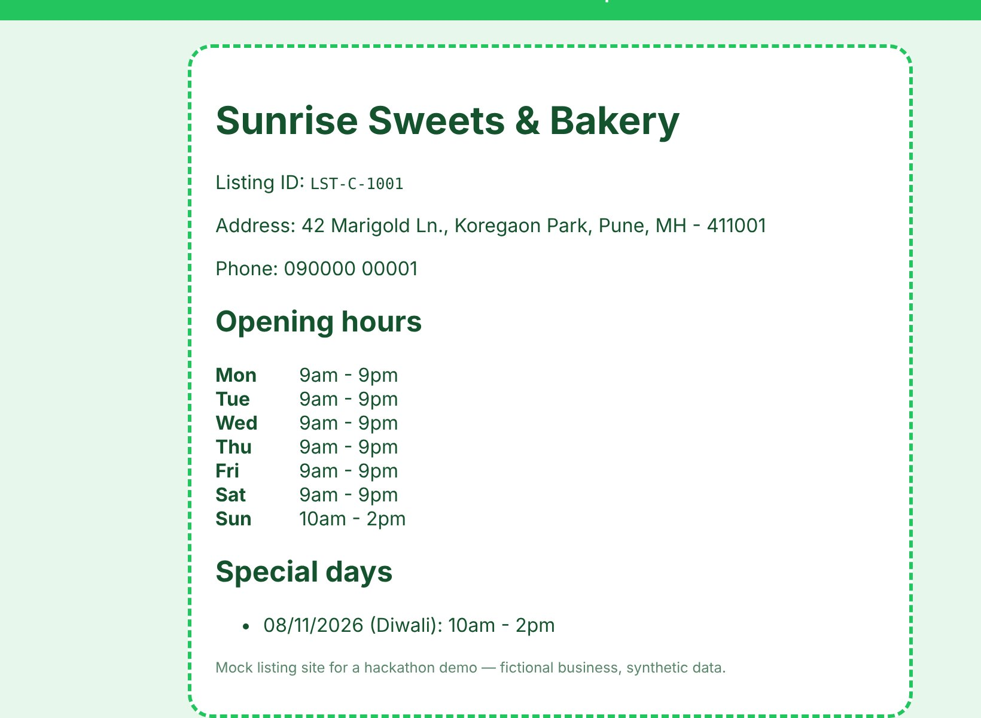
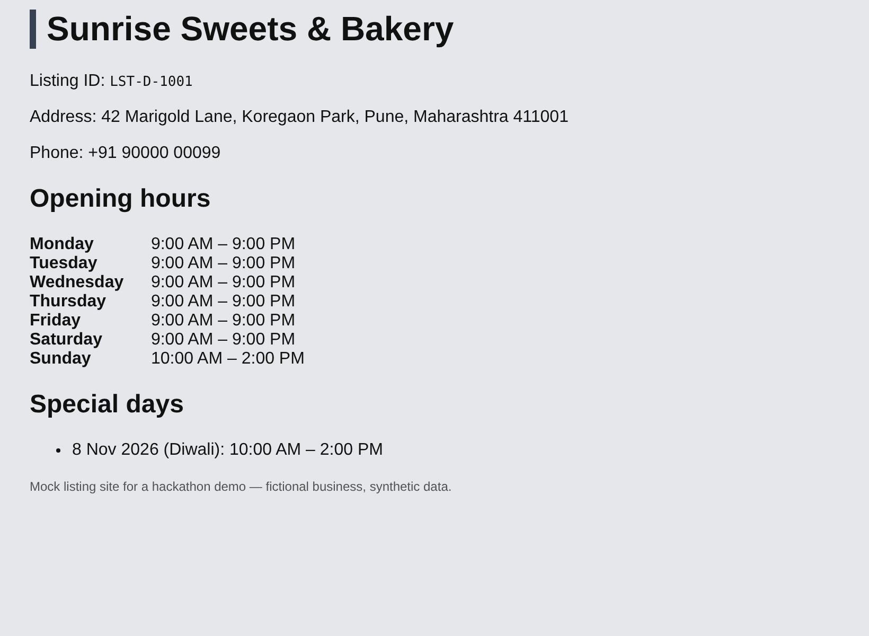
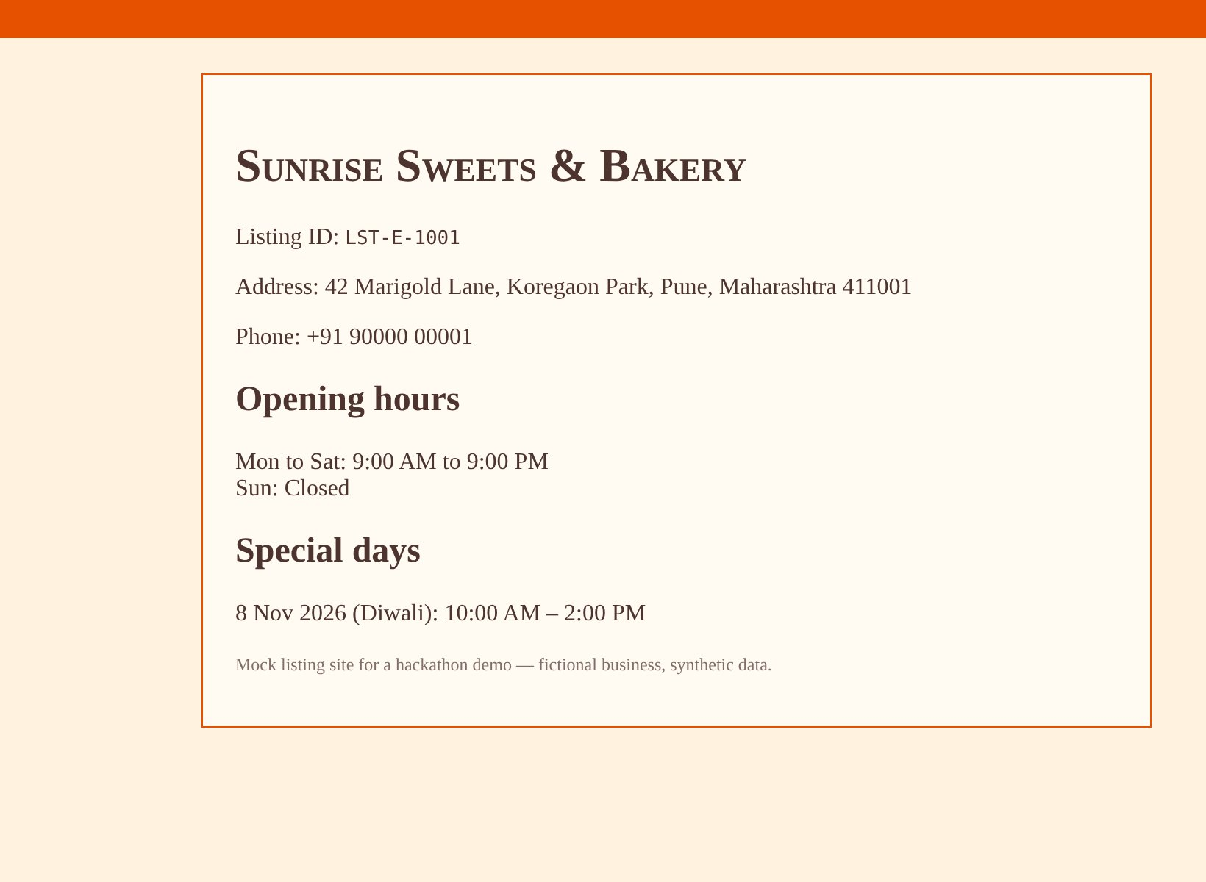
1 · THE PROBLEM
One bakery, five listing sites, five different stories
A · Listify
B · CityPages
C · LocalLoop
D · NearbyNow
E · ShopFront
Matches the record
Diwali shown as Closed (record: 10:00-2:00)
Phone and address written differently, same meaning
Other phone number; claimed by another account
Sunday shown as Closed (record: 10:00-2:00)
What is a listing inconsistency?
In our test bed (fictional bakery, Pune)
Any difference between what the owner means and what a listing site shows: name, address, phone or hours. Some are obvious (a wrong holiday). Some only a careful reader catches, and some look different but mean the same thing.
Wrong holiday hours on one site (B)
Same facts, different format (C): "090000 00001" equals "+91 90000 00001"
Stale phone on a listing that another account has claimed (D)
Regular hours differ (E): Sunday listed as Closed
Business Listing Consistency Agent · Agentic AI Hackathon 2026
3
Notes:
These are the five public pages for the same bakery, captured from the running app before anything is fixed. A matches. B says Diwali is closed. C writes the phone and address differently but means the same thing, so a smart tool must not 'fix' it. D shows a different phone and is claimed by someone else, so we are not even allowed to edit it. E says Sunday is closed. Five layouts, five formats, one business.

Slide 4
1 · THE PROBLEM
Why it matters, and why owners can't fix it by hand
WHY IT MATTERS
WHY OWNERS STRUGGLE
Customers are turned away
Many sites, many formats
Every change is repeated
A holiday or Sunday shown as Closed sends paying customers elsewhere. The reverse sends them to a locked door.
Each site stores phones and hours its own way. We parse four different hours layouts.
One new holiday means one edit per site, each with its own login and form.
Calls go to the wrong number
Not every listing is yours
Edits do not always go live
A stale phone number on one site means missed orders and a business that looks careless.
A listing claimed by someone else cannot be edited. A bot must not try.
Moderation queues and dropped edits: "saved" is not the same as "live".
Conflicting details cost trust
Look-alike businesses
Nobody checks afterwards
Every platform shows its own version of the business, and customers notice when versions disagree.
"Sunrise Sweet House" sits next to our bakery. Editing the wrong one is worse than doing nothing.
Drift returns silently, so the cleanup never stays done.
By hand it is slow and gets forgotten. Letting a bot edit freely is unsafe. The real problem is trust.
Business Listing Consistency Agent · Agentic AI Hackathon 2026
4
Notes:
Why it matters: wrong hours turn customers away, a wrong number loses orders, and conflicting details look careless. Why owners cannot just fix it: sites format things differently, every change is repeated per site, some listings belong to someone else, edits can sit in moderation or silently fail, look-alike businesses exist, and nobody re-checks afterwards. A script that edits freely would be dangerous, so the real problem is building automation an owner can trust.

Slide 5
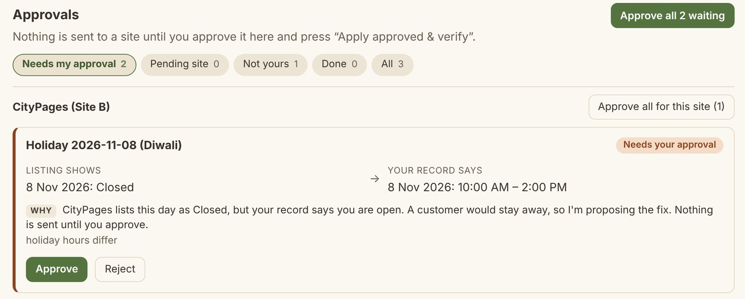
2 · OUR SOLUTION
Tell us the truth once. The agent keeps every site honest.
Scan
1
Reads all five sites and compares meaning, not formatting: 25 field checks in about 150 ms.
Review
2
Every proposed fix is a card with a plain-English reason. You approve or reject each one.
Apply
3
Approvals: what the site shows versus what your record says, and why.
Only approved changes are sent, and never to a listing you do not own.
Your record is the single source of truth
Verify
Name
Address
Phone
Weekly hours
Holidays
4
The agent reloads the public page and marks VERIFIED only if the value is really there.
Five kinds of fact, one place. Nothing reaches a listing until you approve it.
Business Listing Consistency Agent · Agentic AI Hackathon 2026
5
Notes:
The product in one line: you tell us the truth once, and the agent keeps every site honest. Four steps. Scan reads every site and compares by meaning. Review shows a card per fix with a plain reason, as in the screenshot. Apply sends only what you approved. Verify reloads the page and only then says verified. The scan of five sites and twenty-five field checks took about 150 milliseconds in our measured runs on the local mock sites.

Slide 6
2 · OUR SOLUTION
Who it helps, and what changes for them
WHO IT HELPS
 | Today, by hand | With the agent
Find mismatches | Open each site and compare by eye | One scan reads every site and every field
Same meaning, other format | Easy to miss, or to "fix" needlessly | Compared by meaning; formatting-only differences are ignored
Fix them | Log in to each site and retype | Review cards and approve; only approved changes are sent
Know it worked | Hope the site saved it | Reloads the live page; moderation shows as pending
Owner effort in our demo | Edit 2 sites by hand, re-check all 5 | 3 clicks: Scan, Approve all, Apply
Stay consistent | A one-off cleanup | Repeatable scans and holiday alerts
Busy owners of local shops
Bakeries, clinics, salons: no time to check five sites, no SEO team.
Owners with more than one business
Each business has its own PIN and fully separate data.
New owners
The agent finds where you are already listed and adds you where you are missing, after you approve.
Business Listing Consistency Agent · Agentic AI Hackathon 2026
6
Notes:
Who it helps: busy owners of local shops first, owners who run several businesses (each has a separate PIN and separate data), and new owners, where the agent finds existing listings and adds the business where it is missing after approval. The table is the process change: from open each site and compare by eye, to one scan, approve, and automatic verification. In our demo scenario the owner does three clicks: Scan, Approve all, Apply. If a site moderates edits, one more click re-checks it.

Slide 7
3 · THE AGENTIC AI
A goal-driven loop, not a chat box
Goal every listing says what the owner's record says. The owner approves; the agent does the legwork and proves the result.
1 Perceive
2 Decide
3 Act
4 Verify
5 Recover
Reads each public page and owner dashboard. Raw values are kept.
Compares meaning per field and picks the next tool from the current state.
Proposes a fix, flags a listing, asks the owner, or applies what was approved.
Reloads the page. VERIFIED only if the approved value is really there.
Page changed? Site down? Edit dropped? Re-ask, retry, or re-send once.
read_listing, normalise
compare, planner
propose, flag_listing, apply_approved
reload_and_verify
same tools, new decision
loops until nothing is left to do
EIGHT TOOLS, ONE REGISTRY
Who decides each step?
read_listing
normalise
compare
propose
A rules planner (default, no key needed) or an optional Gemini planner. Same tools, same guardrails. Each trace row carries a badge: Gemini, Deterministic, Fallback or Blocked.
page + dashboard
E.164, address, hours
meaning per field
one card per fix
apply_approved
reload_and_verify
flag_listing
ask_owner
approved rows only
checks the live page
not ours: no write
asks for approval
Business Listing Consistency Agent · Agentic AI Hackathon 2026
7
Notes:
What makes it agentic: it has a goal, not a script. Each step it looks at the current state of every site, chooses one of eight tools, acts, checks the result, and loops until nothing is left to do. Perceive, decide, act, verify, recover. The decision-maker is pluggable: a rules planner by default, or Gemini if a key is configured. Both use the same tool registry and the same guardrails, and every step is written to a trace with a badge saying who decided.

Slide 8
3 · THE AGENTIC AI
From plain-language request to verified result
Interprets requests
Selects tools
Runs multi-step workflows
Verifies and recovers
Typed text becomes an intent: a question, a detail edit or a closure date.
chrono-node plus rules turn "26th December" into Sat 26 Dec 2026 (IST).
Unclear input gets exactly one clarifying question.
Optional Gemini cross-checks the reading; if it disagrees, the owner chooses.
Nothing is saved before Confirm.
Each step the planner sees the tool list, the record and every site's state.
Nothing read yet: read_listing. Then normalise, then compare.
Owner's listing differs: propose. Permission denied: flag_listing (forced in code).
Approved rows: apply_approved.
An unsafe pick is blocked and the rules choose instead.
Scan phase reads and proposes. Execute phase applies and verifies.
One closure request fans out to every site (TC5: 3 verified, 1 flagged, 1 pending moderation).
27 tool calls for the TC1 holiday fix, each a visible trace row.
Every run ends with a short "what I did and why" briefing.
Reloads and compares. "Saved" is never trusted.
Moderated site: PENDING_MODERATION until the page really changes (TC4).
Page changed after approval: sends nothing, asks again with the new facts (TC7).
Site down: retries. Edit dropped: re-sent once, then verified (TC8).
"closed on 26th December" > Action: Closed, Date: Sat 26 Dec 2026
Rogue planner test: 6 unsafe picks, 6 blocked, 0 writes
TC1: MISMATCH > PROPOSED > APPROVED > APPLIED > VERIFIED
TC8: outage retried, lost write re-sent, VERIFIED
Honest note The default decision-maker is a rules planner. The Gemini planner is optional and falls back to rules on 429, timeout or invalid JSON; it is covered by 12 mocked-client tests, and no live Gemini run is in our evidence set (no key in the build environment).
Business Listing Consistency Agent · Agentic AI Hackathon 2026
8
Notes:
Four things the judges asked about. How it interprets requests: the Edit and Ask box turns text into an intent, resolves dates with chrono-node, asks exactly one clarifying question when unclear, and saves nothing until Confirm. How it selects tools: every step it looks at the state and picks a tool, and code blocks unsafe picks. How it runs multi-step workflows: scan then execute, fanning one request out to every site. How it verifies and recovers: reload and compare, wait on moderation, re-ask if the page changed after approval, retry outages and re-send a dropped edit once. Be upfront: the default planner is rules-based; Gemini is optional and tested with a mocked client.

Slide 9
4 · TECHNICAL IMPLEMENTATION
One service: console, agent, readers, five mock platforms
Node 22 service · Express 5 · TypeScript
read +
Readers
API + auth
Agent core
Playwright (optional) with an HTTP + cheerio fallback
Owner's browser
PIN-only login (HMAC), sessions, every call scoped to one business
loop · planner · guardrail · 8 tools · verifier
write
React 19 + Vite console
PIN-only login
Nine sections: details, sites, approvals, consistency, edit & ask, change log, agent trace, holidays, add business
Step bar: Scan, Review, Apply
Agent Trace map
HTTPS
Five mock platforms
Listify · CityPages · LocalLoop · NearbyNow · ShopFront
Public page, owner dashboard and edit API on each
Different markup, hours formats, ownership and moderation
/mock/admin: moderator queue
Owner-facing intelligence
SQLite
intent parser · holiday foresight · score-matched onboarding
field states · audit log · trace · change log (Zod-validated)
Evidence runner TC1-TC8 on a fresh reset, 295 tests, before/after CSV, trace and audit reports
Gemini (optional) Interactions API
Business Listing Consistency Agent · Agentic AI Hackathon 2026
9
Notes:
This is the real architecture, not a diagram of aspirations. One deployable Node service. The React console talks to an Express API over HTTPS. Behind it: auth, the agent core with its loop, planner, guardrail, eight tools and verifier, the owner-facing intelligence, and SQLite for field states, audit, trace and change log. Readers fetch pages with Playwright or a plain HTTP fallback, from five mock listing platforms that deliberately differ in markup, hours format, ownership and moderation. Gemini is an optional side connection.

Slide 10
4 · TECHNICAL IMPLEMENTATION
Stack, data flow and how it talks to listing platforms
STACK
DATA FLOW OF A RUN
INTEGRATING WITH PLATFORMS
Language TypeScript end to end, Node 22
Server Express 5, Zod 4 validation
Console React 19 + Vite, served by Express
Data SQLite (better-sqlite3, node:sqlite fallback)
Readers Playwright, plus fetch + cheerio
Language tools chrono-node for dates
LLM (optional) @google/genai, Interactions API
Quality Vitest: 295 tests, 24 files
Deploy Docker, Render free tier, /health
1
Owner record (SQLite) is the source of truth
One reader per site turns four different hours layouts into one weekly schedule
Every read asserts the page's listing ID equals the registered ID; look-alike listings are never read as ours
Writes use each site's dashboard API with server-signed credentials; permission denied becomes a flag, never an edit
Edit accepted but page unchanged and queued: PENDING_MODERATION
Real platforms would need their own APIs and consent flows; we do not claim that yet
2
Read each public page and dashboard; keep raw values
3
Normalise: E.164 phone, tidy address, parse hours
4
Compare meaning per field
5
Propose: one card per mismatch
6
Owner approves: DB row becomes APPROVED
7
Apply: read-before-write, idempotent
8
Reload and verify: VERIFIED, PENDING or MISMATCH
9
Report: trace, audit log, change log, CSV
Business Listing Consistency Agent · Agentic AI Hackathon 2026
10
Notes:
The stack is deliberately boring and testable: TypeScript everywhere, Express, React and Vite, SQLite, Zod for validation, Playwright with an HTTP fallback, chrono-node for dates, and the Google GenAI Interactions API as an optional extra. The middle column is the data flow of one run, from the owner's record to the report. The right column is how it integrates with listing platforms: per-site readers, identity assertions so look-alikes are never touched, dashboard APIs for writes with permission handling, and moderation awareness. We are explicit that real platforms need their own APIs and consent flows.

Slide 11
4 · TECHNICAL IMPLEMENTATION
Safety is enforced in code, not in prompts
agent proposes
owner only
agent sends
verifier only
GUARDRAILS IN CODE
MISMATCH
PROPOSED
APPROVED
APPLIED
VERIFIED
No apply without a DB row the owner approved
Permission denied forces flag_listing
Only the verifier can mark VERIFIED, after a reload
Pending moderation is never reported as fixed
Decoy listings are never read as ours or edited
Re-running never double-applies
FLAGGED_NOT_OWNER
REJECTED
PENDING_MODERATION
permission denied: no write
owner rejects
queued, page unchanged; VERIFIED after moderator and reload
Entering APPROVED requires the actor "owner"; entering VERIFIED requires the actor "verifier". Enforced in src/core/states.ts and unit-tested.
6 / 6
Isolation and secrets
One business can never read another's data: a session-scoped business ID is required on every call; foreign IDs answer 404.
PINs are never stored (HMAC-SHA256, constant-time compare, rate-limited). The API key never reaches git, logs, /health or the trace.
unsafe actions blocked by a scripted rogue planner: 0 writes, 0 false VERIFIED
Business Listing Consistency Agent · Agentic AI Hackathon 2026
11
Notes:
The safety story is code, not prompt engineering. Each field moves through a state machine. Only the owner can approve, only the verifier can mark verified, and a listing we do not own can only be flagged. We tested the guardrails with a scripted rogue planner that tried six unsafe things: apply without approval, apply unapproved fields, verify without applying, touch the look-alike, flag an editable listing. All six were blocked, zero writes reached any site. Business isolation and PIN handling are enforced and tested the same way.

Slide 12
5 · THE INNOVATION
Not a dashboard, not a chatbot, not a cron job
 | Typical dashboard | Typical chatbot | Typical rule-based sync | Our agent
Compares meaning, not formatting | No | Partly | No | Yes
Knows who owns a listing and refuses to edit it | Partly | No | No | Yes
Reloads the page to prove the edit went live | No | No | No | Yes
Tells "pending moderation" from "done" | No | No | No | Yes
Explains every step it took (trace) | No | Partly | No | Yes
Recovers when a page changes or a site is down | No | No | Partly | Yes
Looks ahead (holiday alerts) | No | No | Partly | Yes
Compared with typical tools in each category, not with specific products. "Partly" means possible, or only if configured.
Verify-after-write
Ownership-aware
Finds you among look-alikes
Looks ahead, speaks plainly
A field becomes VERIFIED only when the reloaded public page shows the approved value.
Claimed by someone else? No edit is attempted, and a claim request is drafted for the owner.
Score = phone 40 + address 35 + name 25. The look-alike scores 37.7, the real listing 100.
Holiday alerts at 30, 14 and 7 days. "Closed on 26th December" becomes a previewed, approved change.
Business Listing Consistency Agent · Agentic AI Hackathon 2026
12
Notes:
Why this is different. A dashboard shows values and leaves all the work to you. A chatbot can talk about listings but has no tools, no ownership checks and no proof. A rule-based sync pushes data and assumes it worked. Our agent compares by meaning, knows when a listing is not ours, reloads the page to prove the edit is live, distinguishes pending moderation from done, explains every step, recovers when the world changes, and looks ahead to holidays. The comparison is against typical tools in each category, not specific products.

Slide 13
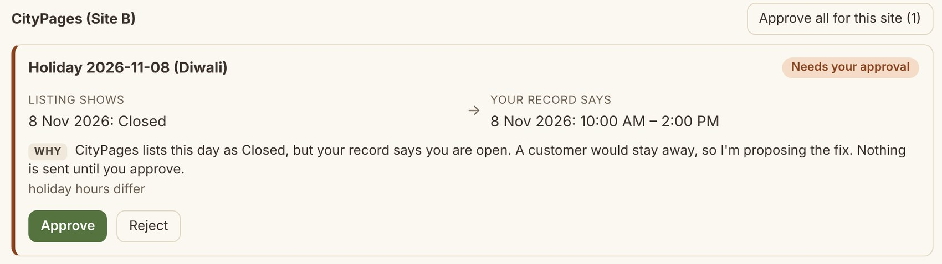
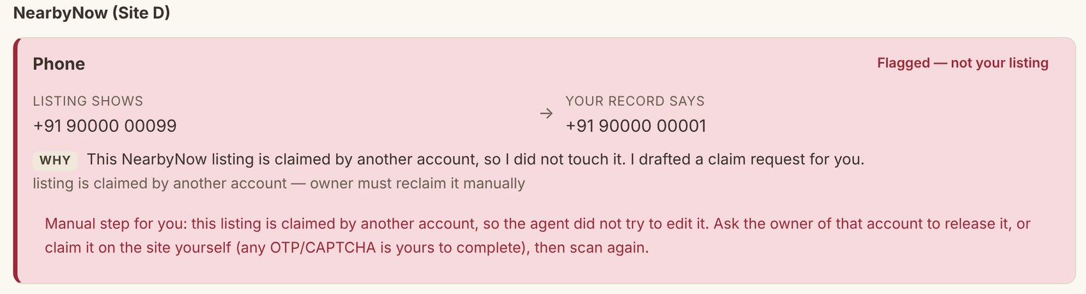
6 · THE DEMONSTRATION
End to end: holiday hours fixed, a stranger's listing left alone
1
Scan Five sites read in about 150 ms: 2 fixes proposed, 1 listing claimed by someone else, 2 format-only ignored.
2
Review CityPages lists Diwali as Closed; the record says 10:00-2:00. The card says why, and you decide.
3
Safety NearbyNow is claimed by another account: zero edits, and a claim request is drafted for you.
Step 2, Review: the card shows both values and the reason.
4
Apply Only approved changes are sent. Every step lands in the trace; each page is reloaded.
5
Moderate ShopFront queues the edit. It stays PENDING until its moderator approves; a re-check then verifies it.
6
Report Before/after table: 2 fixed and verified, 1 needs you, 2 ignored. CSV export.
Step 3, Safety: not our listing, so no edit is attempted and the manual steps are spelled out.
Watch the 2-minute video: docs/demo/demo.mp4 · Try it live: zirohacksub.onrender.com · demo PIN 7KQ4X-M9PHT
Business Listing Consistency Agent · Agentic AI Hackathon 2026
13
Notes:
Walk through the scenario, ideally live. Press Scan: the agent reads five sites and tells you what it found, two fixes, one listing claimed by someone else, two formatting-only differences it ignores. Review: CityPages lists Diwali as closed, and the card explains why that matters. NearbyNow belongs to another account, so the agent makes no edit and drafts a claim request instead. Approve and Apply: only approved changes are sent and the pages are reloaded. ShopFront has a moderation queue, so the edit stays pending until the moderator approves, then a re-check verifies it. The report shows the before and after table with a CSV export. There is a two-minute video of exactly this flow.

Slide 14
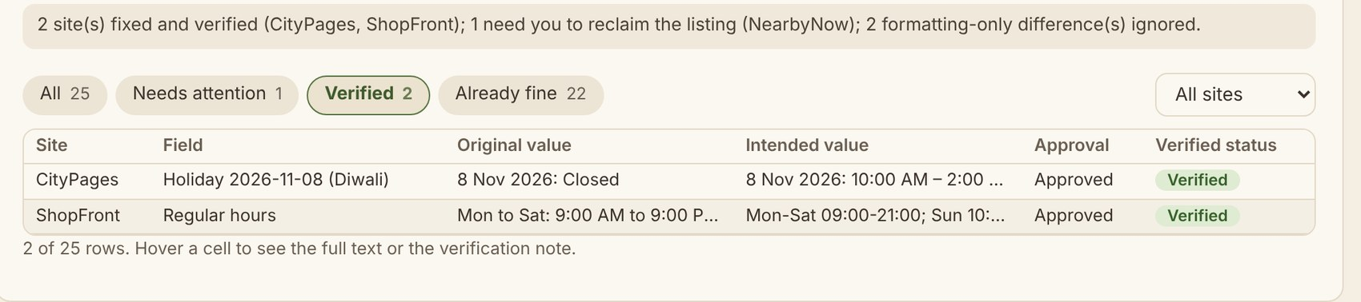
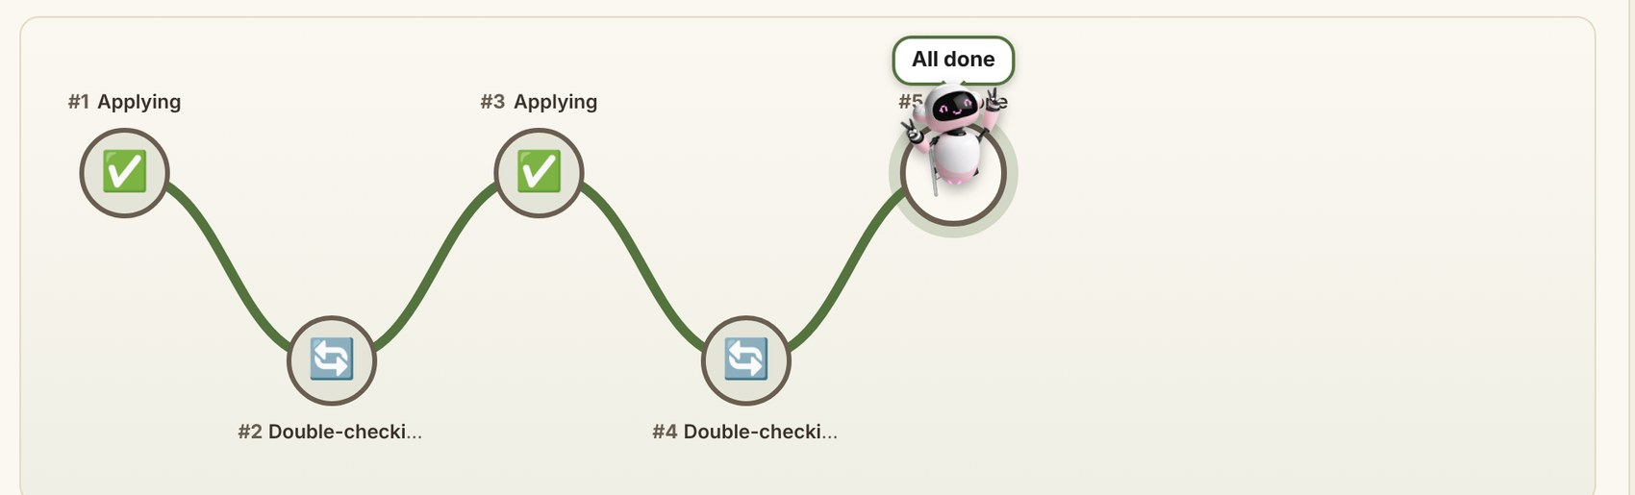
6 · THE DEMONSTRATION
The result on screen: verified, pending or flagged
How to read it
Verified: the reloaded page shows the approved value
Pending: the site's moderator has not approved yet
Flagged: not your listing, nothing was sent
Consistency table, filtered to Verified: both fixes were confirmed by reloading the page.
Agent Trace: every step, in order
Each row names the tool, who decided (Gemini, Deterministic, Fallback or Blocked), what it found and how long it took
Verification is a visible step: Applying, then Double-checking, then All done
Blocked actions show in red with the reason
The little agent follows your pointer along the route
Agent Trace: the route of the run, step by step.
Business Listing Consistency Agent · Agentic AI Hackathon 2026
14
Notes:
This is what the owner sees when the run is finished. The Consistency table is the before and after report, here filtered to Verified: CityPages and ShopFront were both fixed and confirmed by reloading the live page. The legend explains the three outcomes: verified, pending a moderator, or flagged because the listing is not ours. Below, the Agent Trace shows every step in order with a badge for who decided it, so nothing the agent did is hidden.

Slide 15
6 · THE DEMONSTRATION
What the run proves: TC1 to TC8 pass from a fresh reset
Test case | Actual result
TC1 Holiday hours differ on one site | MISMATCH > PROPOSED > APPROVED > APPLIED > VERIFIED; 1 write
TC2 Phone formatted differently | FORMAT_ONLY_EQUIVALENT; 0 proposals, 0 writes
TC3 Listing claimed by someone else | FLAGGED_NOT_OWNER; 0 write attempts
TC4 Edit pending moderation | ... PENDING_MODERATION > VERIFIED after moderator and reload
TC5 Plain-language closure | 3 VERIFIED, 1 FLAGGED_NOT_OWNER, 1 PENDING_MODERATION
TC6 Foresight alert, no exception | "Bhai Dooj (11 Nov 2026) is in 21 days and has no opening-hours exception"
TC7 Listing changes after approval | Nothing sent; asked again with the new facts, then VERIFIED
TC8 Site down, then drops an edit | Outage retried; lost write re-sent once; VERIFIED
8 / 8
official test cases pass from a fresh reset
295
automated tests pass across 24 files
6 / 6
unsafe actions blocked in the rogue-planner test, with 0 writes
Re-run it yourself open /tests, press Run all
Deterministic run with the date pinned to 21 Oct 2026; each test starts from a fresh reset. The Gemini run needs an API key and is not part of this evidence.
Business Listing Consistency Agent · Agentic AI Hackathon 2026
15
Notes:
This is the evidence behind the demo. The eight official test cases each start from a fresh reset and record input, expected and actual results. TC1 is the holiday fix, TC2 proves we ignore formatting-only differences, TC3 proves zero write attempts on a listing we do not own, TC4 proves pending moderation is never reported as fixed. TC5 to TC8 cover plain-language closures, holiday foresight, a page that changes after approval, and an outage with a dropped edit. All eight pass, alongside 295 automated tests. Anyone can open the test page in the demo and press Run all.

Slide 16
7 · THE IMPACT
Value we can measure today, and where it scales
about 150 ms
3 clicks
0
full scan: 5 sites x 5 fields = 25 checks (local mock sites; three runs: 139-156 ms)
owner effort in the demo: Scan, Approve all, Apply
unapproved writes, decoy edits or false VERIFIED in the tests
8 / 8
6 / 6
295
official test cases pass from a fresh reset
unsafe actions blocked in the rogue-planner test
automated tests pass
Practical value
Scalability
Future potential
Hours saved on every holiday change, and no more wrong-hours surprises
Safe by design: no write without approval, none to listings you do not own
Owners get proof (VERIFIED, trace, CSV), not promises
Each new platform is one more reader; the mock sites already differ in markup, formats and rules
Work per scan grows with sites x fields (25 checks today)
Every business is isolated by a session-scoped ID; one Docker service on a free host
Real platform APIs and consent flows; OTP and phone checks stay with a human
Scheduled scans and alerts when drift returns
More fields (categories, photos, menus) and a multi-location view
Business Listing Consistency Agent · Agentic AI Hackathon 2026
16
Notes:
Impact, with numbers we actually measured. A full scan of five sites and twenty-five field checks takes about 150 milliseconds on the local mock sites, so this excludes real-world network latency. In the demo the owner does three clicks. Eight of eight test cases and 295 automated tests pass; the rogue planner could not get a single write through. Scalability: each platform is another reader, work per scan grows with sites times fields, and each business is isolated by a session-scoped ID. The future: real platform APIs with consent flows, scheduled scans, and more fields. We do not claim production traffic numbers; we have none.

Slide 17
7 · THE IMPACT
What is real today, and what comes next
Real and tested today
Mocked or not built yet
Scan, approve, apply, verify across five mock platforms
Ownership flags, moderation handling, retries and re-planning (TC1-TC8)
PIN-only login, per-business isolation, score-matched onboarding
Plain-language edits and questions, holiday foresight
Trace, change log and CSV evidence; 295 tests
Deployed demo on a free host (first load can take 30-60 s)
The platforms are mock sites; real ones need their own APIs and consent flows
Claiming a listing is mocked (no OTP). On real sites that step stays human: the agent never automates OTP or CAPTCHA
Festival dates must be confirmed by the owner (approximate calendar)
No live Gemini run in the evidence (no key in the build environment)
A lost PIN cannot be recovered; no phone verification yet
NEXT STEPS
1
A real platform adapter with its consent flow
2
Scheduled scans and drift alerts
3
PIN recovery and phone verification as a human step
4
More fields and a multi-location view
Business Listing Consistency Agent · Agentic AI Hackathon 2026
17
Notes:
We would rather be honest than impressive. What is real: the full loop on five mock platforms, ownership and moderation handling, recovery, isolated businesses, onboarding, plain-language edits and holiday foresight, all covered by tests. What is not: real platforms, which need their own APIs and consent flows; OTP, which stays a human step; a calendar of approximate festival dates; and a live Gemini run, because the build environment had no key. Next steps: a real platform adapter, scheduled scans, PIN recovery and phone verification, and more fields.

Slide 18
IN ONE SENTENCE
An agent you can trust near your public listings.
Safe by construction
Proven
Ready to try
No write without approval, none to listings you do not own.
TC1-TC8, 295 tests, plus trace and CSV evidence.
Live demo, a 2-minute video and the open repo.
Live demo zirohacksub.onrender.com demo PIN 7KQ4X-M9PHT (synthetic)
Video docs/demo/demo.mp4 Repo github.com/yourgrok/zirohacksub
Thank you. Questions?
Notes:
Close: safe by construction, proven by evidence, ready to try. Invite the judges to open the live demo, log in with the synthetic demo PIN, press Scan, and watch the agent work. Then take questions.

