Slide 1
Predict clinical outcomes using CT data
CS 760 Final Project
Hokeun Cha | Woojin Kim | YoonChae Na

Slide 2
INDEX
최종업뎃 필요
1. Introduction
Project Description | Literature Review | Overview
2. Methodology
Data processing | Regression | Random forest | KNN
3. Results
Model Performance | Prediction | Key features Importance
4. Conclusion

Slide 3
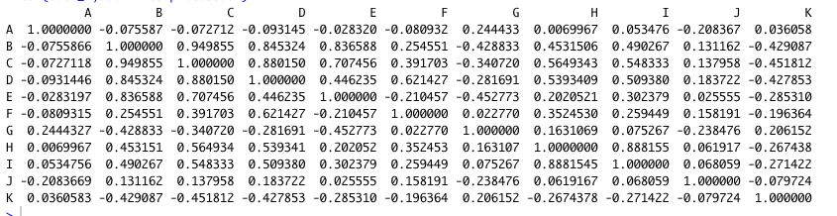
Data Processing & Augmentation
1) Save missing data
Parameter | Data | Count
FRS 10-year risk (%) | X | 593
FRAX 10y Fx Prob (Orange-w/ DXA) | - | 107
FRAX 10y Hip Fx Prob (Orange-w/ DXA) | - | 107
Estimate Value by Linear Regression
using the other clinical Data
FRX = θ (BMI, SEX, Tobaco, age…)
2) Select Feature
Excluding Feature by Correlation
TAT, Muscle Area (more than 0.89)
TAT <-> total Body, VAT, SAT
Muscle Area <-> L3 SMI

Slide 4
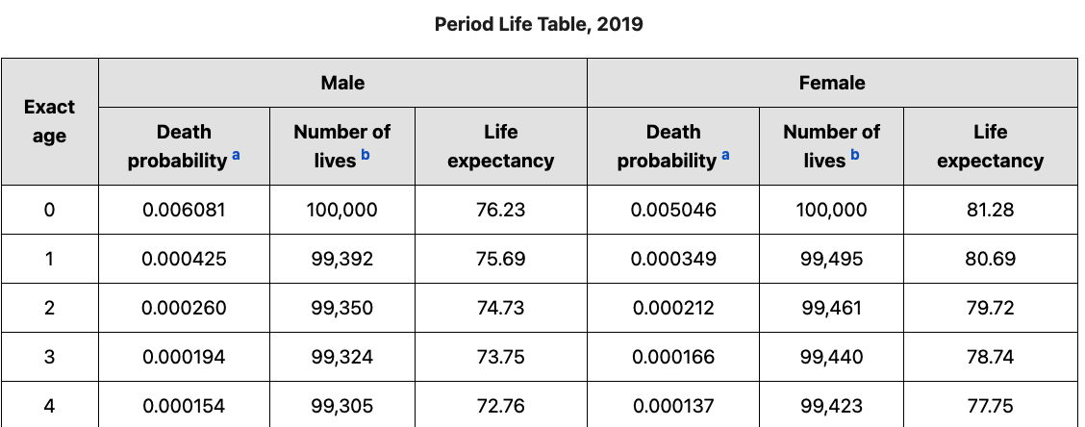

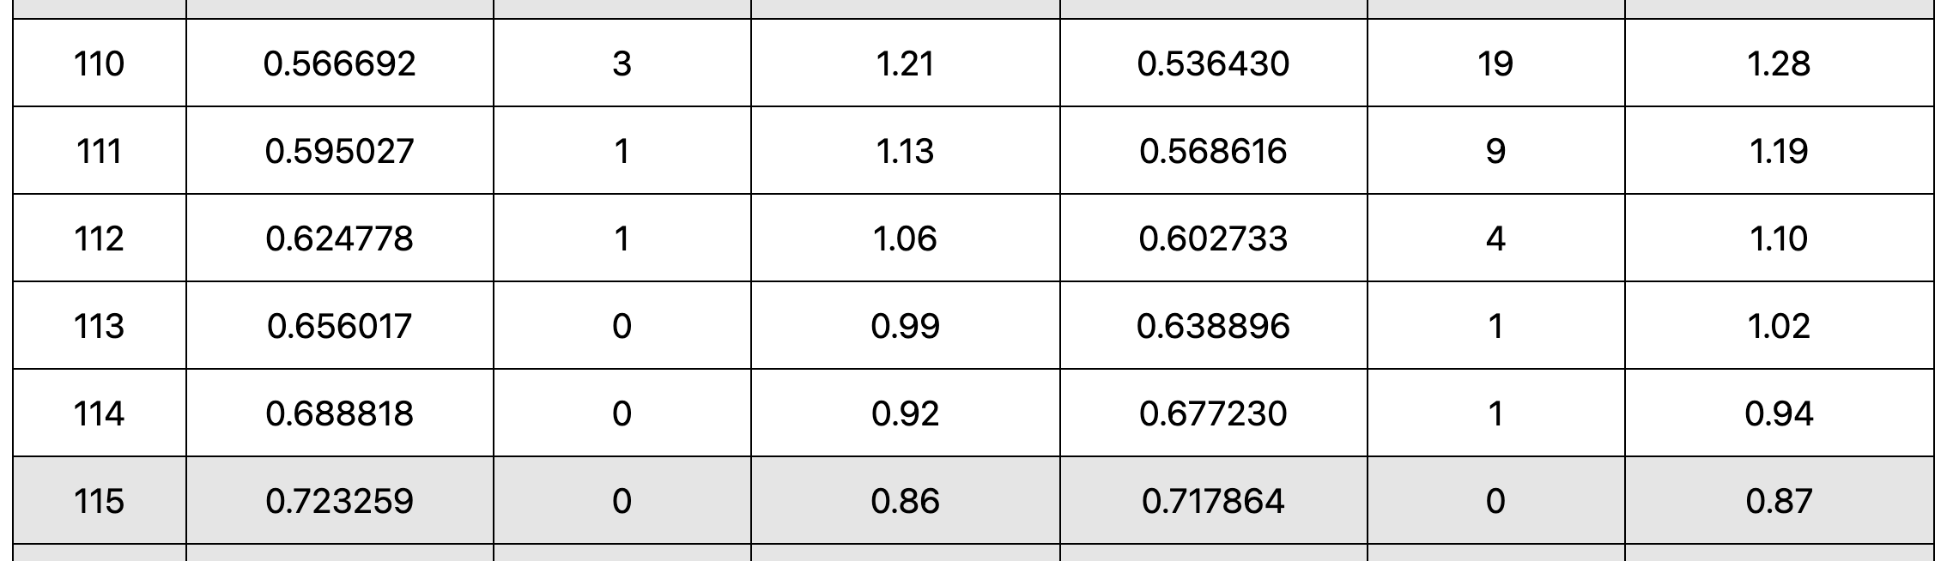
Data Processing & Augmentation
3) Data Augmentation
Problem
There were a few D_from_CT data
: 494/8,877
Data is skewed
: given data 0~14 yrs, reality 0~110 yrs
…..
Solution
Estimate “D_from_CT” data
by “Age at CT” + Period Life Table
https://www.ssa.gov/oact/STATS/table4c6.html
(Only for not given one)

Slide 5
Modeling & Result - ①
교수님은 test set으로
Only Given만하라함
->우리가 생각해보니
세상엔 수명이 30,40년 남은 사람도 많은데 그부분을 검증할 방법이 없고
오히려 Given data로만 구성하면 모델이 skewed 된거라서
50% 믹스 성능을 올렸다라고 설명?
Regression 25% -> Add train data 28% -> classification +Regression 41%
Train Data(75%) : Add by Period Life Table + Given with dead
Test Data(25%) : Add by Period Life Table + Given with dead
Correctness : 3yr difference (btw Predict value and given d_from_ct)
 | Only Given dead | Only live (Add value with Life table) | 50% mixed | Hyper Parameter
Linear Regression | 00 % | 00 % | 00 % | -
KNN Regression | 00 % | 00 % | 00 % | neighbors=5
Neural N/W | 31% | 19% | 25% | hidden_layer = (16,16,16) activation='relu' learning_rate_init=0.005 max_iter=5000 solver=’adam'
단어 고민
Only Given dead
Only live 맞나??
Test set
Type
Model

Slide 6
Modeling & Result - ①
Regression 25% -> Add train data 28% -> classification +Regression 41%
The percentage of augmented data in trainset was too high (94.5%)
 | Model | Only Given dead | Only live (Add value with Life table) | 50% mixed
Regression only | Neural N/W | 31 % 0%↑ | 19 % 0%↓ | 25 % 00%↓
Adjust ratio for train data (Given : Table= 50% : 50%) | Neural N/W | 33% 2%↑ | 22% 3%↑ | 27.5% 2.5%↑
숫자 안맞음 확인 필요, 50대 50 에서 비율 더 안올린건?
최초 가정대로 Given data가 너무 쏠려서???

Slide 7
Modeling & Result - ①
호근
2step 표현
Regression 25% -> Add train data 28% -> classification +Regression 41%
1 step : classification Dead or not
2 step : Each case calculate regression
2) Improvement to get better classification (60% -> 81.5%)
Test set
Type
 | Model | Only dead (Given with dead only) | Only live (Add Life table only) | 50% mixed
Classification only | SVM | 25 % 00%↑ | 95 % 00%↓ | 60 % 00%↓
Adjust train data ratio (Given : Table= 50% : 50%) | Neural N/W | 75 % 50%↑ | 74 % 21%↓ | 74.5 % 14.5%↑
Add data for train data (Train data 750 -> 1,020) Age>=80 -> dead | Neural N/W | 72% 03%↓ | 91% 16%↑ | 81.5% 7.5%↑
Model
숫자 안맞음 확인 필요

Slide 8
Modeling & Result - ②
호근
Regression 25% -> Add train data 28% -> classification +Regression 41%
-> Use Clinical Data 00%
내용을 정확히 모름 추가데이터 넣고 하는 방식 서술 필요
Test set
Type
 | Model | Only dead (Given with dead only) | Only live (Add Life table only) | 50% mixed
Classification only | SVM | 25 % 00%↑ | 95 % 00%↓ | 60 % 00%↓
Adjust train data ratio (Given : Table= 50% : 50%) | Neural N/W | 75 % 50%↑ | 74 % 21%↓ | 74.5 % 14.5%↑
Add data for train data (Train data 750 -> 1,020) Age>=80 -> dead | Neural N/W | 72% 03%↓ | 91% 16%↑ | 81.5% 7.5%↑
Model
숫자 안맞음 확인 필요

Slide 9
Modeling & Result - ③
호근
검증
Biological Age Modeling
exclude who is going to die in 3yrs
- Definition
Biological age X = Someone has an average ‘X’ age and healthy people’s CT data.
- Verification method
1) Make test set
- 주어진 데이터에서 D_from_CT 가 없는 경우 값을 만들어 냅니다. (앞에서의 방법 활용)
- 해당 날짜를 기준으로 나이를 생성합니다.
- 3년 이내에 사망할 것 같은 사람은 제외하여 평균 계산
- 각 나이별로 평균 CT 값을 산출하여 테스트set 을 완성합니다.
2) 정확성 검증
- 만들어진 모델에 test set의 CT값을 넣어 산출된 Age와 Test set의 age와 비교합니다.
(3년이내일 경우 정답 처리)

Slide 10
Modeling & Result - ③
호근
검증
Biological Age Modeling
Regression 50% -> classification +Regression 65%
Test set
Type
 | Model | Only dead (Given with dead only) | Only live (Add Life table only) | 50% mixed
Classification only | SVM | 25 % 00%↑ | 95 % 00%↓ | 60 % 00%↓
Adjust train data ratio (Given : Table= 50% : 50%) | Neural N/W | 75 % 50%↑ | 74 % 21%↓ | 74.5 % 14.5%↑
Add data for train data (Train data 750 -> 1,020) Age>=80 -> dead | Neural N/W | 72% 03%↓ | 91% 16%↑ | 81.5% 7.5%↑
Model

Slide 11
Modeling & Result - ③
우진
appendix?
Biological Age Modeling
수학적 증명

Slide 12
Modeling & Result - appendix
우진
appendix?
Additional Clinical outcomes
000(90%), 000 (95%) 로 예측 가능
 | 아이템 A | 아이템 B | 아이템 C | Hyper Parameter
Linear Regression | 00 % | 00 % | 00 % | -
KNN Regression | 00 % | 00 % | 00 % | neighbors=5
Neural N/W | 31% | 19% | 25%
Feature
Model

Slide 13
Thank you
CS 760 Final Project

