Slide 1
Prediction of Clinical Outcomes & Biological Age
CS 760 Final Project
Hokeun Cha | Woojin Kim | YoonChae Na

Slide 2
INDEX
1. Data Preprocessing
2. Prediction Using CT Data
3. Prediction Using CT Data & Clinical Data
4. Biological Age

Slide 3
Data Preprocessing
1) Estimate Missing Clinical Data
Parameter | Data | Count
FRS 10-year risk (%) | X | 593
FRAX 10y Fx Prob (Orange-w/ DXA) | - | 107
FRAX 10y Hip Fx Prob (Orange-w/ DXA) | - | 107
Use linear function on the other clinical data to estimate value

Slide 4
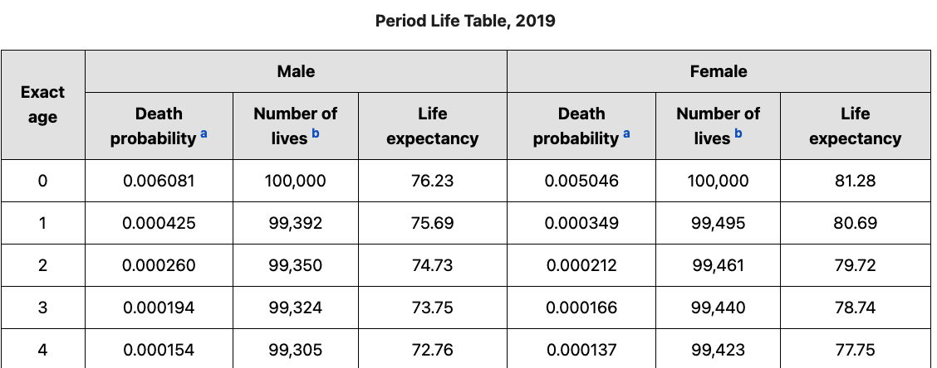

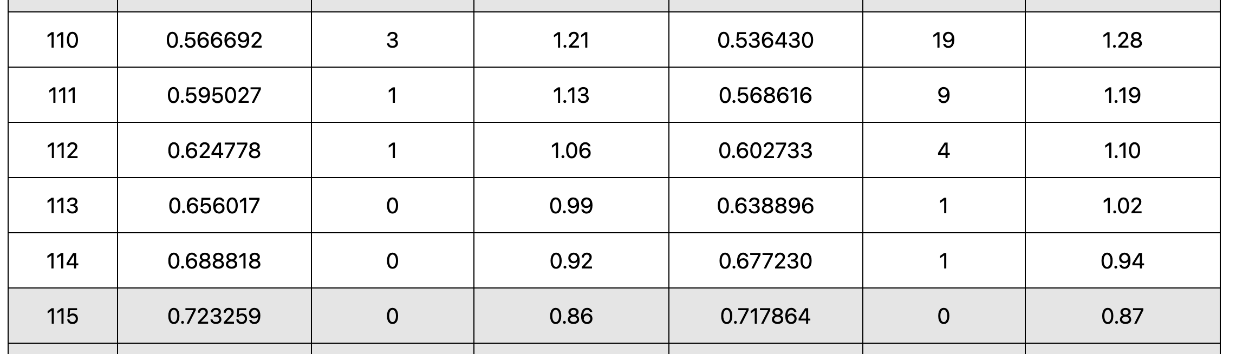
Data Preprocessing
2) Estimate Missing Death
Problem
There are a few data with death value (494 / 8,877)
Death values are skewed (0 - 14 years vs 0 - 110 years)
…..
Solution
Use age at CT and period life table to estimate death value of alive data
https://www.ssa.gov/oact/STATS/table4c6.html

Slide 5

Prediction Using CT Data
Improve prediction accuracy
: Prediction is correct if |Predicted value – True value| $≤$ 3 years
Method 1: Regression
Method 2: Regression with balanced training set
Method 3: Classification + Regression with balanced training set

Slide 6
Prediction Using CT Data
Regression 26% → Balance training data 26% → Classification + Regression 39%
Training data: 75% of data
Test data: 25% of data
 | Only dead | Only alive | Average | Hyperparameter
Linear regression | 5.33 % | 44.53 % | 24.93 % | -
KNN regression | 1.33 % | 45.95 % | 23.64 % | neighbors=10
Neural network | 5.33 % | 46.69 % | 26.01 % | hidden_layer = (16, 16, 16) activation='relu' learning_rate_init=0.005 max_iter=5000 solver=’adam'
Test data
Model

Slide 7
Prediction Using CT Data
Regression 26% → Balance training data 26% → Classification + Regression 39%
Alive data dominates the training data (94.5%)
Accuracy is very low for dead test data (5.33%)
Training data: 75% of dead data + same number of alive data
Test data: 25% of dead data + same number of alive data
 | Only dead | Only alive | Average
Regression only (Neural network) | 5.33 % | 46.69 % | 26.01 %
+ Balanced training data (Neural network) | 32.0 % 26.67%↑ | 20.14% 26.55%↓ | 26.07 % 0.06%↑
Test data
Model

Slide 8
Prediction Using CT Data
Regression 26% → Balance training data 26% → Classification + Regression 39%
There is discrepancy between CT data of healthy people and unhealthy people
Step 1: Classify data as alive data and dead data
Step 2: Run regression for each class
 | Only dead | Only alive | Average
Regression only (Neural network) | 5.33 % | 46.69 % | 26.01 %
+ Balanced training data (Neural network) | 32.0 % 26.67%↑ | 20.14% 26.55%↓ | 26.07 % 0.06%↑
+ Classification & Regression (Neural network) | 37.5 % 5.5%↑ | 40.51% 20.37%↑ | 39.01 % 12.94%↑
Test data
Model

Slide 9
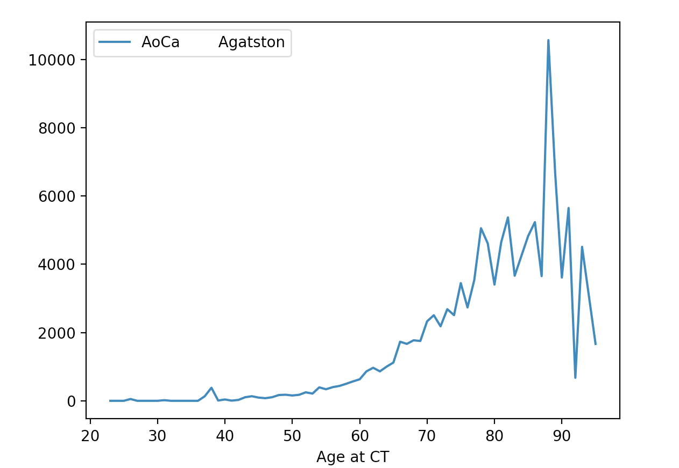

Slide 10
Prediction Using CT Data
Regression 26% → Balance training data 26% → Classification + Regression 39%
There is discrepancy between CT data of healthy people and unhealthy people
Step 1: Classify data as alive data and dead data
Step 2: Run regression for each class
 | Only dead | Only alive | Average
Regression only (Neural network) | 5.33 % | 46.69 % | 26.01 %
+ Balanced training data (Neural network) | 32.0 % 26.67%↑ | 20.14% 26.55%↓ | 26.07 % 0.06%↑
+ Classification & Regression (Neural network) | 37.5 % 5.5%↑ | 40.51% 20.37%↑ | 39.01 % 12.94%↑
Test data
Model

Slide 11
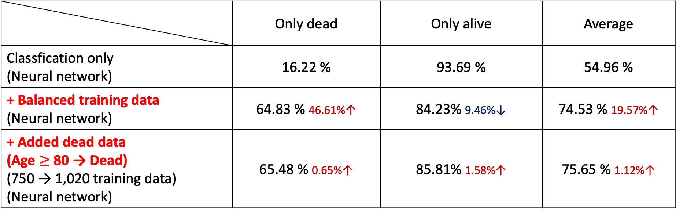
Prediction Using CT Data
Regression 26% → Balance training data 26% → Classification + Regression 39%
왜 여기만 공간이 비었지???
 | Only dead | Only alive | Average
Classfication only (Neural network) | 16.22 % | 93.69 % | 54.96 %
+ Balanced training data (Neural network) | 64.83 % 46.61%↑ | 84.23% 9.46%↓ | 74.53 % 19.57%↑
+ Added dead data (Age $≥$ 80 → Dead) (750 → 1,020 training data) (Neural network) | 65.48 % 0.65%↑ | 85.81% 1.58%↑ | 75.65 % 1.12%↑
Test data
Model

Slide 12
Prediction Using CT Data & Clinical Data
Regression 26% → Balance training data 26% → Classification + Regression 39%
→ Use CT data and clinical data 72%
Every model accuracy was increased
Final accuracy is 72% (difference 3yrs)

Slide 13

Biological Age
1) Definition
$Biological age=Age+Average life expectancy of age at CT−\frac{Death}{365}$
The biological age of a person with average healthy age ‘X’’s CT data is ‘X’
Exclude people who will die in 3 years
Age | L1 HU BMD | SAT | VAT | MUSCLE | …….
65 | 100 | 1 | 1 | 100
65 | 200 | 2 | 1 | 120
65 | 100 | 1 | 1 | 120
65 | 200 | 2 | 1 | 100
AVG(65) | 150 | 1.5 | 1 | 110
Some one has CT(150,1.5,1,110) -> Biological age 65

Slide 14

Biological Age
2) First Verification
$X=Biological age−Age$
$\frac{Death}{365}=Life expectancy$
$X=Average life expectancy of age at CT−Life expectancy$
$𝔼\left[X\right]=0$
$\overline{X}\underset{→}{d}N\left(0, \frac{σ^{2}}{n}\right)$
$H_{0}: \hat{\overline{X}}\sim N\left(μ, \frac{σ^{2}}{n}\right), μ=0, H_{1}: \hat{\overline{X}}\sim N\left(μ, \frac{σ^{2}}{n}\right), μ≠0, {\left(\frac{\sqrt{n}\hat{\overline{X}}}{σ}\right)}^{2}≷_{H_{0}}^{H_{1}}Φ_{χ}^{−1}(0.05)$
$n=8,877, \hat{\overline{X}}=57.41 −56.91=0.5,\left(\frac{\sqrt{n}\hat{\overline{X}}}{σ}\right)≤Φ_{χ}^{−1}\left(0.05\right)$ if $σ≥24.04$
Biological age is fairly valid

Slide 15

Biological Age
3) Second Verification
Make Test data: Average healthy age ‘X’’s CT Data (using given dataset)
Develop model to predict biological age
Prediction is correct if |Predicted value – ’X’| $≤$ 3 years
 | KNN regression | Neural network | Gaussian naive Bayes
Regression only | 27.27 % | 25.45 % | 50.91 %
+ Classification & Regression | 30.91 % 3.64%↑ | 29.09% 3.64%↑ | 63.64 % 12.73%↑
Regression model
Model

Slide 16
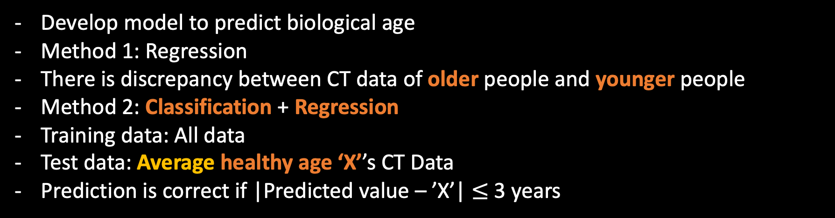
Biological Age
3) Second Verification
Develop model to predict biological age
Method 1: Regression
There is discrepancy between CT data of older people and younger people
Method 2: Classification + Regression
Training data: All data
Test data: Average healthy age ‘X’’s CT Data
Prediction is correct if |Predicted value – ’X’| $≤$ 3 years

Slide 17
Biological Age
3) Second Verification
 | KNN regression | Neural network | Gaussian naive Bayes
Regression only | 27.27 % | 25.45 % | 50.91 %
+ Classification & Regression | 30.91 % 3.64%↑ | 29.09% 3.64%↑ | 63.64 % 12.73%↑
Regression model
Model

Slide 18
Thank you
CS 760 Final Project

