Slide 1
Predict Clinical Outcomes Using CT Data
CS 760 Final Project
Hokeun Cha | Woojin Kim | YoonChae Na

Slide 2
INDEX
최종업뎃 필요
1. Introduction
Project Description | Literature Review | Overview
2. Methodology
Data processing | Regression | Random forest | KNN
3. Results
Model Performance | Prediction | Key features Importance
4. Conclusion

Slide 3
Data Preprocessing
1) Estimate missing clinical data
Parameter | Data | Count
FRS 10-year risk (%) | X | 593
FRAX 10y Fx Prob (Orange-w/ DXA) | - | 107
FRAX 10y Hip Fx Prob (Orange-w/ DXA) | - | 107
Use linear function on the other clinical data to estimate value

Slide 4
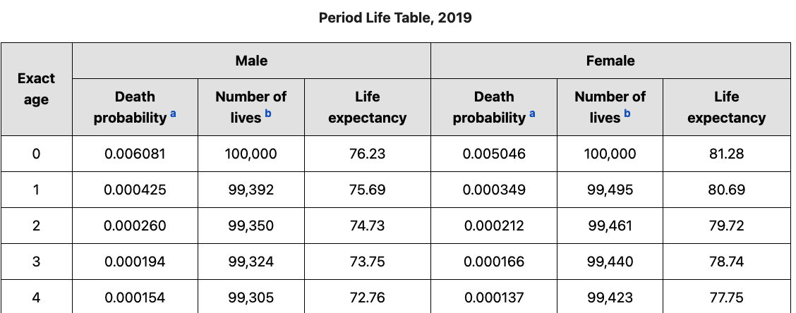

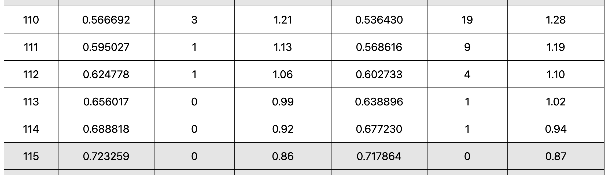
Data Preprocessing
2) Estimate death
Problem
There were a few data with death value (494 / 8,877)
Data are skewed (0 - 14 years vs 0 - 110 years)
…..
Solution
Use age at CT and period life table to estimate death value of alive data
https://www.ssa.gov/oact/STATS/table4c6.html

Slide 5

Modeling & Result - ①
교수님은 test set으로
Only Given만하라함
->우리가 생각해보니
세상엔 수명이 30,40년 남은 사람도 많은데 그부분을 검증할 방법이 없고
오히려 Given data로만 구성하면 모델이 skewed 된거라서
50% 믹스 성능을 올렸다라고 설명?
Regression 26% → Balance training data 26% → Classification + Regression 39%
Training data(75%) : alive + dead
Test data(25%) : alive + dead
Prediction is correct if |Predicted value – True value| $≤$ 3 years
 | Only dead | Only alive | 50% dead + 50% alive | Hyperparameter
Linear regression | 5.33 % | 44.53 % | 24.93 % | -
KNN regression | 1.33 % | 45.95 % | 23.64 % | neighbors=10
Neural network | 5.33 % | 46.69 % | 26.01 % | hidden_layer = (16,16,16) activation='relu' learning_rate_init=0.005 max_iter=5000 solver=’adam'
단어 고민
Only Given dead
Only live 맞나??
Test data
Model

Slide 6
Modeling & Result - ①
Regression 26% → Balance training data 26% → Classification + Regression 39%
Augmented data dominates the training data (94.5%)
Step 1: Classify data as alive data and dead data
Step 2: Run regression for each class
 | Only dead | Only alive | 50% dead + 50% alive
Regression only (Neural network) | 5.33 % | 46.69 % | 26.01 %
+Balanced training data (Dead : Alive = 50% : 50%) (Neural network) | 32.0 % 26.67%↑ | 20.14% 26.55%↓ | 26.07 % 0.06%↑
+Classification & Regression (Neural network) | 37.5 % 5.5%↑ | 40.51% 20.37%↑ | 39.01 % 12.94%↑
Test data
Model

Slide 7
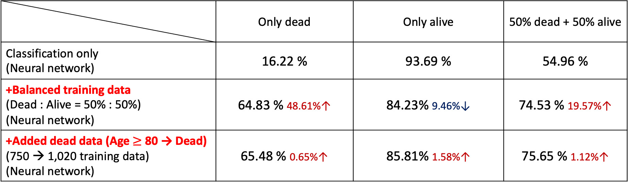
Modeling & Result - ①
Regression 26% → Balance training data 26% → Classification + Regression 39%
Accuracy improvements in classification:
 | Only dead | Only alive | 50% dead + 50% alive
Classification only (Neural network) | 16.22 % | 93.69 % | 54.96 %
+Balanced training data (Dead : Alive = 50% : 50%) (Neural network) | 64.83 % 48.61%↑ | 84.23% 9.46%↓ | 74.53 % 19.57%↑
+Added dead data (Age $≥$ 80 → Dead) (750 → 1,020 training data) (Neural network) | 65.48 % 0.65%↑ | 85.81% 1.58%↑ | 75.65 % 1.12%↑
Test data
Model

Slide 8
Modeling & Result - ②
Regression 26% → Balance training data 26% → Classification + Regression 39%
→ Use CT data and clinical data 72%
 | Only dead | Only alive | 50% dead + 50% alive
Regression only (Neural network) | 21.58 % | 96.06 % | 58.82 %
+Balanced training data (Dead : Alive = 50% : 50%) (Neural network) | 40.67 % 19.09%↑ | 34.03 % 62.03%↓ | 37.35 % 21.47%↓
+Classification & Regression (Neural network) | 65.36 % 24.69%↑ | 79.43 % 45.4%↑ | 72.4 % 35.05%↑
Test data
Model
Test set
Type
Model

Slide 9
Modeling & Result - ③
Biological Age Definition
Biological age = Average life expectancy of age at CT – Death
The biological age of a person with average healthy age ‘X’s CT data is ‘X’
Exclude people who will die in 3 years

Slide 10

Modeling & Result - ③
Biological Age Verification
$X=Biological age−Age$
$Death=Life expectancy−Age$
$X=Average life expectancy of age at CT−Life expectancy$
$𝔼\left[X\right]=0$
$\overline{X}\underset{→}{d}N\left(0, \frac{σ^{2}}{n}\right)$
$H_{0}: \hat{\overline{X}}\sim N\left(μ, \frac{σ^{2}}{n}\right), μ=0, H_{1}: \hat{\overline{X}}\sim N\left(μ, \frac{σ^{2}}{n}\right), μ≠0, {\left(\frac{\sqrt{n}\hat{\overline{X}}}{σ}\right)}^{2}≷_{H_{0}}^{H_{1}}Φ_{χ}^{−1}(0.05)$
$n=8,877, \hat{\overline{X}}=57.41 −56.91=0.5,\left(\frac{\sqrt{n}\hat{\overline{X}}}{σ}\right)≤Φ_{χ}^{−1}\left(0.05\right)$ if $σ≥24.04$
Biological age is fairly valid

Slide 11
Modeling & Result - ③
Biological Age Verification
1) Regression 43%
2) Death Classification + Regression 44%
3) Cluster Classification + Regression 46%
 | Linear regression | KNN regression | Neural network
Regression only | 39.18 % | 40.73 % | 43.19 %
+Death Classification & Regression | 42.38 % 1.83%↑ | 42.60 % 0.96%↑ | 44.42 % 2.25%↑
+Clustering Classification & Regression | 45.19 % 2.81%↑ | 44.84 % 2.24%↑ | 46.21 % 1.79%↑
Regression model
Model

Slide 12
Modeling & Result - appendix
우진
appendix?
Additional Clinical outcomes
000(90%), 000 (95%) 로 예측 가능
 | 아이템 A | 아이템 B | 아이템 C | Hyper Parameter
Linear Regression | 00 % | 00 % | 00 % | -
KNN Regression | 00 % | 00 % | 00 % | neighbors=5
Neural N/W | 31% | 19% | 25%
Feature
Model

Slide 13
Thank you
CS 760 Final Project

