Slide 1
Prediction of Clinical Outcomes & Biological Age
CS 760 Final Project
Hokeun Cha | Woojin Kim | YoonChae Na
Notes:
Hi.
We're gonna talk about prediction of clinical outcomes and biological age.

Slide 2
INDEX
1. Data Preprocessing
2. Prediction Using CT Data
3. Prediction Using CT Data & Clinical Data
4. Biological Age
Notes:
We'll introduce data preprocessing first.
Then, we'll explain prediction using CT data, which is related to the first goal.
Next, we'll explain prediction using CT data & clinical data, which is related to the second goal.
Finally, we'll introduce our biological age, which is related to the last goal.

Slide 3
Data Preprocessing
1) Estimate Missing Clinical Data
Parameter | Data | Count
FRS 10-year risk (%) | X | 593
FRAX 10y Fx Prob (Orange-w/ DXA) | - | 107
FRAX 10y Hip Fx Prob (Orange-w/ DXA) | - | 107
Use linear function on the other clinical data to estimate value
Notes:
The first topic is data preprocessing.
The first main data preprocessing is estimation of missing clinical data.
We found that clinical data in the left table were useful in prediction.
So we estimated missing such values using linear regression.

Slide 4
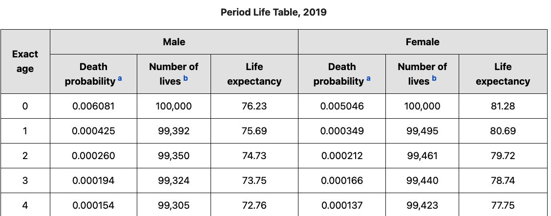

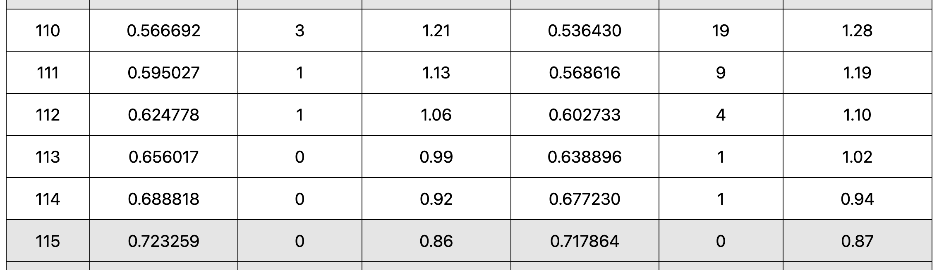
Data Preprocessing
2) Estimate Missing Death
Problem
There are a few data with death value (494 / 8,877)
Death values are skewed (0 - 14 years vs 0 - 110 years)
…..
Solution
Use age at CT and period life table to estimate death value of alive data
https://www.ssa.gov/oact/STATS/table4c6.html
Notes:
The second data preprocessing is estimation of missing death.
There were a few data with death values.
Also, the range of death values didn't include many possible values.
To improve modeling performance, we estimated death value of alive data using age and period life table.

Slide 5

Prediction Using CT Data
Methods to Improve Modeling Performance
: Prediction is correct if |Predicted value – True value| $≤$ 3 years
Method 1: Regression
Method 2: Regression with balanced training set
Method 3: Classification + Regression with balanced training set
Notes:
The next topic is prediction using CT data.
We consider our prediction is correct if the difference isn't bigger than 3 years.
We used 3 methods to improve modeling performance.
The first one was regression, the second one was regression with balanced training set, and the last one was classification + regression with balanced training set.

Slide 6
Prediction Using CT Data
Regression 26% → Balance training data 26% → Classification + Regression 39%
Training data: 75% of data
Test data: 25% of data
 | Only dead | Only alive | Average | Hyperparameter
Linear regression | 5.33 % | 44.53 % | 24.93 % | -
KNN regression | 1.33 % | 45.95 % | 23.64 % | neighbors=10
Neural network | 5.33 % | 46.69 % | 26.01 % | hidden_layer = (16, 16, 16) activation='relu' learning_rate_init=0.005 max_iter=5000 solver=’adam'
Test data
Model
Notes:
In the first method, we used 3 regression models, and the accuracy was low as this table.

Slide 7
Prediction Using CT Data
Regression 26% → Balance training data 26% → Classification + Regression 39%
Alive data dominates the training data (94.5%)
Accuracy is very low for dead test data (5.33%)
Training data: 75% of dead data + same number of alive data
Test data: 25% of dead data + same number of alive data
 | Only dead | Only alive | Average
Regression only (Neural network) | 5.33 % | 46.69 % | 26.01 %
+ Balanced training data (Neural network) | 32.0 % 26.67%↑ | 20.14% 26.55%↓ | 26.07 % 0.06%↑
Test data
Model
Notes:
In the first method, we found alive data dominated the training data, so the accuracy was very low for dead test data.
So we set the ratio of dead data and alive data as 1 : 1 in the training data in the second method.
As a result, the accuracy for dead data was increased as this table.

Slide 8
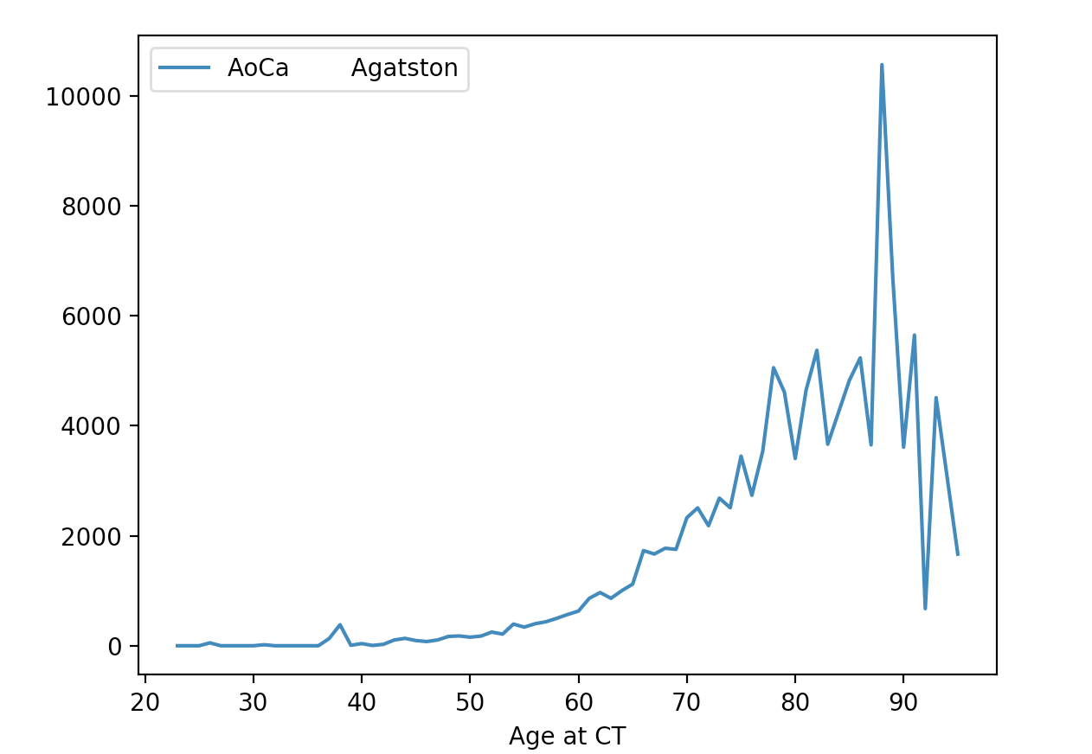
Prediction Using CT Data
There is discrepancy between CT data of old people and young people
Notes:
We also found that there was discrepancy between CT data of old people and young people as this graph.

Slide 9
Prediction Using CT Data
Regression 26% → Balance training data 26% → Classification + Regression 39%
There is discrepancy between CT data of old people and young people
Step 1: Classify data as data in old group and data in young group
Step 2: Run regression for each group
 | Only dead | Only alive | Average
Regression only (Neural network) | 5.33 % | 46.69 % | 26.01 %
+ Balanced training data (Neural network) | 32.0 % 26.67%↑ | 20.14% 26.55%↓ | 26.07 % 0.06%↑
+ Classification & Regression (Neural network) | 37.5 % 5.5%↑ | 40.51% 20.37%↑ | 39.01 % 12.94%↑
Test data
Model
Notes:
So we classified data as data in old group and dead data in young group and ran regression for each group in the third method.
As a result, the accuracy was increased as this table.

Slide 10
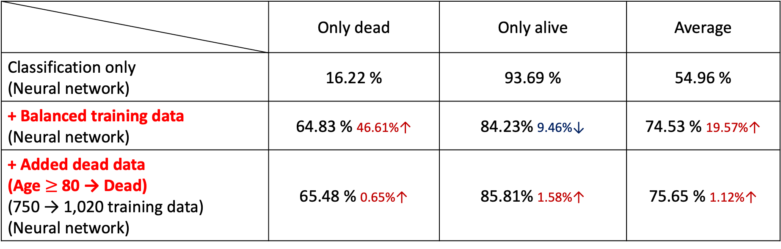
Prediction Using CT Data
Regression 26% → Balance training data 26% → Classification + Regression 39%
 | Only dead | Only alive | Average
Classification only (Neural network) | 16.22 % | 93.69 % | 54.96 %
+ Balanced training data (Neural network) | 64.83 % 46.61%↑ | 84.23% 9.46%↓ | 74.53 % 19.57%↑
+ Added dead data (Age $≥$ 80 → Dead) (750 → 1,020 training data) (Neural network) | 65.48 % 0.65%↑ | 85.81% 1.58%↑ | 75.65 % 1.12%↑
Test data
Model
Notes:
Using these approaches also increased the accuracy of classification as this table.

Slide 11
Prediction Using CT Data & Clinical Data
Regression 26% → Balance training data 26% → Classification + Regression 39%
→ Use CT data and clinical data 72%
Accuracy for dead data: Increased by 9 – 28%
Accuracy for alive data: Increased by 14 – 50%
Accuracy: Increased by 11 – 33%
Final accuracy is 72%
Notes:
Now, let's see how prediction was improved when we also used clinical data.
The above charts are ones comparing the accuracy of two predictions, and the below box shows the increase between two predictions.
As a result of adding clinical data, the accuracy was highly improved.

Slide 12

Biological Age
1) Definition
$Biological age=Age+Average life expectancy of age at CT−\frac{Death}{365}$
The biological age of a person with average healthy age ‘X’’s CT data is ‘X’
Exclude people who will die in 3 years
Age | L1 HU BMD | SAT | VAT | MUSCLE | …….
65 | 100 | 1 | 1 | 100
65 | 200 | 2 | 1 | 120
65 | 100 | 1 | 1 | 120
65 | 200 | 2 | 1 | 100
AVG(65) | 150 | 1.5 | 1 | 110
Person with CT(150,1.5,1,110) → Biological age 65
Notes:
The final topic is biological age.
This is the definition of our biological age.
We thought that the biological age of a person with average healthy CT data is same as age as this example.

Slide 13

Biological Age
2) First Verification
$X=Biological age−Age$
$\frac{Death}{365}=Life expectancy$
$X=Average life expectancy of age at CT−Life expectancy$
$𝔼\left[X\right]=0$
$\overline{X}\underset{→}{d}N\left(0, \frac{σ^{2}}{n}\right)$
$H_{0}: \hat{\overline{X}}\sim N\left(μ, \frac{σ^{2}}{n}\right), μ=0, H_{1}: \hat{\overline{X}}\sim N\left(μ, \frac{σ^{2}}{n}\right), μ≠0, {\left(\frac{\sqrt{n}\hat{\overline{X}}}{σ}\right)}^{2}≷_{H_{0}}^{H_{1}}Φ_{χ}^{−1}(0.05)$
$n=8,877, \hat{\overline{X}}=57.41 −56.91=0.5,\left(\frac{\sqrt{n}\hat{\overline{X}}}{σ}\right)≤Φ_{χ}^{−1}\left(0.05\right)$ if $σ≥24.04$
Biological age is fairly valid
Notes:
We first verify our biological age based on the definition.
X is biological age - age, sigma is the standard deviation of X, and by using hypothesis test, we found our biological age is valid for this sigma.
This sigma is slightly high, but not really high, so we concluded that our biological age is fairly valid.

Slide 14

Biological Age
3) Second Verification
Develop model to predict biological age
Training data: All given data
Test data: Average healthy age ‘X’’s CT Data
Prediction is correct if |Predicted value – ’X’| $≤$ 3 years
 | KNN regression | Neural network | Gaussian naive Bayes
Regression only | 27.27 % | 25.45 % | 50.91 %
+ Classification & Regression | 30.91 % 3.64%↑ | 29.09% 3.64%↑ | 63.64 % 12.73%↑
→ Biological age is fairly valid
Notes:
Then, we verify our biological age based on our thought.
We developed model to predict biological age using the same methodology with the test set consisting of average CT data.
The accuracy of the model was fairly high, so we concluded biological age is fairly valid.

Slide 15
Thank you
CS 760 Final Project
Notes:
That 's all of our talk.
Thank you for listening to our talk.

