Slide 1
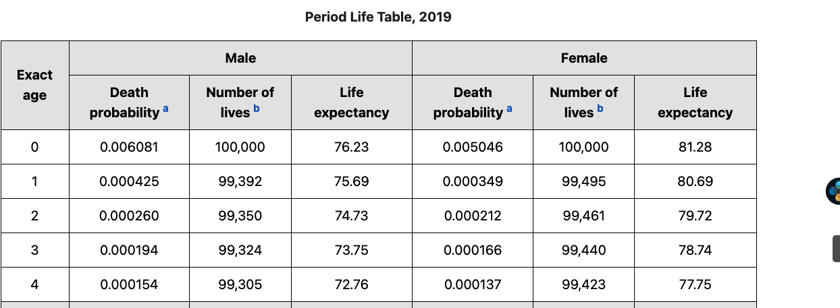
Project Direction
- Definition
Biological age X = Someone has an average ‘X’ age people’s CT data.
- modeling
X= CT data
Y= death from CT
( We assume that someone died after 200 days after CT is more reliable than “age at CT”)
Data augments :
There is few people who died + not evenly distributed( Remain life can be 100yrs ~ 0yrs)
We are calculating Y by “Age at CT” by using this table
Model verification
There are two types of Y, 1) Exists one, 2) Augments one
Can we use both of type data for verification(Model accuracy??)
Modeling process
1) Classification
: Some who will going to dead in 3yrs or not
2) Classification
: Guess group(0~35yr, 35~45, 45~55, 55~65, 65~75)
3) Regression
: Run regression inside the group
https://www.ssa.gov/oact/STATS/table4c6.html

