Slide 1
2025 BUSINESS INSIGHTS CASE STUDY
Intuit Dome Arena
Store Analysis
A defensible view of revenue mix, transaction economics, and demand timing
$1.156M
31,346
3
NET SALES
TRANSACTIONS
PLAYOFF GAMES
Oluwaseyi Caleb Folorunso
Notes:
Scope: three Clippers home playoff games against Denver on Apr 24, Apr 26, and May 1, 2025. Source: LA Clippers 2025 Business Insights Challenge workbook supplied for analysis.

Slide 2
INTUIT DOME / ARENA-STORE ANALYSIS
Four facts replace four vague claims
$1.156M
62.8%
NET SALES
FOOD & BEVERAGE SHARE
31,346 transactions from 16,835 purchasing accounts.
Food & beverage was 1.69× retail—or 69.1% higher.
3 of 3
0
REVENUE PEAK
MATCHING ENTRY IDS
The final hour before scheduled tipoff led every game.
Individual entry-to-purchase conversion is not identifiable.
Descriptive window: Games 3, 4, and 6 of one playoff series
Source: 2025 Clippers Business Insights challenge dataset; author analysis.
2
Notes:
All values are calculated from the aggregate tables in data/processed. Net sales are not profit; the workbook contains no cost or margin fields.

Slide 3
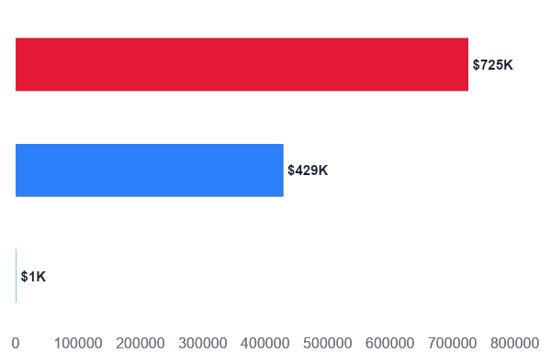
INTUIT DOME / ARENA-STORE ANALYSIS
Food & beverage is the scale engine
$725K
Food & beverage
FOOD & BEVERAGE
1.69×
Retail
versus retail sales
99.1%
Service items
F&B share inside mixed-format stores
Correct framing: 69.1% higher—not 1.7% better.
Source: 2025 Clippers Business Insights challenge dataset; author analysis.
3
Notes:
Source: business_vertical_summary.csv and mixed_store_vertical_summary.csv, built from the supplied challenge workbook. Definitions: net sales is the sum of NetAmount; shares are across all three games.

Slide 4
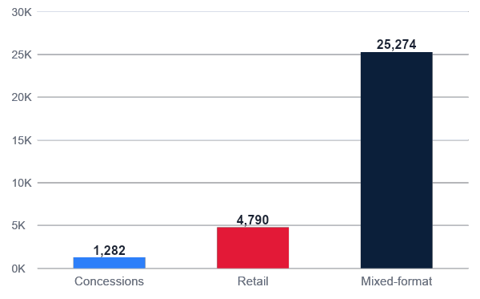
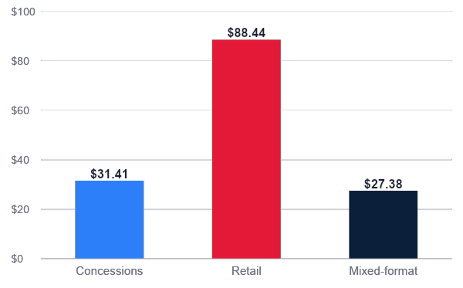
INTUIT DOME / ARENA-STORE ANALYSIS
Mixed stores win volume; retail wins ticket
TRANSACTION VOLUME
AVERAGE TRANSACTION VALUE
OPERATING IMPLICATION
Run distinct tests: throughput at mixed stores; attach at retail.
ATV is calculated after aggregating all line items to one transaction.
Source: 2025 Clippers Business Insights challenge dataset; author analysis.
4
Notes:
Source: store_type_summary.csv. Average transaction value is net sales divided by unique transactions within each store type; it is not the mean line-item amount.

Slide 5
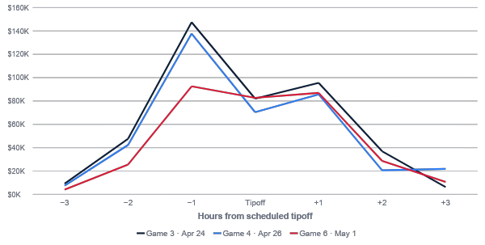
INTUIT DOME / ARENA-STORE ANALYSIS
Normalize to tipoff: hour −1 is the revenue peak
HOUR −1 SHARE
34.0%
Game 3
35.6%
Game 4
27.6%
Game 6
Peak revenue, not necessarily peak transaction count.
Displayed window contains 98.8% of sales.
Source: transaction timestamps; scheduled tipoffs and official game books in speaker notes.
5
Notes:
Scheduled tipoffs used: Apr 24 7:00 PM local, Apr 26 3:00 PM local, May 1 7:00 PM local. Official game durations: Apr 24 2:19 (https://statsdmz.nba.com/pdfs/20250424/20250424_DENLAC.pdf); Apr 26 2:30 (https://statsdmz.nba.com/pdfs/20250426/20250426_DENLAC.pdf); May 1 2:13 (https://statsdmz.nba.com/pdfs/20250501/20250501_DENLAC.pdf). Source data: game_hour_summary.csv.

Slide 6
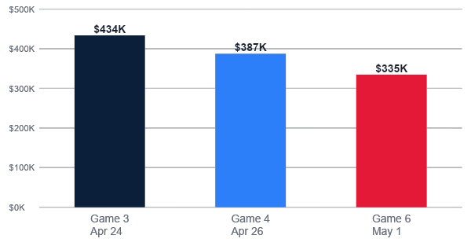
INTUIT DOME / ARENA-STORE ANALYSIS
Game 6 net sales finished 22.8% below Game 3
DECLINE, GAME 3 → GAME 6
−22.8%
net sales
−13.7%
transactions
−10.6%
average ticket
Cause remains unobserved
323 accounts
purchased in all 3 games
1.9% of customers
13.5% of sales
Descriptive cohort signal
Source: 2025 Clippers Business Insights challenge dataset; author analysis.
6
Notes:
Source: game_summary.csv and customer_frequency_summary.csv. Declines: (Game 6 / Game 3) − 1. Customer cohorts count distinct game dates with a purchase; no causal loyalty claim is made.

Slide 7
INTUIT DOME / ARENA-STORE ANALYSIS
Conversion is not identifiable in this workbook
0 matches
×
49,223
NBAId
CustomerIDs
No person-level conversion
store-entry events
account crosswalk
Quality check | Observed | Treatment
Sales rows mapped to stores | 100% | PASS · many-to-one; dollars reconcile
Store-entry mapping | 89.7% | REVIEW · 5,088 events lack lookup rows
Duplicate-looking sales lines | 94 | REVIEW · retained; no immutable line ID
Missing / repeat identified entry events | 3,549 / 22,468 | REVIEW · rows are events, not attendees
Entry IDs found in customer map | 0 | BLOCKER · do not calculate conversion
Also blocked: EntryScans IDs have zero overlap with CustomerIDs.
Source: 2025 Clippers Business Insights challenge dataset; author analysis.
07
Notes:
Source: data_quality_summary.csv, store_entry_summary.csv, and unmatched_entry_checkpoints.csv. StoreEntries contains 20,603 unique IDs, 3,549 events with missing IDs, and 22,468 repeat identified events beyond the first per person/game. CustomerIDs has 16,747 exact duplicate rows. Arena EntryScans IDs also have zero overlap with CustomerIDs.

Slide 8
INTUIT DOME / ARENA-STORE ANALYSIS
Test, measure, then scale
01
Protect hour −1
02
Test retail attach
Pilot incremental staffing, replenishment, and queue coverage.
Randomize or phase a merchandise-plus-concessions prompt.
MEASURE Revenue/min · wait · abandonment · stockouts
MEASURE Exposure · lift · basket · margin · cannibalization
03
Diagnose the decline
04
Repair measurement
Explain the Game 3-to-Game 6 drop before choosing a remedy.
Complete checkpoint mapping and create a governed identity bridge.
MEASURE Attendance · open minutes · staffing · inventory · promo
MEASURE Match rate · consent · retention · event definition
BOUNDARY
3 games • net sales ≠ profit • no attendance, margin, inventory, queue, staffing, or exposure fields
Decision plan based on three observed games; causal lift is not yet measured.
08
Notes:
Recommendations are test designs, not claims of causal impact. Required instrumentation: experiment exposure, attendance, operating minutes, staffing, wait time, abandonment, inventory/stockouts, promotions, cost, and margin.

