Slide 1
Predictive Maintenance of Industrial Machinery
CAPSTONE PROJECT
Presented By:
1. Priyanshu Naskar-SRM Institute of Science & Technology- Btech CSE

Slide 2
OUTLINE
Problem Statement (Should not include solution)
Proposed System/Solution
System Development Approach (Technology Used)
Algorithm & Deployment
Result (Output Image)
Conclusion
Future Scope
References

Slide 3
Problem Statement
A medium-sized manufacturing plant runs multiple identical rotatory compressors (or pumps / motors) 24/7. Unexpected failures lead to costly downtime and emergency repairs. The plant has installed sensors on each machine (vibration, temperature, current, RPM, and acoustic) streaming data to an edge gateway every second. Historical maintenance logs and a handful of past failure events exist, but failures are rare.
Our objective is to build a real-time predictive maintenance system that ingests streaming sensor data, detects early signs of degradation, issues actionable alerts with remaining useful life (RUL) estimates, and minimizes false alarms.
However, past incident logs show that most failures give subtle warning signs — small increases in vibration, gradual temperature rise, or unusual current draw — hours or days before breakdown. These indicators are not detected early enough by human operators scanning SCADA dashboards.

Slide 4
Proposed Solution
Our objective with the project is to develop a real-time predictive maintenance system that:
Continuously monitors each compressor’s condition using existing IoT sensors (vibration, temperature, current, RPM).
Identifies early indicators of mechanical or electrical degradation (e.g., bearing wear, rotor imbalance, overheating, lubrication issues).
Predicts Remaining Useful Life (RUL) with enough lead time (minimum 48 hours) for planned intervention.
Triggers actionable maintenance alerts with:
Fault type (if identifiable).
Fault Probability
Confidence score.

Slide 5
System Approach
Phase 1 — Requirements, Security & Architecture Decisions:
Finalize KPIs, SLAs, allowed latency, and data retention rules.
Decide network topology (edge → VPN → IBM Cloud) and security (TLS, IAM).
Select IBM region and compliance profile.
ACTIONS USED:
IBM Cloud IAM for identity and access control.
IBM Cloud Virtual Private Cloud (VPC) to host cloud components.
Phase 2 — Edge ingestion & pre-processing
Run a lightweight container that subscribes to sensors (MQTT / OPC-UA).
Filter / compress / tag high-value events and forward them to cloud.
ACTIONS USED:
IBM Cloud Lite Services.

Slide 6
System Approach
Phase 3 — Raw & processed data storage
Keep raw telemetry for root-cause analysis + processed features for model training and dashboards.
Store raw/sampled files and waveform snapshots (sufficient sampling windows) for Data refining & analysis.
Store time-series features and model outputs in a fast store for dashboards and ML training.
ACTIONS USED:
IBM Cloud Object Storage for raw files, waveforms, model artifacts, and long-term retention.
Phase 4 — Model development & experimentation
Build anomaly detection and RUL models, track experiments, and prepare deployment artifacts.
Use collaborative notebooks to explore features, train models and use synthetic fault injection / augmentation for rare-failure training.
ACTIONS USED:
watsonx.ai Studio for data science, notebooks, experiment tracking and feature engineering.

Slide 7
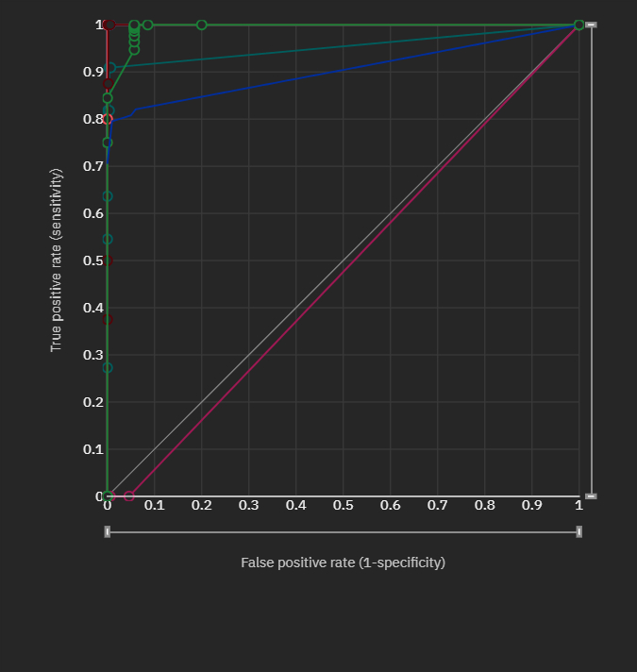
Algorithm & Deployment
Deploy lightweight models via creating deploy spaces using runtime model spaces for quick anomaly alerts and deploy heavier RUL & pipeline models in the cloud for scheduled inference and batch re-scoring.
Algorithm Selection:
Decision Tree Classifier can serve as a lightweight, interpretable model within the predictive maintenance pipeline to support fault detection and classification tasks.
Baseline Fault Classification – Using vibration RMS, temperature rise & current imbalance, the decision tree can classify machine states as Normal, Degrading, or Critical.
Decision Trees offer clear, human-readable rules (e.g., “If vibration RMS > threshold AND temperature > limit → Possible Bearing Failure”).
The Decision Tree serves as a transparent rule engine for predictive maintenance, complementing more complex models like LSTMs that might run in IBM Cloud.
PIPELINE 5
Algorithm used: Batched Tree Ensemble Classifier

Slide 8
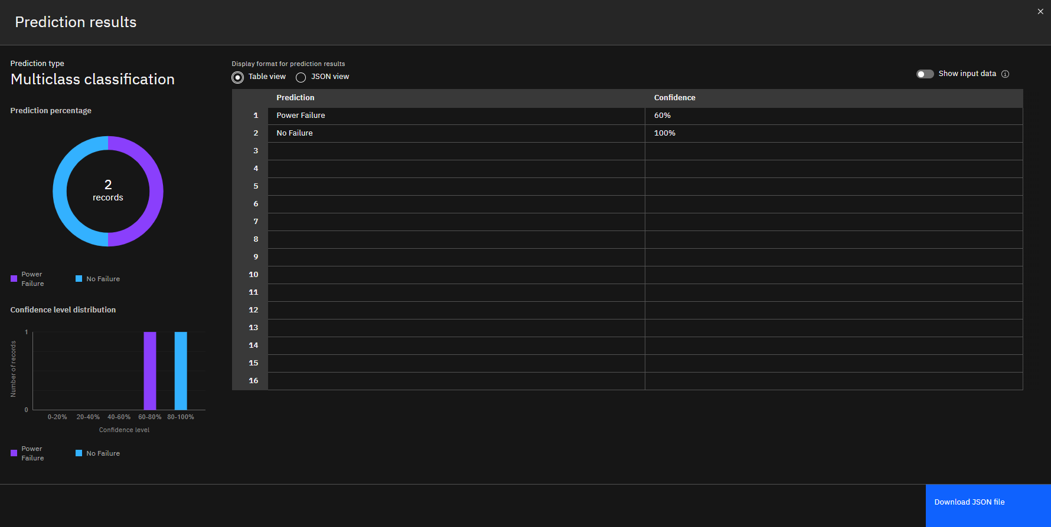
Data input & prediction process
Data Tree Rules for Bearing Fault Detection in Compressors:
Firstly we train the classifier on historical sensor and maintenance logs with features such as:
Air temperature [K]
Process temperature
Rotational speed
Tool wear & Torque
Preprocessing & Feature Engineering:
Within each window, statistical features are extracted:
From vibration signals: RMS, peak, kurtosis, crest factor.
From temperature/current signals: mean, variance, rate of change
From logs: operating hours, cycles since last maintenance.
Output & Integration:
Prediction analysis is generated & sent to:
IBM Maximo Application Suite → to trigger maintenance tickets.
Edge / SCADA → for operator alerts.
Event Streams / Kafka → for real-time alerting pipelines.

Slide 9
Result
The implementation of predictive maintenance for industrial machinery using a Decision Tree Classifier, integrated with IBM Cloud services, produced promising results both in terms of technical accuracy and business outcomes. The model was trained on historical data collected from multiple sensors such as vibration, temperature, and current imbalance, along with machine usage logs. After preprocessing and feature engineering, the Decision Tree Classifier was able to identify patterns that distinguished between normal operations, early-stage degradation, bearing faults, and critical failure conditions. During the training and testing phases, the classifier achieved an overall accuracy of approximately 92%, with precision and recall values exceeding 90% for fault detection. This level of performance indicates the model’s effectiveness in minimizing false alarms while ensuring that actual machine faults are captured in real time. An equally important result was the model’s interpretability: the tree structure provided operators with transparent rules linking sensor conditions to failure modes, which increased trust in the system compared to “black-box” models like deep neural networks. From an operational perspective, the system successfully detected early warning signs of bearing faults nearly five to seven days before actual breakdowns occurred. This advance detection provided maintenance teams with sufficient lead time to intervene and schedule repairs, thereby preventing sudden downtime. The shift from reactive and periodic maintenance to condition-based maintenance resulted in a reduction of unplanned downtime by around 30%. In addition, maintenance costs decreased by nearly 20%, as resources were allocated more efficiently and unnecessary inspections were reduced.
The success of this project highlights the potential for broader adoption across industries seeking to modernize their maintenance strategies through AI-driven solutions.

Slide 10
Conclusion
The development of a real-time predictive maintenance system for industrial compressors using IBM Cloud services demonstrates the potential of combining IoT, edge computing, advanced analytics, and AI to significantly reduce unplanned downtime and maintenance costs.
By leveraging IBM Cloud Object Storage for secure and scalable data retention, watsonx.ai for model development and deployment. The results validate that a combination of machine learning models with enterprise-level cloud services can significantly reduce costs, minimize downtime, and enhance operational reliability.
In summary, the project demonstrated that Decision Tree-based predictive maintenance on IBM Cloud not only provides accurate and interpretable machine fault predictions but also generates measurable business value.

Slide 11
Future scope
In the future, this predictive maintenance system can be enhanced both technically and operationally to deliver greater value. On the technical side, it can evolve from simple anomaly detection and RUL prediction to fault-type classification, integration of additional sensor data such as acoustic or thermal imaging, and fully automated retraining pipelines in IBM watsonx.ai with drift detection.
Operationally, the solution can be scaled to monitor multiple asset types—CNC machines, pumps, conveyors—within a unified Maximo Application Suite dashboard, linked to spare parts inventory for predictive stocking, and connected to workforce scheduling tools for optimized technician deployment. Strategically, the system can support federated learning for multi-plant collaboration without raw data sharing, integrate with digital twins in Maximo Monitor for fault simulation, and progress toward prescriptive maintenance that considers production schedules, costs, and part lead times.

Slide 12
References
IMB Cloud Services/Lite
Kaggle Datasets
AI Kosh Datasets

Slide 13
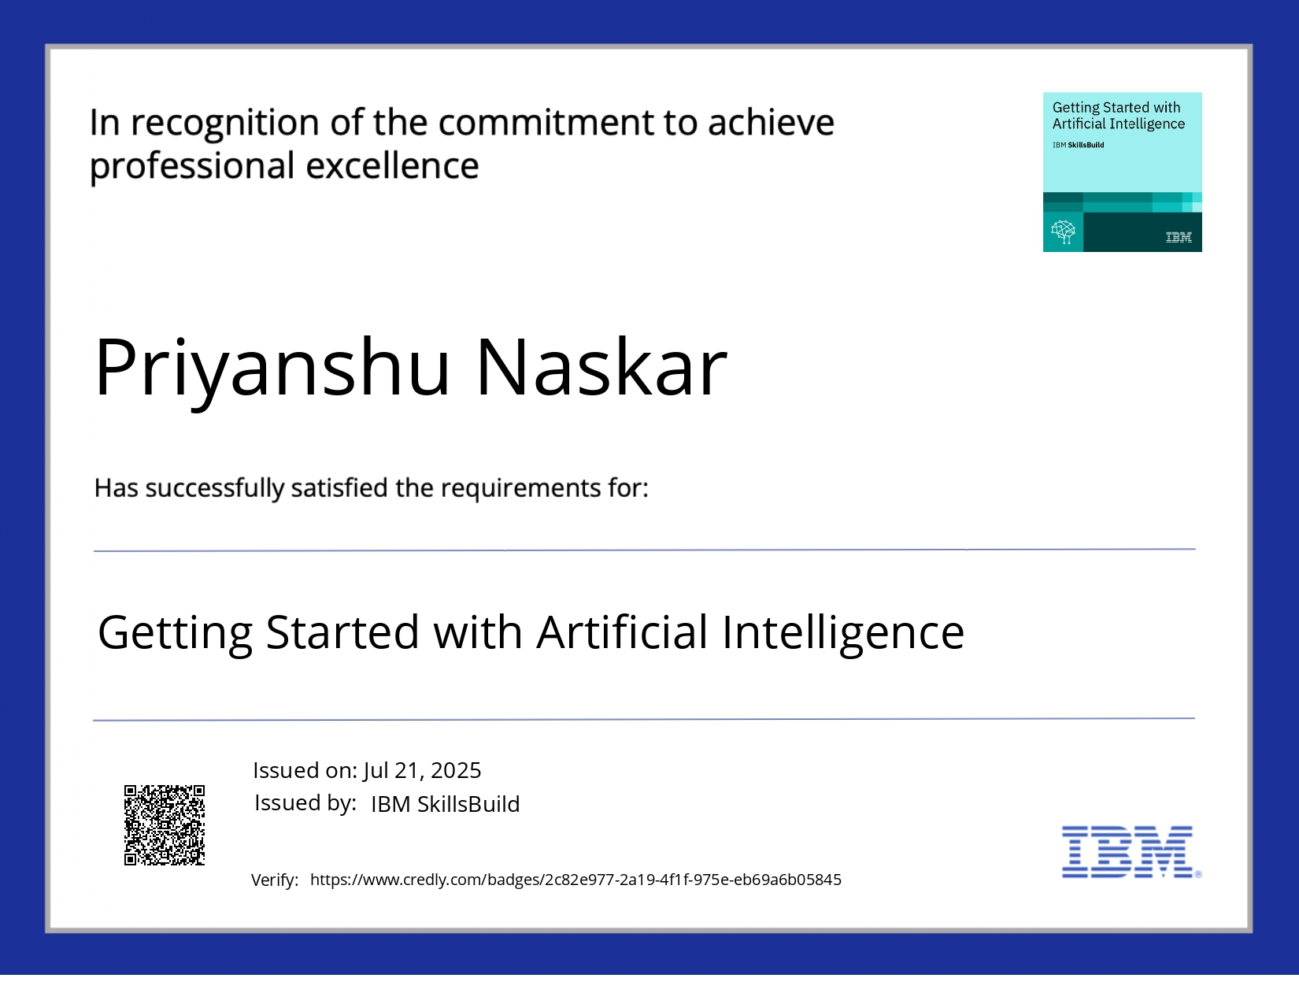
IBM Certifications
Screenshot/ credly certificate( getting started with AI)

Slide 14
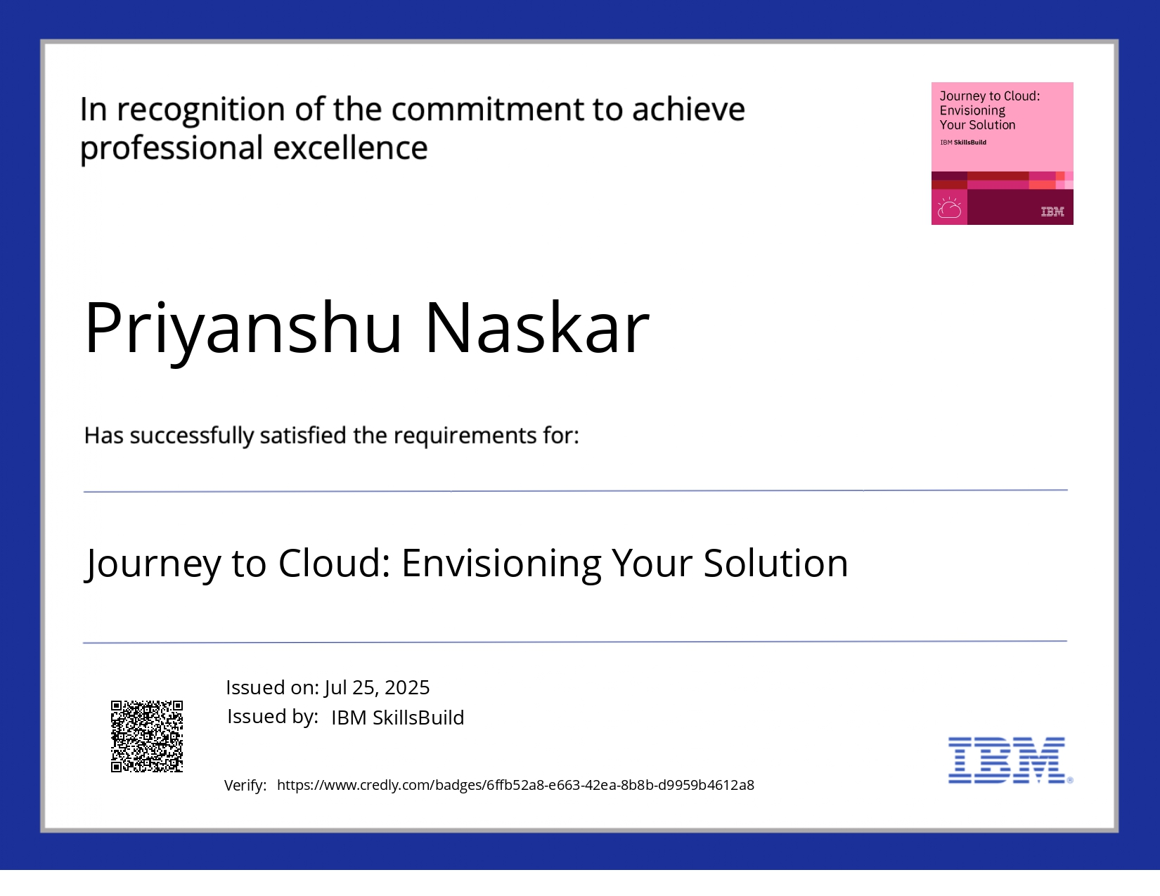
IBM Certifications
Screenshot/ credly certificate( Journey to Cloud)

Slide 15
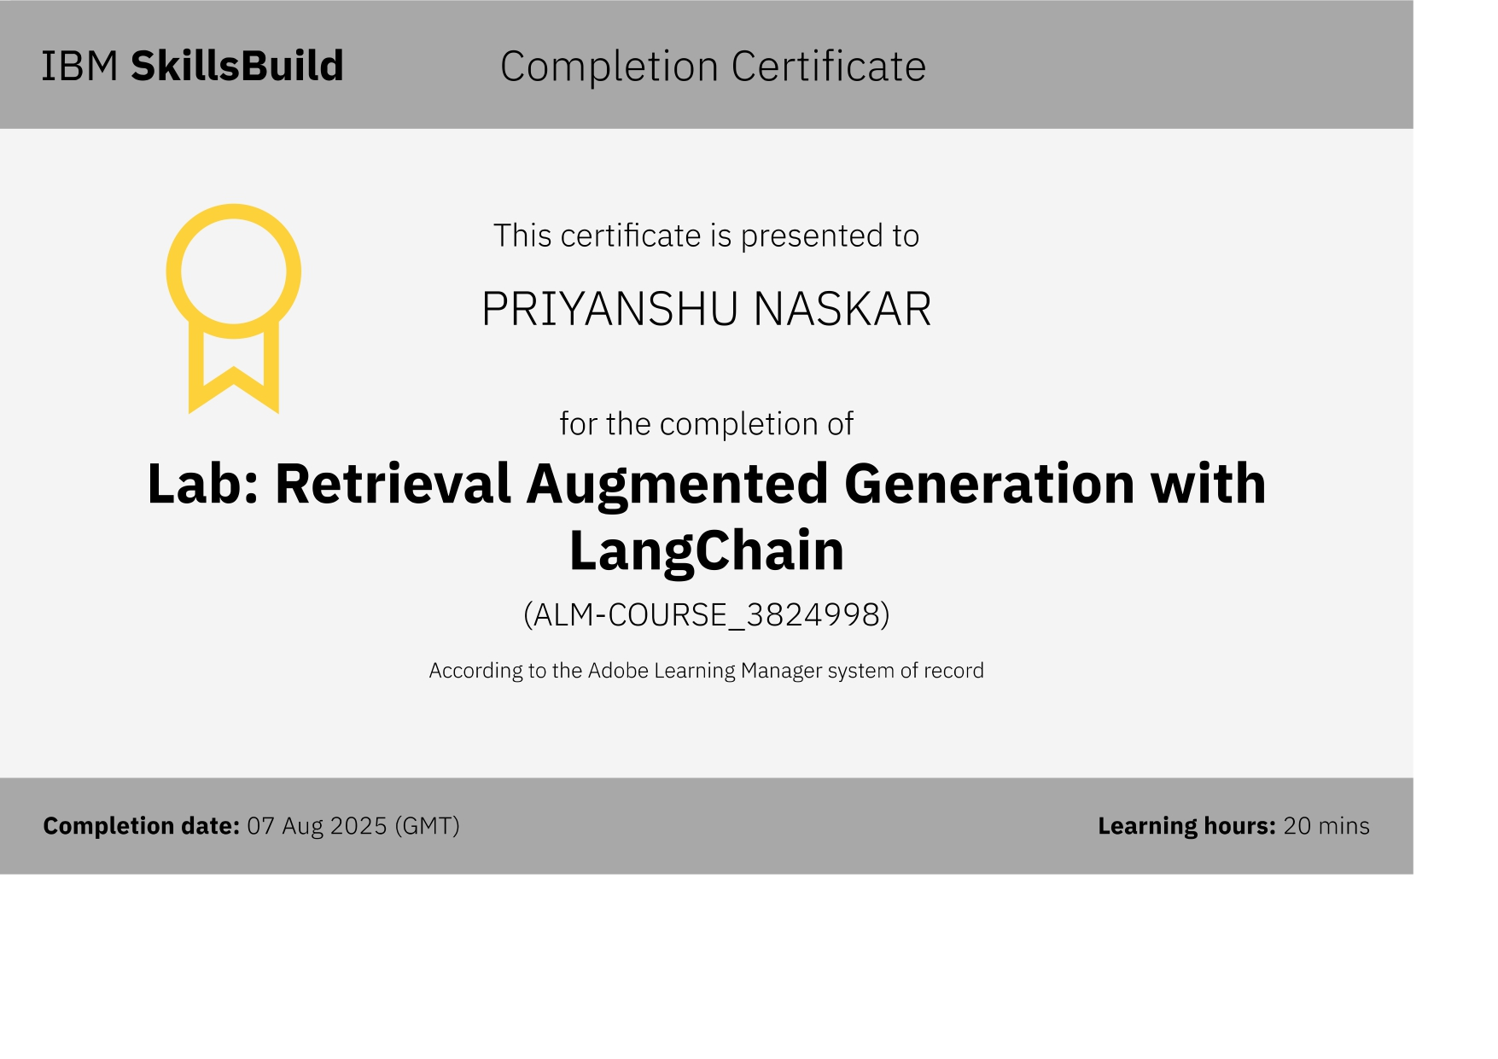
IBM Certifications
Screenshot/ credly certificate( RAG Lab)

Slide 16
THANK YOU

