Slide 1


Rentify Pro
Renting Made Simple ( See How Simple It Is )

Slide 2

PROBLEM STATEMENT
No Centralised marketplace
Scattered across multiple platforms
Fragmented Rental Market
Trust Building Time Consuming
Existing platforms too niche or not user friendly

Slide 3

PAIN POINTS
Renters
Owners
Lack of Availability: Difficulty finding a wide range of rental options for different items in one place.
Untrustworthy Listings: Limited trust and transparency in listings.
Complicated Renting Process: Lack of standardized procedures for renting items, leading to confusion over pricing, contracts, and availability.
Inconsistent Customer Support: Slow or unreliable customer service, especially with item-related issues.
Managing Multiple Platforms: Owners struggle to list and manage items across various rental sites.
Trust Issues: Fear of renting out valuable equipment or vehicles without a reliable system for verification.
Late Payments and Lack of Security: Difficulty in tracking payments and ensuring that renters return items in good condition.

Slide 4


Solution Overview
Renters
1
One Stop Marketplace
Search for everything from cameras to vehicles, event equipment, and even furniture, all in one place.
2
Verified Listings
Each rental listing is vetted to ensure quality, reliability, and transparency.
3
Smart Search Filters
Users can easily filter by type, location, price, and availability.
4
Instant Booking
Renters can instantly book items with transparent pricing and clear rental terms.

Slide 5

Solution Overview
Owners
1
Unified Asset Hub
A centralized dashboard for listing, monitoring, and managing all rental items in real time.
2
Robust Security & Insurance
Comprehensive verification, risk mitigation, and insurance options to protect valuable assets.
3
Automated Revenue Management
Streamlined payment processing, transparent invoicing, and real-time financial tracking.
4
Dedicated Owner Support
Personalized assistance and dispute resolution to ensure a smooth rental experience for owners.

Slide 6

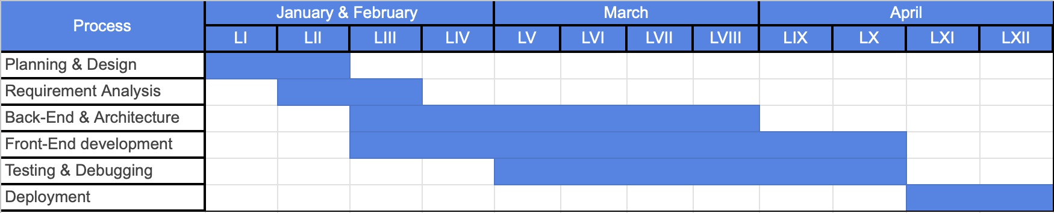
TIMELINE

Slide 7
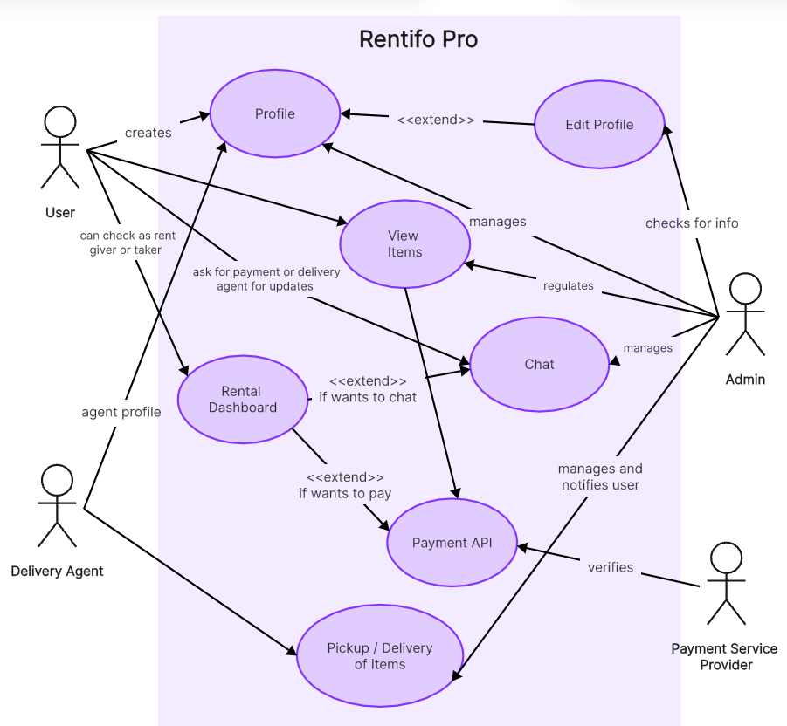

Use Case Diagram

Slide 8

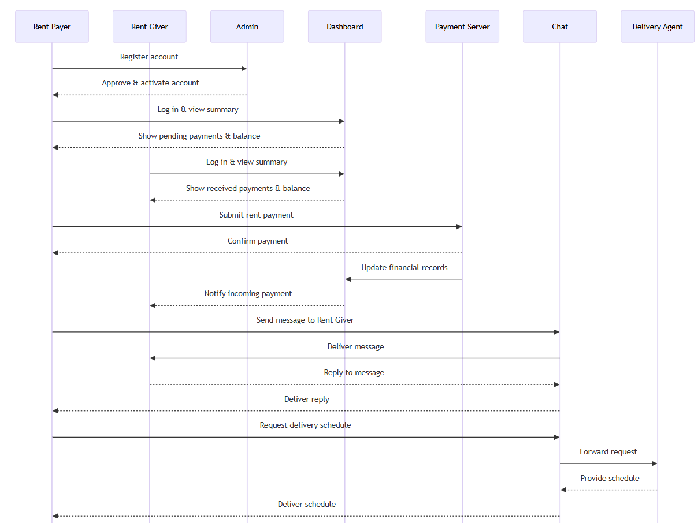
Sequence Diagram

Slide 9

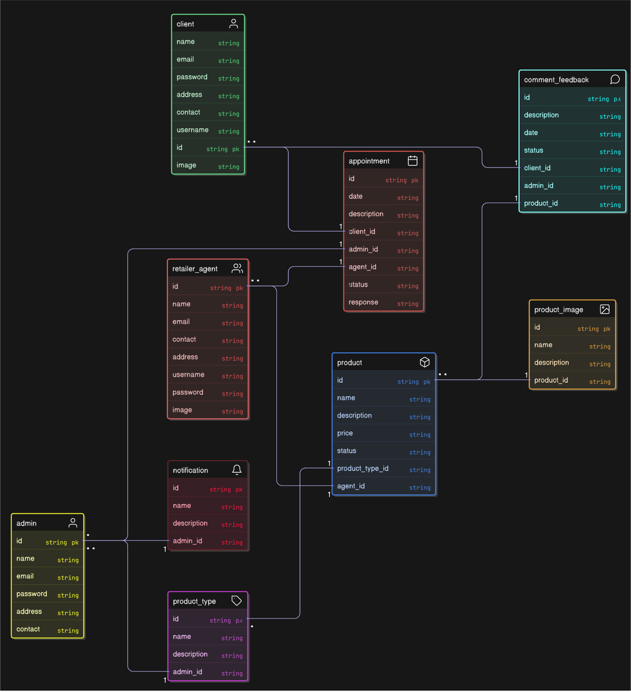
ER Diagram

Slide 10

Conclusion
Verified and secure transactions
Community expansion
Streamlined process
Future Directions
Advanced Technologies
( AI-driven recommendations and dynamic pricing )
Unified
Diverse
Listings

Slide 11

THANK YOU
Made By :
Moksh Yadav Priyanshu Kumar Robin Idicula Varughese
(221210071) (221210083) (221210090)

