Slide 1
Faster Content Distribution with Content Addressable NDN Repository
https://github.com/yoursunny/carepo
Junxiao Shi

Slide 2
Background: Named Data Networking
Today’s Internet is primarily used for content distribution
Named Data Networking (NDN), an emerging future Internet architecture, makes Data the first class entity
NDN has a receiver-driven communication model
Consumer sends Interest packet (request)
Producer replies Data packet (response)
Interest
Interest
Interest
Data
Data
Data

Slide 3
NDN universal caching
Router opportunistically caches Data packets
Cached Data packets are used to satisfy future Interests with the same Name
Data packet crosses each link only once
Every Data packet carries a signature
so it could be verified regardless of whether it’s from producer or from a cache
Interest
Data from cache

Slide 4
Caching relies on naming
cached: Linux Mint 15 MATE 64-bit DVD, segment 0
request 1: Linux Mint 15 MATE 64-bit DVD, segment 0
OK, satisfy from cache
request 2: Linux Mint Olivia MATE 64-bit DVD, segment 0
Router does not know they are the same
codename of Linux Mint 15

Slide 5
Problem: same payload under different Names
numeric version vs codename
slightly updated file: different version marker, most chunks unchanged
tape archive (TAR) vs individual files
web content: HTML / XML / plain text

Slide 6
Scenario
People in a local area network download files from a remote repository
Identical payload appears in those files under different Names
We want to identify identical payload in Data packets
in order to shorten download completion time, and save bandwidth

Slide 7
Solution
Producer
publish file chunks as Data packets
publish a hash list
Repository
index Data packets by Name
index Data packets by payload hash
Consumer
fetch the hash list, and search local and nearby repositories for Data packets with same payload
download unfulfilled segments from remote repository

Slide 8
server
Internet
local area network
request hash list
client
hash list
0: 4004 octets, hash1
1: 2100 octets, hash2
2: 4200 octets, hash3
3: 2100 octets, hash2
receive hash list
need 3 unique chunks
0: 4004 octets, hash1
1,3: 2100 octets, hash2
2: 4200 octets, hash3
SHA256 hash collision is unlikely.
If two Data packets have the same payload hash, we assume they have identical payload.
hash1?
hash request(s)
hash2?
hash index
hash1 hash3
hash3?
name request(s)
segment 1?
0
1
2
3

Slide 9
Hash request & Name request
Hash request
Name request
/%C1.R.SHA256/hash
neighbor scope (1-hop), multicast to local area network
concurrency: 30
timeout: 500ms
no retry, send Name request after timeout
/repo/filename/version/segment
global scope, forward toward remote repository
concurrency: 10
timeout: 4000ms
retry twice

Slide 10
Chunking
We want to maximize number of identical chunks
Fixed chunking is not resistant to insertions
A | R | I | Z | O | N | A | . | E | D | U
9FB3313F |  |  |  | C1ED0864 |  |  |  | CC868CDF
C | S | . | A | R | I | Z | O | N | A | . | E | D | U
B8858AB9 |  |  |  | 17229319 |  |  |  | 9163767A |  |  |  | 363F6587
NO DUPLICATE CHUNK
This illustration shows the first 32 bits of MD5 hash. carepo uses stronger SHA256 hash.

Slide 11
Rabin fingerprint chunking
This is a simplification.
The actual Rabin fingerprint chunking calculates a rolling hash for every 31-octet window, and claims a boundary when the hash ends with several zeros.
Rabin fingerprint chunking selects chunk boundary according to content, not offset
Let’s claim end of chunk on every period
A | R | I | Z | O | N | A | . | E | D | U
D9318D04 |  |  |  |  |  |  |  | CC868CDF
C | S | . | A | R | I | Z | O | N | A | . | E | D | U
3B630D26 |  |  | D9318D04 |  |  |  |  |  |  |  | CC868CDF
2 DUPLICATE CHUNKS
This illustration shows the first 32 bits of MD5 hash. carepo uses stronger SHA256 hash.

Slide 12
Chunk size is not arbitrary in network
Chunks are enclosed in Data packets
packet too large: inefficient or infeasible to transmit
packet too small: higher overhead in network
Rabin configuration
average chunk size: 4096 octets
min/max chunk size: [1024,8192] octets

Slide 13
Trust model
In NDN, every Data packet must carry a signature
Publisher only needs to RSA-sign the hash list
Chunks don’t need strong signatures, because they can be verified by hash
signed
hash verified
hash list
0: 4004 octets, hash1
1: 2100 octets, hash2
2: 4200 octets, hash3
3: 2100 octets, hash2
hash verified
hash verified

Slide 14
Implementation
https://github.com/yoursunny/carepo

Slide 15
Implementation
Platform: Ubuntu 12.04, NDNx 0.2
Language: C99
License: BSD
https://github.com/yoursunny/carepo

Slide 16
Programs
caput: publisher
car: repository with hash index
a modified version of ndnr
caget: downloader

Slide 17
Workload Analysis

Slide 18
CCNx source code
CCNx releases at http://www.ccnx.org/releases/
29 versions from 0.1.0 to 0.8.1, uncompressed TAR

Slide 19
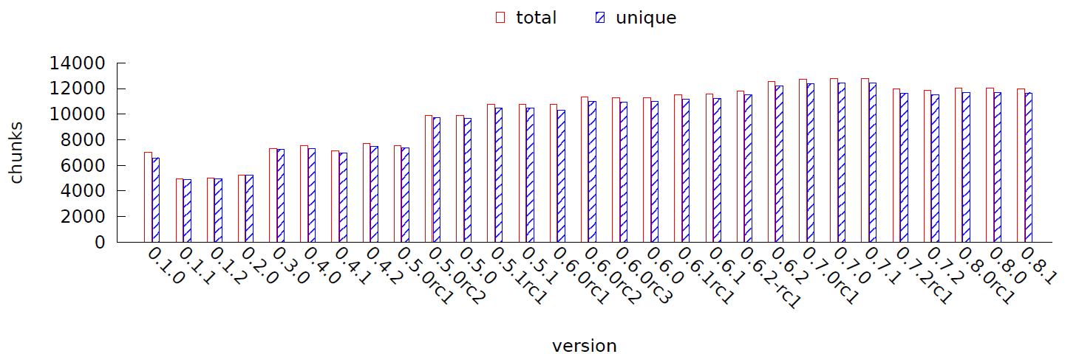
CCNx intra-file similarity
2.6% segments are duplicates within a file

Slide 20
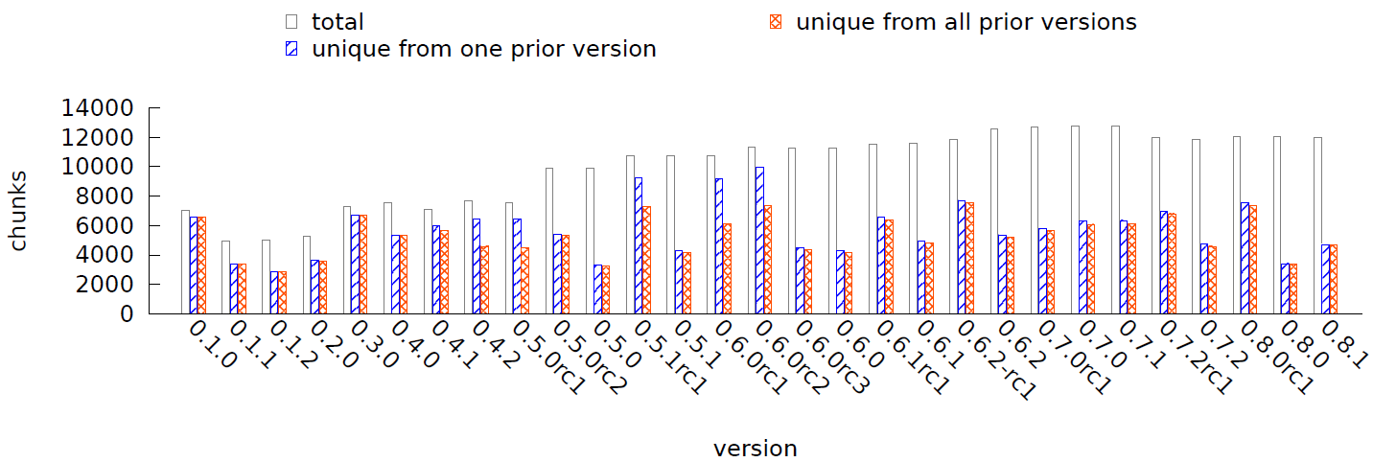
CCNx inter-file similarity
Client has ALL prior versions: need to download 55.3% chunks
Client has ONE immediate prior version: need to download 60.3% chunks
Duplicate chunk percentage varies with each version

Slide 21
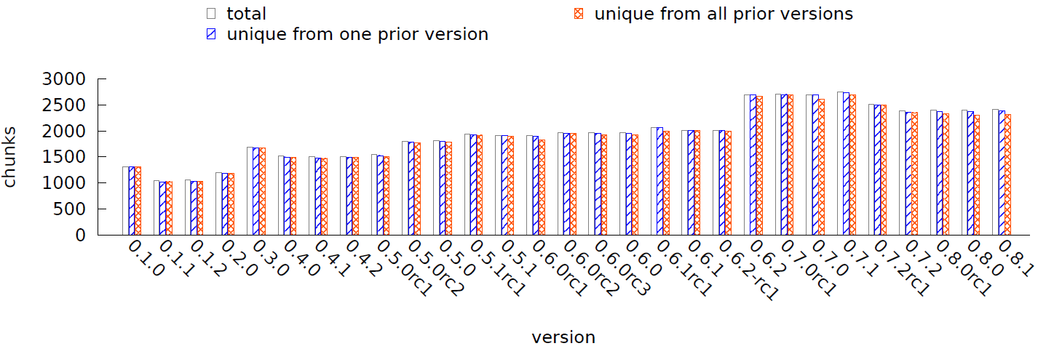
What about compressed TAR.GZ?
intra-file similarity: NONE
DEFLATE algorithm has duplicate string elimination
inter-file similar - client has ALL prior versions: need to download 98.2% chunks

Slide 22
Linux Mint ‘Olivia’
 | MATE 64-bit | MATE no-codecs 64-bit
filename | linuxmint-15-mate-dvd-64bit.iso | linuxmint-15-mate-dvd-nocodecs-64bit.iso
size | 1000MB | 981MB
media | DVD | DVD
package base | Ubuntu Raring | Ubuntu Raring
desktop | MATE | MATE
video playback | included | not included

Slide 23
Linux Mint analysis
 |  | MATE 64-bit | MATE no-codecs 64-bit
number of chunks |  | 238436 | 233852
chunk size | average | 4398 | 4399
 | standard deviation | 2460 | 2460
intra-file unique chunks |  | 235509 | 231270
inter-file unique chunks |  | 254276
If a client already has MATE 64-bit locally, only 18767 chunks need to be downloaded in order to construct MATE no-codecs 64-bit.

Slide 24
Performance Evaluation

Slide 25
Deployment on virtual machines
slow link
–2.5Mbps, 20ms delay→
←0.5Mbps, 20ms delay–
simulated by NetEm
local area network
fast links
server
gateway
clients

Slide 26
Systems under comparison
carepo
ndn
slow link
slow link
ndnd
ndnr
caput
ndnd
ndnd
ndnr
ndnputfile
ndnd
ndnd
car
caget
ndnd
ndngetfile
tftp block size = 8000 octets
tftp
slow link
tftpd-hpa
atftp

Slide 27
Download time: CCNx source code
download ccnx-0.6.0.tar onto client1
download ccnx-0.6.1.tar onto client2
download ccnx-0.6.2.tar onto client3

Slide 28
Download time: Linux Mint
download MATE 64-bit (1000MB) onto client1
download MATE no-codecs 64-bit (981MB) onto client2
total download time for two files: carepo is 38% less than ndn

Slide 29
Publishing overhead
 | carepo |  | ndn
 | caput | car | ndnputfile | ndnr
where | server and client |  | server only
chunking | Rabin |  | fixed
SHA256 | payload | payload | Data packet
RSA-sign | hash list only |  | all chunks
index |  | Name index hash index |  | Name index

Slide 30
Publishing time
overhead of Rabin chunking
benefit of omitting strong signatures
overhead of computing hash again at repo, and maintaining hash index
not a big problem
server: publish once, serve many clients
client: file is available on download completion; publish to help neighbors

Slide 31
Conclusion

Slide 32
Conclusion
NDN universal caching relies on Naming, but identical payload may appear under different Names
identify identical payload by hash
Repository maintains hash index; Producer publishes hash list; Client finds identical payload on nearby nodes by hash
Download time is reduced by 38% for two DVD images
Publishing time is increased to 3.8x

