Slide 1

Predictive Maintenance for Manufacturing Machines Using Machine Learning
Presented By : Muhammad Yousaf Maqsood
Reg# 2024-MSDS-104
Date: December 2024

Slide 2
Problem Statement
Customer Problem: Unexpected machine failures lead to unplanned downtime, decreased efficiency, and increased costs.
Goal: Develop a predictive maintenance model to classify machine failure risks based on operational data to reduce downtime and improve maintenance planning.

Slide 3
Asking the Right Questions
Key Questions:
What does "machine failure" mean in this context?
What is the operational impact of failure?
What are the business objectives (minimize downtime, extend machine life, reduce costs)?
Which sensor readings and operational data are most indicative of failure?

Slide 4
Data Source
https://archive.ics.uci.edu/dataset/601/ai4i+2020+predictive+maintenance+dataset
University of California Irvine machine learning repository

Slide 5
Data Overview
Columns:
UDI (Unique Device Identifier)
Product ID
Type (Machine Type: L, M, H)
Air Temperature, Process Temperature (in Kelvin)
Rotational Speed (rpm)
Torque (Nm)
Tool Wear (min)
Machine Failure (Target Variable)

Slide 6
Data Preprocessing & EDA
Preprocessing Steps:
Discard unnecessary columns (UDI, Product ID)
Handle missing values and categorical features (Type column)
Convert data types to appropriate formats (float for numerical features)

Slide 7
Data Preprocessing & EDA
Feature Distributions: Heatmap of correlations to understand relationships between features and target.
# Loop through each column and plot its histogram separately
for column in numerical_columns:
plt.figure(figsize=(2, 3)) # Set figure size
plt.hist(df[column], bins=30, edgecolor='black') # Plot histogram
plt.title(f'Distribution of {column}') # Set the title
plt.xlabel(column) # Set x-axis label
plt.ylabel('Frequency') # Set y-axis label
plt.show() # Display the plot

Slide 8
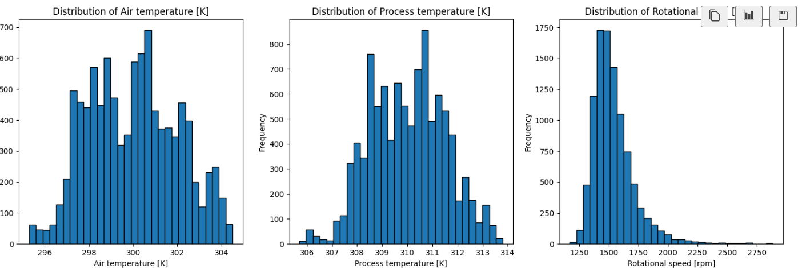
Feature Distributions

Slide 9
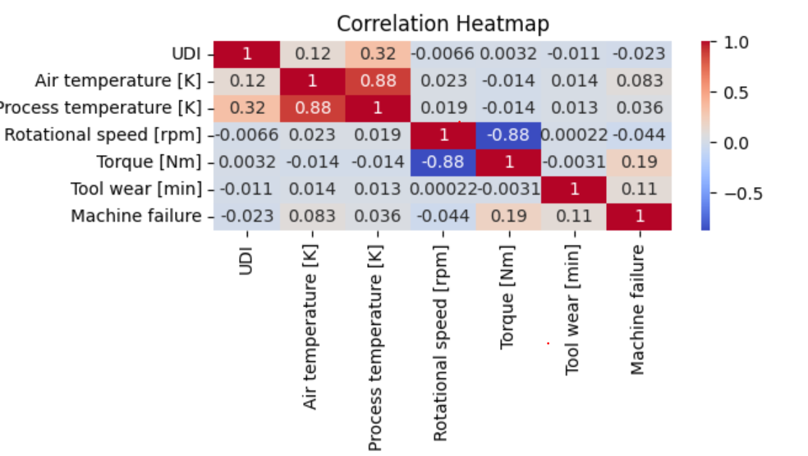
Correlation Heatmap

Slide 10
Model Training
Model Choice: RandomForestClassifier for binary classification.
Data Split: 70% for training, 30% for testing.

Slide 11
Model Training
from sklearn.model_selection import train_test_split
# Split df into features and target
X = df[['Air temperature [K]', 'Rotational speed [rpm]', 'Torque [Nm]', 'Tool wear [min]']]
y = df['IsFail']
# Split the dataset into the training and testing sets
X_train, X_test, y_train, y_test = train_test_split(X, y, test_size=0.3, random_state=42)
from sklearn.ensemble import RandomForestClassifier
# Train a Random Forest model
#model = RandomForestClassifier(n_estimators=100, random_state=42,class_weight='balanced')
model = RandomForestClassifier(n_estimators=100, random_state=42)
model.fit(X_train, y_train)
# Make predictions
y_pred = model.predict(X_test)

Slide 12
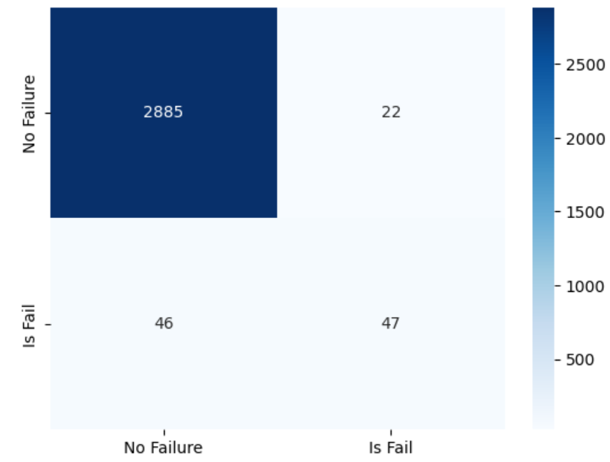
Confusion Matrix
Visualized balance between predicted and actual values.

Slide 13
Evaluation Metrics
Precision, Recall, F1-Score, ROC-AUC (important due to class imbalance).

Slide 14
Handling Imbalanced Classes
Class Imbalance: Non-failure instances dominate the dataset.
Solutions:
Class Weighting: Using class_weight='balanced' in RandomForestClassifier.
SMOTE: Applied Synthetic Minority Over-sampling Technique to generate synthetic samples for the minority class (failure).

Slide 15
Model Optimization
Hyperparameter Tuning: Adjusted Random Forest parameters (e.g., n_estimators, max_depth) to improve model performance.
Final Evaluation: Model retrained and evaluated with tuned parameters, showing improved performance.

Slide 16
Conclusion
Summary: The predictive maintenance model successfully identifies machine failures, reducing unplanned downtime, and improving maintenance efficiency.
Future Work: Implement real-time predictions and further enhance the model by incorporating additional features.

Slide 17
Thank you!

