Slide 1

Note: The data and information in this document is reflective of a hypothetical situation and client. This document is to be used for KPMG Virtual Internship purposes only.
Sprocket Central Pty Ltd
Data analytics approach
Muhammad Yousaf Saddique

Slide 2
Note: The data and information in this document is reflective of a hypothetical situation and client. This document is to be used for KPMG Virtual Internship purposes only.
Agenda
Introduction
Data Exploration
Model Development
Interpretation

Slide 3
Note: The data and information in this document is reflective of a hypothetical situation and client. This document is to be used for KPMG Virtual Internship purposes only.
Introduction
Three Steps Approach to identify our Target Customers for Marketing Campaign
The process we will be following will included Business and Data Understanding and Exploration, then using the insights from that to build a Data Model to be implemented and then test the data and build targeted results for the client to form and launch their Marketing Strategy.
Data Exploration
Interpretation
Modelling

Slide 4
Note: The data and information in this document is reflective of a hypothetical situation and client. This document is to be used for KPMG Virtual Internship purposes only.
Data Exploration
Initially, I explored all the 3 datasets, understood the characteristics of data and identified the underlying aspects that might be used to drive the desired output.
Then I cleaned the dataset for missing values and type errors, formed structured data and comprehended the joined datasets attributes. I joined the datasets based on the index/key value and created a complete larger dataset for analysis and visualization of model.
Then I finalized the datasets into one aggregated dataset to be used to form a model and draw data driven conclusions.

Slide 5
Note: The data and information in this document is reflective of a hypothetical situation and client. This document is to be used for KPMG Virtual Internship purposes only.
Model Development
I used the aggregated data set to lookup for hypothesis that can be used to provide the solution for our challenge .i.e. Which of the attributes may be mainly useful.
I created a data model based on those attributes and created calculated fields such as Age from provided date of birth and categorized the data based on Age segments.
Then I tested the performance of the model using different visual and stats.

Slide 6
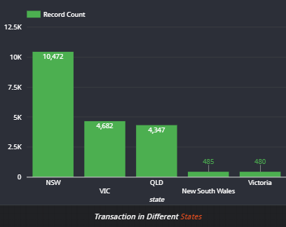
Note: The data and information in this document is reflective of a hypothetical situation and client. This document is to be used for KPMG Virtual Internship purposes only.
Interpretation
Following Insights were interpreted based on Data Model and Analysis from the datasets.
76 percent (10408 + 5262) of the Total Transactions made were by people in the Age Group of 31-65. So, the New Potential Customers to be targeted should be in this age group.
Almost 95 percent of the Total Transactions made were by people in residing in NSW, VIC and QLD. So, these states should be mainly targeted for Marketing Campaign.

Slide 7
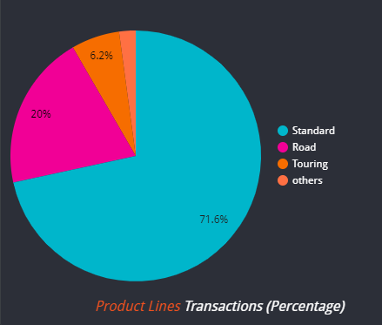
Note: The data and information in this document is reflective of a hypothetical situation and client. This document is to be used for KPMG Virtual Internship purposes only.
Interpretation
Mostly customers are Field Workers as derived by their Job Titles. So, our target should be mainly Field Workers who might use Bikes and Cycles. Moreover, knowing the Job Titles of all the Customers will help us in targeting the potential customers as many Customers have their title's unknown.
Almost 92 percent of the Total Sales were in the Product Lines Standard and Road. So, these Product Lines should be mainly marketed to Potential New Customers.
Almost 67 percent of the Total Sales were in the Product Class Medium. So, the Medium Product class should be mainly marketed to Potential New Customers.

