Slide 1
USED CARS MODEL yousef ahmed 231004873

Slide 2
Project overview
Goal: Predict prices of used cars using machine learning models
Approach: Use simple features (model year, mileage) and compare model performance
Models Used: Linear Regression, Decision Tree, Random Forest

Slide 3
Dataset description
Source: used_cars.csv
Features include: brand, model, model_year, milage, price
Target variable: price
Size: 594 kb

Slide 4
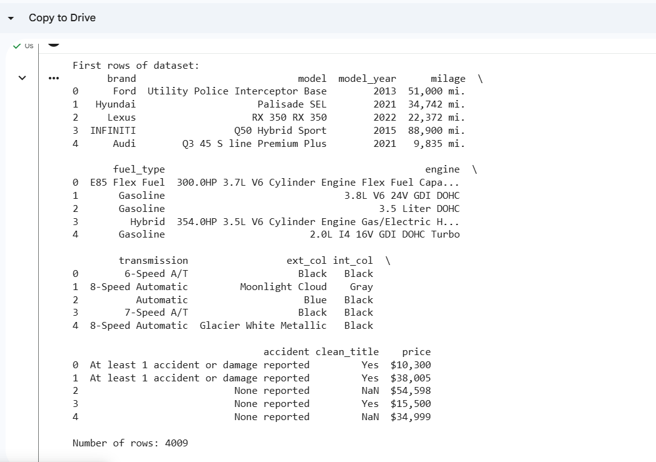
Sample rows

Slide 5
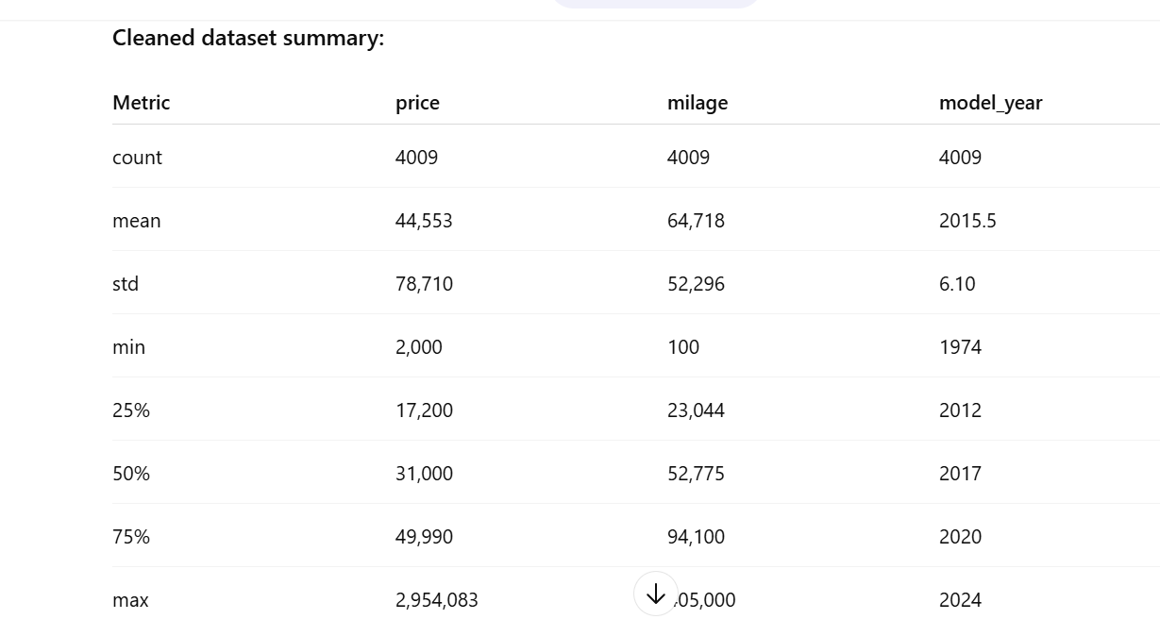
Summary statistics

Slide 6
Data preprocessing
Converted price to numeric (removed $ and commas)
Converted milage to numeric (removed commas and "mi.")
Dropped rows with missing price values
Selected features for prediction: model_year, milage

Slide 7
Ml models
Linear Regression: Simple baseline model
Decision Tree Regressor: Captures non-linear relationships
Random Forest Regressor: Ensemble method for better accuracy

Slide 8
Model Training Process
Split dataset into training and testing sets (80% train, 20% test)
Fit each model on training data (model.fit(X_train, y_train))
Predict car prices on test data

Slide 9
Evaluation Metric Used
MSE measures average squared difference between predicted and actual prices
Lower MSE → better model performance
Used sklearn.metrics.mean_squared_error for evaluation

Slide 10
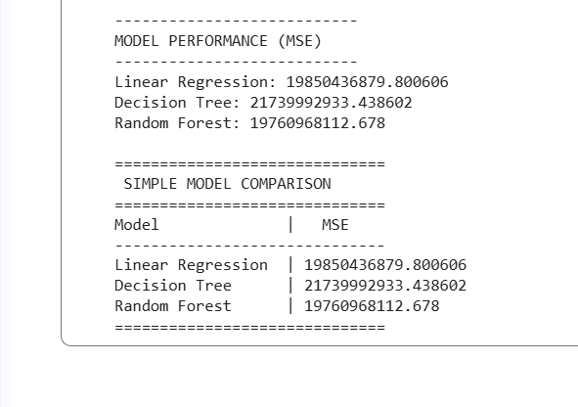
Model Comparison Table

Slide 11
Best Model & Why
Random Forest had the lowest MSE → most accurate predictions
Reason: Combines multiple trees, reduces overfitting compared to a single decision tree
Recommended for predicting used car prices

Slide 12
conclusion
Predicting car prices is feasible using simple ML models and basic features
Random Forest performed best for this dataset
Future improvements: Add more features (brand, model type, condition) for better accuracy

Slide 13
Thank you

