Slide 1



FACE EXPRESSION
PROJECT
Selected 2

Slide 2
Architecture used in paper
• Authors name
• paper name
K. Clawson & S. Delicato & C. Bowerman
Human Centric Facial Expression Recognition
• publisher name
• year of publication
Sunderland University Institutional Repository
2018
• The implemented algorithms
• The dataset used
FER-2013
convolutional neural network (CNN) modelling

Slide 3

Dataset Details
Dataset name :
FER-2013
Link :
https://www.kaggle.com/datasets/msambare/fer2013
Total number of samples :
The training set consists of 28,709 examples and
the test set consists of 7,178 examples
The dimension of image :
48X48 pixel

Slide 4
Dataset Details
Number of classes :
Number of total images :
seven classes
35,887
Labels of classes :
1. Angry
2. Disgust
3. Fear
4. Happy
5. Sad
6. Surprise
7. Neutral

Slide 5

Implementation details
Initial learning rate
0.001
0.25
Number of images in training
Regularization
28,709
Optimizer
adam
Number of images in testing
10
Batch size
7,178
70
Number of epochs

Slide 6
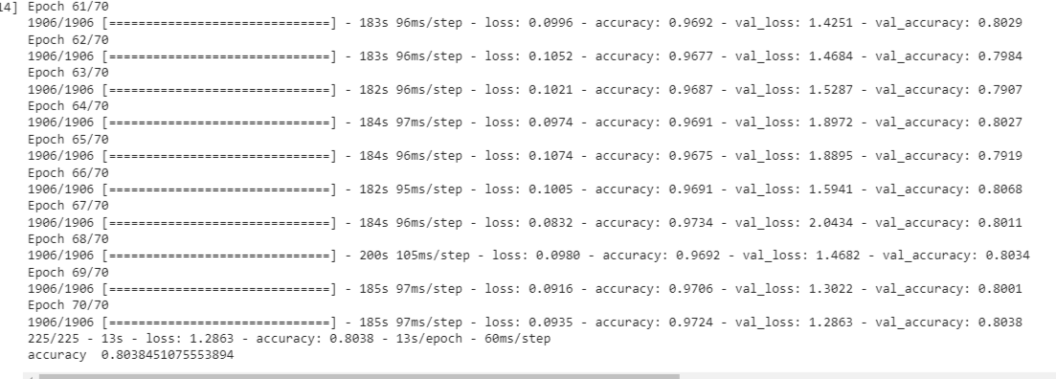
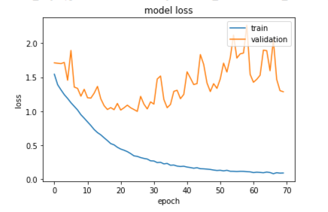
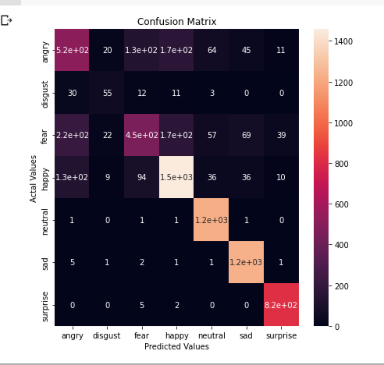
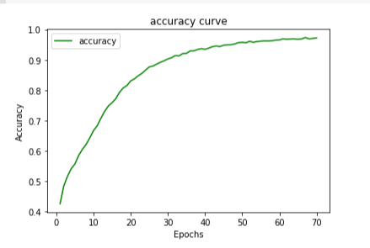
Results & Visualization

