Slide 1

Audio Signal Analysis for Emotion
A Comprehensive Voice Monitoring & Emotion Detection System
Under the supervision of: Dr. Doaa Adel | Eng. Fatma Elzahraa

Slide 2

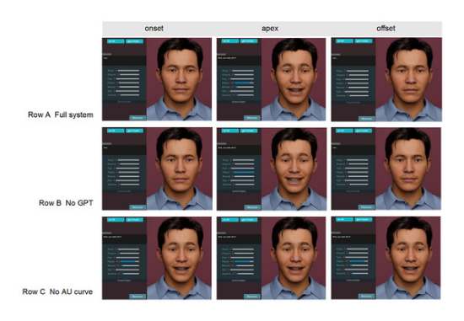
Project Overview
This project bridges Hardware and Software to analyze human voice patterns. By capturing audio peaks via Arduino and processing them in real-time with Python, the system classifies the speaker's emotional state based on sound intensity.
→
Real-time Signal Acquisition
→
Digital Signal Processing (DSP)
→
Emotion Classification Logic

Slide 3






The Challenge
Latency
Noise
Visualization
Detecting emotion in real-time requires high-speed data processing without delay.
Environmental noise can distort audio readings, requiring a baseline calculation.
Representing complex waveforms in a way that is intuitive for users.

Slide 4
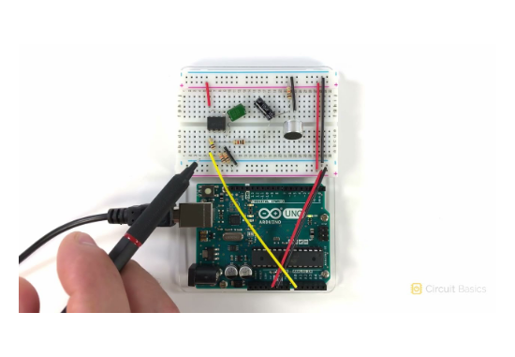
System Architecture
→
Hardware Layer: Arduino Uno + High-Sensitivity Microphone Sensor.
→
Transport Layer: Serial Communication (USB) at 9600 Baud Rate.
→
Software Layer: Python (Tkinter GUI, Matplotlib Graphics).
→
Analysis Layer: Moving Average Smoothing & Baseline Adaptation.

Slide 5


Hardware Layer
Input Mechanism
The system utilizes the Analog Input (A0) of the Arduino. The microphone captures sound pressure waves and converts them into voltage fluctuations.
→
Operating Voltage: 5V
→
Sensitivity Adjustment: Potentiometer on Mic Module
→
Sample Window: 50ms for stable signal detection

Slide 6
Signal Logic
To accurately measure sound intensity, we use the Peak-to-Peak method within the Arduino loop. This filters out DC offset and focuses on wave magnitude.
The resulting value represents the true loudness of the ambient sound, which is then transmitted via Serial.println().

Slide 7
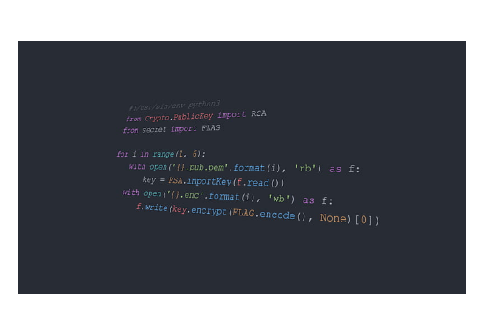
Python Environment
Libraries Used
→
PySerial: Connects Python to Arduino hardware.
→
Tkinter: Professional Dark-mode GUI development.
→
Collections (Deque): Efficient real-time data buffering.
→
NumPy: Mathematical calculations for baseline averages.

Slide 8
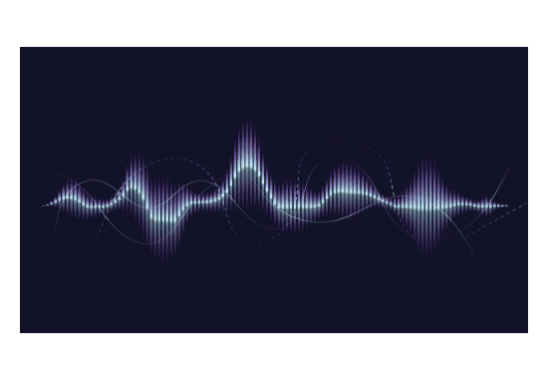
Live Visualization
Smooth Graph Engine
The UI integrates a Matplotlib figure into a Tkinter canvas. To prevent jittery lines, we implement a smoothing loop:
avg = sum(temp[start:i+1]) / len(temp[start:i+1])
This provides a professional, fluid "medical-grade" waveform display.

Slide 9



Emotion Classification
The system adaptively learns the room's noise floor (Baseline) and categorizes input based on deviation thresholds:
Calm 😌
Normal 🙂
Angry 😡
Deviation < 10 units above baseline. Indicates silence or soft speaking.
Deviation < 40 units. Represents conversational speaking levels.
Deviation > 40 units. Sharp spikes indicating shouting or high emotion.

Slide 10
Baseline Adaptation
How it learns?
The program maintains a baseline list of the first 50 readings. This allows the system to calibrate itself to different room environments before starting the analysis.
→
Dynamic Calibration
→
Buffer size: 15 points
→
Moving Average: 20ms refresh rate

Slide 11
Project Team
Name
Yousef Mohamed Elsayed
Khaled ELSAYED mohamed mohamed
Abdelrhman Saeed Tawakol
Ebrahim Abdelsalam qamh
Omar ahmed ahmed
Ahmed abdelaziz mohamed abbas

Slide 12

Thank You
We extend our deepest gratitude to our mentors for their guidance.
Dr. Doaa Adel | Eng. Fatma Elzahraa

