Slide 1
Cairo University · Faculty of Computers & Artificial Intelligence · AI Department
Driver Monitoring System
An AI-Based Real-Time Driver Safety & Distraction Detection System
Drowsiness
Yawning
Phone Usage
Smoking/Vape
Yousef Abdelaziz Mohamed · ID: 20220398 (Team Leader)
Supervisor: Prof. Asmaa · Academic Year 2025 – 2026
Notes:
Good morning/afternoon committee. My name is Yousef Abdelaziz Mohamed and I am the team leader for our graduation project — the Driver Monitoring System. Today I will walk you through our complete AI-powered solution that detects four unsafe driver behaviors in real time using nothing more than an ordinary smartphone camera.

Slide 2
The Problem
1.19M
No Detection
Ordinary vehicles have zero mechanism to detect drowsy or distracted drivers
deaths per year from
road traffic crashes
(WHO, 2023)
High Cost
Premium driver monitoring systems exist only in expensive vehicles, inaccessible to most
Delayed Alerts
By the time a lane-departure system triggers, it may already be too late to react
Notes:
The scale of the problem is enormous. The WHO reports 1.19 million deaths annually from road crashes. The majority are caused by human factors — fatigue, drowsiness, and distraction. Yet ordinary vehicles provide no mechanism to detect when a driver is falling asleep, yawning repeatedly, using a phone, or smoking. Premium solutions exist, but they require dedicated in-vehicle hardware that most drivers simply cannot afford.

Slide 3
Our Solution — Modulzy DMS
A real-time AI driver safety system running entirely from an ordinary smartphone camera — no special hardware required.
Drowsiness
Yawning
Eye Aspect Ratio (EAR)
+ MediaPipe FaceMesh
100.0% accuracy
Mouth Aspect Ratio (MAR)
+ MediaPipe FaceMesh
98.7% accuracy
Phone Usage
Smoking/Vape
YOLOv8 Classification
+ Hand-to-Ear Gesture
99.9% accuracy
YOLOv8 Detection
+ CBAM Attention Module
64.4% mAP@0.5
Notes:
Our solution is a complete driver monitoring system we call Modulzy. It detects four unsafe behaviors simultaneously. For drowsiness and yawning we use geometric algorithms — the Eye Aspect Ratio and Mouth Aspect Ratio — computed from MediaPipe facial landmarks. These run at up to 45 frames per second with no model inference needed. For phone usage we use a trained YOLOv8 classifier. For smoking and vaping we use a YOLOv8 detector enhanced with our CBAM attention contribution. The key point: all of this runs from a regular smartphone.

Slide 4
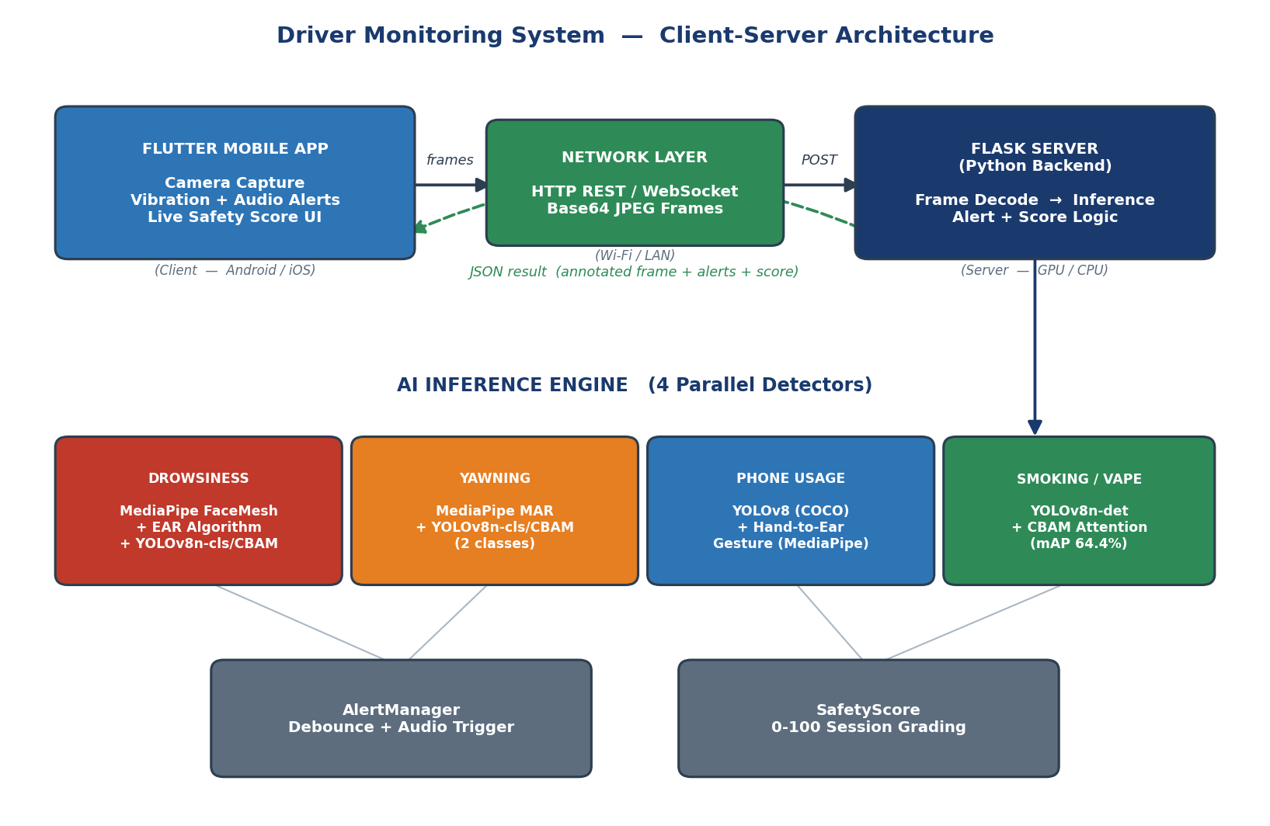
System Architecture
Notes:
The system has two front-ends sharing one AI engine. A Streamlit desktop dashboard for direct monitoring, and a Flutter mobile application that streams frames via WebSocket to a Flask Python backend. The backend runs all four detectors and returns annotated frames plus a live safety score. The phone connects over local WiFi — no internet required.

Slide 5
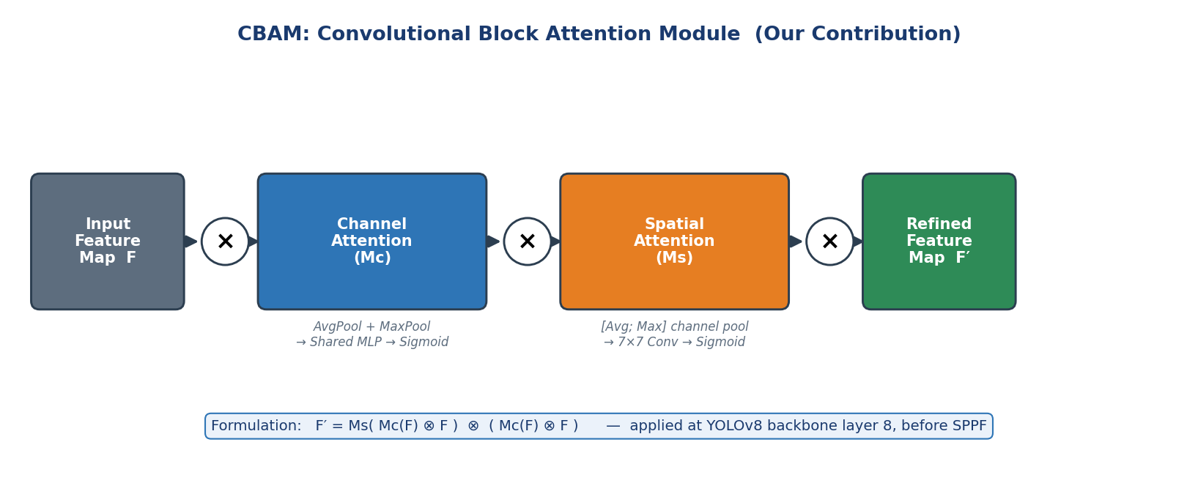
Our Technical Contribution
CBAM — Convolutional Block Attention Module (Woo et al., ECCV 2018)
Channel Attention
Spatial Attention
Insertion Point
Why It Helps
Learns WHICH feature
channels matter most
Learns WHERE in the
image to focus
Backbone layer 8,
before SPPF
Cigarettes & vapes are
tiny, easy to miss
Notes:
Our main technical contribution is integrating the CBAM attention module into the YOLOv8 backbone. It works in two stages: first channel attention asks which of the 1024 feature maps are most informative, then spatial attention asks where in the image to focus. We insert it at backbone layer 8, right before the SPPF layer. The motivation is that cigarettes and vapes are very small objects that occupy only a few pixels in the frame — CBAM helps the network attend to those critical regions.

Slide 6
Datasets & Training
Detector | Dataset | Images | Task | Platform
Drowsiness | Driver Drowsiness Eye Dataset | 1,452 | Classification | Kaggle
Yawning | Yawn / No-Yawn Face Dataset | 5,056 | Classification | Kaggle
Phone Usage | State Farm Distracted Driver Detection | 4,978 | Classification | Kaggle
Smoking/Vape | Smoking_person v3 (merged, 2 sources) | 8,013 | Detection | Roboflow
Key Challenge — Class Imbalance in Smoking Dataset:
Smoke: 5,449 instances · Person: 5,076 · Cigarette: 624 · Vape: only 54 (100:1 ratio)
→ Solved by merging two Roboflow datasets + heavy augmentation, growing training set from 5,658 to 8,013 images
Notes:
We used four public datasets, one per detector. All were balanced before training — we checked class distribution and applied random downsampling where needed. The biggest challenge was the smoking dataset: vape had only 54 training instances versus 5,449 for smoke — a 100-to-1 imbalance. We addressed this at the data level by merging two datasets, at the architecture level with CBAM, and at training time with heavy augmentation.

Slide 7
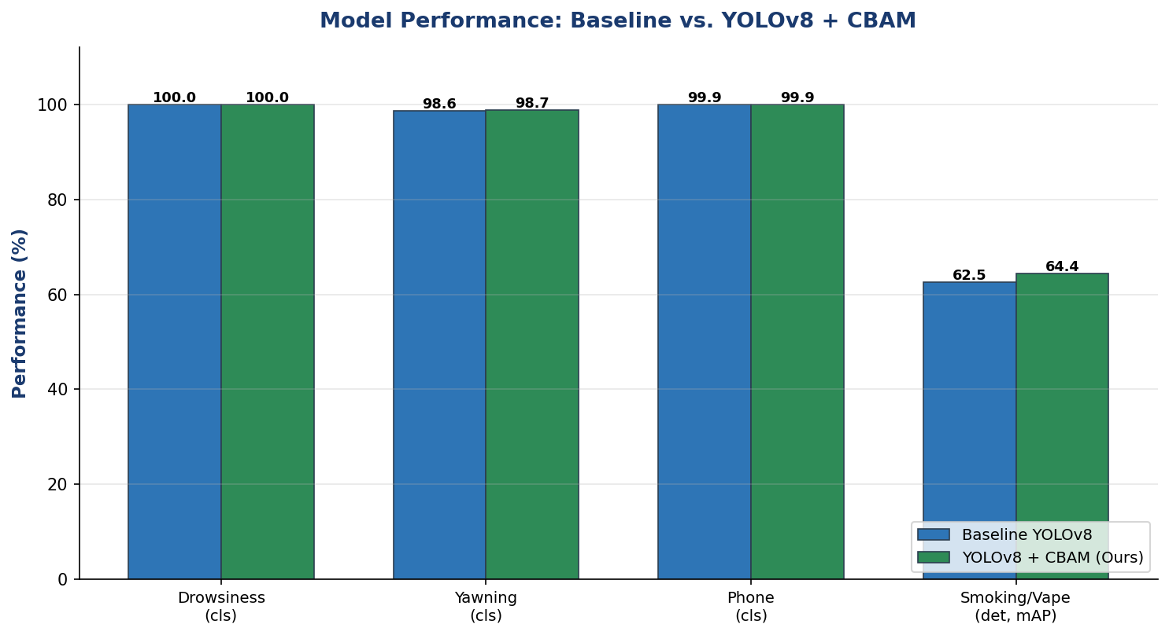
Results
100.0%
Drowsiness
Accuracy
98.7%
Yawning
Accuracy
99.9%
Phone
Accuracy
64.4%
Smoking
mAP@0.5
Notes:
Our results are strong across all four detectors. Drowsiness classification reached 100% accuracy on the balanced eye-state dataset. Yawning reached 98.7%. Phone usage 99.9% — the classifier is extremely reliable. For smoking and vaping, the CBAM-enhanced model reached 64.4% mAP at IoU 0.5, compared to 62.5% for the baseline — a 1.9 percentage point improvement on a severely imbalanced detection problem. The CBAM consistently lowered box loss compared to baseline.

Slide 8
Live Demo
1
Server Startup
2
App Connect
3
Drowsiness
Flask server loads all 4 AI models
Flutter app connects via WebSocket
Close eyes → EAR drops → ALERT
4
Yawning
5
Phone Usage
6
Smoking/Vaping
Yawn → MAR rises → ALERT
Phone to ear → YOLOv8 → ALERT
Hand to mouth → CBAM → ALERT
Safety score updates live throughout the session — each alert deducts points from 100
Notes:
Now I will show you the system working live. We will start the Flask server on the laptop, connect the Flutter app on the phone, and demonstrate each of the four detectors one by one. Watch the safety score at the top of the screen — it starts at 100 and decrements with each confirmed alert. The demo video is also available if there are any connection issues.

Slide 9
Tools & Technologies
AI / ML
Computer Vision
Python · PyTorch · YOLOv8 (Ultralytics) · CBAM (custom)
MediaPipe FaceMesh & Hands · OpenCV · EAR / MAR geometry
Back-end
Mobile
Flask · Flask-SocketIO · REST API · WebSocket
Flutter (Dart) · Android / iOS · Camera · AudioPlayers
Training
Data Sources
Google Colab · Tesla T4 GPU · 4 training notebooks
Kaggle (3 datasets) · Roboflow (smoking, merged)
Notes:
The project uses a modern, entirely open-source stack. Python and PyTorch for training, YOLOv8 for the detection and classification models, MediaPipe for the geometric landmark algorithms, Flask for the API server, and Flutter for the cross-platform mobile application. Training was done on Google Colab with a Tesla T4 GPU at no hardware cost.

Slide 10
Conclusion & Future Work
What We Achieved
Future Work
4 detectors unified in one real-time system
CBAM contribution: mAP improved 62.5% → 64.4%
Full stack: models + Flask API + Flutter app
100% accuracy on drowsiness classification
Live safety score with audio + haptic alerts
On-device inference (TensorFlow Lite)
More vape training data collection
Night / low-light robustness
Driver history & fleet reporting
Additional behaviors (eating, distraction)
github.com/yousef2468-1/driver-monitoring-system · Cairo University, FCAI, AI Department, 2025–2026
Notes:
To summarize: we built a complete, working driver monitoring system that detects four unsafe behaviors in real time from an ordinary smartphone. Our CBAM contribution improved smoking detection from 62.5 to 64.4 percent mAP. The system is fully deployed with a mobile app, a desktop dashboard, trained models, and complete documentation. Future work includes on-device inference to eliminate the server dependency, more vape training data, and low-light robustness. Thank you — we are happy to take your questions.

