Slide 1
LiDAR in Robotics
RESEARCH PRESENTATION
What it is, how robots use it, where it falls short, and how it compares with cameras
Yousef Ahmadzai and Timothy Titus
Notes:
Project team: Yousef Ahmadzai and Timothy Titus.
Yousef Ahmadzai handled the camera module setup and wrote all project code, including person tracking, servo control, IMU integration, and calibration routines. He also tuned and tested the software.
Timothy Titus handled the chassis and gimbal printing, servo calibration, and IMU hardware setup.

Slide 2
What we cover
OUTLINE
01
02
What LiDAR is
LiDAR in robotics
A laser sensor that measures distance
How the MiR250 navigates with it
03
04
Limits of LiDAR
LiDAR vs. cameras
Cost, identity, range, weather
Where each one wins, and why robots combine them

Slide 3
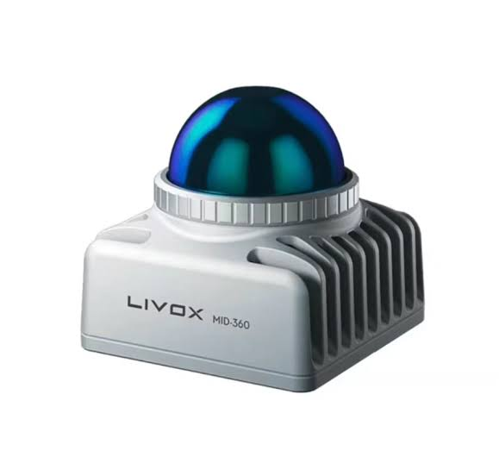
What is LiDAR?
WHAT LIDAR IS
Light Detection and Ranging: a sensor that uses a laser to measure distances.
Active sensing
It sends out its own laser signal, unlike a camera that tracks what is visibly seen.
Measurements
Each reflected pulse becomes a distance and angle that locate points on an object.
Noise filtering
Measurements are filtered to remove noise and environment obstructions.
Pictured: Livox Mid-360 LiDAR sensor
Notes:
Yousef Ahmadzai There are many approaches to using sensors and camera systems in order to scan, log, and track objects or environments, however for our case we are focusing on the use of LiDAR and how it is used in robotic navigation. Unlike an optical camera which can track based on what is visibly seen, LiDAR uses active sensing by sending out its own laser signal that measure distance and angle. When it comes to how LiDAR data is actually recorded and implemented into software, it works in a process of the sensor sending out a laser pulse and then using its reflection in order to convert this to measurements that are useful such as distances and angle. These can then be used to calculate the actual specific points of an object or environment and depending on how the software converts this information it can be used in a way that can give a very clear sort of image of the object. The information that is then sent out, received, and converted into measurements also has to filter out noise and other environment obstructions.

Slide 4
Distance from a pulse’s round trip
TIME OF FLIGHT
cΔt
d =
2
d distance to the object
c speed of light, about 3 × 10⁸ m/s
Δt time between sending the pulse and detecting its return
÷ 2 the light travels out to the object and back
Notes:
In this equation, d represents the distance to the object, c is the speed of light, which is 3 times 10^8 meters per second, and Delta t is the time it took. The result is divided by two because the light travels from the sensor to the object and then back to the sensor. A longer time means that the object is farther away.

Slide 5
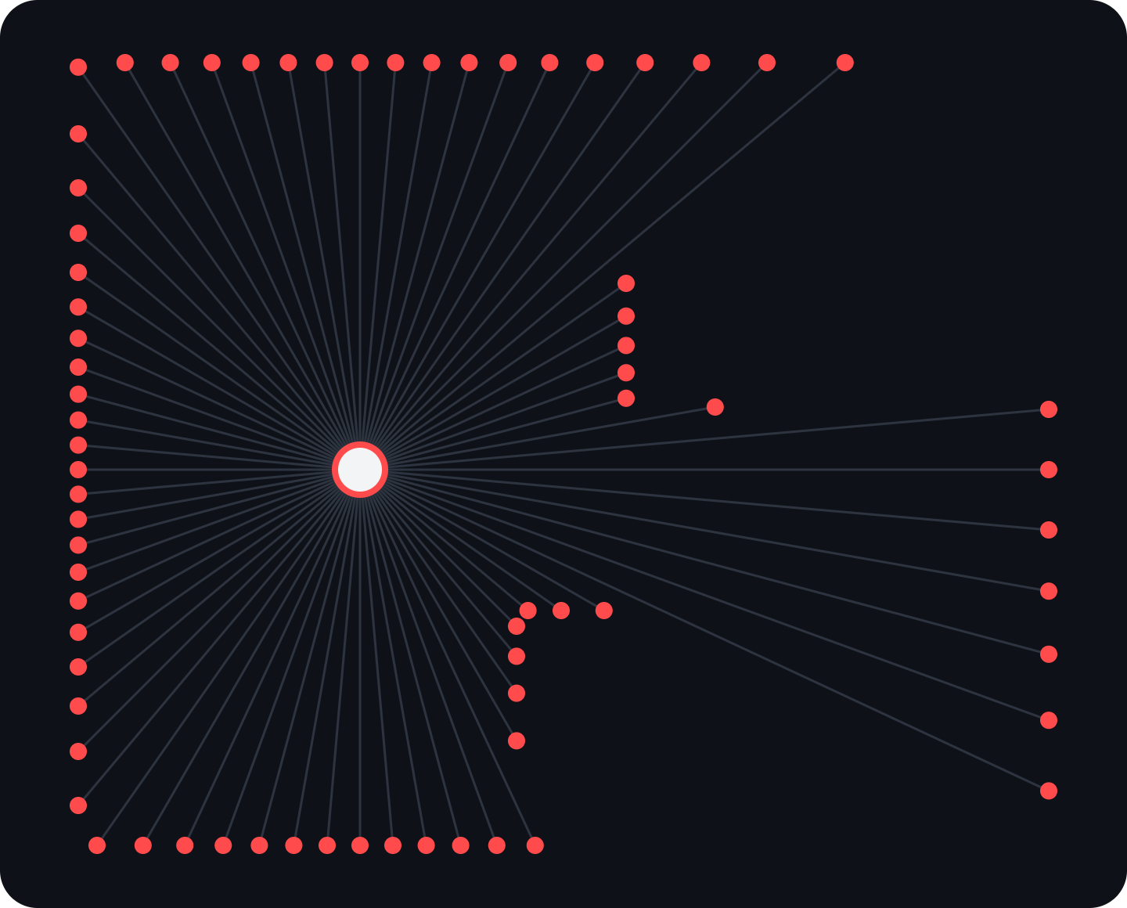
From points to a map
HOW IT MAPS
Measurements at different angles are combined to find the position of objects.
Positions are written as x, y, and z coordinates; together they form a point cloud of the surfaces around the sensor.
Constant repeated scans keep the robot’s picture of its surroundings up to date and show where the robot itself is.
Notes:
In order to create a map of its surroundings it needs to run measurements at different angles which it then combines to figure out the exact position of objects. The positions can be represented by x, y, and z coordinates, which creates a point cloud that describes the surfaces detected around the sensor. This makes it so robots can navigate their surroundings and detect obstacles. For example, a robot operating in a warehouse can use LiDAR to locate obstacles which would help it navigate the warehouse. Constant repeated scans allow the robot to constantly update its understanding of the surroundings as it moves, it also is used to tell the position of the robot itself.

Slide 6
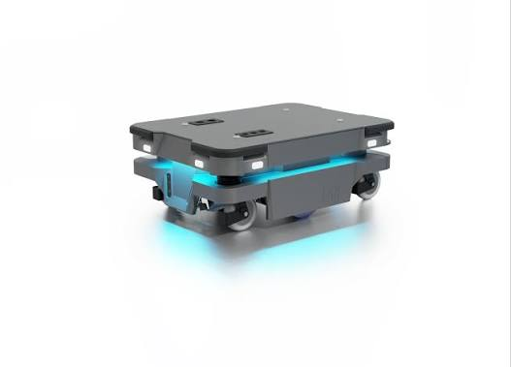
Case: MiR250 at DENSO
LIDAR IN ROBOTICS
The MiR250, made by Mobile Industrial Robots, moves materials in factories and warehouses.
DENSO uses six of them at its Athens, Tennessee plant to move parts between its warehouse and production areas, so workers don’t have to keep pushing carts.
To do this, the robot has to know where it is and what is around it.
Pictured: MiR250. Source: Mobile Industrial Robots and DENSO case study, Business Wire, November 2022
Notes:
An example of this being used in an actual robot is the MiR250 which is made by Mobile Industrial Robots. It is used in factories and warehouses to move materials from one area to another. A company named DENSO uses these robots to move parts between its warehouse and production areas so workers don’t have to keep pushing carts around themselves. For this to work the robot has to know where it is and what is around it.

Slide 7
How the MiR250 navigates
LIDAR IN ROBOTICS
1
Scan
Two laser scanners together cover all the way around the robot.
2
Map
Scan points plus movement information are used to make a map of the area.
3
Locate
New scans are compared with the map’s walls; wheel encoders and an IMU track movement.
4
Plan
The software picks a direction and changes path if something is in the way.
5
Stop
An object inside the safety area monitored by the scanners stops the robot.
6
Detect
3D cameras help detect things above or below where the lasers scan.
Notes:
When it comes to how the LiDAR data is actually used, the robot has two laser scanners that together scan all the way around it. They send out laser pulses and use the reflections to collect points showing where objects are. These points get sent to the robot’s computer and can be used with information about its movement to make a map of the area. The software then compares new scans with the walls on the map to figure out where the robot is. It also uses wheel encoders and an IMU to keep track of its movement. The software uses this information to decide which way the robot needs to go. While it is moving it keeps checking for objects and can change its path if something is in the way. If an object gets inside the area that the laser scanners are monitoring for safety, the robot stops. It also has 3D cameras to help detect things above or below where the lasers are scanning. For this case the LiDAR data is being used to help the robot get the parts to the right place while avoiding objects along the way.

Slide 8
Limits of LiDAR
DOWNSIDES
Cost and power
No identity
Sparse points
Units are usually pricier, heavier, and more power-hungry than cameras.
It returns geometry only, so it cannot read signs or tell a person from a pole.
A 2D scanner sees one flat slice, and 3D density thins out with distance.
Weather
Heavy data
MiR250
Rain, fog, and dust add false returns; glass and dark surfaces cause dropouts.
Point clouds are costly to process, and fusing sensors needs careful calibration.
Its laser scanners see only a chair’s four legs, so 3D cameras are added.
MiR250 example: Mobile Industrial Robots, MiR250 technical guide

Slide 9
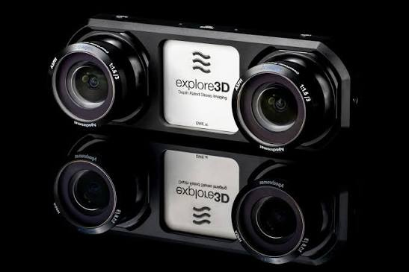
Cameras and stereo vision
DIFFERENCES
Cameras recognize what something is: objects, color, text, and signs.
A stereo camera uses two lenses to estimate depth, best at close to mid range.
Cameras are passive: glare and darkness hurt them, and depth accuracy falls with distance.
Pictured: explore3D stereo vision camera

Slide 10
LiDAR vs. cameras
DIFFERENCES
LiDAR is better at distance and 3D shape; cameras are better at recognizing what something is.
Factor | LiDAR | Camera
Best at | Accurate distance and 3D geometry | Identifying objects, color, text
Lighting | Active: works in the dark | Passive: depends on ambient light
Depth | Measured directly | None from one camera; stereo or 3D cameras estimate it
Cost and size | Higher | Lower
Weak spot | No identity; weather and glass | Glare, low light, no direct range

Slide 11
The MiR250 uses both
COMBINING SENSORS
Laser scanners
3D cameras
Mapping and localization
Obstacle detection while driving
Safety stops
See above and below the scan plane
Used for navigation only, not for safety
Can detect phantom obstacles in strong direct light
Each sensor covers the other’s weak spot.
Source: Mobile Industrial Robots, MiR250 technical guide

Slide 12
What we covered
SUMMARY
What LiDAR is
LiDAR in robotics
A laser sensor that times each pulse’s round trip to measure distance and builds a point cloud of its surroundings.
The MiR250 uses laser scanners to map, find its position, avoid obstacles, and stop for safety.
Limits of LiDAR
LiDAR vs. cameras
Cost and power, no identity, sparse points, weather, and heavy data.
LiDAR wins on distance and 3D shape; cameras win on recognizing objects, color, and text. The MiR250 uses both.
Sources: Mobile Industrial Robots, MiR250 technical guide; Mobile Industrial Robots and DENSO case study, Business Wire, November 2022

Slide 13
Thank you
Questions?

