Slide 1

DATABASE SYSTEMS PROJECT • CSCE-351
Online Library
Management System
A relational database design for digital book borrowing, reservation, and library administration.
SUBMITTED BY
Yousef Mataq Al-Rashidi — 202205757
COURSE
CSCE-351 – Database Systems | First Term 2025/2026 (22619)
INSTITUTION
University of Hail – College of Computer Science and Engineering

Slide 2

INTRODUCTION
Why an Online Library System?
1
Digital transformation
Access to scientific resources and e-books is now essential for students, researchers, and readers.
2
Traditional libraries fall short
Limited working hours and difficulty accessing books from distant locations restrict use.
3
A digital alternative
Users can search for books, borrow them digitally, or reserve a physical copy online.
Core Idea
Search, borrow, and reserve books anytime — with a single admin layer keeping data consistent.
4
Centralized administration
An admin panel manages books, users, and borrowing / reservation requests.
Online Library Management System
2

Slide 3


PROJECT REQUIREMENTS
What the System Must Track
Users
Books
Admins
User_ID (unique)
Book_ID (unique)
Admin_ID (unique)
User_Name & Email
Title & Author
Name & Email
User_Type
Category
Role privileges
Can borrow or reserve books
Availability_Status
Manages users, books & transactions
Online Library Management System
3

Slide 4
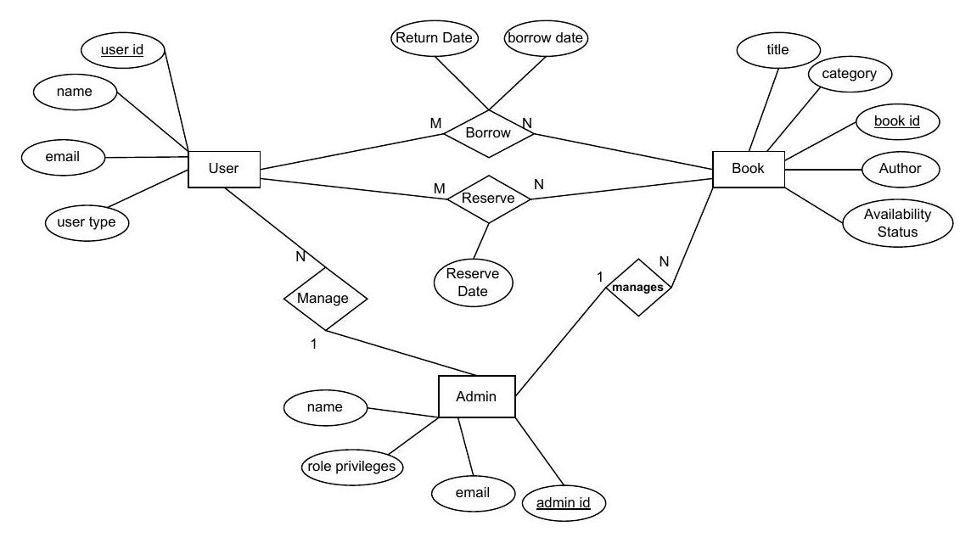
CONCEPTUAL DESIGN
Entity–Relationship Diagram
Three entities — User, Book, Admin — connected through Borrow, Reserve, and Manage relationships.
Online Library Management System
4

Slide 5
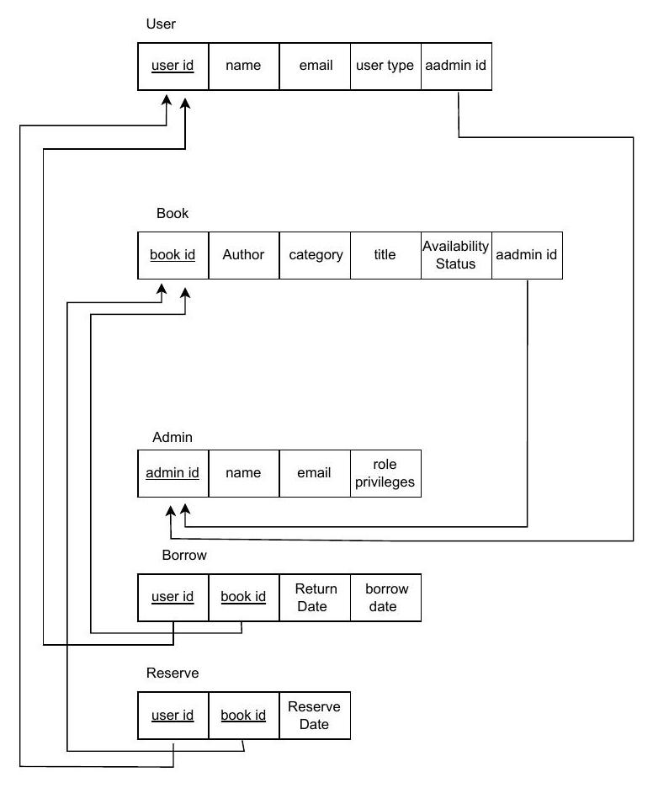

LOGICAL DESIGN
Relational Schema
The ER model maps into five relational tables linked by foreign keys.
Reading the Schema
Underline
Primary key of the table
admin_id in User & Book
Foreign key referencing Admin
Borrow / Reserve
Composite key (user_id + book_id)
Arrows
Point from a foreign key to its referenced primary key
Online Library Management System
5

Slide 6


DATABASE TABLES
Five Tables, One Consistent Design
TABLE
PRIMARY KEY
OTHER COLUMNS
Admin
admin_id
name, email, role_privileges
User
user_id
name, email, user_type, admin_id (FK)
Book
book_id
title, author, category, availability_status, admin_id (FK)
Borrow
user_id + book_id
borrow_date, return_date
Reserve
user_id + book_id
reserve_date
Online Library Management System
6

Slide 7

RELATIONSHIPS
How the Tables Connect
1 : N
M : N
M : N
Admin → User / Book
User ↔ Book (Borrow)
User ↔ Book (Reserve)
Each admin manages many users and many books; admin_id is a foreign key in both tables.
A user can borrow many books over time, and a book can be borrowed by many users — tracked with borrow_date and return_date.
A user can reserve many books, and a book can be reserved by many users — tracked with reserve_date.
Referential integrity
Every foreign key (admin_id, user_id, book_id) must reference an existing row, so a book or borrow record can never point to an admin or user that doesn't exist.
Online Library Management System
7

Slide 8
IMPLEMENTATION
From Design to a Working Database
The schema was implemented in SQL and populated with sample records for testing.
3 Admins
Sample Records Loaded
Each with distinct role privileges (Manage Users, Books, System).
3 Users
A student, a teacher, and a researcher — showing varied user_type values.
3 Books
Covering Technology and Programming categories, with mixed availability.
Active transactions
2 borrow records and 1 reservation demonstrate the M:N relationships in action.
Online Library Management System
8

Slide 9



CONCLUSION
A Solid Foundation for a Digital Library
Normalized structure
Enforced integrity
Ready to extend
Five focused tables avoid data duplication across users, books, and admins.
Primary and foreign keys keep borrow and reserve records consistent and traceable.
Future work: due-date fines, notifications, multiple copies per book, and search filters.
Thank you
Yousef Mataq Al-Rashidi • 202205757 • CSCE-351, University of Hail

