Slide 1
System D
Yousef Amar

Slide 2
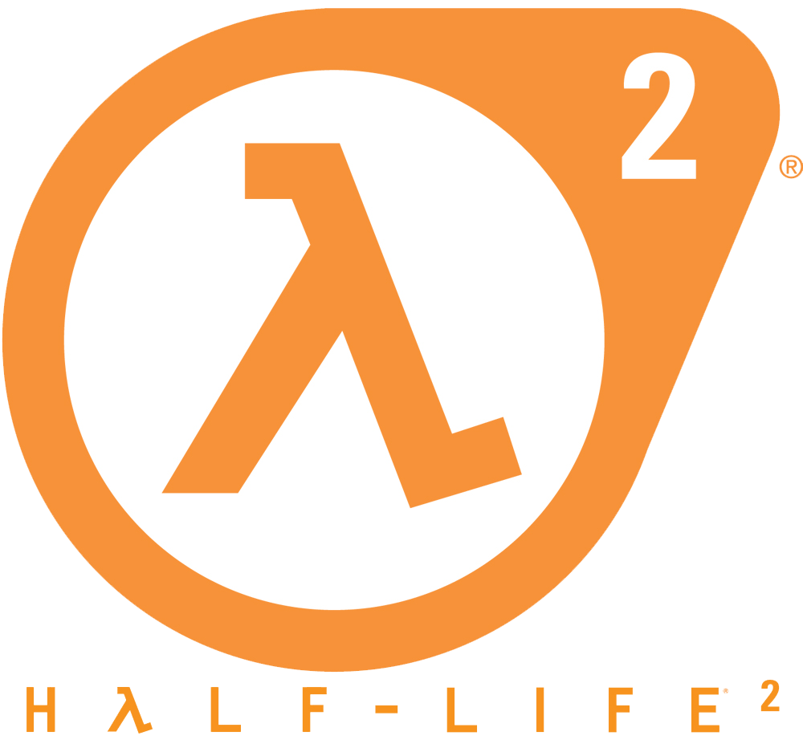
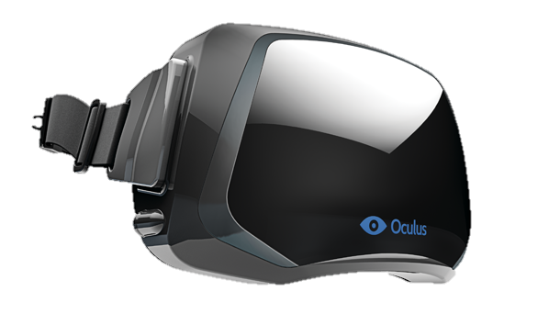
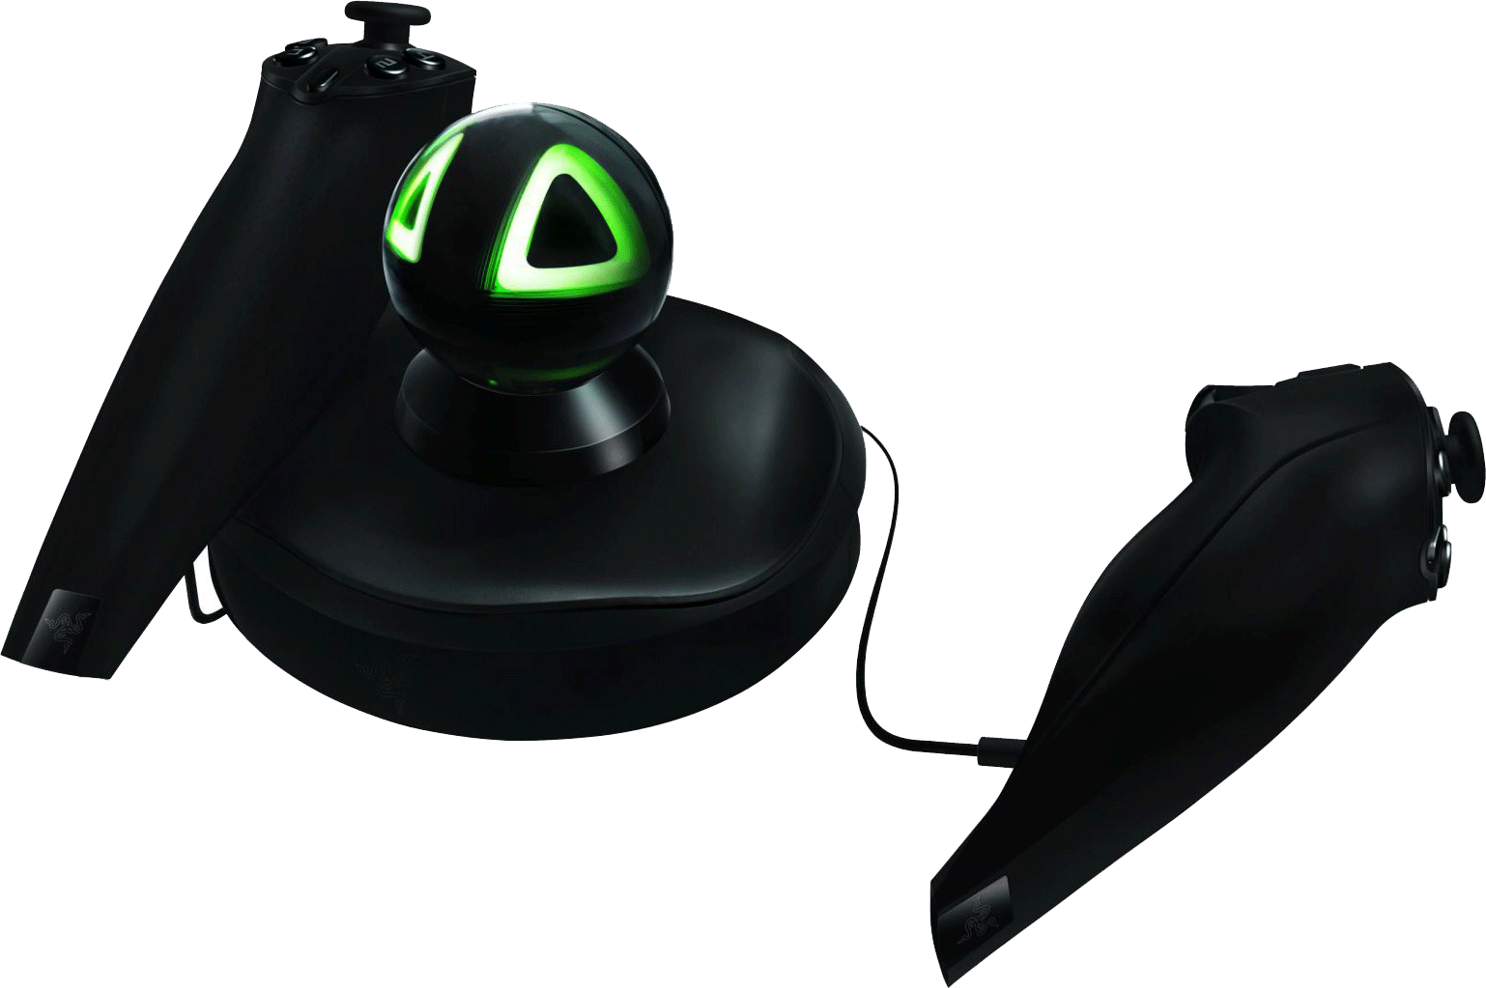
The Setup

Slide 3
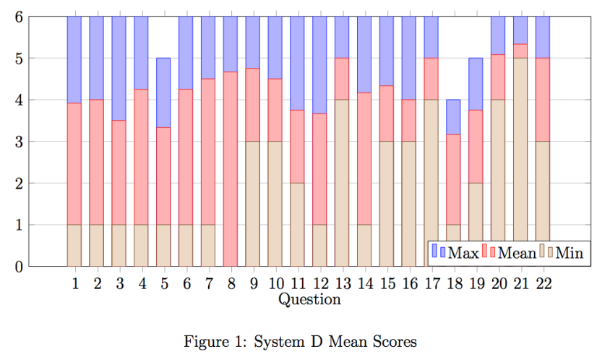
Questionnaire Results
Notes:
Sample size (negative, positive, serious)
Most well except 18 (sense of moving; part of quality of interface)
Hydra controls were bad
The interface and its use (questions 18 and 19) were bad
Audio was good and impacted scores

Slide 4
Scoring
Cronbach’s Alpha = 0.947
 | Realism | Possibility to Act | Quality of Interface | Possibility to Examine | Self-eval of performance | Sounds | Haptic | Total
R1 | 36 | 22 | 16 | 9 | 10 | 18 | 0 | 111
R2 | 32 | 17 | 15 | 15 | 10 | 16 | 0 | 105
R3 | 12 | 5 | 10 | 5 | 7 | 13 | 7 | 52
R4 | 39 | 24 | 12 | 16 | 9 | 13 | 0 | 113
R5 | 24 | 16 | 6 | 10 | 8 | 18 | 0 | 82
R6 | 33 | 20 | 15 | 12 | 6 | 14,5 | 0 | 100,5
Total | 176 | 104 | 74 | 67 | 50 | 92,5 | 7 | 563,5
Mean | 29,3 | 17,3 | 12,3 | 11,2 | 8,3 | 15,4 | 1,17 | 93,9
Var | 81,2 | 37,9 | 12,2 | 13,8 | 2,2 | 4,37 | 6,8 | 453,5
S.D. | 9,01 | 6,16 | 3,5 | 3,7 | 1,5 | 2,09 | 2,6 | 21,3
Notes:
- High internal consistency measures of reliability (ambiguous given sample size)

Slide 5
Factor Weighting
Realism: 29%
Possibility to act: 17%
Quality of interface: 12.5%
Possibility to examine: 12.5%
Self-evaluation of performance: 8%
Sounds: 12.5%
Haptic: 8%

Slide 6
Normalised Scoring [0-6]
Realism: 4.19
Possibility to act: 4.325
Quality of interface: 4.1
Possibility to examine: 3.73
Self-evaluation of performance: 4.15
Sounds: 5.13

Slide 7


Existing Issues
Realism factors
Sensory factors
Distraction factors
Control factors

Slide 8
Possible Improvements
Increase Oculus Rift resolution and FOV
Revamp player controls; wrist twisting is not an intuitive mechanism for rotation
Controller mapping and game do not match, remap or replace
Scrap Rift, replace Hydra with an Xbox controller. Based on Witmer and Singer, presence will actually be improved for this VE

Slide 9
Thank you for your attention!
Questions?

