Slide 1
Introduction to Software engineering

Slide 2
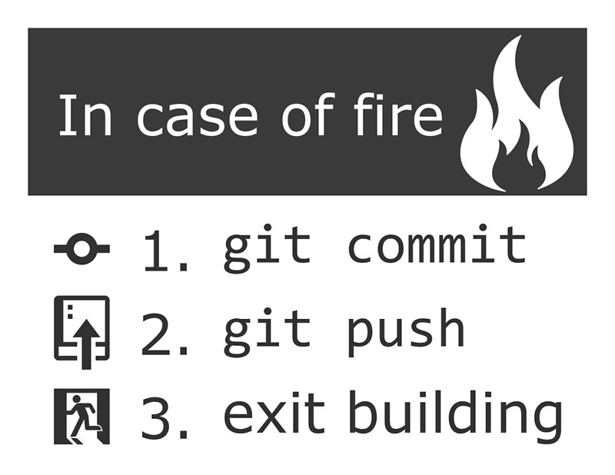

Slide 3
Need
Small project, only one person, small changes.
But when you work on big project with a team and the changes will not be small !!

Slide 4
Version control system
Version control software allows you to have “versions” of a project, which show the changes that were made to the code over time, and allows you to backtrack if necessary and undo those changes.

Slide 5
Repositories
A repository is the heart of any version control system. It is the central place where developers store all their work.
Repository not only stores files but also the history.

Slide 6
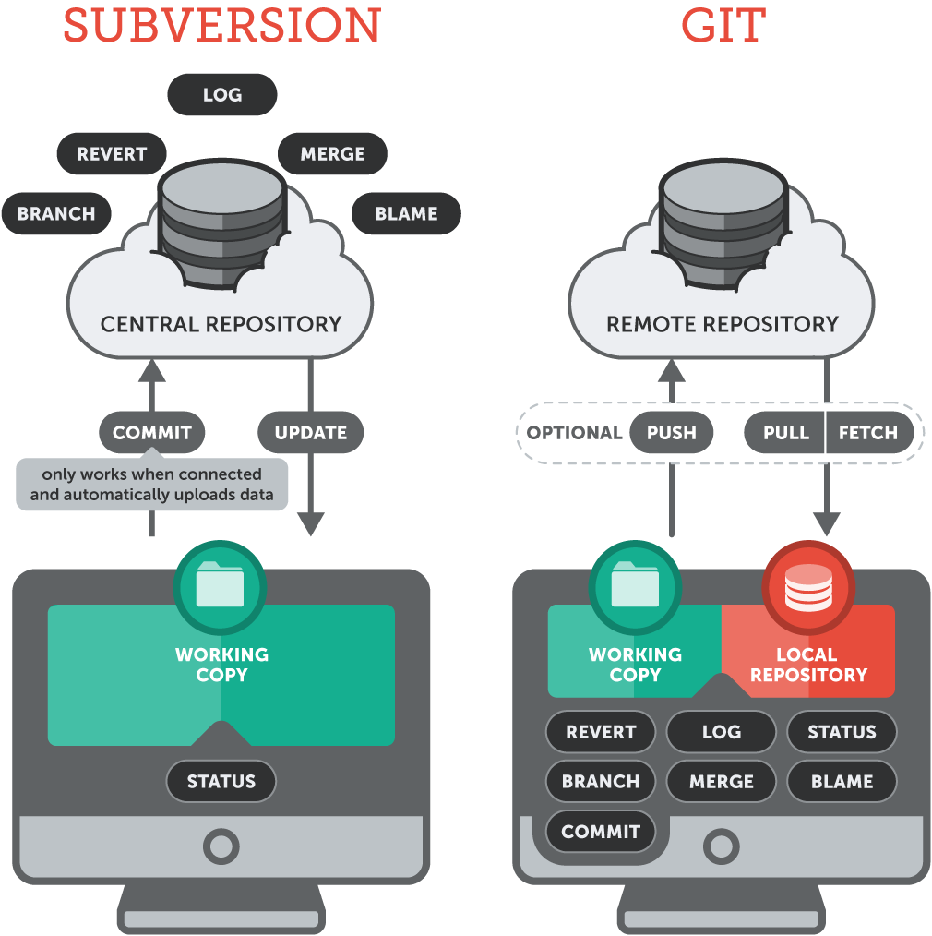
Centralized VS Distributed version control systems

Slide 7
Software and online repositories
Online repositories
Github
Bitbucket
Gitlab
Version control software
Git
SVN

Slide 8
Commit
records changes to the LOCAL repository
In most of software companies. Commit should be done after implementing some requirements.
Commit = screenshot of the current software

Slide 9
Push
Transfer the last commit(s) to a remote server
You can create an online repository (on github for example) and push your commits to this repository

Slide 10
Pull
Download the latest version of the system from the online server to your machine
This command not just downloads the source code but also the commits (the history of this system)

