Slide 1





CYCLISTIC BIKE SHARE ANALYSIS
By : Yousef Ayman
August 2022

Slide 2
Objective
How do annual members and casual riders use Cyclistic bikes differently.

Slide 3
Sources
Data was obtained directly from company records available at
https://divvy-tripdata.s3.amazonaws.com/index.html
License of the data
Data License Agreement | Divvy Bikes
Data timeline from 2021 august to 2022 july

Slide 4
Tools
Data was cleaned , transformed and analyzed via r
Data visualization via excel

Slide 5
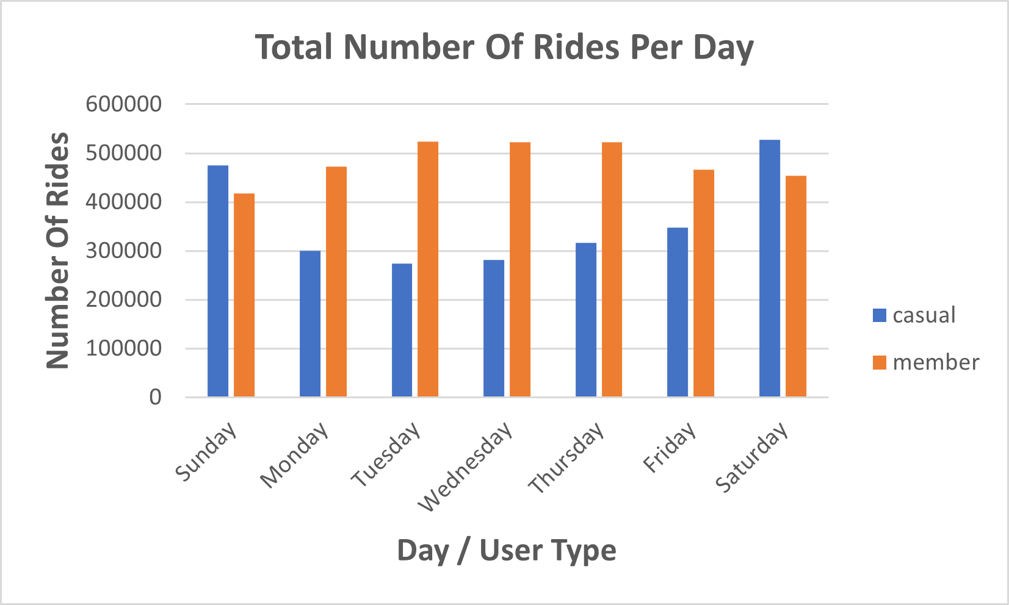
Number Of Rides Per Day
Casual riders seems to use bikes more on the weekends

Slide 6
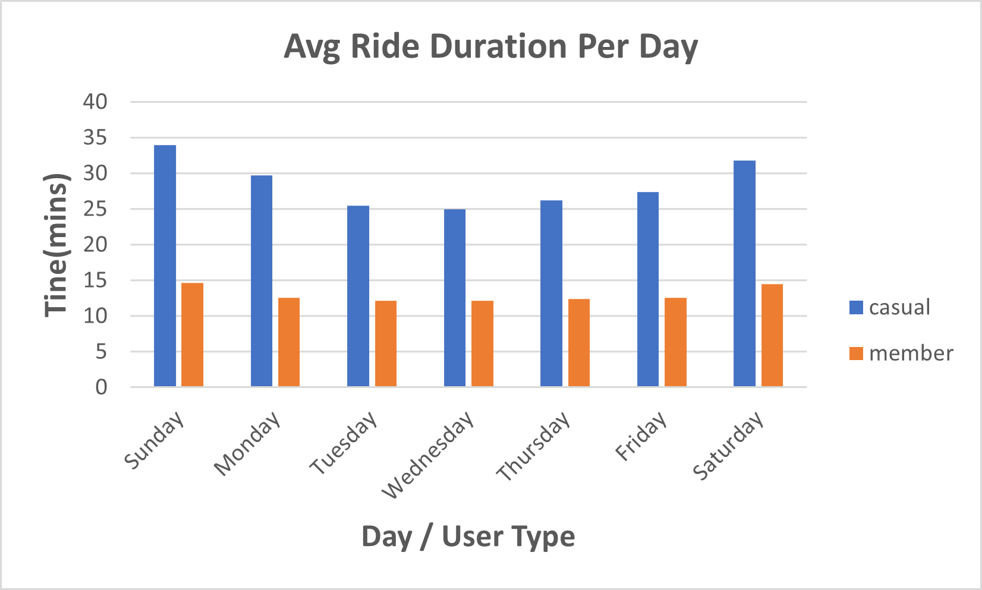
Ride Duration Per Day
Casual riders seems to Take Longer trips
Annual member uses bikes for shorter trips
Casual riders use bikes for average of 34 mins
Annual riders use bikes for average of 15 mins

Slide 7
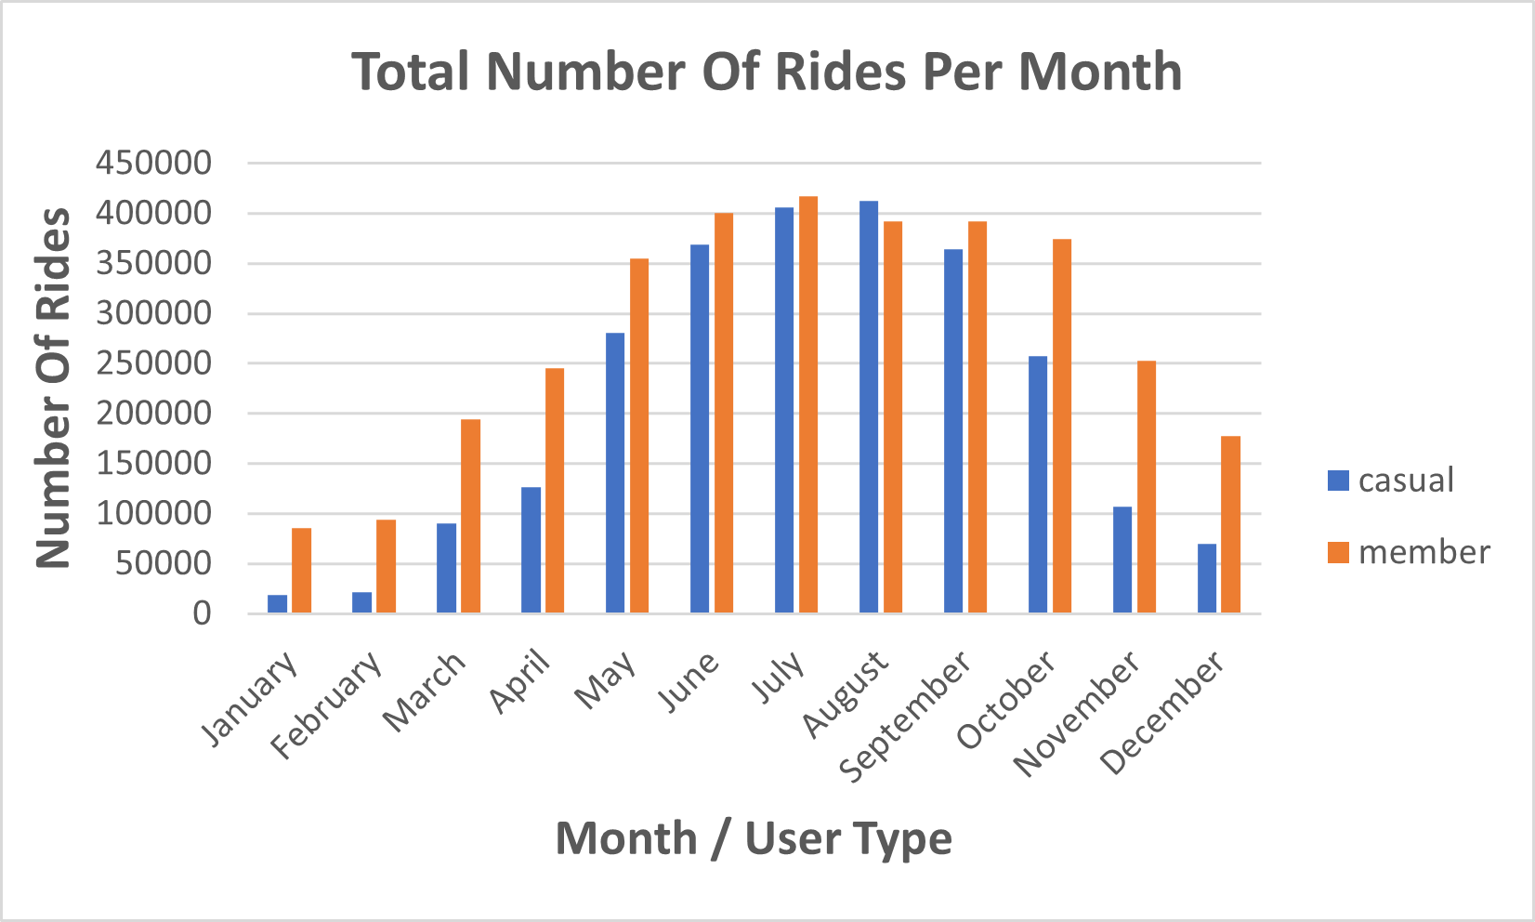
Number Of Rides Per Month
Casual riders seems to use bikes more on the warmer months
Casual riders rarely uses bikes on cold or windy months
Annual member uses bikes almost all year long

Slide 8
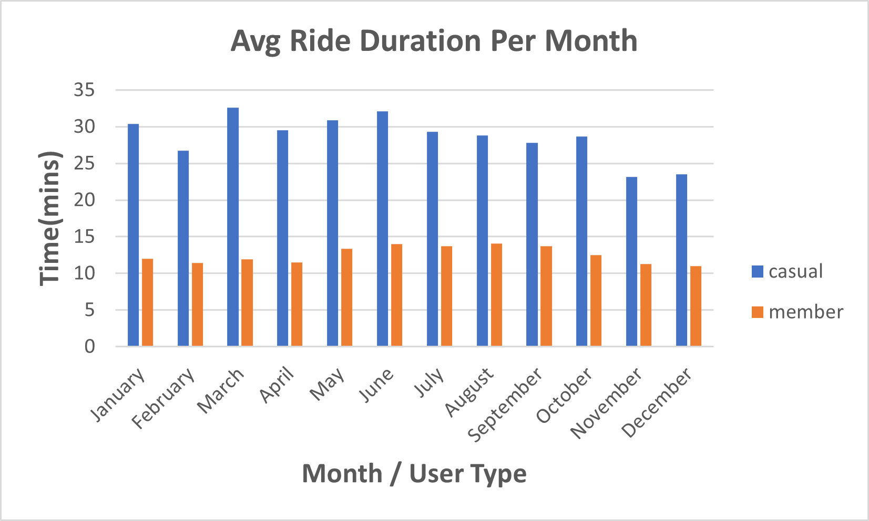
Ride Duration Per Month
Casual riders seems to use bike for much longer time than annual member

Slide 9
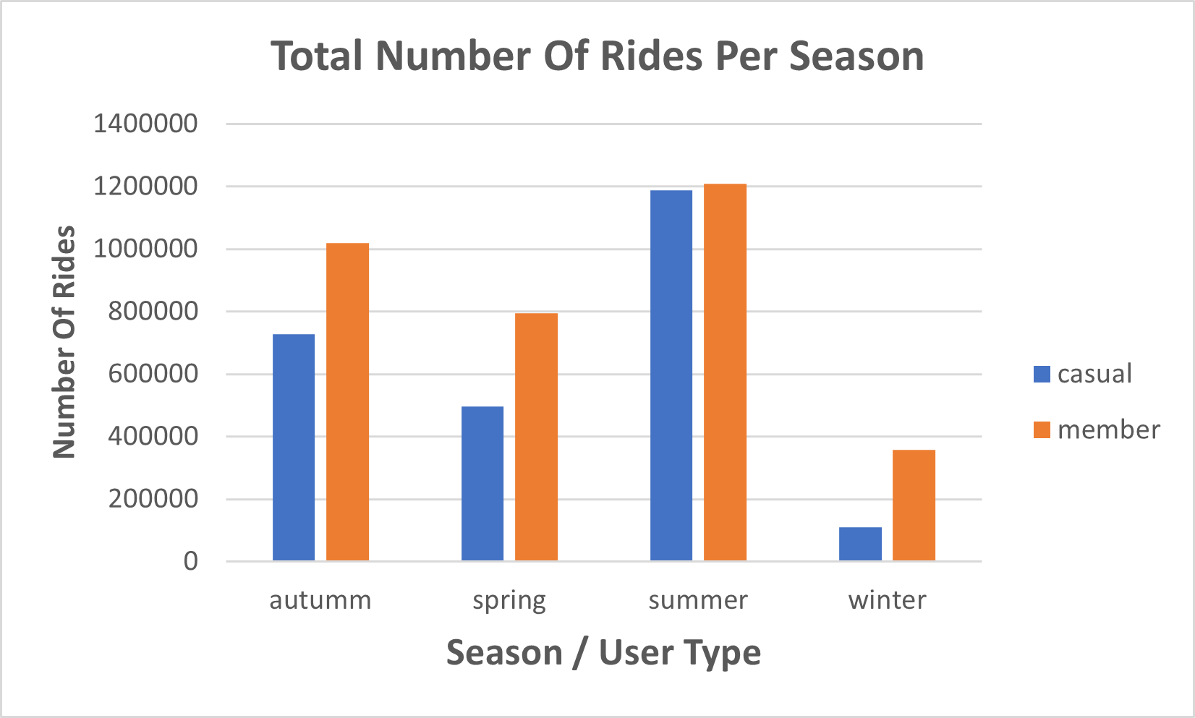
Number Of Rides Per Season
Casual users use bikes almost up to 12000000 in summer and in winter only 1000000

Slide 10
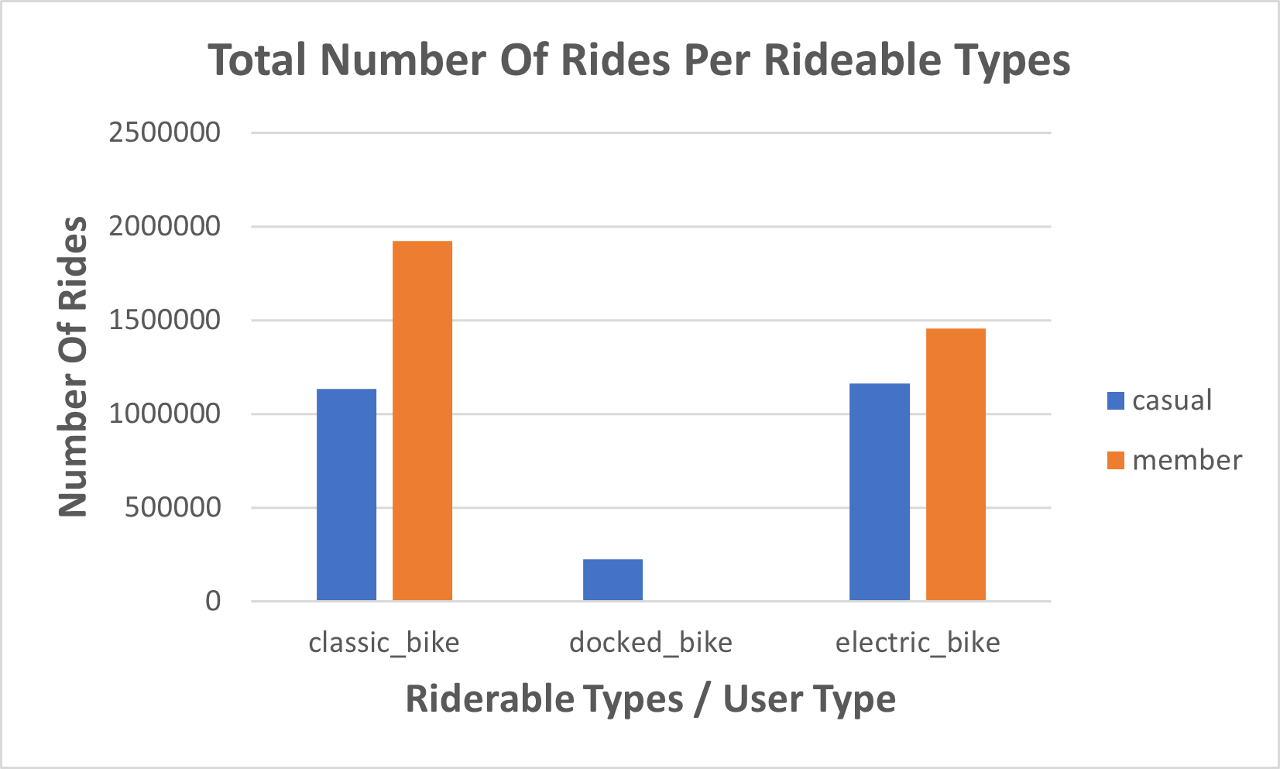
Which Type Of Biked Is Used The Most
It seems that annual members don’t use docked bikes
Casual member uses docked bikes rarely
Classical bike is the most used type
Electric bikes is also used frequently by users

Slide 11
Summary
Casual users use bikes more on the weekend
Annual members use bikes almost the same all week long
Casual users take longer trips than annual member
Casual users use bikes more in the warmer months
Casual users rarely use bikes in cold / windy months
Annual member use bikes all year long
Docked bikes are rarely used by casual users
Annual member don’t use docked bikes
Classical bike is the most used for annual member
electric bike is used almost equally with classical bike by casual users

Slide 12
Recommendations
Phase out docked bikes
Increase the number of classical bikes then electric bikes
Making discounts for annual pass in the summer months
Making the long trips cost more for non annual members
Introducing a weekend pass, priced below the annual pass, that allows unlimited rides for 35 mins on Saturday and Sunday only, casual users will most likely see the value in this
Making discounts in cold and windy seasons to encourage customers to use our product

Slide 13

Contact
www.linkedin.com/in/yousef-ayman-2a0796230
yousefayman2003 (Yousef Ayman) (github.com)
yousefayman20003@gmail.com

Slide 14

Thank You For Your Time

