Slide 1

Arabic Handwritten Digit Recognition
By: Yousef Ayman
22 MAY 2023

Slide 2
Outline
Introduction
Dataset and Preprocessing
ANN Model
ANN Evaluation
CNN Model
CNN Evaluation
Conclusion

Slide 3
Introduction
This project uses Artificial Neural Networks (ANN) and Convolutional Neural Networks (CNN) to recognize handwritten digits.
The models are trained and evaluated on the Arabic Handwritten Digits dataset, which contains 70,000 images of handwritten digits (60,000 for training and 10,000 for testing) with their corresponding labels you can check the dataset from kaggle from this link.
The goal is to train models that can accurately classify new images of handwritten digits.

Slide 4
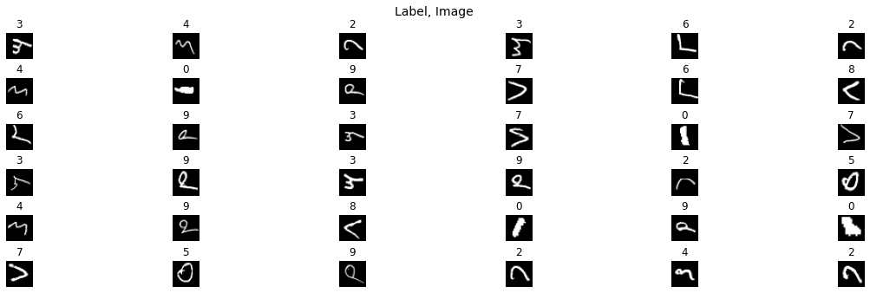
Some images in our dataset

Slide 5
Preprocessing
The Dataset was loaded from a zip file and converted into NumPy arrays
The Data was preprocessed by scaling the pixel values to be between 0 and 1, splitting the data into training and validation sets, and reshaping the data to be compatible with the ANN model and Then for The CNN model.
We Split the Training Data To Be 80% for Training and 20% For Validation

Slide 6

ANN Model:
The ANN model was created using the Keras Sequential API with three dense layers and one dropout layer .
The model was compiled with the Adam optimizer, sparse categorical cross-entropy loss function, and accuracy metric,
it was trained on the training data and evaluated with validation data for 100 epochs.

Slide 7
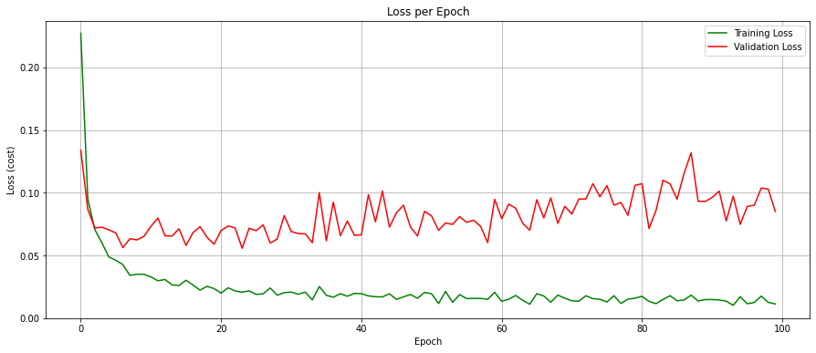
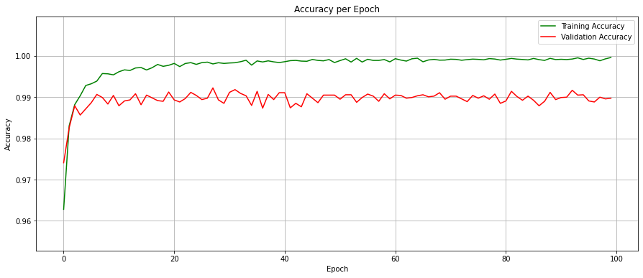
ANN Model Evaluation

Slide 8
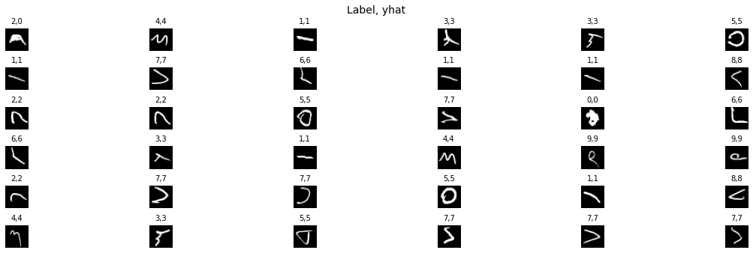
ANN Model Evaluation (True Label, Model Prediction)

Slide 9
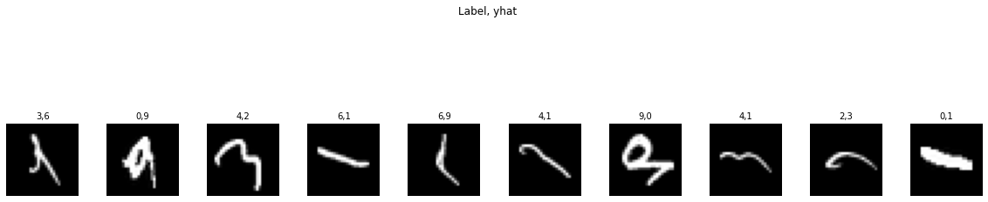
ANN Model Evaluation (some miss classified images)

Slide 10
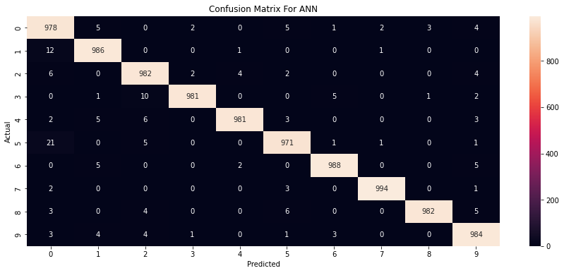
ANN Model Evaluation

Slide 11


ANN Model Evaluation
precision recall f1-score support
0 0.95 0.98 0.96 1000
1 0.98 0.99 0.98 1000
2 0.97 0.98 0.98 1000
3 0.99 0.98 0.99 1000
4 0.99 0.98 0.99 1000
5 0.98 0.97 0.98 1000
6 0.99 0.99 0.99 1000
7 1.00 0.99 0.99 1000
8 1.00 0.98 0.99 1000
9 0.98 0.98 0.98 1000
accuracy 0.98 10000
macro avg 0.98 0.98 0.98 10000
weighted avg 0.98 0.98 0.98 10000

Slide 12
CNN Model
The CNN model was created using the Keras Sequential API with two convolutional layers, two max pooling layers, one flatten layer, one dense layer,and one dropout layer and Output Layer.
The model was compiled with the Adam optimizer, sparse categorical cross-entropy loss function, and accuracy metric,
It was trained on the training data for 100 epochs.

Slide 13
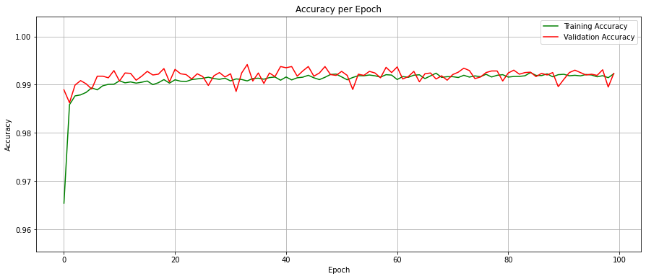
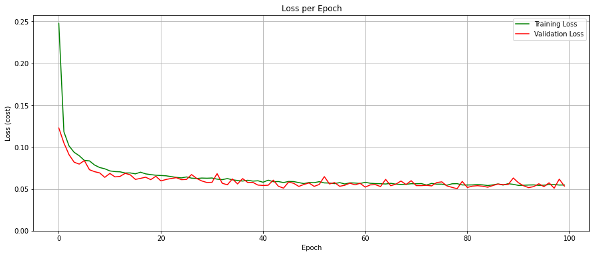
CNN Model Evaluation

Slide 14
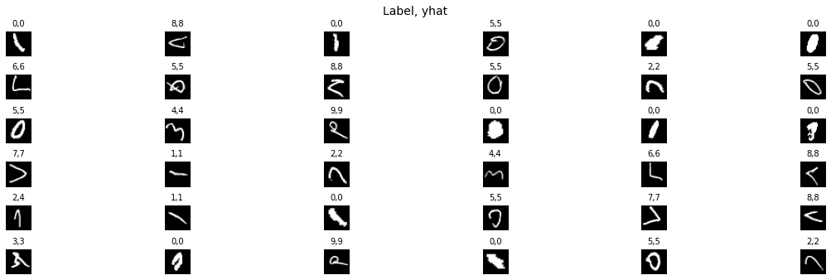
CNN Model Evaluation (True Label, Model Prediction)

Slide 15
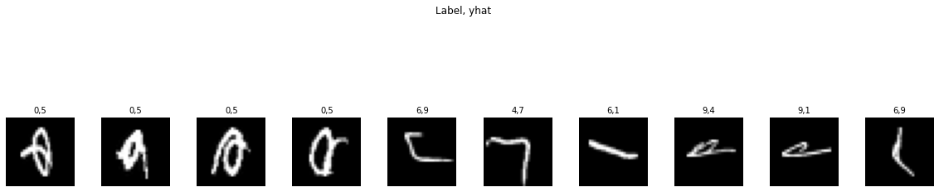
CNN Model Evaluation (some miss classified images)

Slide 16

CNN Model Evaluation

Slide 17
CNN Model Evaluation
precision recall f1-score support
0 0.98 0.97 0.98 1000
1 0.99 0.99 0.99 1000
2 0.97 0.99 0.98 1000
3 1.00 0.98 0.99 1000
4 0.98 0.99 0.99 1000
5 0.97 0.99 0.98 1000
6 0.99 0.99 0.99 1000
7 1.00 0.99 0.99 1000
8 1.00 0.99 0.99 1000
9 0.99 0.99 0.99 1000
accuracy 0.99 10000
macro avg 0.99 0.99 0.99 10000
weighted avg 0.99 0.99 0.99 10000

Slide 18
Conclusion
The CNN model outperformed the ANN model with 99% Accuracy on test data. the Arabic handwritten digits recognizing has significant implications for real-world scenarios that rely on automated digit recognition. This includes applications such as automated form recognition, digital signatures, and postal services.
Overall, the use of CNN models for digit recognition in real-world scenarios has the potential to improve the accuracy, speed, and reliability of automated processes. This can have significant benefits for organizations, individuals, and society as a whole, by reducing errors, improving efficiency, and increasing trust in digital services. However, it is important to note that the performance of the CNN model may depend on the quality and diversity of the training data, the complexity of the digit recognition task, and other factors. Therefore, further research and development are needed to optimize the use of CNN models for digit recognition in real-world scenarios.

