Slide 1







Technology Trends
Yousef Ayman
September 2022

Slide 2



OUTLINE
Executive Summary
Introduction
Methodology
Results
Visualization – Charts
Dashboard
Discussion
Findings & Implications
Conclusion
Appendix

Slide 3

EXECUTIVE SUMMARY
The most popular programming languages are web-based one such as JavaScript and HTML/CSS.
Cloud-based service is getting more relevant
The most popular web frameworks are React.js, Angular.js and jQuery.
non-relational databases is getting more relevant.

Slide 4

INTRODUCTION
About: Analyzing the trends in software development
Purpose: Identify skill requirements for future.
What are the top programming languages in demand?
What are the top database skills in demand?
What are the top platforms?
What are the top web-frameworks in demand?
Is there a gender gap in the tech industry?

Slide 5

METHODOLOGY
Data Collection Sources:
Stack Overflow Developer 2019 Survey
GitHub Job Postings API
Data Wrangling
Data Analyzing
Data Visualization
Building Dashboard
Presentation

Slide 6
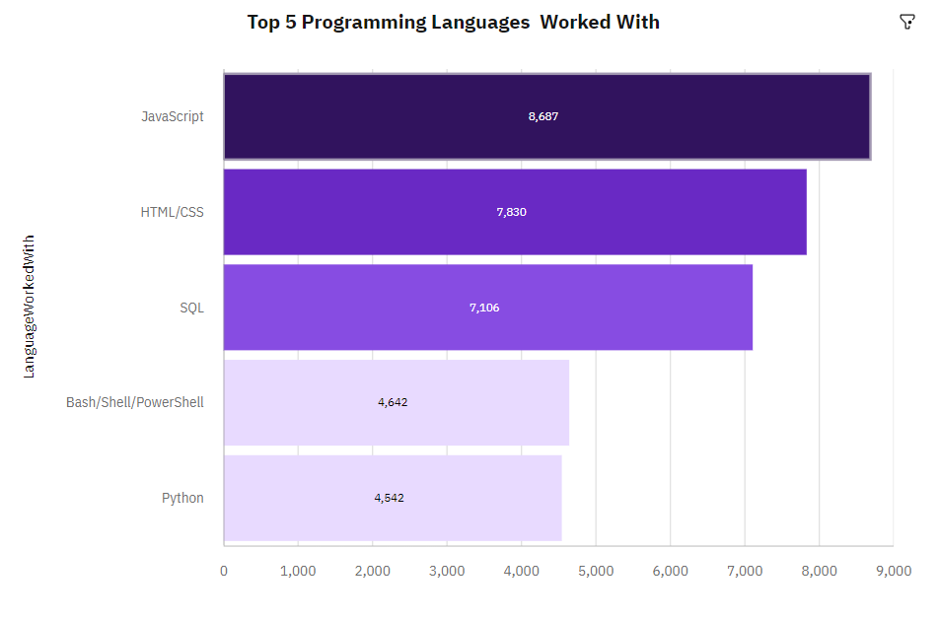
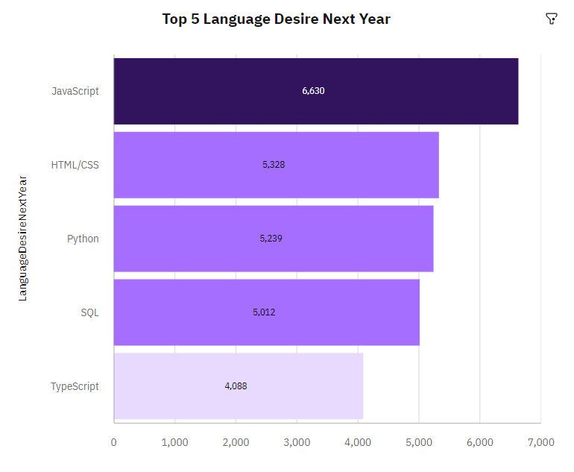
PROGRAMMING LANGUAGE TRENDS
Current Year
Next Year

Slide 7
PROGRAMMING LANGUAGE TRENDS - FINDINGS & IMPLICATIONS
Findings
JavaScript & HTML/CSS are top programming languages for both current and future trend.
Python moves from 5th position to 3rd position.
PowerShell disappeared from top 5
Implications
Web programming languages are still in high demand.
Python becoming more popular because of the importance of AI and ML
Scripting languages getting out of interest compared to others

Slide 8
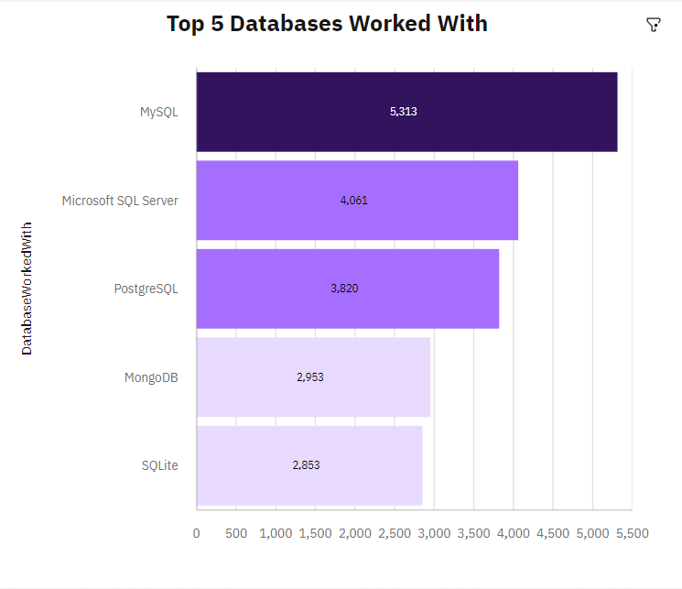
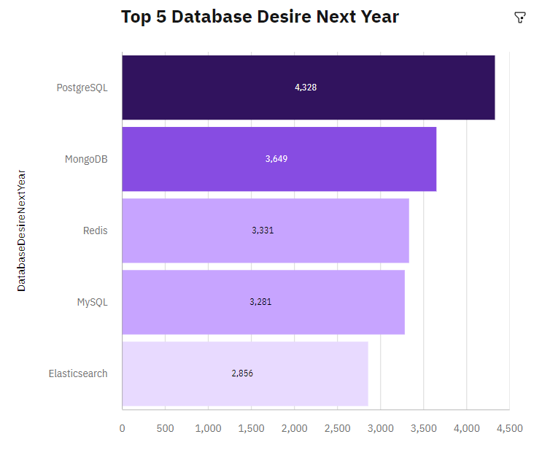
DATABASE TRENDS
Current Year
Next Year

Slide 9
DATABASE TRENDS - FINDINGS & IMPLICATIONS
Findings
MongoDB , PostgreSQL and Redis are getting more popular.
MYSQL drops from No.1 to No.4.
MS SQL and SQLITE drops out of top 5.
Implications
Open-source database is the most preferable than commercial databases .
Non-relational database see increasingly usage in the future.
Relational database still has the leading in the future.
Redis supports abstract data types.

Slide 10

DASHBOARD
https://eu2.ca.analytics.ibm.com/bi/?perspective=dashboard&pathRef=.my_folders%2FIBM%2Bcapstone&action=view&mode=dashboard&subView=model000001836bb2f9d4_00000000

Slide 11
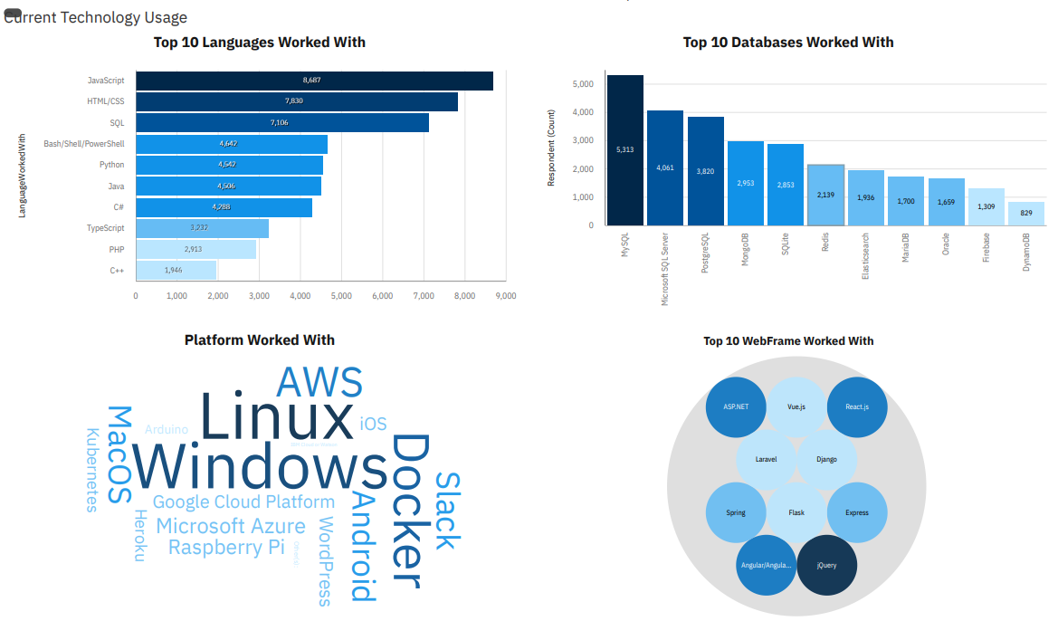
DASHBOARD TAB 1

Slide 12
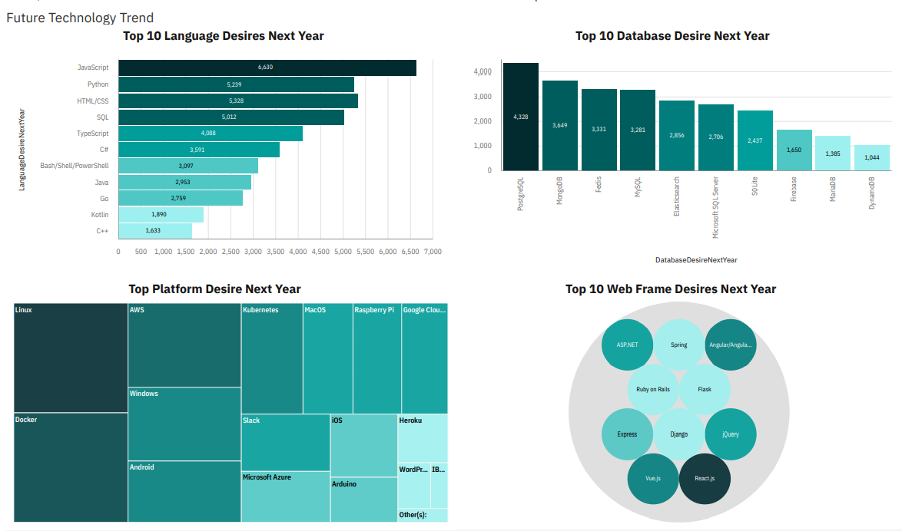
DASHBOARD TAB 2

Slide 13
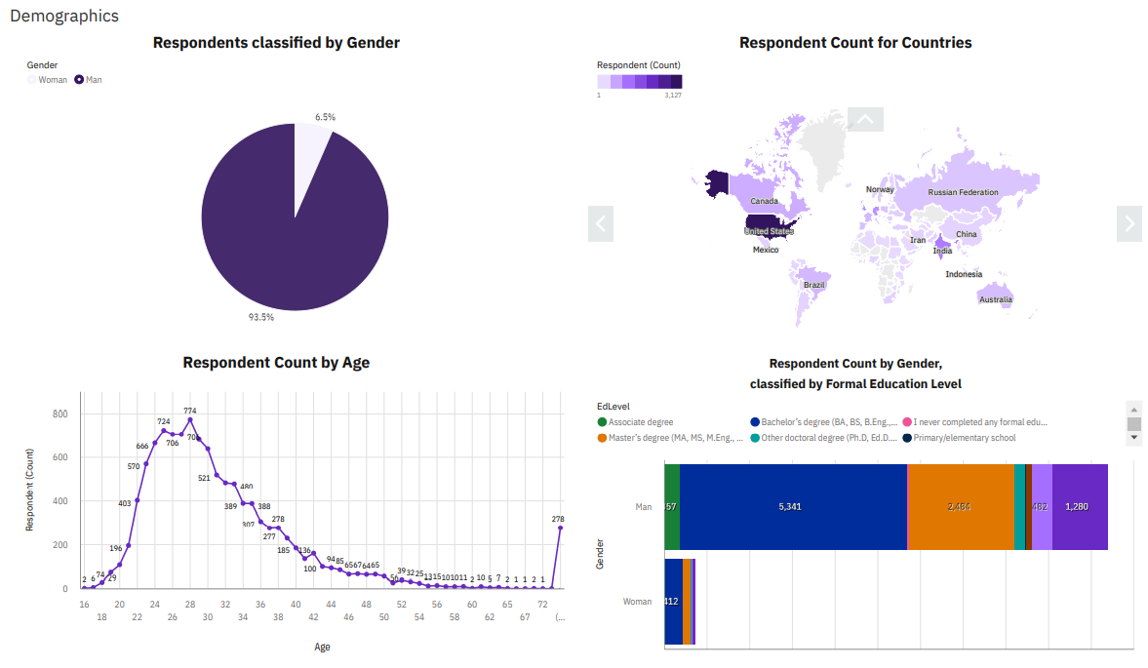
DASHBOARD TAB 3

Slide 14
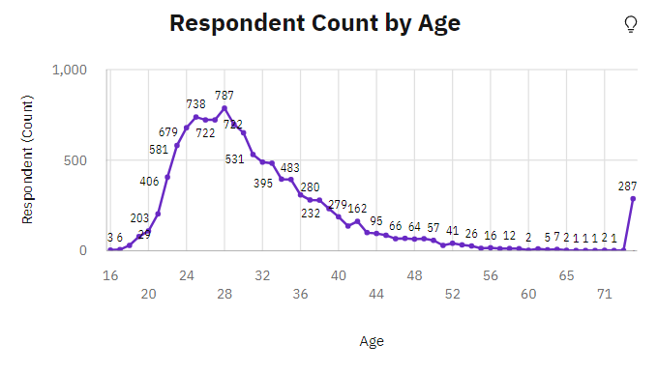
DISCUSSION
Majority of respondents ages between 24 and 30 this could skew the results for recent technologies.

Slide 15
OVERALL FINDINGS & IMPLICATIONS
Findings
The most popular languages are web based (JS, HTML/CSS)
The most used upcoming web framework is React.js
Platforms like Docker and AWS are growing in the future
Gender gap in tech industry
Changing in technology every year
Non-relational database is getting more popular
Implications
Web based application is taking over the other application.
Developers need to be flexible and adjust to rapid changes
Impact of job hiring
Shift to faster app deployments and cloud services in future
More semi-structured and unstructured data is being analyzed.

Slide 16

CONCLUSION
It’s important to learn web languages and non-relational database, To stay relevant in the tech industry
Cloud-based service is the right direction for IT investment.
Among web frameworks, React.js is the best to learn for the future.
There is a big gender gap in the tech industry

Slide 17
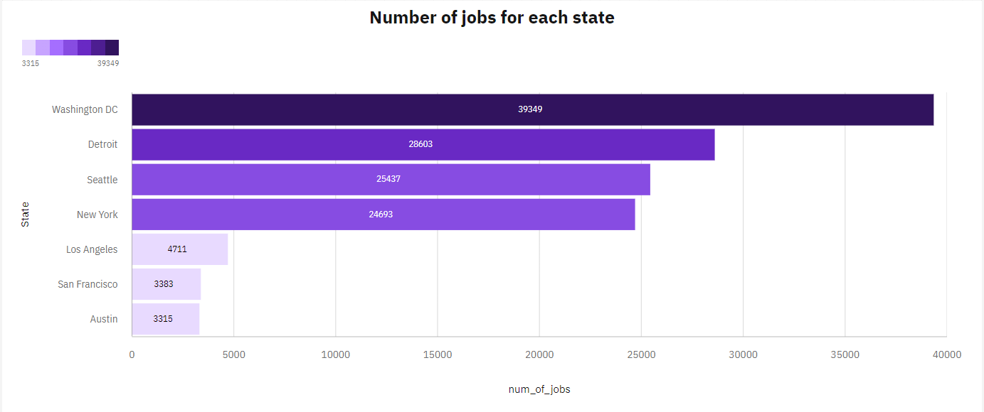

APPENDIX

Slide 18
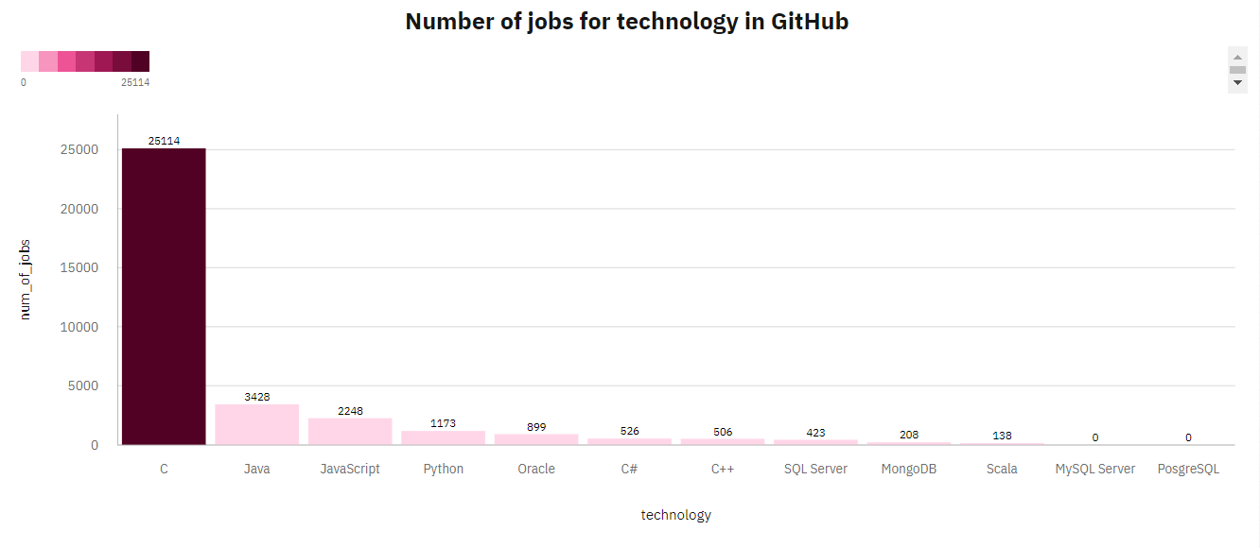
JOB POSTINGS
.

Slide 19
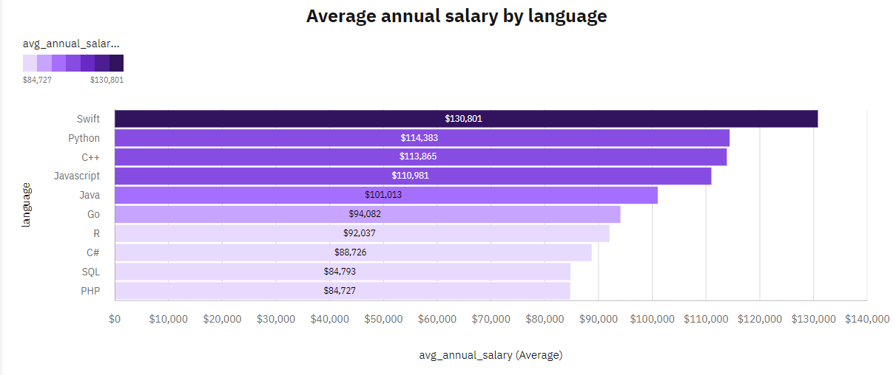
POPULAR LANGUAGES
.

Slide 20
Thank you
Email: yousefayman20003@gmail.com
LinkedIn: www.linkedin.com/in/yousef-ayman-2a0796230

