Slide 1

Smart Home
IOT Training Final Project

Slide 2
Project Description :
A smart home allows homeowners to control appliances, thermostats, lights, and other devices remotely using a smartphone or tablet through an internet connection.
Smart homes can be set up through wireless or hardwired systems. Smart home technology provides homeowners with convenience and cost savings.

Slide 3
Project Team :
Mohammed Mustafa ID:20221466196
Youssef Ayman ID:20221041099
Kholoud Wahed ID: 20221444910
Maryam Wael ID : 20221444884
Nour Ashraf ID: 210101067
Rawana Khaled ID: 20221376722

Slide 4
Project phases and roles :
Maquette Design : Nour Ashraf , Maryam Wael , Kholoud Wahed.
Simulation for the smart home on tinker cad and its code : Kholoud Wahed and Maryam Wael .
Hardware and kit application and its Arduino code : Mohammed Mustafa .
Firebase phase : Youssef Ayman .
Web phase : Rawana khaled and Nour Ashraf .

Slide 5
Project phases overview :
Phase one : a wooden maquette is designed to simulate a smart home which is based on the harmony between sensors and actuators ..
Sensors used in the smart home :
- Gas sensor
- PIR sensor
- Ultrasonic sensor
Actuators used :
- Servo motor .

Slide 6
Project phases overview :
There are also some other used components :
-Breadboard
4 LEDS
Jumper wires
Keypad
LCD
ESP32 (micro-controller)

Slide 7
Project phases overview :
Simulation on tinker cad :
We used Tinkercad to simulate the circuit using Arduino Uno and the rest of components dragged , dropped and all connected together to build a visual imagination after being coded .
Link of the simulation :
https://www.tinkercad.com/things/bRb61NGK3dI?sharecode=tx5S9LCKjHGuqVAyJrgXZ_x08jBMtTzOGH3mv601Guk

Slide 8
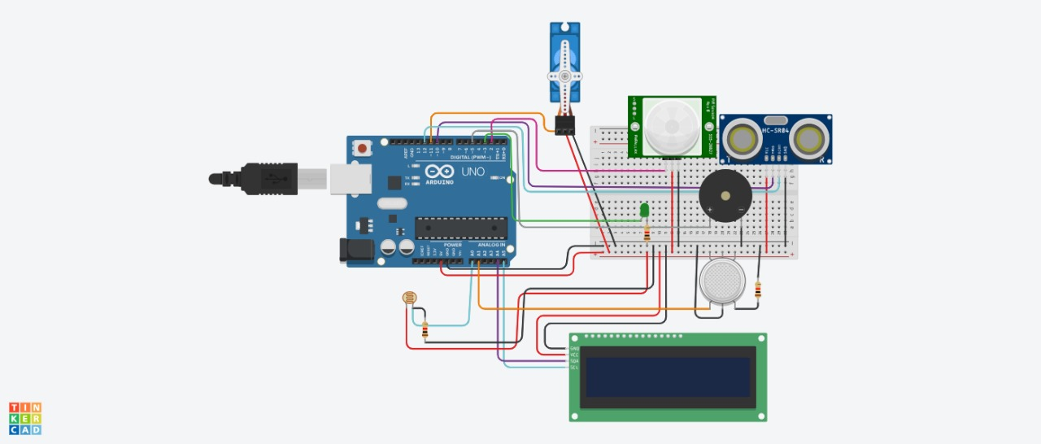
Project phases overview:
Simulation on tinkercad :

Slide 9
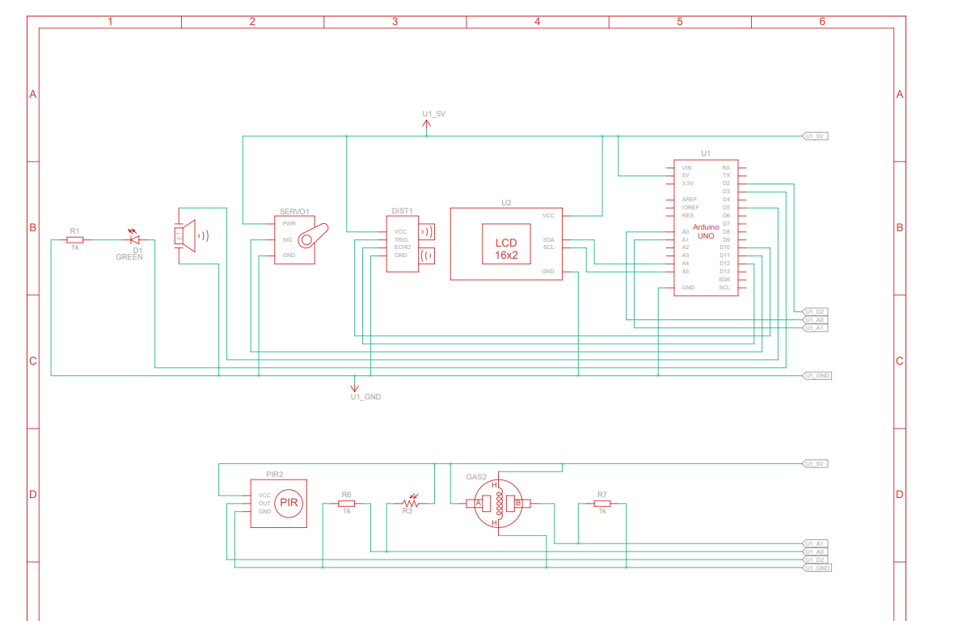
Project phases overview:
Schema of the circuit:

Slide 10

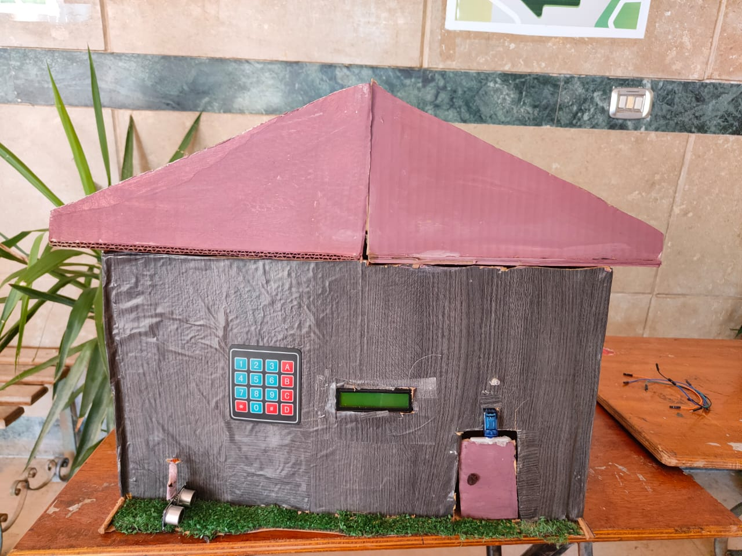
Project phases overview:
Hardware application of the circuit using real components then applying them on the maquette ..

Slide 11
Project phases overview:
The web application phase :
Working with firebase : React Dashboard with Firebase Integration
Components and Libraries Used:
React , Firebase & Firebase Real_time Database.
Key Features:
State Management: State variables are updated using the corresponding set functions.
Data Fetching :on Value function from the firebase/database library is used to listen for changes in the database and update the React state accordingly.

Slide 12
Project phases overview:
Working with firebase : React Dashboard with Firebase Integration
Components and Libraries Used:
React , Firebase & Firebase Real_time Database.
Key Features:
State Management: State variables are updated using the corresponding set functions.
Data Fetching :on Value function from the firebase/database library is used to listen for changes in the database and update the React state accordingly.

Slide 13
Project phases overview:
Key Features:
Data Updates: The updateLedStatus and updateDoorStatus functions handle the updating of LED and door status in the database. They use the set function from the firebase/database .
Error Handling and Notifications
Emergency Conditions:
An error notification is displayed if either invalid_password or thief conditions are true.
Initial Data Fetch
Sensor Data Display: The lastSensorReading state variable stores the latest sensor reading fetched from the database.

Slide 14
Project phases overview:
Firebase Phase:
1. Initialization Phase:
Include the Firebase and helper libraries
Define necessary constants like WiFi credentials, Firebase API key, database URL
Define Firebase auth objects like auth and config
Define variables to store sensor data and paths
2. Connection Phase:
Initialize WiFi connection
Configure NTP time synchronization
Assign config properties like API key and database URL
Assign user authentication credentials
Call Firebase.begin() to start connection

Slide 15
Firebase Phase Cont. :
3. Streaming Phase:
Define streamCallback and streamTimeoutCallback functions
Begin streaming with Firebase.beginStream()
Set stream callback functions
4. Writing Phase:
Get timestamp
Set sensor data paths
Write data to RTDB with writeDataInt() and writeDataBool() functions

Slide 16
Firebase Phase Cont.
5. Action Phase:
Handle any triggered actions based on sensor values
Unlock door
Control lights
6. Loop Continuous:
Periodically get new sensor data
Write updates to RTDB
Handle any actions in loop continuously

Slide 17
Firebase Phase Cont.
So in summary, it initializes connection, begins streaming, reads/writes data, and handles actions in a continuous loop to sync data and control IoT devices via Firebase Realtime Database.

Slide 18
Project phases overview:
The last phase is to run all codes and integrate them to end up with a simple model for a smart home ..
To sum up the idea of the smart home:
-Distance measurement using an ultrasonic sensor is performed by sending an ultrasonic pulse and measuring the time it takes to receive the echo. The distance is calculated based on the speed of sound.If the measured distance is less than or equal to 5 cm, it indicates that someone is nearby the door.

Slide 19
Project phases overview:
The code prompts for a password via the Serial monitor and checks if the entered password matches the predefined password. If the password is correct, the door is opened (servo rotates to 90 degrees) and then closed (servo rotates to 0 degrees) after a delay.
If the password is incorrect, an appropriate message is displayed on the LCD.

Slide 20
Project phases overview:
If the measured distance is greater than 5 cm, the code continues to check other functionalities:Gas level is read from the gas sensor. The distance and gas level are displayed on the LCD.If the gas level is above 100, the buzzer and LED are activated to indicate a high gas level.PIR sensor is checked for motion detection. If motion is detected, the LED is turned on, otherwise, it is turned off.
Light level is read from the light-dependent resistor (LDR). If the light level is below 100, the LED is turned on, otherwise, it is turned off.

Slide 21
Thank You

