Slide 1
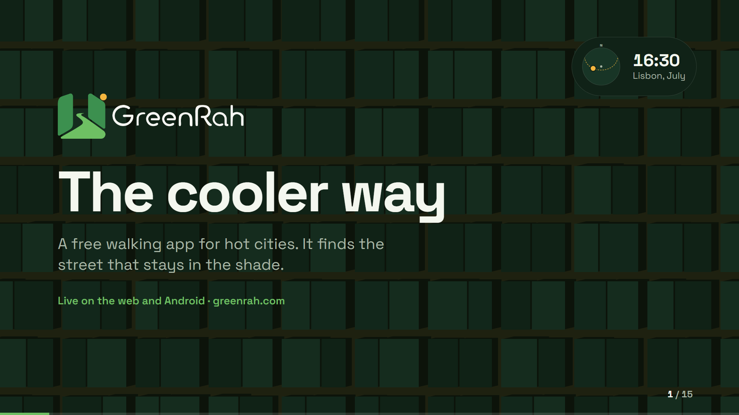
Notes:
Hello, I am Yousef, founder of GreenRah. GreenRah is a free walking app for hot cities. In a European summer, the shortest street is often the one that bakes you in the sun. GreenRah finds the street that stays in the shade. It is live today on the web at greenrah.com/app and on Android. The shadows behind me move with the real sun over Lisbon in July. That is the whole idea: shade moves, so your route should move with it. Our tagline says it simply: The cooler way.

Slide 2
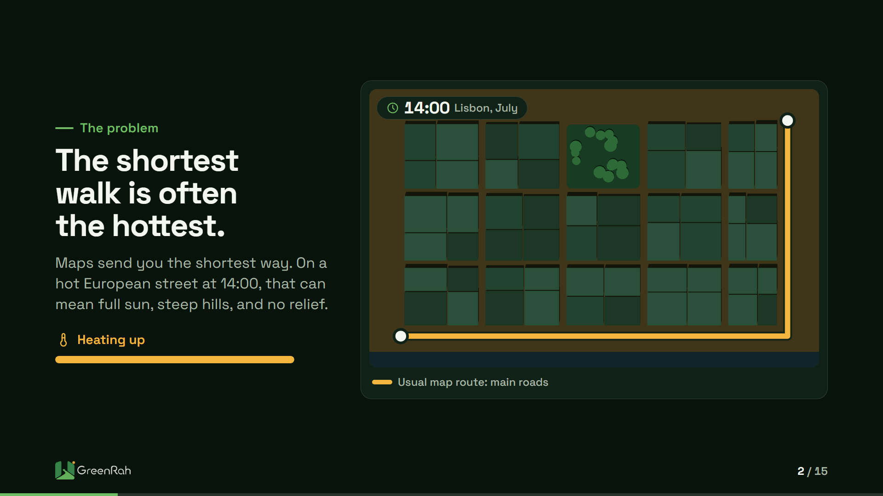
Notes:
Think about the last time you crossed a city at two in the afternoon in July. Your map gave you the shortest route. It did not ask whether that street had any shade, or whether it climbed a hill in full sun. On screen, the same route heats up as the morning turns into early afternoon. Nothing about the route changed. The heat did. Maps optimise for minutes. People feel degrees. For seniors, parents with strollers, and visitors who do not know the streets, that gap is more than discomfort.

Slide 3
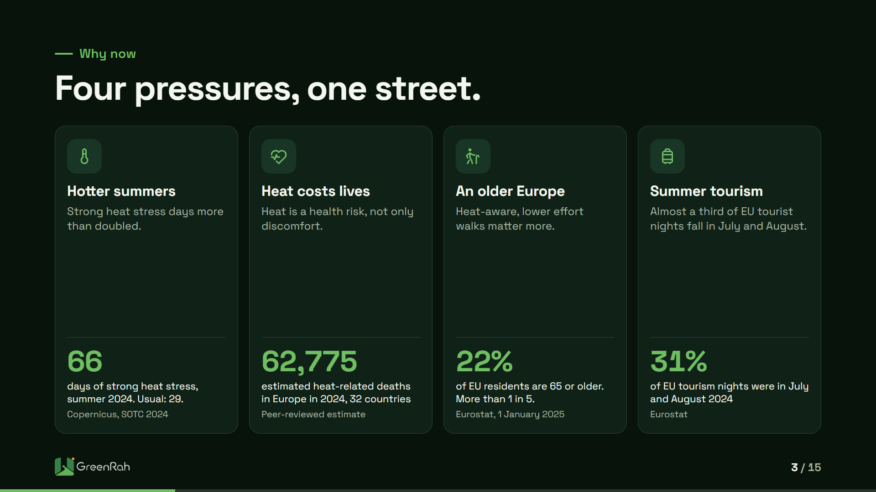
Notes:
Four things are happening at once. In summer 2024, southeastern Europe had 66 days of strong heat stress, more than twice the usual 29, according to Copernicus. Heat costs lives: a peer-reviewed estimate puts heat-related deaths in Europe in 2024 at 62,775 across 32 countries. Europe is ageing: 22 percent of EU residents are 65 or older. And summer is when people walk: 31 percent of EU tourist nights fall in July and August, and 89.1 percent of surveyed Lisbon tourists walked. Lisbon is projected to see almost 10 days a year above 35 degrees this century.

Slide 4
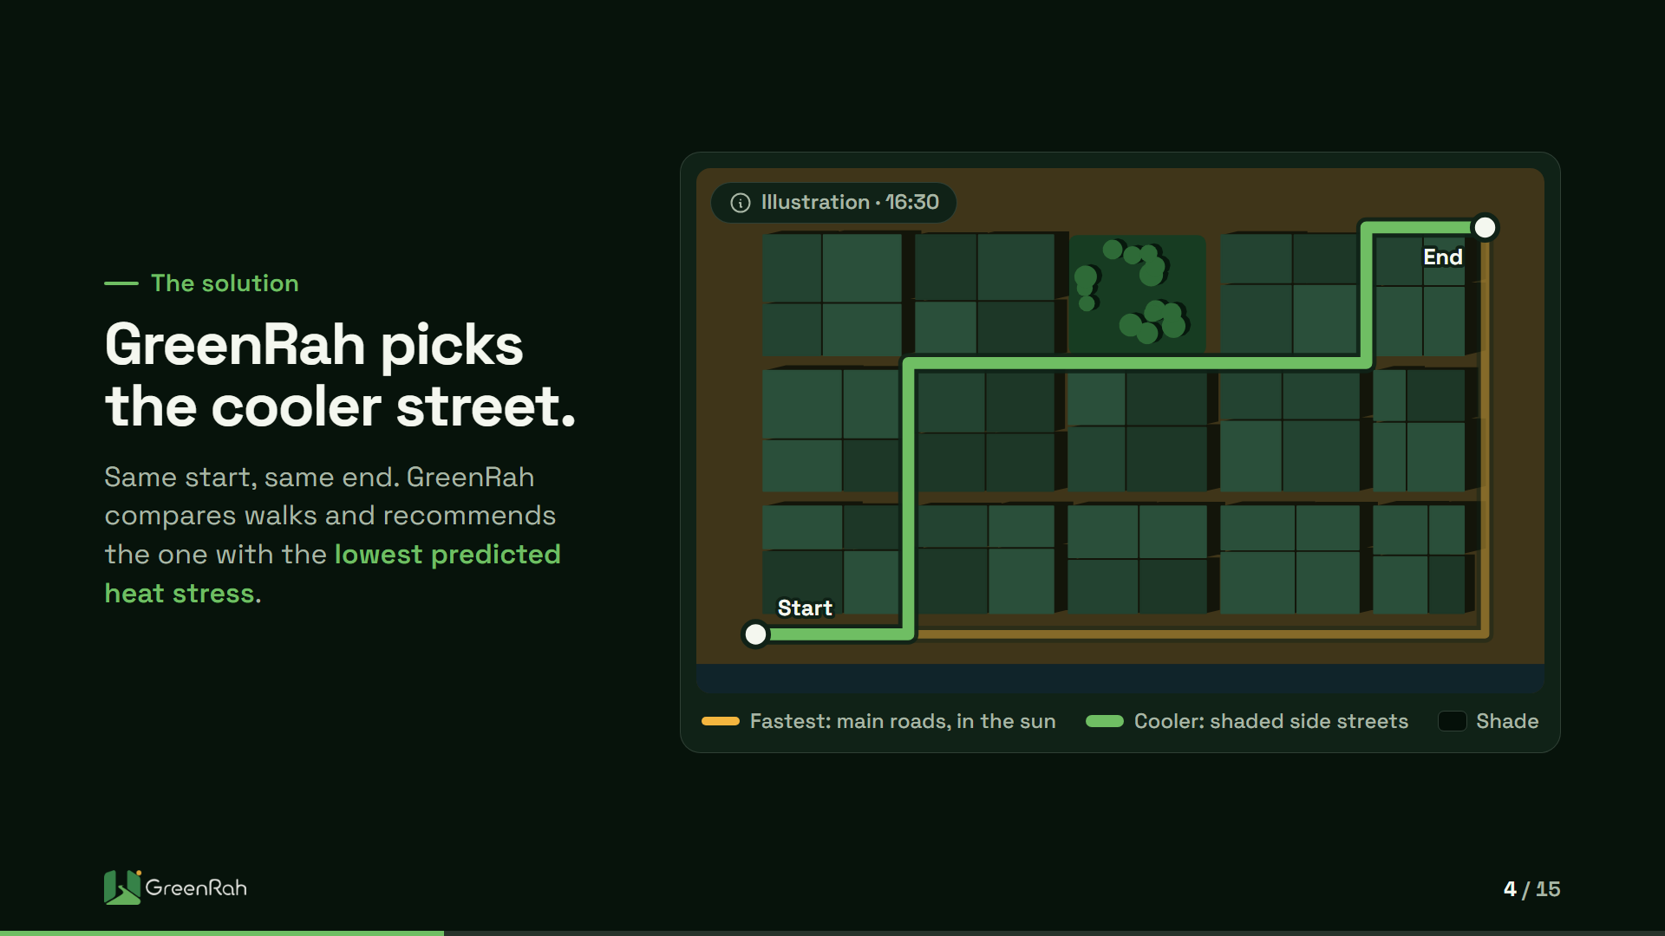
Notes:
Here is the core idea in one picture. Same start, same end. The amber line is the fastest walk. It takes the wide main roads: direct, but in full sun. The green line is the cooler walk. It follows narrow side streets where buildings cast shade at this hour. GreenRah compares the options and recommends the one with the lowest predicted heat stress. We still show the fastest walk, so you can see the trade-off. If asked about the science: MIT Senseable City Lab found a shaded route about 1.3 percent longer with 8.8 percent less direct sun.

Slide 5
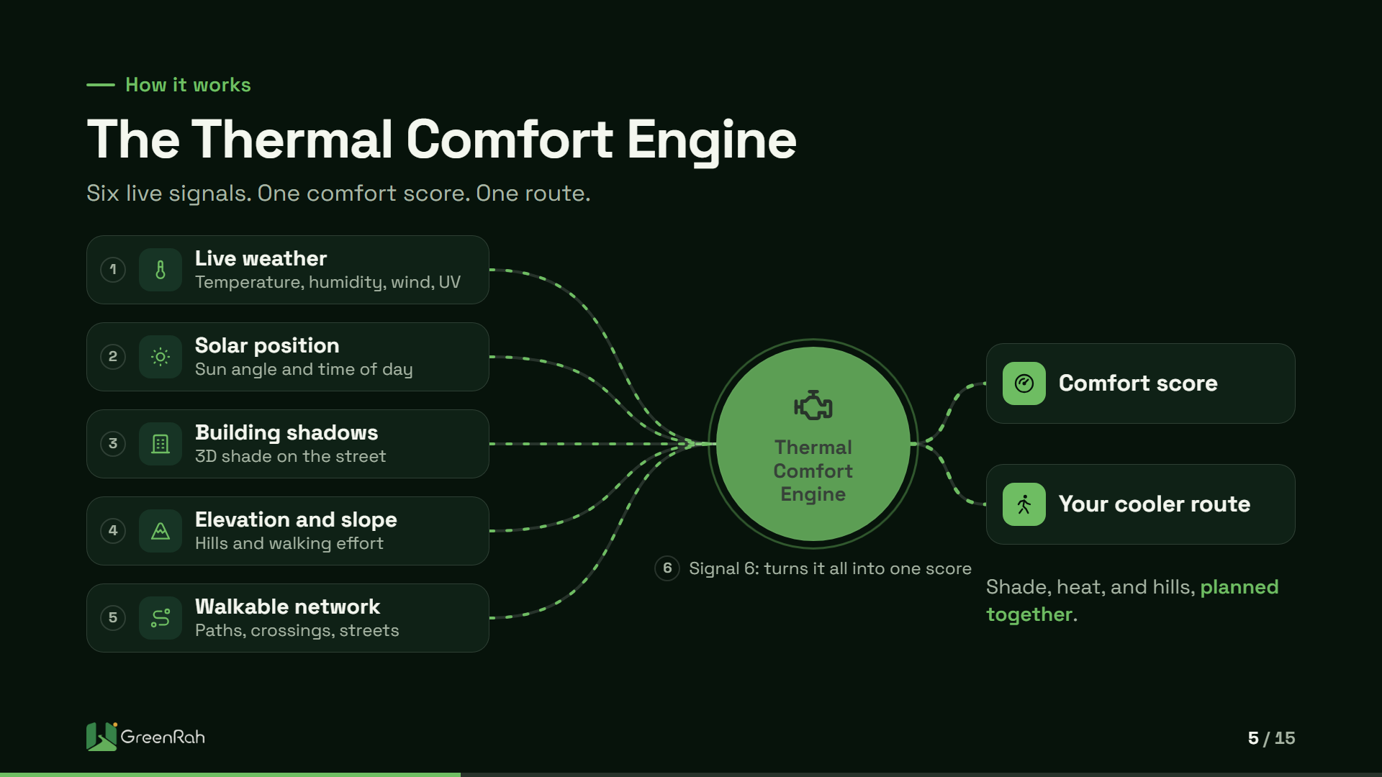
Notes:
Under the hood is the Thermal Comfort Engine. It combines six signals. Live weather: temperature, humidity, wind, and UV. The position of the sun for your date and time. Building shadows from 3D shapes, so we know which side of a street is shaded. Elevation and slope, because a hill in the sun is harder than a flat street. The walkable network: paths, crossings, and streets. And the engine itself, which turns all of that into one comfort score and a route. Google Maps plans for time. We plan shade, heat, and hills together.

Slide 6
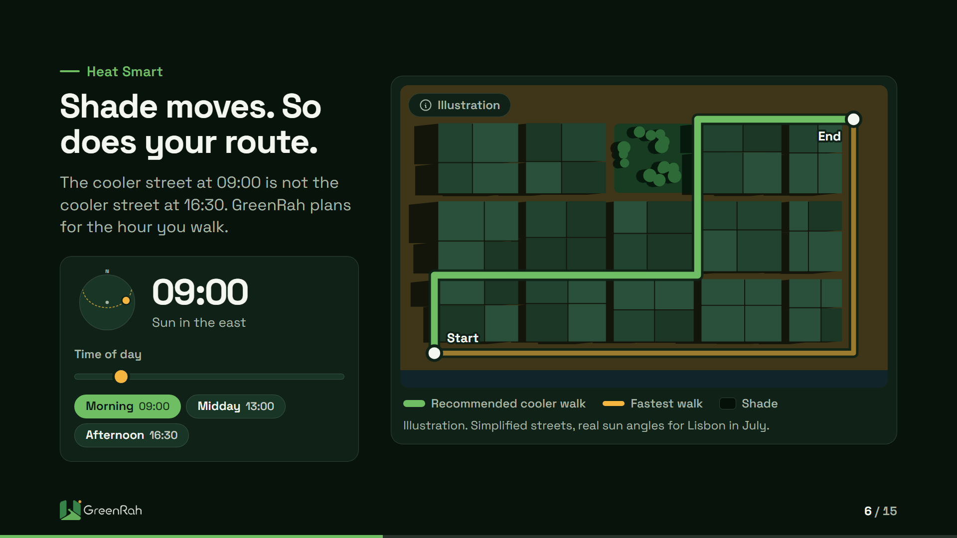
Notes:
This is the part people remember: shade moves. The map uses simplified streets but real sun angles for Lisbon in July. At nine, the sun is in the east and one set of side streets is shaded. At one, shadows are short and there is little shade anywhere. By half past four, the sun is in the west and a different street becomes the cooler one. The main roads stay in the sun almost all day. GreenRah plans for the hour you will walk, not the hour you open the app. You can drag the slider live if someone asks. No percentages here, on purpose.

Slide 7
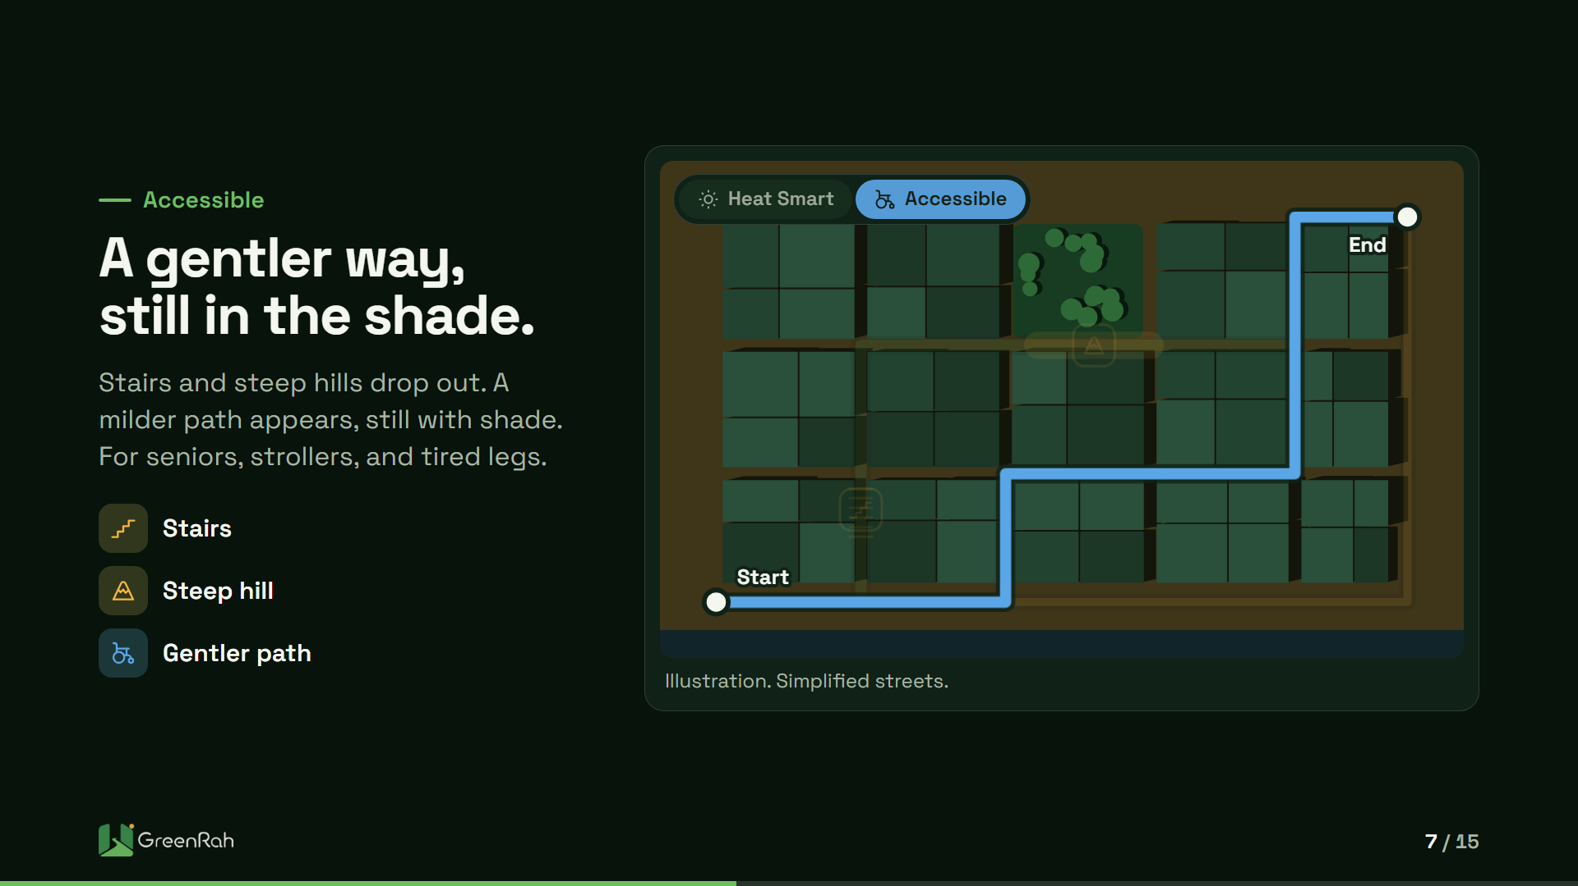
Notes:
Heat is not the only problem. For a senior, a parent with a stroller, or someone using a wheelchair, stairs and steep hills can make a route impossible. Switch to Accessible, and GreenRah avoids stairs and prefers milder slopes, while still looking for shade. On screen, the stairs and the steep block drop out, and a gentler path appears in blue. It may not be the shortest, but it is a walk people can actually take. Accessible works across EU countries and Great Britain, the same as Heat Smart.

Slide 8
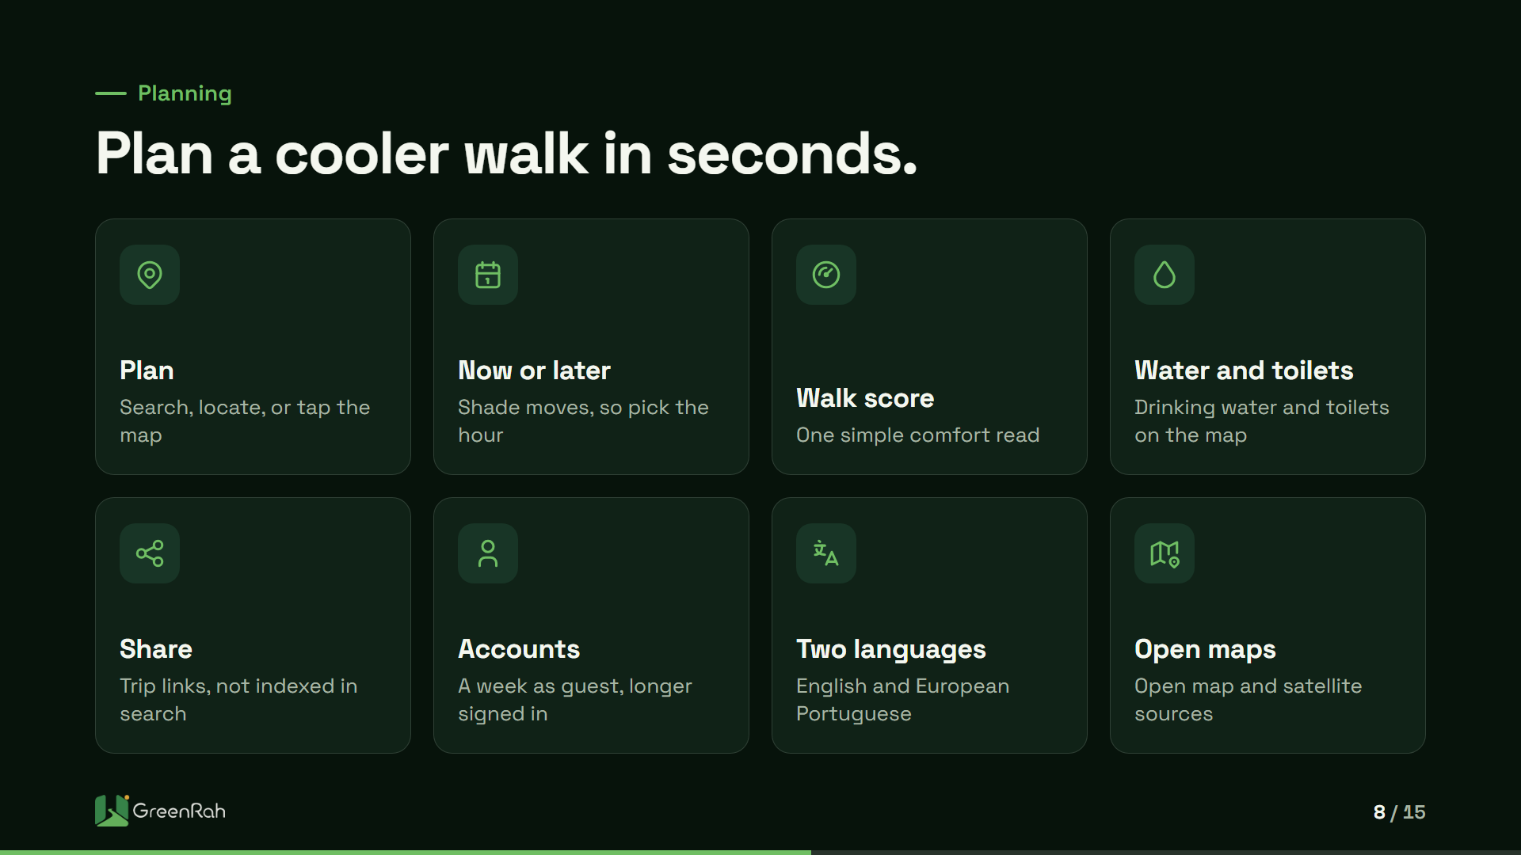
Notes:
Planning is simple. Search a place, use your location, or tap the map, and swap start and end in one tap. Pick now or later, because shade at nine is not shade at five. Each route gets a walk score: one simple comfort read, not a pile of weather numbers. The map shows drinking water and public toilets, which matter in summer. You can share a trip link, and those links are not indexed in search. Guests plan about a week ahead; signed in accounts get a longer window. English and European Portuguese today.

Slide 9
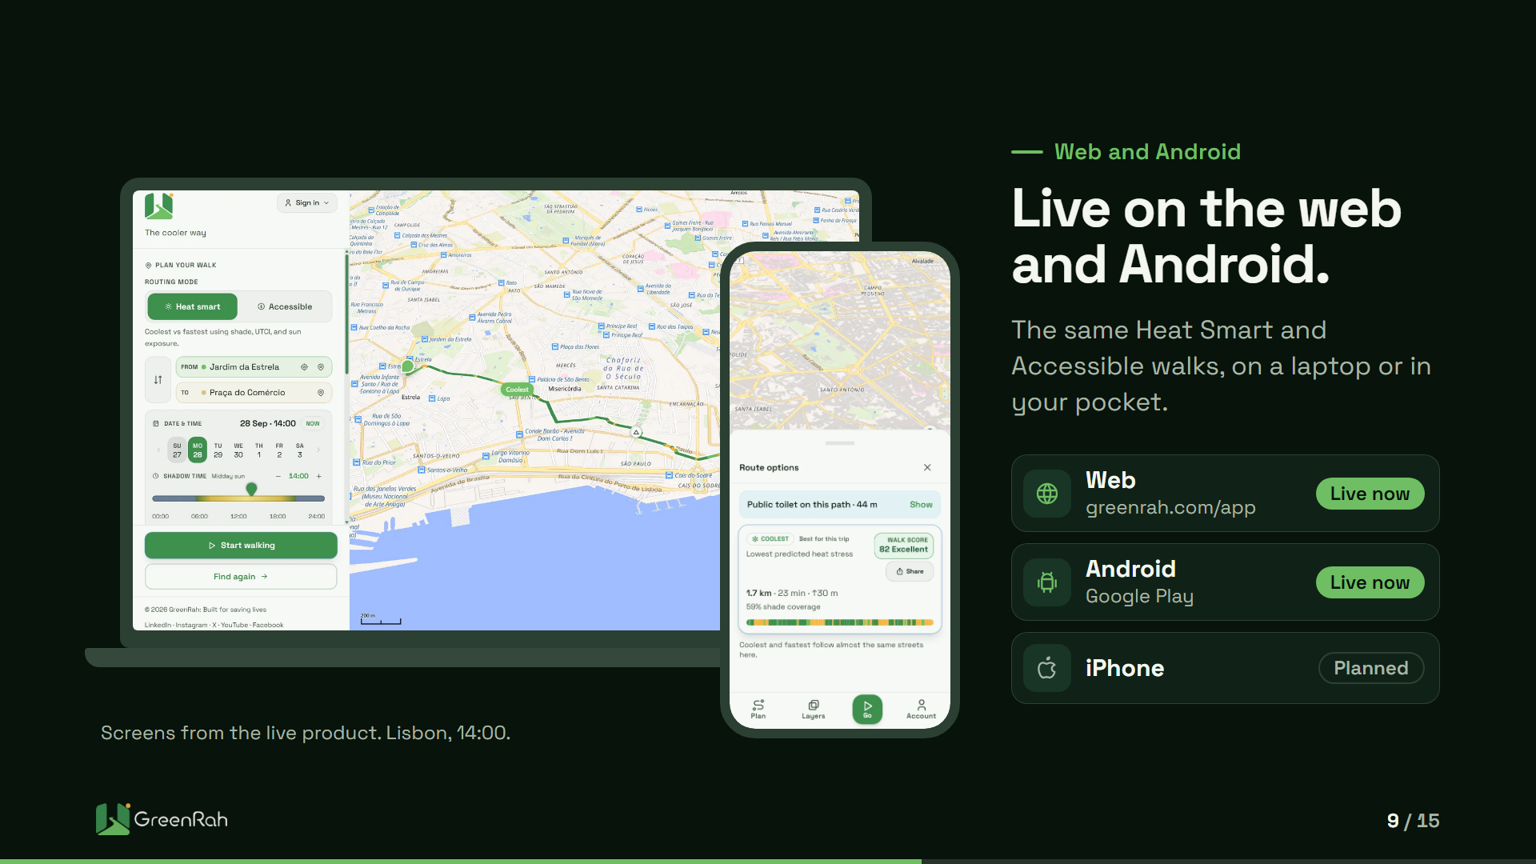
Notes:
GreenRah is live, not a concept. On a laptop, the map is at greenrah.com/app. In your pocket, the Android app is on Google Play, with the same Heat Smart and Accessible modes. An iPhone app is planned. The screens are from the live product: walks from Jardim da Estrela in Lisbon at two in the afternoon, with a walk score, a share button, and a public toilet along the path. Everything is free. There is no paywall on the walk.

Slide 10
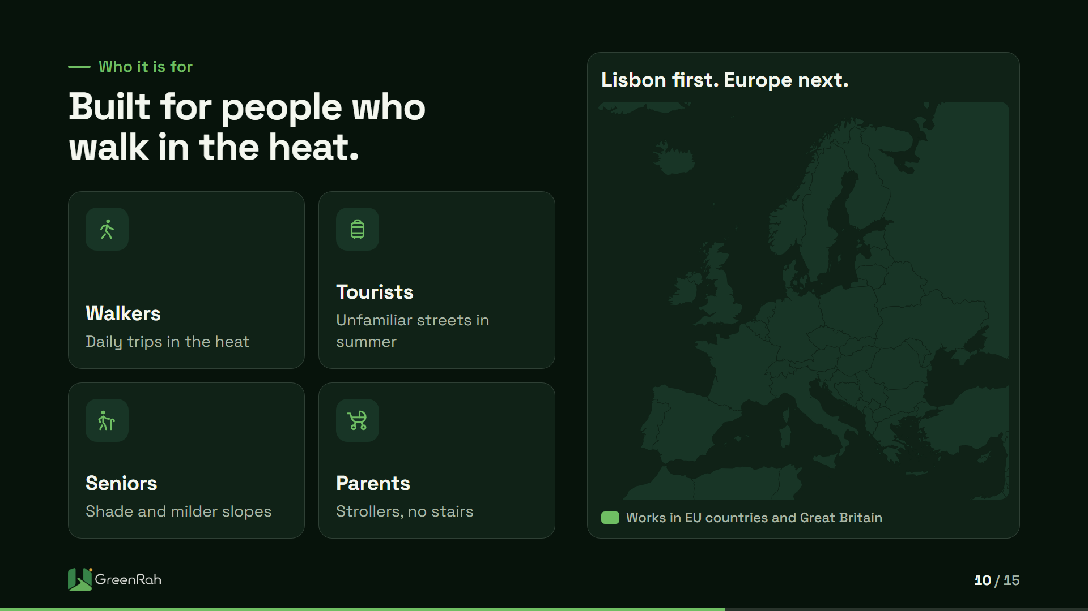
Notes:
Who is this for? Walkers doing daily trips in the heat. Tourists on unfamiliar streets in summer. Seniors, who need shade and milder slopes. Parents with strollers, who need a path without stairs. Lisbon is the first city our story is built around: hilly, sunny, and full of visitors. The product already works across EU countries and Great Britain, highlighted on the map. The app works only inside that area today. Europe is the aim.

Slide 11
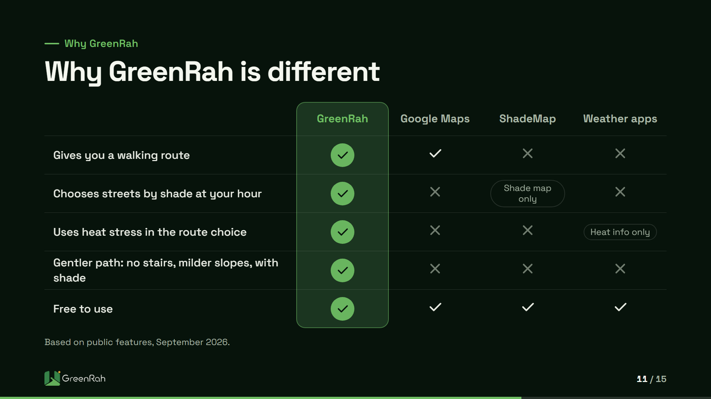
Notes:
How is this different? Google Maps is excellent at getting you somewhere fast, but it does not choose streets by shade at your hour, or weigh heat stress. ShadeMap is a lovely tool that shows where shadows fall at any hour, but it does not plan a walk for you. Weather apps tell you it is hot, but give no route. GreenRah combines the route, the shade, and the heat, and adds a gentler path without stairs. This table is based on public features as of September 2026.

Slide 12

Notes:
Where are we today? GreenRah is live on the web and on Android. Heat Smart and Accessible routing cover EU countries and Great Britain: that is 28 countries and more than 2,000 cities with walking maps. Shade detail is richest in Lisbon and Coimbra, and we keep rebuilding it city by city with open building data. Two languages, English and European Portuguese. Two platforms, with iPhone planned. In November we are at Web Summit in Lisbon as an ALPHA startup, from the tenth to the twelfth. Come and find us.

Slide 13
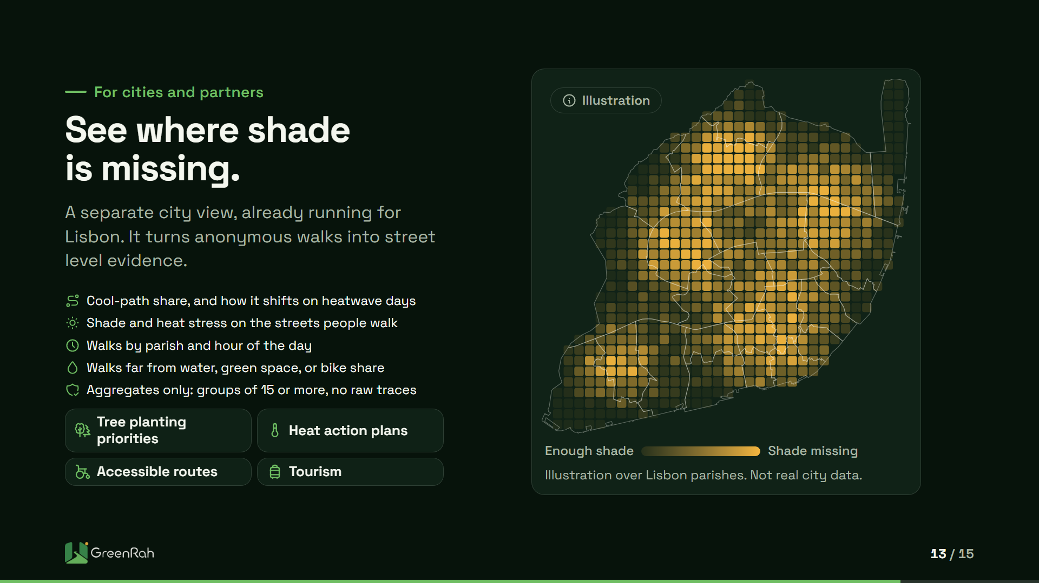
Notes:
The same technology helps cities. The city view already runs for Lisbon, separate from the public app. From consented, anonymous walks it shows how often people pick the cooler path, and whether that rises on heatwave days. It shows shade and heat stress on the corridors people use, walks by parish and hour, and trips far from drinking water, green space, or bike share. That tells teams where to plant trees, add water, or fix a route first. Data is aggregated in groups of at least 15 people, and we never sell raw traces. The grid here is an illustration.

Slide 14
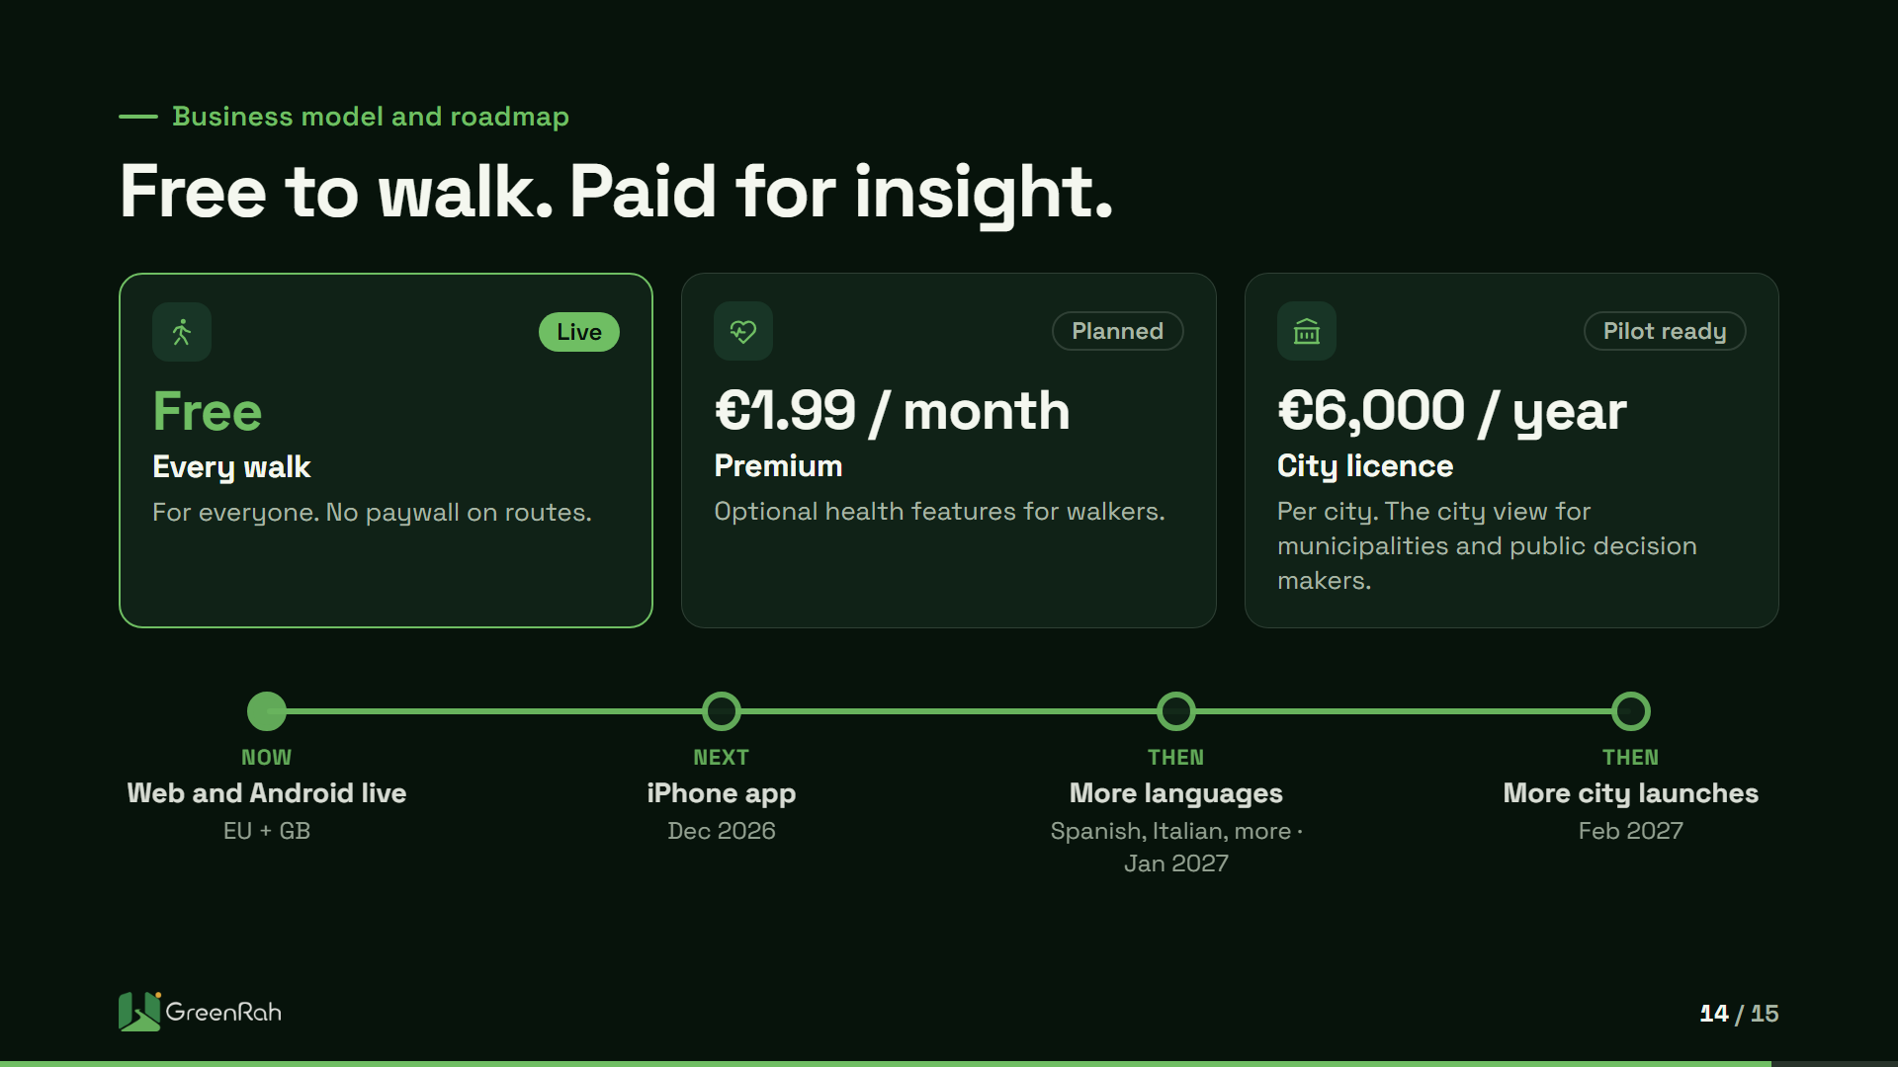
Notes:
How does GreenRah make money? The walk stays free for everyone. That is the promise, and it is how we grow. On top of that come two paid layers. Premium, at 1.99 euros a month, adds optional health features for walkers who want them. A city licence, at 6,000 euros per year per city, gives municipalities the city view. It is built and running for Lisbon, and it grows more useful as walk volume grows. Next: the iPhone app in December 2026, Spanish and Italian in January 2027, and more city launches in February 2027.

Slide 15

Notes:
I am Yousef Ebrahimi, founder and product lead of GreenRah. We are raising investment to grow: to improve the product, to fund marketing, and to hire so the team can grow. We are looking for three kinds of partners. Investors who see heat adaptation as everyday infrastructure. Cities and public bodies who want to pilot the city view. And tourism and health partners who want their visitors and patients to walk safer in summer. Scan the code to open GreenRah on your phone right now. GreenRah is built by Greenrah OÜ in Estonia. Thank you. The best path is not the fastest. It is the coolest.

