Slide 1
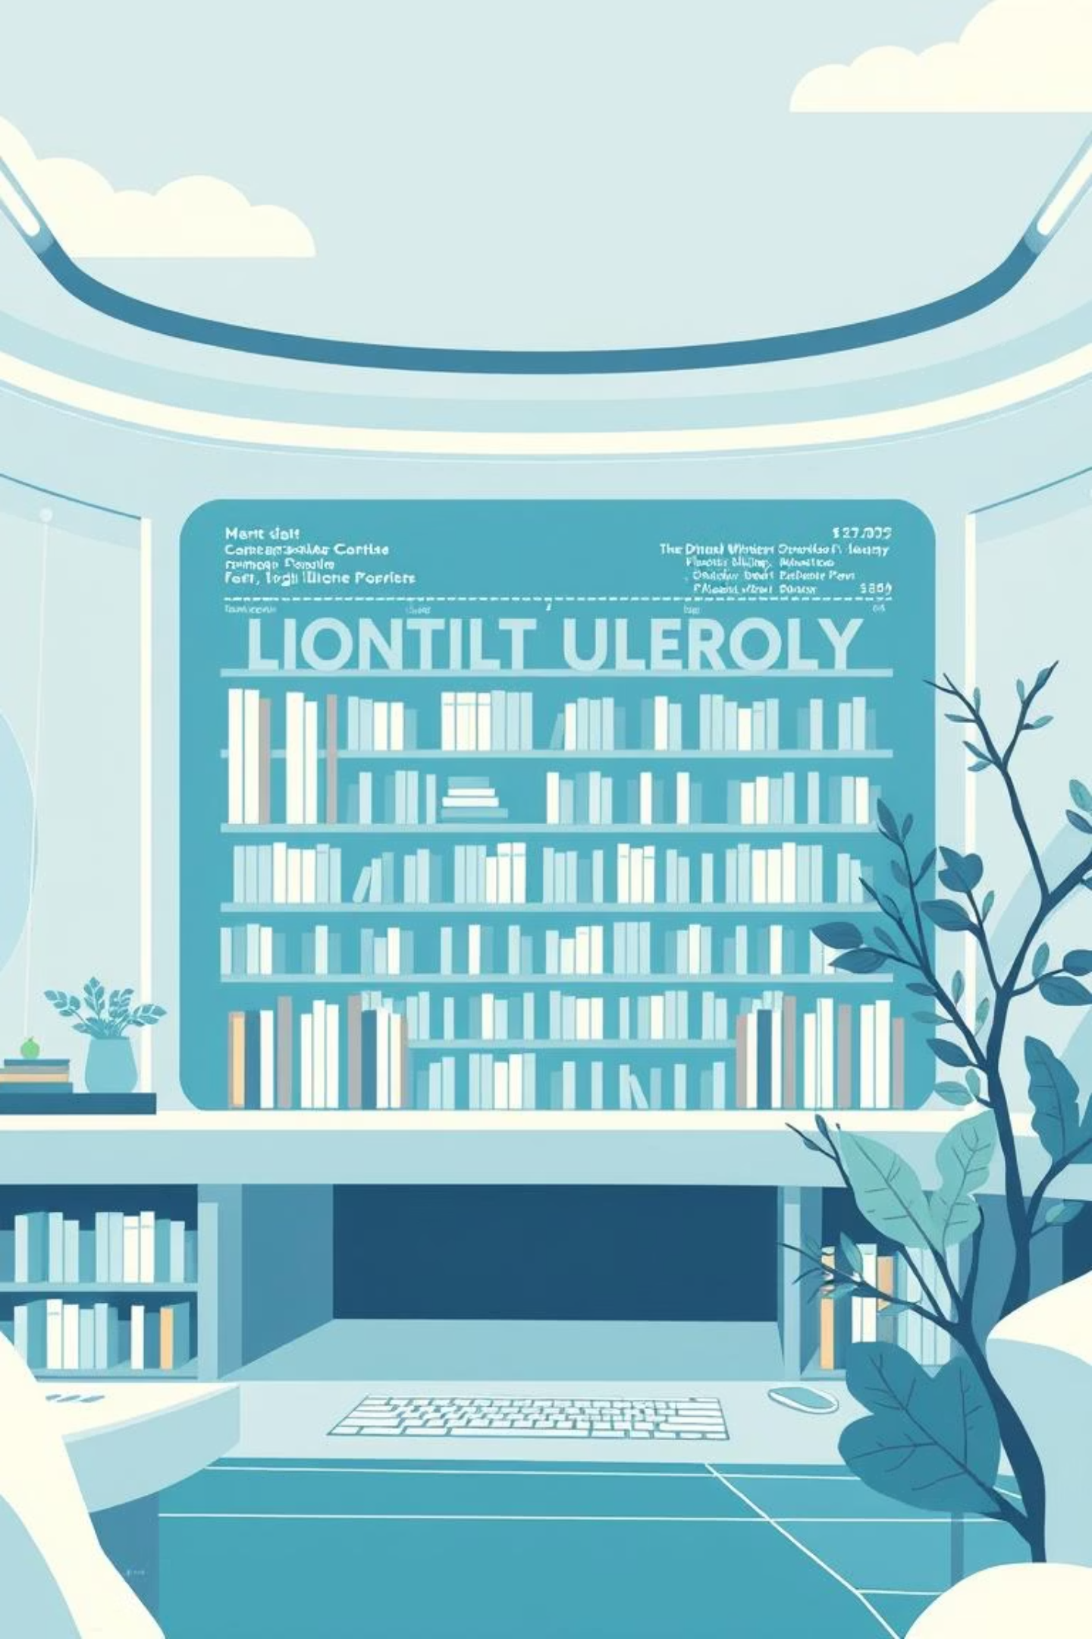
EBook - Digital Library System
A Modern Web Application with Clean Architecture
Presented by: E-Book Team
Project Realese, September 2025

Slide 2

Project Vision & Goal
Our vision is to create a comprehensive digital library platform that seamlessly connects booksellers (libraries) and readers worldwide.
Main Objective
To provide an intuitive, scalable, and secure system for managing, selling, and lending both digital and physical books.
Target Audience
Vendors
Customers
Libraries, publishing houses, and booksellers seeking an efficient management solution.
Readers, students, and educational institutions looking for diverse content and easy access.

Slide 3





Key Features: For Customers
Our platform offers a rich set of functionalities designed to enhance the reading experience and streamline access to books.
Account Access
Advanced Search
Purchase Options
Effortlessly log in or create a new account to manage your profile.
Discover books quickly with powerful search capabilities and filters.
Securely purchase electronic (PDF) or physical book copies.
Digital Lending
Personal Dashboard
Borrow digital books for a limited duration, perfect for casual reading.
Track all your orders, borrowed items, and activity in one centralized place.

Slide 4




Key Features: For Vendors
We empower libraries and publishers with robust tools to manage their inventory, sales, and user interactions efficiently.
Registration & Approval
Book Management
Streamlined system for vendors to register and gain manager approval.
Comprehensive control panel to add, edit, and delete book entries.
Detailed Reporting
Order & Finance Tracking
Access in-depth reports on sales and lending activities for informed decisions.
Manage customer orders and monitor financial performance seamlessly.

Slide 5
Customer Journey
Experience a fluid and intuitive path from discovery to enjoying your chosen books.
01
02
Register / Login
Search & Discover
Begin by creating a new account or logging into your existing profile.
Explore our vast collection using advanced search and browsing tools.
03
04
Buy or Borrow
Checkout
Add selected books to your cart, choosing between purchase or digital borrowing.
Complete your transaction securely through our integrated payment process.
05
06
Access
Dashboard
Instantly download your eBook or track the shipment of your physical copy.
Manage your requests, borrowed items, and track order statuses from your personalized dashboard.

Slide 6

Technical Deep Dive: The Architecture
Our digital library system is meticulously engineered using a Clean Architecture approach, ensuring a robust, flexible, and future-proof foundation.
Why Clean Architecture?
Separation of Concerns
Enhanced Maintainability
Each component has a single, well-defined responsibility, preventing tangled codebases.
Modifications in one part of the system have minimal impact on others, simplifying updates and bug fixes.
Improved Testability
Business logic can be tested independently of external dependencies like databases or UI, ensuring high quality.

Slide 7

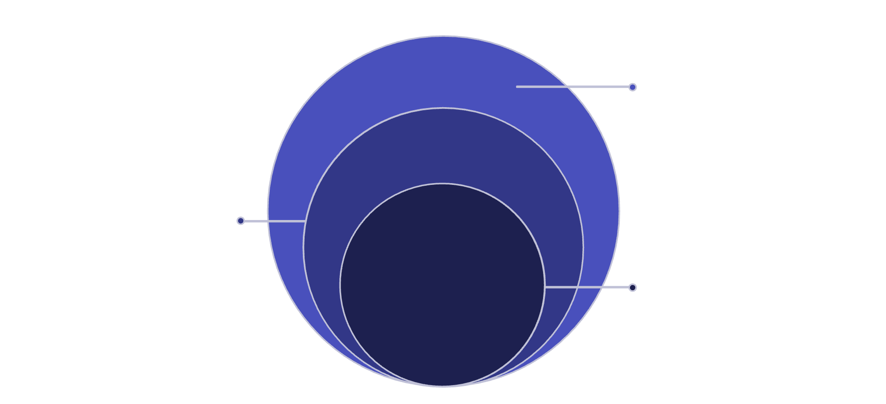
Our Three-Layer Architecture
The core principle of Clean Architecture is the Dependency Rule: all dependencies point inwards.
Digital-Library.Web
UI, controllers, request handling
Digital-Library.Infrastructure
Data access, external services, adapters
Digital-Library.Core
Business rules and domain models
Dependency Rule: Outer layers know about inner layers, but inner layers remain completely unaware of the outside world. This crucial rule promotes isolation and flexibility.

Slide 8
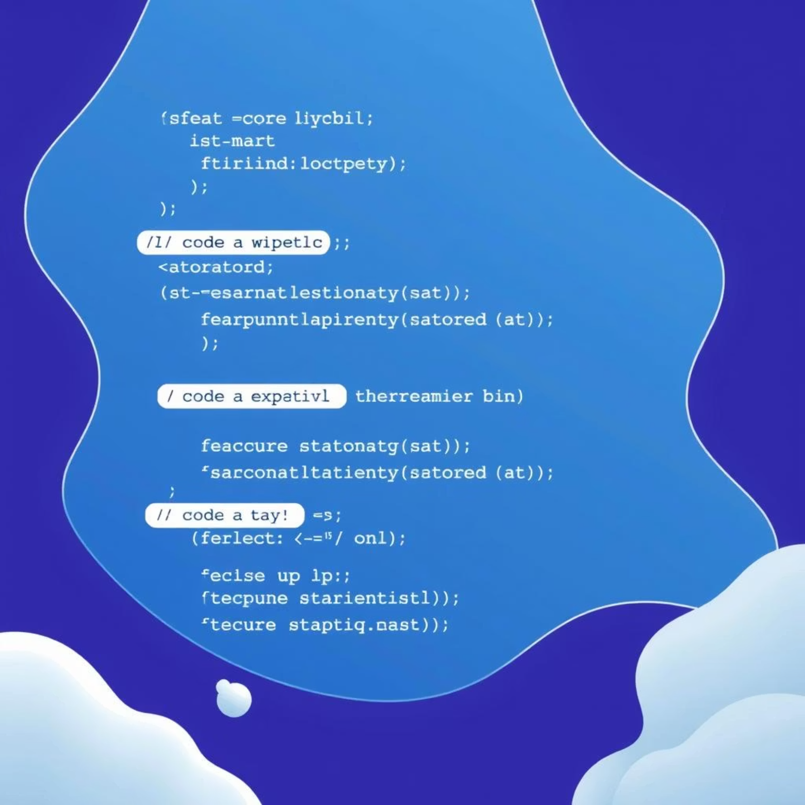

Deep Dive: Core & Infrastructure Layers
Layer 1: The Core (Digital-Library.Core)
Layer 2: The Infrastructure (Digital-Library.Infrastructure)
Purpose: The heart of the application, containing the foundational business rules and entities.
Purpose: Implements technical details and handles interactions with external services and data storage.
Key Components:
Key Components:
Models: Fundamental entities like User, Book, and Vendor.
DbContext: Connects to the database using Entity Framework Core.
Enums: Enumerations such as VendorStatus.
Services: Provide concrete implementations of interfaces defined in the Core, like an EmailSender.
Interfaces (Contracts): Define expected behaviors for services (e.g., IAuthService, IEmailSender).
Crucial Feature: Technical details are isolated here. Changing databases or external services only requires modifying this layer.
Crucial Feature: This layer has no external dependencies, making it independent of specific databases or UI technologies.

Slide 9
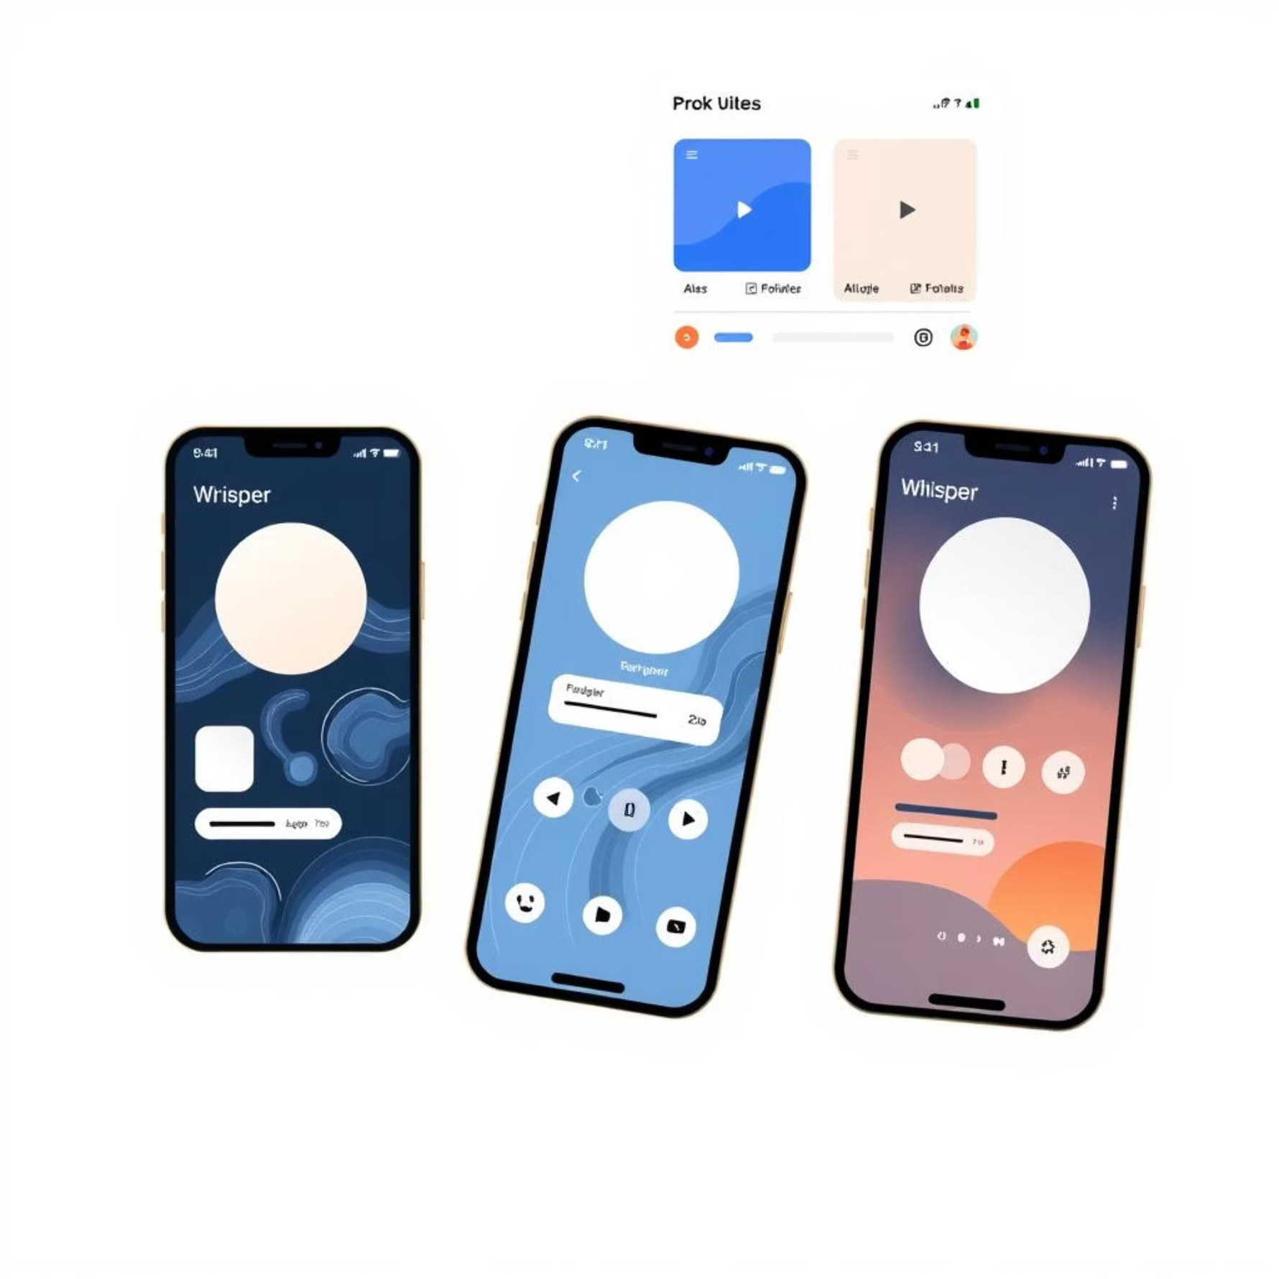









Deep Dive: Web Layer & Technology Stack
Layer 3: The Web (Digital-Library.Web)
Technology Stack
Leveraging modern, robust technologies to build a high-performance and scalable application.
Backend: ASP.NET Core 8, C#, Entity Framework Core, ASP.NET Core Identity.
Frontend: HTML5, Tailwind CSS, JavaScript, jQuery, Chart.js.
Database: SQL Server (flexible for other EF Core-supported databases).
Architecture: Clean Architecture, Dependency Injection.
Purpose: The presentation layer, responsible for user interaction and displaying information.
Key Components:
Controllers: Receive user requests and orchestrate calls to business services (kept "thin").
Views: Dynamic HTML pages powered by Razor and styled with Tailwind CSS.
ViewModels: Interface-specific models ensuring security and data separation.
Program.cs: The application's entry point, stitching all layers together using Dependency Injection.

Slide 10
Future Enhancements & Conclusion
Our commitment to continuous improvement means exciting features are on the horizon for the Digital Library System.
Subscription Model
1
Introduce monthly subscription tiers for unlimited book access.
AI Recommendations
2
Implement intelligent book suggestions based on user reading history.
Multi-Language Support
3
Expand accessibility to a global audience with multiple language options.
Institutional Packages
4
Offer specialized plans tailored for schools and universities.
Robust Testing
5
Strengthen code quality with comprehensive Unit & Integration Tests.

Slide 11
Conclusion
We have successfully established a robust foundation for a modern digital library, leveraging cutting-edge technologies and a resilient Clean Architecture. This project stands as a testament to building professionally organized, full-stack web applications that are both scalable and maintainable for long-term success.

Slide 12
Thank You All!

