Slide 1

Phishing Email Detector "OopsHooked" A Cybersecurity Project
Developed by Yousef Elzidani, a first-year cybersecurity and digital forensics student at University of West of England (UWE), this Python-based tool analyses suspicious emails to detect phishing attempts. It uses keyword analysis, link detection, and formatting checks to calculate a confidence score.
Author: YOUSEF ELZIDANI
The project link “GitHub” : https://github.com/yousefelzidani/-OopsHooked-Phishing_Email_Detector.git

Slide 2





Tools and Materials
Python
Matplotlib
Primary programming language used for development.
Library for data visualisation and creating result charts.
NLTK
PyCharm
Natural Language Toolkit for text processing and keyword analysis.
Integrated Development Environment (IDE) for coding and testing.

Slide 3
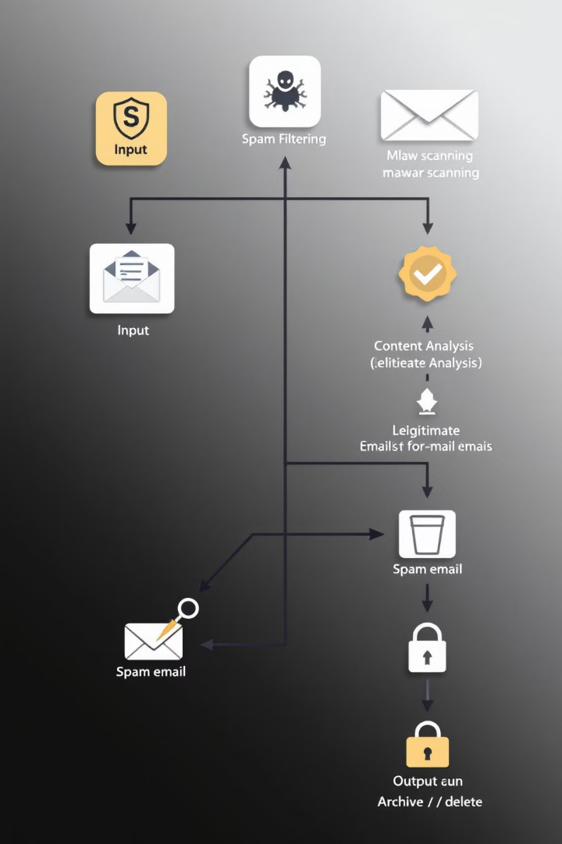




How the Program Works
Input Email
User enters the suspicious email text into the email space variable.
Scan and Analyse
Program detects suspicious keywords, links, and unusual formatting patterns.
Calculate Score
A phishing confidence score is generated based on the analysis.
Output Results
Analysis details are displayed in the console and visualized graphically.

Slide 4
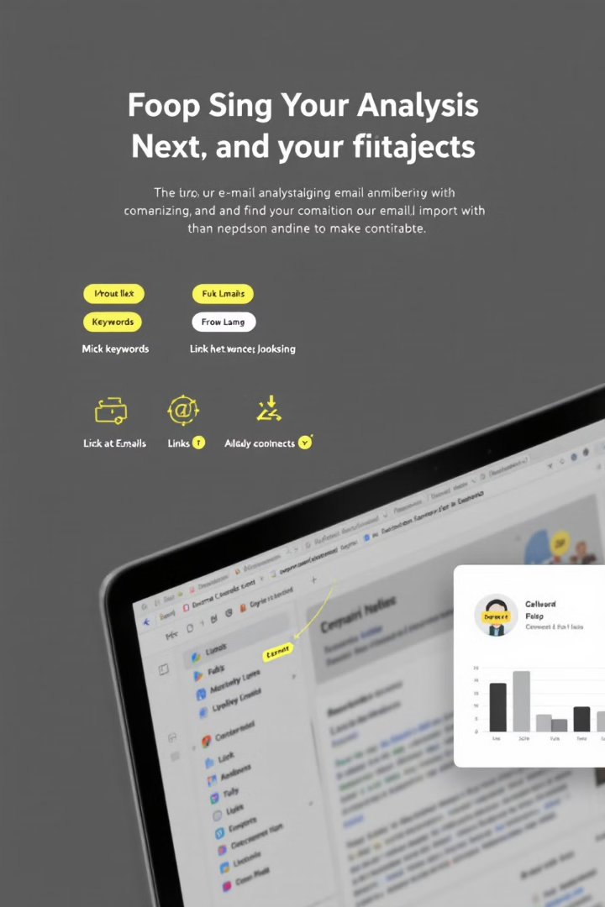
Key Features
Keyword Detection
Link Analysis
Identifies suspicious words commonly used in phishing attempts.
Counts and flags excessive use of hyperlinks in emails.
Format Check
Visualization
Recognizes unusual email formatting that may indicate phishing.
Generates a bar chart to visually summarize the analysis results.

Slide 5
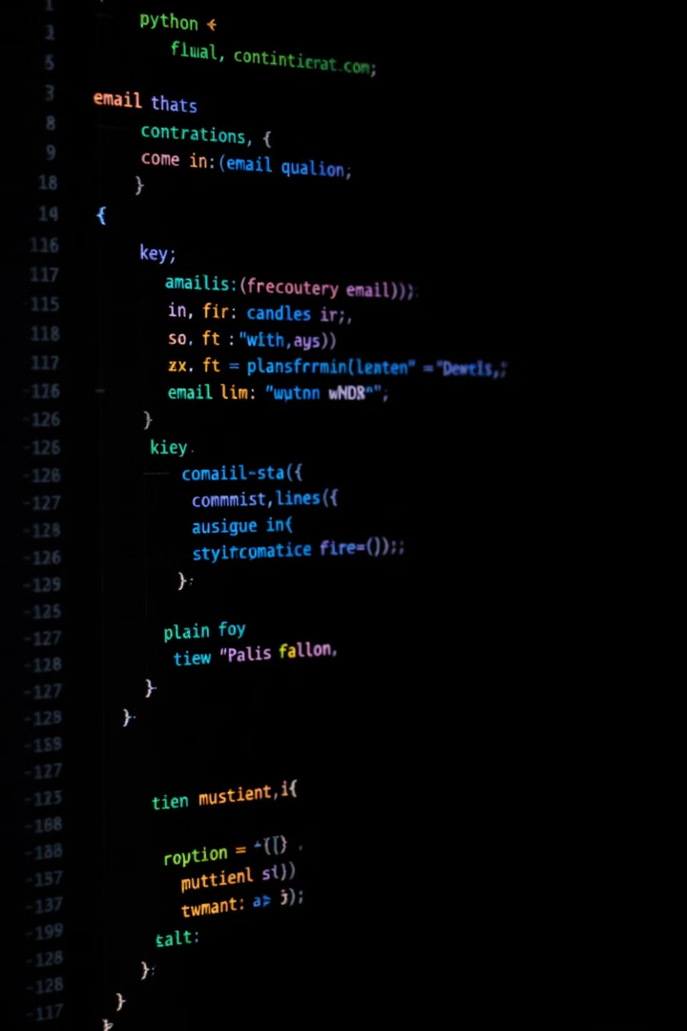
Python Code Overview
Import Libraries
Define Suspicious Keywords
Utilises re, nltk, and matplotlib for various functionalities.
Lists common phrases found in phishing emails.
Analyse Email Function
Visualisation
Creates and saves a bar chart of the analysis results.
Core function that processes the email and calculates the score.

Slide 6
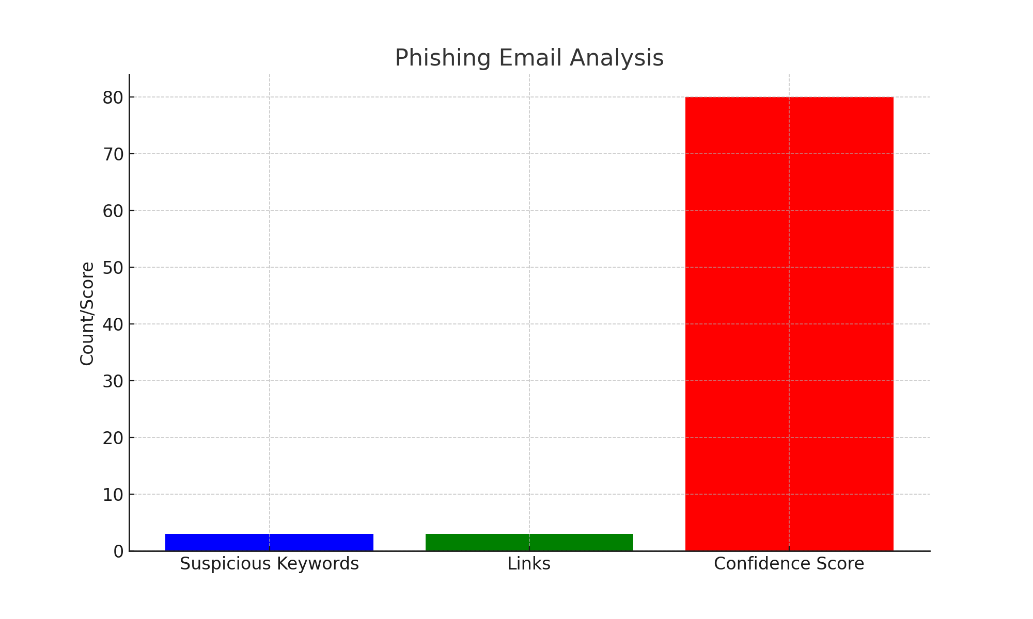
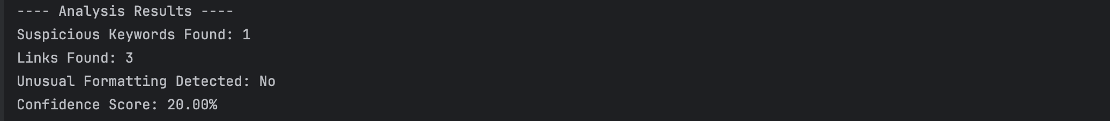
Results and Analysis
Output Components
Visual Representation
Confidence score indicating phishing likelihood
A bar chart is generated to visually display the analysis results, making it easier to interpret the findings at a glance.
Count of suspicious keywords detected
Number of links found in the email
Flag for unusual formatting patterns

Slide 7
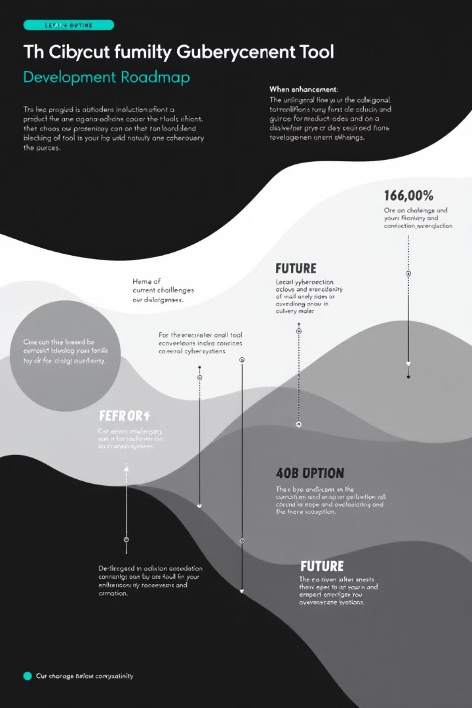
Challenges and Future Enhancements
1
Current Challenges
Matplotlib font cache delay and dependency management issues.
2
Short-term Improvements
Optimise code for faster execution and streamline library installations.
3
Long-term Goals
Implement machine learning for advanced detection and create a web based UI.

Slide 8
Conclusion and Next Steps
1
Refine Detection Algorithms
2
Expand Feature Set
3
Improve User Interface
Add domain analysis for identifying fake senders.
Develop a more intuitive, web-based interface.
Enhance accuracy of phishing identification.
4
Integrate Machine Learning
Implement AI for more sophisticated phishing detection.

