Slide 1
SpaceDrums
Camera-Based AI Virtual Drumming System
Current prototype and verified evidence
Six team roles
17 October 2026
Notes:
# Team leader: opening, results and closing
Assign this duty to one of the six role presenters, preferably the core-processing presenter. No additional team member is implied. Role scripts describe team responsibilities, not personal authorship. Target: opening 90 seconds; results/closing 70 seconds, plus transitions. Rehearse with a timer.
## Opening: slides 1–5
“Good morning. Our project is SpaceDrums, a camera-based AI virtual drumming system. We are presenting the current prototype and the evidence behind it.
A physical drum kit needs equipment and space. Our goal is to let one person explore drumming using a camera, virtual drum zones and local sounds. We also want to investigate whether motion prediction can reduce delay. That research question is still open.
The prototype already captures camera frames, estimates hand or stick-tip positions, identifies candidate strikes and schedules drum samples. It also provides a desktop kit display and diagnostic logs. Reliable play across lighting conditions and complete physical latency measurement still need work.
The architecture slide shows the actual path through the code. Camera frames feed perception. Per-hand tracking and drum geometry produce strike candidates. Commit rules decide which events can reach audio. The interface displays those results.
We organize the project into six responsibilities: computer vision, strike detection, frontend, core processing, mobile planning and audio. Mobile implementation and approved scope remain unresolved.
Python and OpenCV connect the local system. MediaPipe supports hand detection. NumPy supports geometry, and sounddevice supports playback. PyTorch and LightGBM belong to the research tools. Our current product demo uses measured Arm A, not a validated learned prediction model.
Our computer-vision presenter will now explain the input modes.”
Show `assets/architecture.png` on slide 4. The same diagram is editable in the deck.
## Results and closing: slides 12–15
“Our results separate software tests from real recordings. The suite passed 1,997 tests, failed one and skipped one. The failed synthetic kit sequence produced tom2 where snare was expected; it failed again on its own. Seven import contracts passed, while lint found one long line. These checks do not measure real-world tracking accuracy.
On one 572-frame recording, default red-tip tracking produced measured points in only 6.8 percent of left-slot frames and 1.6 percent of right-slot frames. Dark mode raised coverage, but this recording has no accuracy labels. We cannot call those percentages correct detections.
The main challenges are lighting, identity during occlusion, reliable calibration, intended-zone selection and physical audio delay. Our next step is independent labeling, followed by controlled tracking and strike tests. We will then validate calibration and measure action-to-sound latency with an external reference. Mobile scope needs an explicit decision.
SpaceDrums demonstrates a connected camera-to-sound software prototype. Its strongest next step is reliable, measurable interaction. Thank you. We welcome your questions.”
## Likely questions
- **Is the project finished?** The integrated prototype and research machinery exist. Independent playing validation, participant results and release acceptance remain pending.
- **Did each person write the code for their role?** This presentation maps responsibilities. Individual authorship has not been verified.
- **Why are there no names or institution on the title?** They were not provided or verified. Add the agreed details before submission.
- **Why show failures?** They identify the actual work remaining and prevent synthetic or software evidence from becoming unsupported user-performance claims.
Sources: project-discovery.md; docs/presentation/project-audit.md. Names, institution and supervisor unverified and omitted.

Slide 2
Problem statement
Drumming usually needs a physical kit
and room to use it.
A more accessible starting point
The engineering problem
Explore drum gestures using a
camera and local sounds.
Recognize intended strikes.
Understand the delay a player hears.
Research question: can causal motion prediction improve timing?
02
Notes:
Leader opening. State motivation without market statistics. Source: project-discovery.md; docs/requirements/rtm.md.

Slide 3
Proposed solution and current scope
Implemented prototype
Still needs validation
Camera and recorded-frame input
Hand or stick-tip measurements
Virtual zones and strike gates
Local sounds and desktop feedback
Reliable play across lighting
Independent calibration checks
Intended drum and hit accuracy
Physical action-to-sound latency
Mobile implementation and approved scope remain unresolved.
03
Notes:
Source: app/play.py:run; app/pipeline.py:DecisionPipeline; docs/reports/phase-18-final-evaluation.md. Current product uses Arm A only. Benefits and research outcomes are goals.

Slide 4
System architecture
Camera / replay
Vision
Per-hand tracking
Frame pixels + timestamps
HAND / visible stick / red tip
Current accepted measurements
Audio output
Commit policy
Drum geometry
Samples, scheduler, mixer
Status, gaps, repeat suppression
Motion + top-edge intersection
Core runner owns lifecycle. UI and logs observe frames and decisions.
Current product path: local processing, measured Arm A
04
Notes:
Sources: capture/source.py:LiveFrameSource; app/main.py:Perception; app/red_tip_perception.py:RedTipPerception; tracking/tracker.py:CausalTracker; geometry/strokes.py:MeasuredStrokeGeometry; commit/policy.py:PerHandCommitPolicy; app/audio_out.py:AudioOutput. Capture, vision, tracking, geometry and commit run under play.run / DecisionPipeline. UI/logs observe frames and results. Research alternatives are separate.

Slide 5
Technology stack
Technology | Verified purpose
Python 3.11 + NumPy | Local orchestration, motion and geometry
OpenCV + MediaPipe | Capture, desktop rendering and hand landmarks
sounddevice + soundfile | Audio output and sample loading
YAML + JSON Schema | Validated configuration and record contracts
PyTorch + LightGBM | Research models and training tools
pytest + Ruff + import-linter | Software, style and architecture checks
Versions and setup caveats are recorded in the audit
05
Notes:
Sources: pyproject.toml; requirements.in; evidence/environment.json; actual imports under src/spacedrums. MediaPipe is used but absent from pyproject dependency list. No mobile framework or web backend verified.

Slide 6
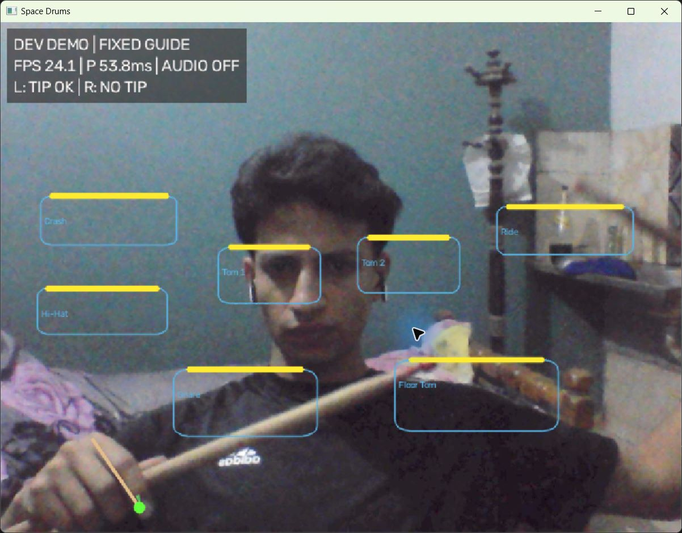
AI and Computer Vision
HAND
MediaPipe landmarks
Index fingertip = landmark 8
Red-tip STICK
Color segmentation +
temporal blob association
Painted-marker condition
Missing evidence must
remain missing.
Recorded-frame replay, audio disabled; screenshot is not an accuracy result
06
Notes:
# AI and Computer Vision
Slide 6. Target: 80–90 seconds. Purpose: explain where accepted position measurements come from. Show `assets/hand-diagnostics-window.jpg`; point to the measured fingertip and the missing second tip. The image is a current application screenshot using recorded stick footage, not a new bare-hand trial.
## Spoken script
“My role is to explain the computer-vision part of the system. It must give the rest of the pipeline a position supported by the current frame.
SpaceDrums has different input paths. HAND mode uses MediaPipe hand landmarks. The fingertip estimator takes landmark eight as the index fingertip and landmark five as its origin. The diagnostic screenshot shows one accepted point and one missing tip. It was captured from recorded footage with audio disabled.
Visible-stick mode instead searches for image support along a hand-guided stick axis. Red-tip STICK mode uses color segmentation and temporal association for painted caps. It does not run the hand model by default. Painted tips are explicitly a marker condition.
The red-tip tracker can report observed, weak, dark, ambiguous or missing evidence. Predicted positions help association but do not become measured strike points. The confidence values are configured evidence classes, not accuracy percentages.
The main problem is reliable detection at playing distance. Dim paint, motion blur and objects with similar colors cause losses or wrong associations. Our next work is to label both real tips on separate evaluation recordings and measure errors and identity swaps.
The strike-detection presenter will explain how accepted points become drum events.”
## Questions and evidence
- **Is red-tip tracking AI?** It is conventional computer vision with color segmentation and temporal association. HAND uses a pretrained MediaPipe model; temporal neural predictors are separate research code.
- **Why not keep predicting through a loss?** The current product requires measured endpoint evidence for strikes, to avoid inventing hits.
- **Does 0.9 confidence mean 90% accuracy?** No. It is a configured evidence class.
- **What proves the implementation?** `app/red_tip_perception.py:RedTipPerception`, `stick/red_tip_estimator.py:_emit`, `stick/visible.py:FingertipEndpointEstimator.estimate`, and the replay logs.
Next-step dependency: core must preserve frame identity and timestamps; strike analysis must connect each missed event to its measurement history. Acceptance needs independently labeled positions and predeclared metrics.
Source paths: src/spacedrums/app/main.py; src/spacedrums/stick/visible.py; src/spacedrums/app/red_tip_perception.py; src/spacedrums/stick/red_tip_estimator.py. Screenshot provenance: assets/README.md.

Slide 7
Strike Detection and Motion Analysis
Measured tip
Downstroke
Top edge
Commit
Drum event
Current frame
Speed + travel
Earliest crossing
Status + repeats
Zone + gain
One zone per downstroke
Demo adds 33 ms look-ahead
Rebound permits the next event.
An upper-pad crossing can consume
a lower-pad stroke.
Sustained downward motion may
trigger before crossing. A stop-short
movement can sound.
Independent live recall and wrong-zone rate remain unverified.
Demo look-ahead is a candidate setting, not measured latency reduction
07
Notes:
# Strike Detection and Motion Analysis
Slide 7. Target: 80–90 seconds. Purpose: explain movement, zone selection and duplicate control. Show `assets/strike-pipeline.png`, also editable on the slide.
## Spoken script
“My role is to explain when motion should produce one drum event. A point being inside a pad is not enough by itself.
The product pipeline uses MeasuredStrokeGeometry. It compares recent accepted positions and checks downward speed, direction and minimum travel. It then checks whether the movement crosses a drum's top edge. If several edges are crossed during one movement, the earliest eligible crossing wins.
After a candidate exists, the commit policy checks tracking status, dropped frames, the current strike episode and short refractory timers. Rebound allows the next stroke. This helps prevent repeated sounds while a tip stays inside a pad.
There is an important demo setting. The fixed-guide configuration enables thirty-three milliseconds of edge look-ahead after sustained downward motion. A stroke stopping just above an edge may therefore trigger. Normal product geometry defaults to an observed crossing.
Target selection still needs independent validation. A movement through an upper pad before reaching a lower pad can select the upper one. Missing tips can also prevent a valid strike.
Our next work is to compare intended, time-labeled strokes with commits, including rolls, wrong-zone events and deliberate non-strike movement. We need trustworthy points from computer vision and stable timing from the core.
The frontend presenter will show how these events appear on screen.”
## Likely questions
- **Do you use force?** No. Downward motion supplies a kinematic intensity proxy for gain.
- **Can two hands strike together?** The pipeline keeps separate per-hand state and event IDs, and the mixer supports overlapping voices. Real simultaneous-hit accuracy still needs testing.
- **What failed in the fresh suite?** The synthetic full-kit ordering test produced tom2 where snare was expected. It failed again alone; we have not diagnosed or fixed the cause during this audit.
- **What is the measured wrong-zone rate?** No accepted independent live rate exists yet.
- **Why can a lower drum be missed?** The first eligible edge can consume an uninterrupted downstroke; lower pads should be approached from the row gap.
Evidence: `geometry/strokes.py:MeasuredStrokeGeometry.observe`, `commit/policy.py:PerHandCommitPolicy.step`, `configs/product.candidate.yaml`, `configs/demo.professor.candidate.yaml`. Acceptance: publish a confusion matrix and missed/false/duplicate event counts against independent truth; do not substitute synthetic pass rates.
Sources: geometry/strokes.py:MeasuredStrokeGeometry.observe; commit/policy.py:PerHandCommitPolicy.step; configs/product.candidate.yaml; configs/demo.professor.candidate.yaml.

Slide 8
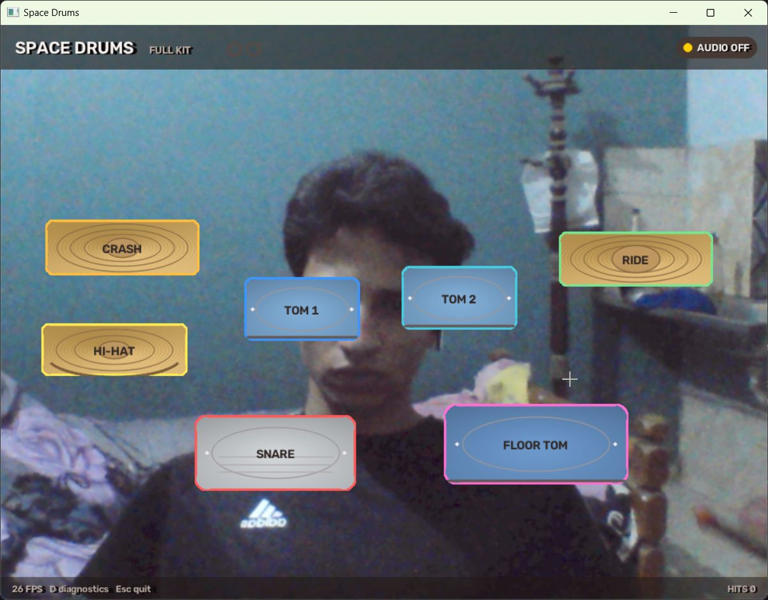
Frontend and User Experience
Seven-piece developer kit
Mirrored camera preview
D opens diagnostics
Layout preview saves pads
Esc / Q exits
Normal product has a
separate calibration flow.
Actual application window using recorded frames; fixed guide, audio disabled
08
Notes:
# Frontend and User Interface
Slide 8. Target: 75–85 seconds. Purpose: explain the actual desktop interface. Show `assets/hand-replay-window.jpg`, a genuine screenshot of current full-kit replay.
## Spoken script
“My role is to explain the user interface. SpaceDrums currently uses an OpenCV desktop window.
This screenshot shows the real seven-piece developer kit. It contains crash, ride, two toms, hi-hat, snare and floor tom. There is no kick-tracking feature. The camera preview is mirrored for the player, while the geometry keeps a consistent coordinate system.
The full-kit view shows the pads, accepted tip trails and committed-hit feedback. Pressing D opens diagnostics with tip states and stroke reasons. The layout-preview tool can move or scale pads and save a layout file.
The normal product has a separate standing and reach-calibration flow. The developer demo uses a fixed guide instead. We must not describe that guide as a successful calibration.
The screenshot was captured while the application processed recorded frames. Audio was disabled. Its counters are software events, and its frame-rate display is not a new live benchmark.
Display brightness adjustment is implemented separately from tracking input. This improves visibility without proving better detection. Our next work is clearer mode and failure messages, followed by a usability rehearsal with the team.
The core-processing presenter will explain how the components exchange information.”
## Likely questions
- **Is this a website or mobile interface?** No. The current interface is Python/OpenCV on the desktop.
- **Does the UI create hits for the animation?** It displays pipeline results; this demo has no keyboard or timer hit generator.
- **Does brighter preview improve tracking?** Default preview tone affects display only. `--tracking-tone auto` is a separate opt-in hand path.
- **Is the seven-piece kit calibrated?** The demo uses configured fixed geometry. Reachability and independent accuracy remain pending.
Evidence: `ui/stage.py:StageRenderer`, `ui/developer_demo.py:DemoOverlay`, `ui/layout_preview.py:LayoutPreview`, `ui/preview_tone.py:PreviewTone`. Dependencies: expose stable CV, strike, audio-health and calibration states. Acceptance: users can identify mode, readiness and failure without mistaking stream status for correctness.
Sources: ui/stage.py:StageRenderer; ui/layout_preview.py:LayoutPreview; ui/developer_demo.py:DemoOverlay; app/play.py:main. Image is the actual HAND replay window.

Slide 9
Backend and Core Processing
FrameSample
Observations
TrackState
Pixels, ID and timestamps
Hand / stick / endpoint evidence
Independent state for each hand
AudioEvent
CommittedStrike
StrikeCandidate
Scheduler records the sound request
Policy accepts a software event
Geometry identifies the target
Bounded capture queue. Replayable input. Structured decision logs.
Each observation must match the current frame, timestamp and hand
09
Notes:
# Backend and Core Processing
Slide 9. Target: 80–90 seconds. Purpose: explain local orchestration and contracts. Show `assets/core-contracts.png`, also editable in the slide.
## Spoken script
“My role is to explain the core processing. Here, backend means the local Python pipeline. There is no cloud server or mobile API in the current project.
The play runner loads and validates configuration, starts capture and perception, and owns shutdown and reporting. The capture source uses a bounded queue so slow processing does not create an unlimited backlog. It records dropped frames and timing.
Components exchange typed records. A frame has an identity and timestamps. Perception produces hand and stick observations. Tracking produces a TrackState. Geometry produces a StrikeCandidate, and the commit policy may turn it into a CommittedStrike. Audio then records an AudioEvent.
The pipeline checks that observations belong to the current frame and hand. Each hand keeps separate state. Tracking resets also reset its strike history.
Replay lets us process saved frames through the application without opening a camera. That is how we collected the presentation screenshots. The current playable product uses measured Arm A only. The broader research runner has rule and model alternatives, with separate validation needs.
Our next work is repeatable integration testing and clear setup documentation. We also need to reconcile older documentation with current defaults.
The audio presenter will now follow a committed event to its sound.”
## Likely questions
- **Do you process every camera frame?** No guarantee. A bounded queue can drop old frames, and drops are logged.
- **Is the whole program one thread?** The frame decision loop is inline, with a capture thread and an audio callback path.
- **Does replay prove live latency?** No. Replay verifies processing behavior under recorded input; hardware and acoustic timing differ.
- **What protects architecture boundaries?** Seven import-linter contracts passed; two zone-type import exceptions are explicitly configured.
Evidence: `app/play.py:run`, `app/pipeline.py:DecisionPipeline.step`, `capture/source.py:LiveFrameSource`, `contracts/records.py`, `.importlinter`. Dependencies: all six roles need agreed contracts; mobile integration needs a new scope/interface decision. Acceptance: reproducible clean setup, current-frame causality, correct failure behavior and traceable logs.
Sources: contracts/records.py; contracts/perception.py; app/pipeline.py:DecisionPipeline.step; capture/source.py; app/play.py. No HTTP service or mobile transport.

Slide 10
Audio and Music Engine
Zone + gain
Scheduler
Sample variant
Mixer / device
Committed strike
Target play time
Layer + rotating take
Overlapping voices
Local sample banks
Implemented controls
Full demo: acoustic Salamander
Other product paths: recorded TR-505
Hash checks, gain mapping, stream
health checks and backlog clearing
Scheduled events and a running stream do not prove correct audible hits.
48 kHz / 128 frames gives a 2.67 ms buffer duration; total physical latency is unknown
10
Notes:
# Audio and Music Engine
Slide 10. Target: 80–90 seconds. Purpose: explain implemented playback and the measurement boundary. Show `assets/audio-pipeline.png`, also editable in the deck.
## Spoken script
“My role is to explain how a committed strike becomes a drum sound.
Each zone maps to a sample identifier. The scheduler receives the committed event and its target time. The audio output selects a sample, applies the configured gain and places the voice in the callback mixer.
The full developer kit uses the acoustic Salamander sample bank. Other product paths use the recorded TR-505 bank. Sample hashes are checked when loading. Grouped acoustic sounds can select soft or hard layers and rotate between takes. This selection is deterministic.
The mixer supports overlapping sounds and starts them at the appropriate position inside an audio buffer. It also counts late events and clipping. The output layer monitors the stream and clears old voices before recovering from a device failure.
Our configuration uses forty-eight kilohertz and a one-hundred-and-twenty-eight-frame buffer. That buffer lasts about two-point-seven milliseconds. It is not the time from a hand movement to an audible sound.
Physical action-to-sound latency remains unmeasured. A running stream or a scheduled event cannot prove audibility or the correct sound. Our next work is a human zone-by-zone sound check and an external timing measurement with stated uncertainty.
The mobile presenter will now explain that role's current status and proposed scope.”
## Likely questions
- **Do you output MIDI?** Direct local sample playback is implemented. Core MIDI is outside the documented V1 requirements.
- **Is gain physical force?** No. It is a mapping from a motion-derived intensity proxy.
- **Is output latency zero?** No. `OutputLatency.unmeasured()` uses 0.0 as a scheduling placeholder with PENDING status.
- **Was sound heard during the presentation capture?** No. The replay screenshots use disabled audio. Earlier logs show running streams, which is a different form of evidence.
Evidence: `app/audio_out.py:AudioOutput`, `audio/scheduler.py:AudioScheduler`, `audio/variants.py:VariantSelector`, `audio/mixer.py:CallbackMixer`, `audio/device.py:SoundDeviceOutput`, both sample manifests. Dependencies: correct zone IDs/timestamps and an accepted external reference. Acceptance: correct audible sample for each zone, controlled overlap/dropout checks and independently measured physical delay.
Sources: app/audio_out.py:AudioOutput.play; audio/bank.py:SampleBank.load; audio/variants.py:VariantSelector.pick; audio/scheduler.py:AudioScheduler.schedule; audio/mixer.py:CallbackMixer.mix; audio/device.py:SoundDeviceOutput.

Slide 11
Mobile Application Development
Not implemented
Approved mobile scope is unresolved.
Proposed first step
Agree the use case and a minimal session-summary format.
If approved, build a viewer for an exported local session.
Test invalid data, missing measurements and offline behavior.
Future proposal only; platform and scope require team approval
11
Notes:
# Mobile Application Development
Slide 11. Target: 70–85 seconds. Purpose: present missing implementation honestly and propose an approval-dependent plan. Show the slide's current-status statement and proposed sequence. There is no mobile screenshot because no app was found.
## Spoken script
“My assigned role is mobile application development. The verified status is that this repository does not contain a mobile application. We also did not find an approved mobile-specific requirement. A possible future phone camera is mentioned in the project documents, but that does not establish a mobile app.
For that reason, I am presenting a proposed next step rather than a completed contribution.
First, the team and supervisor should decide whether mobile belongs in the project and what problem it should solve. One possible starting point is a session-summary viewer that reads a manually exported file. It could show the session mode, software event counts and missing measurements. A companion controller would require a separate interface and more integration work.
If the summary-viewer scope is approved, the core role would define a small versioned data format. The mobile role would then build an actual application that opens one exported session and handles missing or invalid data. The interface must clearly distinguish counts from accuracy.
We should not claim camera streaming, remote sound triggering or low network delay before implementing and measuring them. Platform selection and approval remain open.
I will now return to our team leader for the verified results and roadmap.”
## Likely questions
- **Why is there no app demo?** No verified implementation exists, and a mockup would misrepresent the project's status.
- **Which platform will you use?** Undecided. The choice should follow the approved use case and team constraints.
- **Can a phone replace the laptop camera?** That is a future possibility, not an implemented or validated path.
- **What can this role do next?** Document the scope decision, agree an export contract, then build and test the approved first use case.
Evidence: repository/source inventory, `project-discovery.md`, `docs/requirements/out-of-scope.md`, and the absence of mobile build manifests. Dependencies: scope approval, core schema and UI semantics. Acceptance if approved: a real build loads a real exported session offline, reports invalid/stale fields correctly and passes agreed platform checks. No personal past contribution is asserted.
Sources: project-discovery.md; docs/requirements/out-of-scope.md; evidence/source-inventory.json; repository manifest search. No verified mobile project or approved mobile requirement found.

Slide 12
Testing and Results
Software checks
1997 passed / 1 failed / 1 skipped
Synthetic kit sequence: tom2 event where snare was expected.
Import contracts: 7 kept Ruff: 1 existing line-length error
Input mode | Left measured | Right measured | Median time
Default red tips | 39 / 572 (6.8%) | 9 / 572 (1.6%) | 2.86 ms
Optional dark mode | 406 / 572 (71.0%) | 474 / 572 (82.9%) | 9.18 ms
More coverage does not establish correct tracking.
Same 572-frame recording, no accuracy labels. Time = median detector/tracker compute.
12
Notes:
# Team leader: opening, results and closing
Assign this duty to one of the six role presenters, preferably the core-processing presenter. No additional team member is implied. Role scripts describe team responsibilities, not personal authorship. Target: opening 90 seconds; results/closing 70 seconds, plus transitions. Rehearse with a timer.
## Opening: slides 1–5
“Good morning. Our project is SpaceDrums, a camera-based AI virtual drumming system. We are presenting the current prototype and the evidence behind it.
A physical drum kit needs equipment and space. Our goal is to let one person explore drumming using a camera, virtual drum zones and local sounds. We also want to investigate whether motion prediction can reduce delay. That research question is still open.
The prototype already captures camera frames, estimates hand or stick-tip positions, identifies candidate strikes and schedules drum samples. It also provides a desktop kit display and diagnostic logs. Reliable play across lighting conditions and complete physical latency measurement still need work.
The architecture slide shows the actual path through the code. Camera frames feed perception. Per-hand tracking and drum geometry produce strike candidates. Commit rules decide which events can reach audio. The interface displays those results.
We organize the project into six responsibilities: computer vision, strike detection, frontend, core processing, mobile planning and audio. Mobile implementation and approved scope remain unresolved.
Python and OpenCV connect the local system. MediaPipe supports hand detection. NumPy supports geometry, and sounddevice supports playback. PyTorch and LightGBM belong to the research tools. Our current product demo uses measured Arm A, not a validated learned prediction model.
Our computer-vision presenter will now explain the input modes.”
Show `assets/architecture.png` on slide 4. The same diagram is editable in the deck.
## Results and closing: slides 12–15
“Our results separate software tests from real recordings. The suite passed 1,997 tests, failed one and skipped one. The failed synthetic kit sequence produced tom2 where snare was expected; it failed again on its own. Seven import contracts passed, while lint found one long line. These checks do not measure real-world tracking accuracy.
On one 572-frame recording, default red-tip tracking produced measured points in only 6.8 percent of left-slot frames and 1.6 percent of right-slot frames. Dark mode raised coverage, but this recording has no accuracy labels. We cannot call those percentages correct detections.
The main challenges are lighting, identity during occlusion, reliable calibration, intended-zone selection and physical audio delay. Our next step is independent labeling, followed by controlled tracking and strike tests. We will then validate calibration and measure action-to-sound latency with an external reference. Mobile scope needs an explicit decision.
SpaceDrums demonstrates a connected camera-to-sound software prototype. Its strongest next step is reliable, measurable interaction. Thank you. We welcome your questions.”
## Likely questions
- **Is the project finished?** The integrated prototype and research machinery exist. Independent playing validation, participant results and release acceptance remain pending.
- **Did each person write the code for their role?** This presentation maps responsibilities. Individual authorship has not been verified.
- **Why are there no names or institution on the title?** They were not provided or verified. Add the agreed details before submission.
- **Why show failures?** They identify the actual work remaining and prevent synthetic or software evidence from becoming unsupported user-performance claims.
Fresh full-suite result: 1 failed, 1997 passed, 1 skipped, 139 warnings in 1020.06s (0:17:00)
Sources: docs/presentation/evidence/pytest-full.txt; ruff.txt; import-linter.txt; experiments/red-tip-lit/summary.json; experiments/red-tip-dark/summary.json. Both analyses use the same 572-frame session and have accuracy_vs_labels=null. Measured share is slot coverage, not detection accuracy. See validation-results.md for failure details.

Slide 13
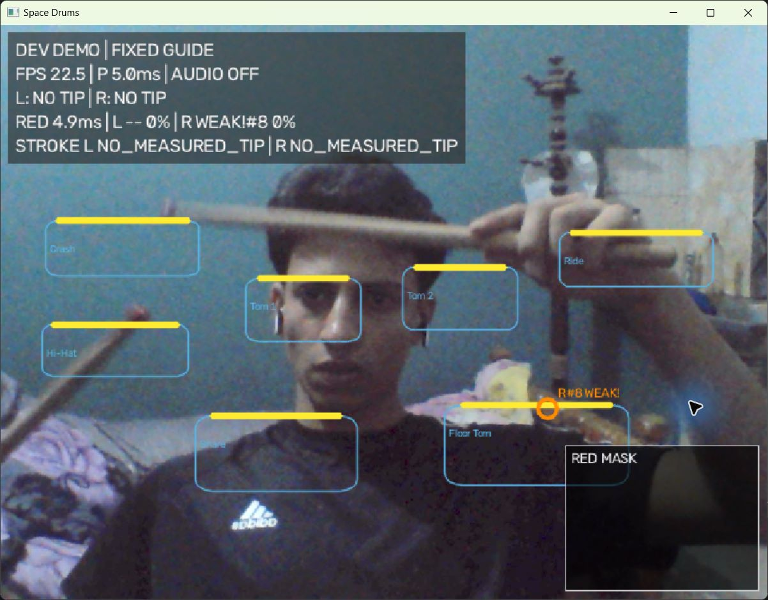
Challenges and Current Limitations
Lighting and blur
Dark paint and occlusion
can break tip association.
Calibration and targets
Reachability and intended
drum accuracy need truth labels.
Physical latency
Action-to-sound measurement
remains pending.
Current red-tip diagnostics on recorded frames, audio disabled
13
Notes:
Sources: experiments/red-tip-lit/summary.json; experiments/red-tip-dark/summary.json; app/play.py report fields; geometry/strokes.py; calib/automatic.py. Actual red-tip replay screenshot shows missing/weak-limit points and rejected stroke evidence. No hidden successful replacement.

Slide 14
Roadmap and Next Steps
01
Regression and independent labels
Investigate the kit-sequence failure and label intended strikes.
02
Tracking and strike validation
Test held-out lighting, crossings, rolls and wrong-zone events.
03
Calibration and physical timing
Verify fitted reach and measure sound with an external reference.
04
Integration and scope decisions
Run regressions, reconcile docs and decide mobile scope.
14
Notes:
Sources: docs/presentation/team-contributions-and-roadmap.md; docs/reports/phase-18-final-evaluation.md. Proposed dependency order, not completed work or a promised schedule.

Slide 15
Conclusion and Q&A
A connected camera-to-sound
software prototype
Implemented capture, perception, drum geometry,
commit rules, playback and desktop diagnostics.
Next milestone: reliable interaction supported
by independent measurements.
15
Notes:
# Team leader: opening, results and closing
Assign this duty to one of the six role presenters, preferably the core-processing presenter. No additional team member is implied. Role scripts describe team responsibilities, not personal authorship. Target: opening 90 seconds; results/closing 70 seconds, plus transitions. Rehearse with a timer.
## Opening: slides 1–5
“Good morning. Our project is SpaceDrums, a camera-based AI virtual drumming system. We are presenting the current prototype and the evidence behind it.
A physical drum kit needs equipment and space. Our goal is to let one person explore drumming using a camera, virtual drum zones and local sounds. We also want to investigate whether motion prediction can reduce delay. That research question is still open.
The prototype already captures camera frames, estimates hand or stick-tip positions, identifies candidate strikes and schedules drum samples. It also provides a desktop kit display and diagnostic logs. Reliable play across lighting conditions and complete physical latency measurement still need work.
The architecture slide shows the actual path through the code. Camera frames feed perception. Per-hand tracking and drum geometry produce strike candidates. Commit rules decide which events can reach audio. The interface displays those results.
We organize the project into six responsibilities: computer vision, strike detection, frontend, core processing, mobile planning and audio. Mobile implementation and approved scope remain unresolved.
Python and OpenCV connect the local system. MediaPipe supports hand detection. NumPy supports geometry, and sounddevice supports playback. PyTorch and LightGBM belong to the research tools. Our current product demo uses measured Arm A, not a validated learned prediction model.
Our computer-vision presenter will now explain the input modes.”
Show `assets/architecture.png` on slide 4. The same diagram is editable in the deck.
## Results and closing: slides 12–15
“Our results separate software tests from real recordings. The suite passed 1,997 tests, failed one and skipped one. The failed synthetic kit sequence produced tom2 where snare was expected; it failed again on its own. Seven import contracts passed, while lint found one long line. These checks do not measure real-world tracking accuracy.
On one 572-frame recording, default red-tip tracking produced measured points in only 6.8 percent of left-slot frames and 1.6 percent of right-slot frames. Dark mode raised coverage, but this recording has no accuracy labels. We cannot call those percentages correct detections.
The main challenges are lighting, identity during occlusion, reliable calibration, intended-zone selection and physical audio delay. Our next step is independent labeling, followed by controlled tracking and strike tests. We will then validate calibration and measure action-to-sound latency with an external reference. Mobile scope needs an explicit decision.
SpaceDrums demonstrates a connected camera-to-sound software prototype. Its strongest next step is reliable, measurable interaction. Thank you. We welcome your questions.”
## Likely questions
- **Is the project finished?** The integrated prototype and research machinery exist. Independent playing validation, participant results and release acceptance remain pending.
- **Did each person write the code for their role?** This presentation maps responsibilities. Individual authorship has not been verified.
- **Why are there no names or institution on the title?** They were not provided or verified. Add the agreed details before submission.
- **Why show failures?** They identify the actual work remaining and prevent synthetic or software evidence from becoming unsupported user-performance claims.
Closing claim boundary: integrated software prototype exists; reliability, independent validation and physical timing remain unfinished. Source: docs/presentation/project-audit.md.

