Slide 1
Introduction to Big Data
Handwritten Digit Recognition
Yousef Elbayoumi

Slide 2
Table of Content
Overview
Researching
Pre-Implementation
Implementation
Results
Summary & Conclusion

Slide 3
Overview
SUPPORT VECTOR MACHINE (SVM)

Slide 4
MULTILAYERED PERCEPTRON (MLP)

Slide 5
CONVOLUTIONAL NEURAL NETWORK (CNN)

Slide 6
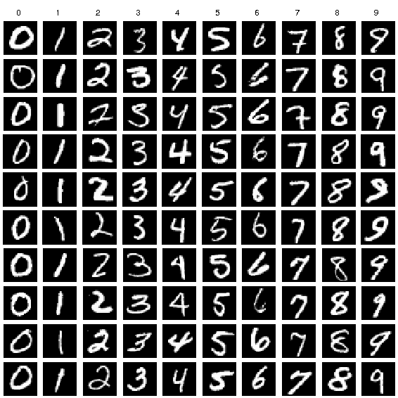
Dataset used:
MNIST dataset

Slide 7
Researching
Search your topic
Predict the result
Based on your research
Create hypothesis
Hypothesis: CNN is the best model for digit recognition
Null hypothesis: CNN isn’t the best model for digit recognition
Better implementation and results

Slide 8
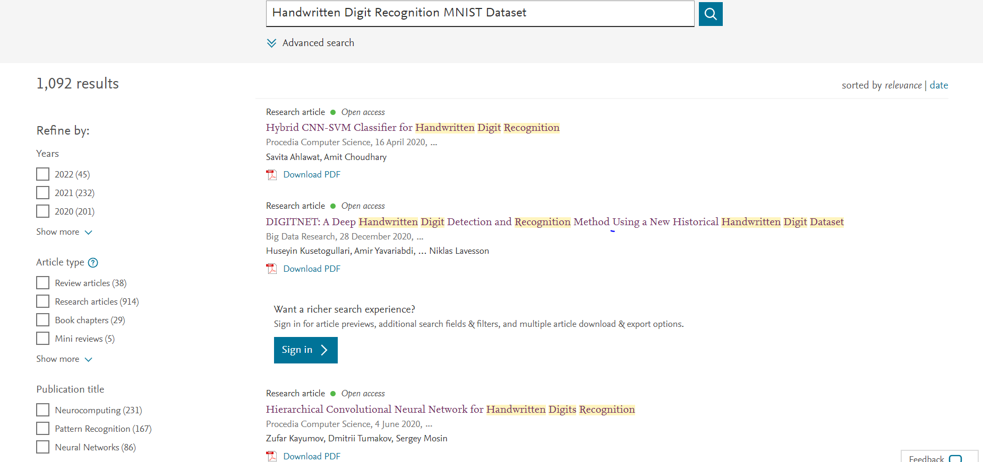
ScienceDirect.com

Slide 9
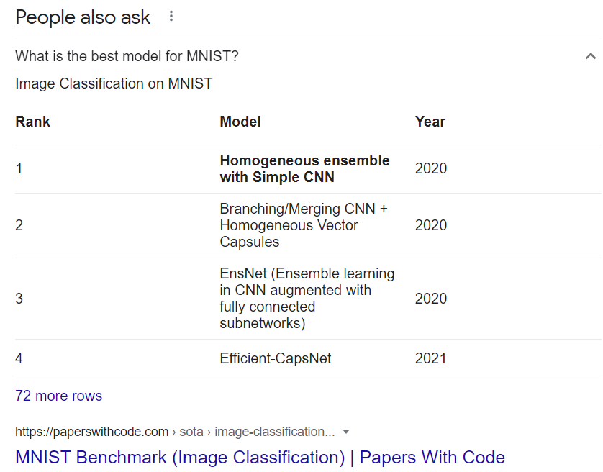
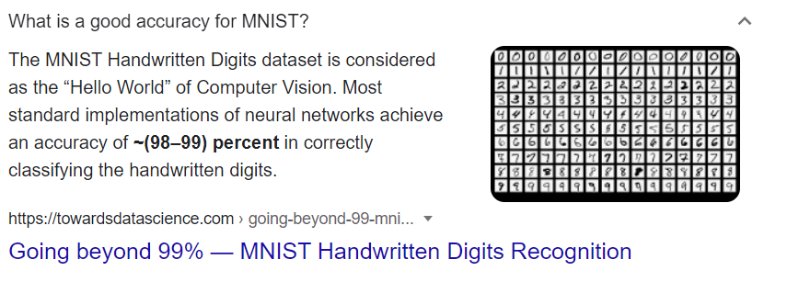
Google.com

Slide 10
Pre-Implementation
Reshaping
Normalization
Feature Selection & Feature Extraction
One-hot encoding

Slide 11

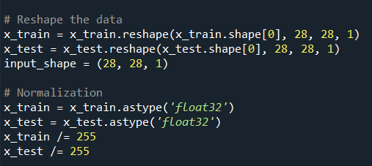
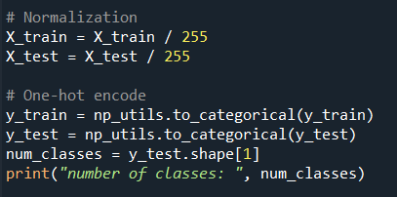


Spyder
CNN
MLP
SVM

Slide 12
Implementation
Libraries:
import numpy as np
import pandas as pd
from sklearn import metrics
from sklearn.model_selection import train_test_split
from sklearn.svm import SVC
from sklearn.preprocessing import scale
from keras.datasets import mnist
from keras.models import Sequential
from keras.layers import Dense
from keras.utils import np_utils
import matplotlib.pyplot as plt
import seaborn as sns
from random import shuffle
import datetime

Slide 13
Results

Slide 14
Summary & Conclusion
SVM had the best accuracy result for training set with value of almost 100 percent. However, the test result wasn’t good comparing with the other models.
MLP had a good results in both training and testing sets. However, it wasn’t the best model.
If we sum the values of training and testing of each model, we will see that CNN is the optimal model for digit recognition and MNIST dataset, as predicted.

Slide 15

Next station → Source Code & Project Report
Thanks for listening

