Slide 1
Challenge: using OMIC data to predict breast cancer outcomes
Matthew Suderman, Paul Yousefi and Josine Min
MRC Integrative Epidemiology Unit
Nov 15, 2021

Slide 2
Outline
Breast cancer
The challenge (briefly)
Biological background
Omic data
Using omic data to make predictions
The challenge (details)

Slide 3
Breast cancer

Slide 4
Breast cancer rates and risk factors
Breast cancer is the most common type of cancer in the UK
1 in 8 women lifetime diagnosis
Risk factors
Age
Family history
Previous diagnosis
Tissue density
Hormone therapy
Obesity
Height
Alcohol
Radiotherapy
Machine learning challenge:
Estimate risk accurately using the most relevant factors.

Slide 5
Breast cancer complexity
Machine learning challenge:
Predict disease outcome using tumor biopsy data.
Stages (growth)
T – the size of the tumour
N – whether the cancer has spread to the lymph nodes
M – whether the cancer has spread to other parts of the body
Grades (speed)
low (G1) – the cells, although abnormal, appear to be growing slowly
medium (G2) – the cells look more abnormal than low-grade cells
high (G3) – the cells look even more abnormal and are more likely to grow quickly
Types Ductal Carcinoma In Situ, Invasive Ductal Carcinoma, Invasive Lobular Carcinoma, Inflammatory Breast Cancer, Lobular Carcinoma In Situ, Molecular subtypes (Luminal A, Luminal B, Triple Negative, HER2-enriched, Normal-like

Slide 6
Breast cancer treatments
Surgery (tumor, mastectomy, lymph node)
Radiotherapy (multiple types)
Chemotherapy (side effects)
Hormone therapy (tamoxifen, aromatase inhibitors, ovarian ablation or suppression)
Targeted therapy (e.g. trastuzumab)
Machine learning challenge: Predict response to each treatment or combination using tumor biopsy data.

Slide 7
The challenge

Slide 8
Challenge summary
Background. Optimal treatment of breast cancer depends on accurate knowledge about future survival and drug response. Unfortunately, prediction accuracy in current clinical practice is not consistent across breast cancer subtypes. In spite of the recent explosion of technologies and assays for exhaustively profiling the multi-dimensional biological states of tumors, clinical prediction models tend to be simple and limited to a small number of well-understood biomarkers.
Aim. We propose to build outcome prediction models from multi-omic data derived from hundreds of breast tumors.
Data. Datasets will include genome-wide measurements of DNA methylation, gene expression, microRNA expression, protein abundance, genetic mutations, and copy number variation.
Methods. We aim to investigate multiple types of models including complex "black-box" models, simple linear models, and models within a single omic data type. Data will be partitioned into two parts, one to be made available for training and validation and a second for testing model performance.

Slide 9
Biological background

Slide 10
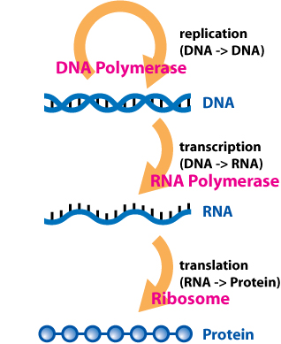
Central dogma of molecular biology
Simplified version but in reality there are many more details and exceptions.
https://en.wikipedia.org/wiki/Central_dogma_of_molecular_biology

Slide 11
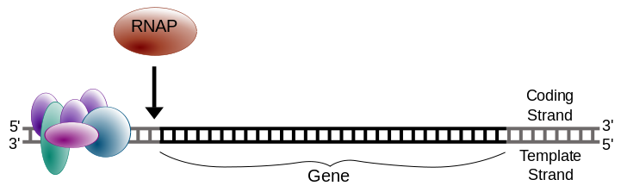
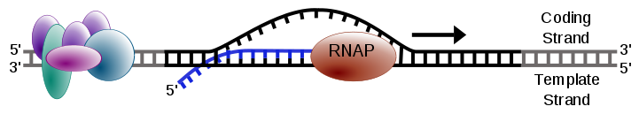
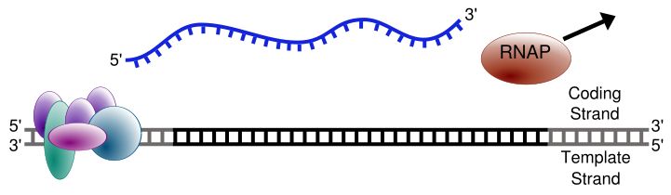
Transcription
Initiation
Elongation
Termination
https://simple.wikipedia.org/wiki/Transcription_(genetics)

Slide 12
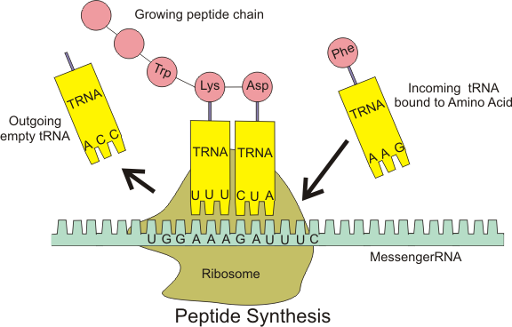
Translation
Mature mRNA are transported out of the nucleus to ribosomes that translate the RNA sequence into a sequence of amino acids, i.e. a protein
https://en.wikipedia.org/wiki/Ribosome

Slide 13
Regulating gene activity
Regulation can occur at any of these steps:
Transcription can be blocked, slowed or accelerated.
RNA splicing choices can be changed.
mRNA can be degraded before transport out of the nucleus.
Mature mRNA transport can be interrupted.
Translation can be blocked, slowed or accelerated.
Proteins can be degraded.

Slide 14
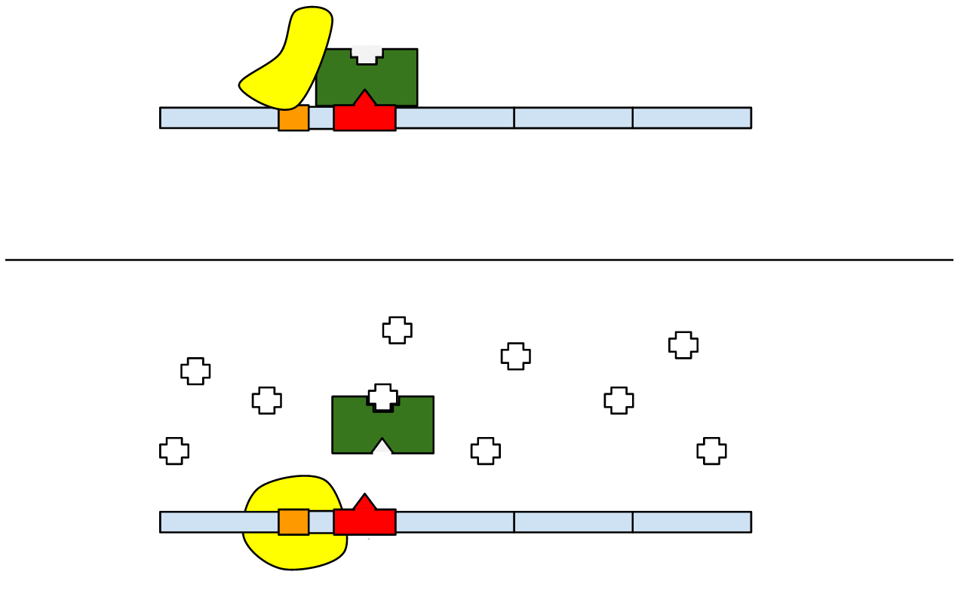
Transcription and repressors
Obstructed RNA polymerase
Repressor
Inactive
Promoter
Binding sequence
Gene
Active
Inhibited Repressor
Active RNA polymerase
http://en.wikipedia.org/wiki/Regulation_of_gene_expression

Slide 15
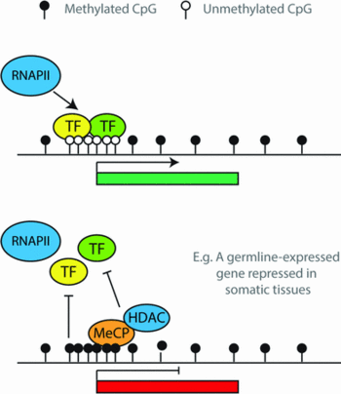
Transcription and DNA methylation
DNA methylation can promote or inhibit DNA binding.
In the typical case, DNA methylation results in reduced gene expression.
http://www.biochemj.org/bj/451/0013/bj4510013f01.htm

Slide 16
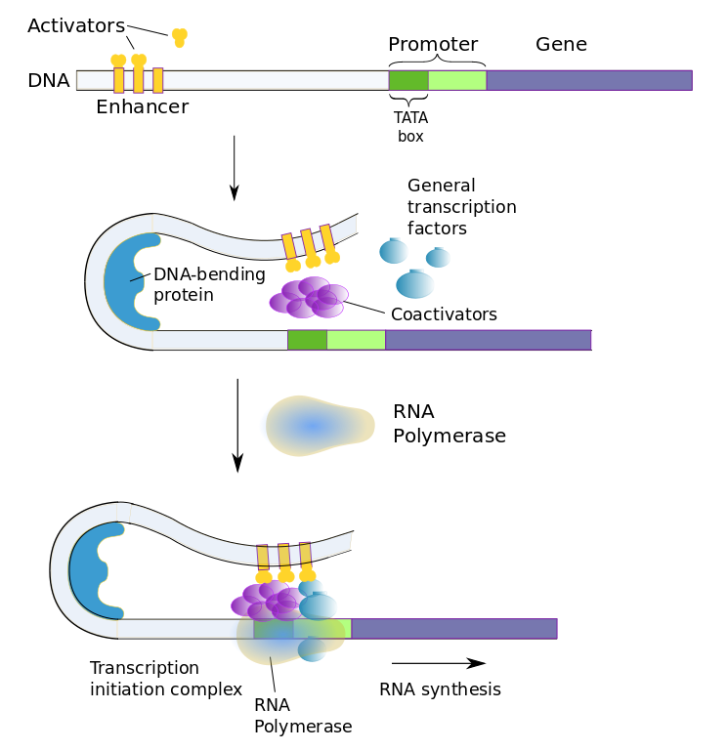
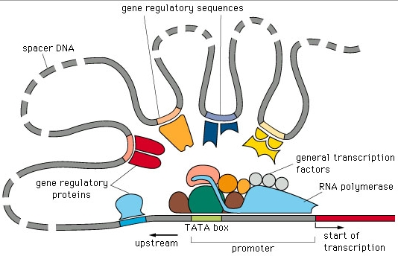
Regulation over long distances
http://pbil.univ-lyon1.fr/members/sagot/htdocs/team/projects/chromo_net/purpose_chromo_net.html
https://natural-universe.net/the-scientific-view-of-the-universe/the-geological-present/what-biochemistry-and-cellular-biology-tell-us/dna-expression-protein-synthesis/

Slide 17
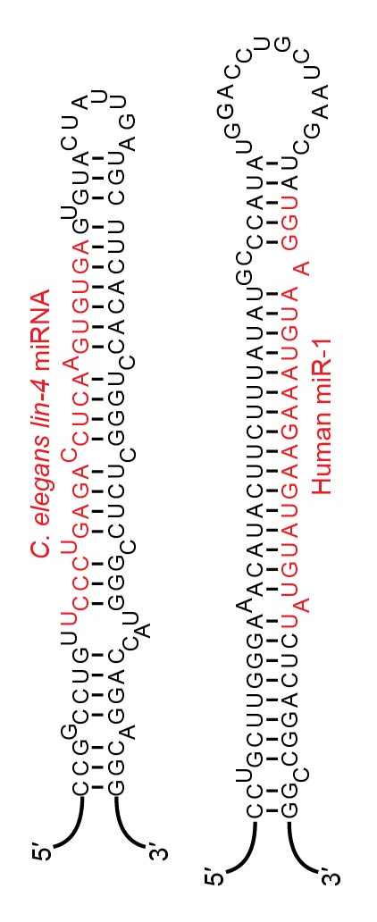
microRNAs
miRNAs (or microRNAs) are 21-24 nucleotide RNA molecules that are not translated into proteins.
They are called ‘micro’ because they are short.
If their sequence (shown in red) matches the sequence of an mRNA molecule, the mRNA molecule is destroyed so that it cannot be translated into a protein.
This is yet another way to repress gene activity.

Slide 18
OMIC datasets

Slide 19
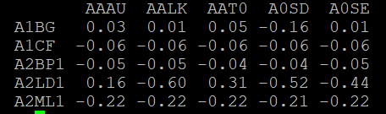
Gene expression data
Genes aren’t just ‘on’ or ‘off’. The activity of a gene can increase or decrease.
‘Gene expression’ refers to the number of mRNA molecules of a gene in a cell.
We don’t have absolute counts, the measurements are qualitative allowing comparison between samples. e.g. Gene A1BG has higher expression in sample AAAU (0.03) than in AALK (0.01) but lower expression than in sample AAT0 (0.05).

Slide 20
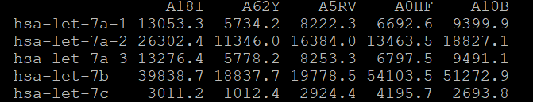
microRNA expression data
microRNA expression data is similar to gene expression data.
All that differs is the names of the microRNA genes.
If a microRNA encounters an mRNA target molecule in the cell, the mRNA will be destroyed. As a result, as the expression of a microRNA goes up, the expression of its targets will tend to decrease.
Notes:
http://www.targetscan.org/vert_80/

Slide 21
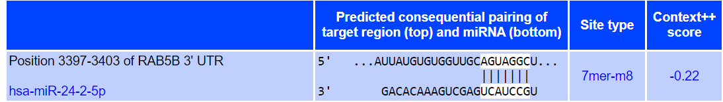
microRNA and mRNA
microRNA hsa-miR-24-2 targets the mRNA of gene RAB5B.
The table below shows the complementary sequence match between the microRNA and the gene.
As expected, as the expression of the microRNA increases, the expression of the gene decreases
(R = -0.21, p = 7.4 x 10⁻⁵)
http://www.targetscan.org/

Slide 22
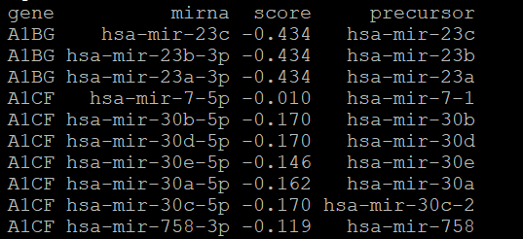
MicroRNA targets
If you want to include microRNA targetting in your model, we've provided a file 'microrna-targets.txt' which lists microRNAs and their targets.
- column 'gene' is for linking to the gene expression data
- column 'precursor' is for linking to the microRNA expression data
- column 'score' indicates the strength of the predicted effect of the microRNA on the expression of the gene. More negative scores indicate a stronger effect.

Slide 23
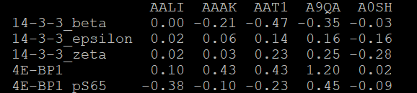
Protein data
Protein expression data is again similar to gene expression data.
All that differs is the names of the protein genes.
The expression level of a protein does not necessarily correlate with the expression of its corresponding gene. This is due to regulation that occurs between gene expression and protein expression (e.g. microRNA targetting).

Slide 24
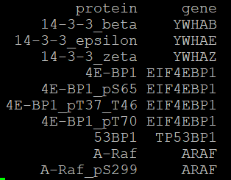
Matching proteins to genes
If you want to link proteins to genes in your model (up to you!), we have provided the 'protein-annotation.txt' file that lists protein-gene pairs.

Slide 25
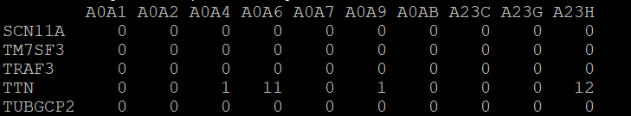
Mutation data
The mutation data provides the number of mutations per gene (rows) per sample (columns). By 'mutations' we mean genetic differences between the tumor DNA and DNA from healthy tissue from the same cancer patient.
In the example below, sample A0A4 has 1 mutation in the TTN gene whereas sample A0A6 has 11 mutations.

Slide 26
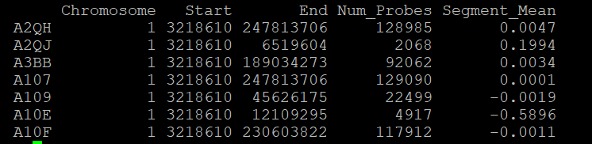
Copy number variation data
The copy number data indicates either the removal (negative 'Segment_Mean') or duplication (positive 'Segment_Mean') of sections of DNA.
e.g. In the example below, sample A2QJ has evidence of duplication in the region chr1:3218610-6519604 whereas sample A10E appears to have a similar region deleted.

Slide 27
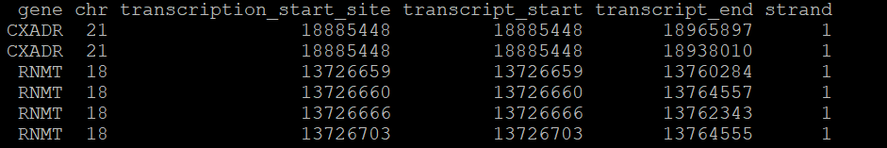
Gene expression and copy number variation
Notice that if a copy of a gene is deleted, then it cannot be expressed. If you would like to link the copy number variation data to the gene expression data, then we have provided a file that gives the location of each gene in the genome.
In the following example, notice that genes may appear multiple times. This is because a gene may have several different versions that start or end at different locations.

Slide 28
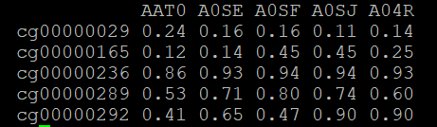
DNA methylation data
90% of cells from sample A04R have methylation at cytosine cg00000292
(which is in the ATP2A1 gene)
…GACCGAGGAG…
M
…GACCGAGGAG…
…GACCGAGGAG…
…GACCGAGGAG…
M
M
…GACCGAGGAG…
M
M
…GACCGAGGAG…
…GACCGAGGAG…
…GACCGAGGAG…
M
M
…GACCGAGGAG…
…GACCGAGGAG…
M
M

Slide 29
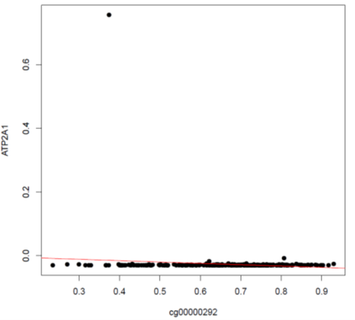
Outliers
Outliers can drive associations
Possibly due to technical errors but may be biological – we don't know!
Handling outliers
Winsorizing: setting values outside percentiles 0.05-0.95 to the closest value within the percetiles
Tukey method: remove any value
< first quartile – 3IQR, or > third quartile + 3IQR

Slide 30
USING OMIC data To make predictions

Slide 31
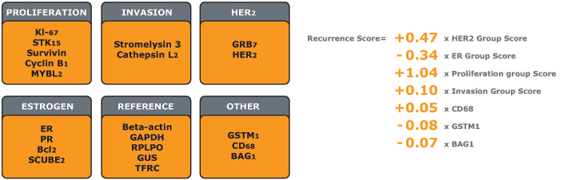
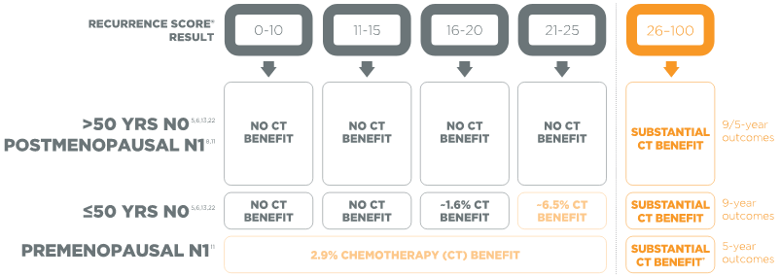
Oncotype DX (https://www.oncotypeiq.com/)
For ER+/HER2- patients, Oncotype DX estimates
chemotherapy benefit and
10-year risk of distant recurrence
using the expression of 21 genes in tumor biopsies.
Notes:
Here’s an example of a multi-modal biomarker model in clinical practice
Where a company has used multi-modal data to produce a risk stratification score
The score uses several protein and gene expression markers from tumor biopsies to identify who’s at greatest risk of breast cancer recurrence risk and should be prioritized to seek diagnostic confirmation.

Slide 32
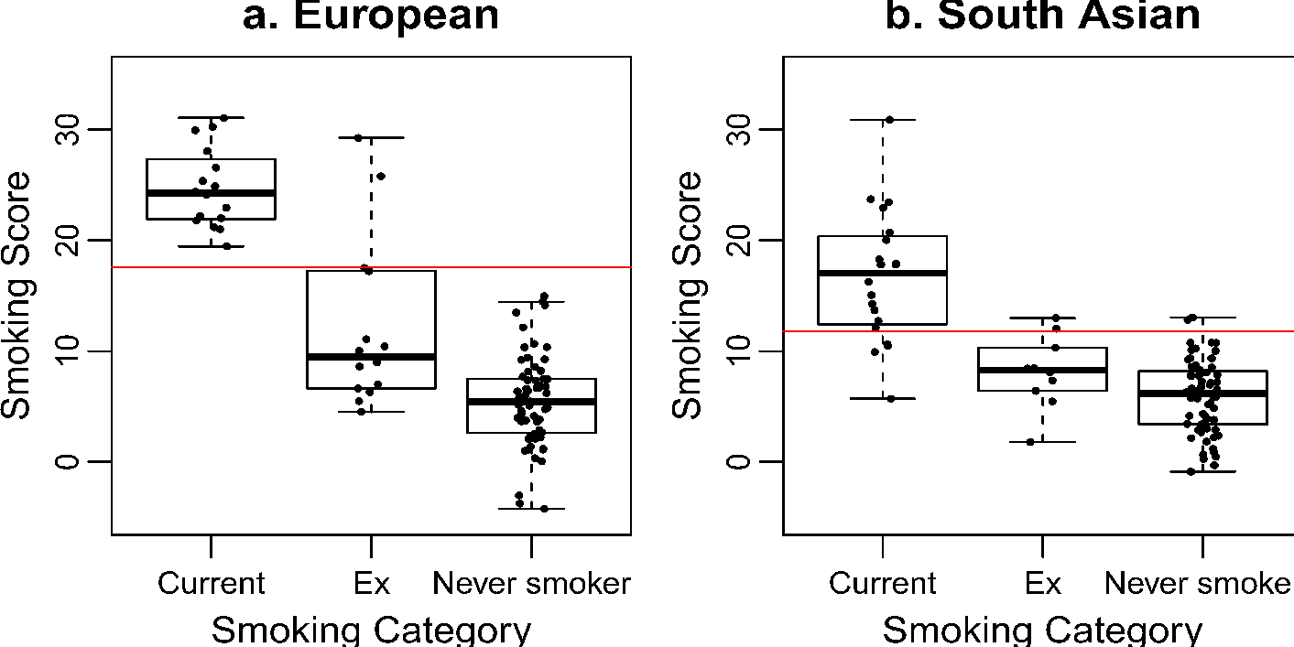
DNA methylation and smoking
Smoker
Non-smoker
Elliott et al. Clinical Epigenetics 2014 6:4
Notes:
So omic measurements have been used to discriminate exposure history
Here’s an example of DNA methylation measurements being able to distinguish current from former or never smokers in multiple populations
You can see that on the y axis there’s a DNAm smoking score – which is essentially a weighted sum where the weights are effect estimates between individual DNAm sites and smoking in a large training population. This is the same approach taken by genetic risk scores

Slide 33
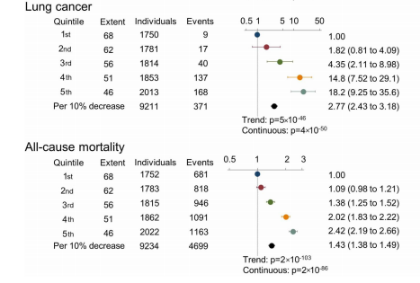
DNA methylation, smoking and lung cancer
Thorax 2017
Notes:
Some of the exposure information history captured by these biomarkers have been demonstrated to be informative for health outcomes.
So here’s an example of the DNAm site that has been consistently been the most associated with smoking history also being predictive of both
* Lung cancer incidence and all cause mortality

Slide 34
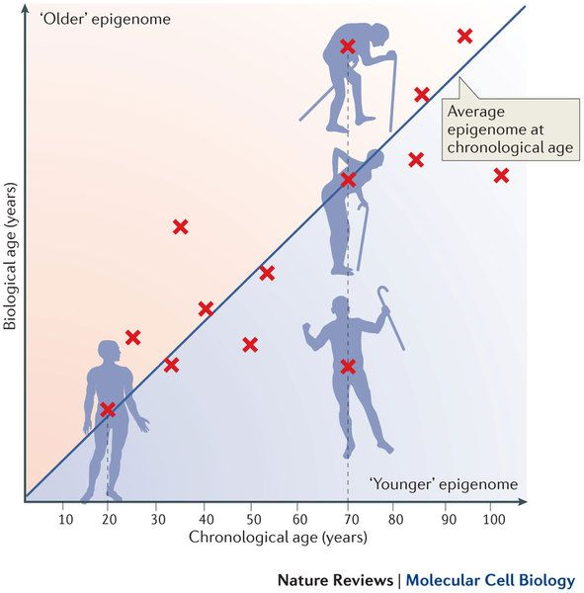
DNA methylation and age
Acceleration is associated with many phenotypes and exposures, e.g.
All-cause mortality (Marioni et al. Genome Biol., 2015)
Physical and cognitive fitness (Marioni et al. IJE, 2015)
Trauma (Boks et al. Psychoneuroendocrinology, 2015)
Obesity in liver (Horvath et al. PNAS, 2014)
Benayoun BA, Pollina EA, Brunet A. Nat Rev Mol Cell Biol. 2015
Notes:
Beyond being used to characterize exposure history, Omic biomarkers can also be used to provide information on health outcomes and phenotypes.
One such phenotype that has received a lot of attention in the literature is age –
Several groups have used genome wide DNAm levels as inputs to elastic net penalized regression models to predict age.
Part of the appeal is the chronological age prediction (so if we have a new DNAm profile measured, we can tell the person’s age)
But more importantly, the idea of that these models might be capturing additional information about the biological aging process emerged
-So this idea that the residual between one’s DNAm measured age and chronological age might be indicative of accelerated or decelerated biological age.
-In populations, those residuals (so people’s DNAm age acceleration/deceleration) have been seen to associate with a wide variety of outcomes and exposures we’d expect to associate with biological age

Slide 35
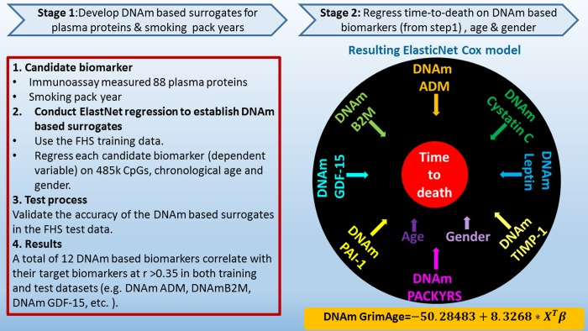
Aging and multi-omics
The resulting model potentially includes CpG sites that would on their own be ignored by elastic net.
The model performs better than the same model based on protein abundances measured directly.
Lu, et al. Aging (Albany NY). 2019
Notes:
The next generation of these aging predictors have progressed by taking a two stage approach to predicting the health outcome
So in the first stage here, the authors developed DNAm predictors of protein levels by elastic net
Then in the second part, they used the DNAm-based protein predictions for another elastic net model for time to death.
This approach cleverly enriched for DNAm signal in the first stage – because the feature space the that the elastic net has to select from is large and noisy
The resulting model thus includes information from feature that it wouldn’t have it it had been done in a single go.
But perhaps most importantly, the final model (using the DNAm predictors) outperforms the same model that used the actual protein levels –
suggesting that the methylation prediction step may be capturing additional biological information (similar to how we saw with age acceleration/deceleration)

Slide 36
Challenge details
Aim. We propose to build outcome prediction models from multi-omic data derived from hundreds of breast tumors.
Inputs.
Omic datasets will include genome-wide measurements of DNA methylation, gene expression, microRNA expression, protein abundance, genetic mutations, and copy number variation.
Patient information will include disease outcome (progression-free interval PFI) and clinical information commonly available such as age, stage, grade and type.
Outputs.
Multi-omic model (any kind)
Multi-omic linear model
Single-omic model (you choose)
A few days before finishing, we will supply you with a test dataset to evaluate performance.

Slide 37
Some things to be aware of ...
There are missing values.
No patient in the study has all data types--imputation may be useful.
When linking between data-types (e.g. between proteins and genes), there will never be a perfect 1-1 match. There are some proteins with no associated gene. This is because they aren't actually derived from a single gene. Biology is messy, we just do the best we can with it!
Our outcome of interest is progress-free interval (PFI). This is a binary variable. There is another variable PFI time ('pfi.time') which gives the time with no progression. This is an integer. This variable will not be available in the test dataset. It was included because it is similar to PFI but provides more information. You might decide train to predict PFI time rather than PFI alone.
Suggest you initially get a fairly simple model working to make sure that you understand the data. After, you can progress to as much complexity as you can dream of.
Finally, this is our first time attempting this. We might have missed something. Please do ask if anything doesn't seem right.

