Slide 1
Utilization of Edge Computing to Improve the Lambda Architecture
Jonathan Lwowski, Parsa Yousefi

Slide 2
Outline
Introduction
Problem Statement
Original Lambda
Edge-Lamba
Implementation Details
Results
Conclusion
References

Slide 3
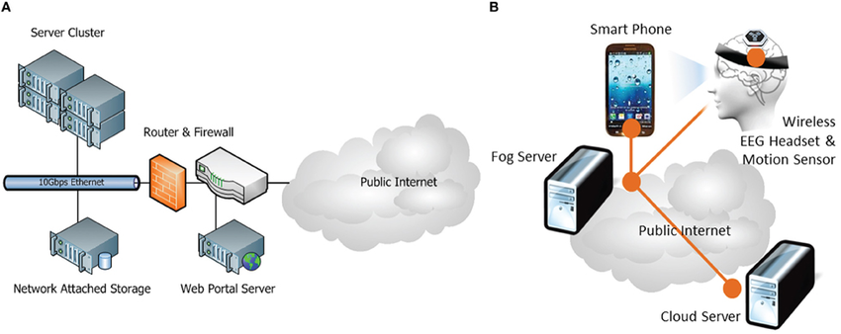
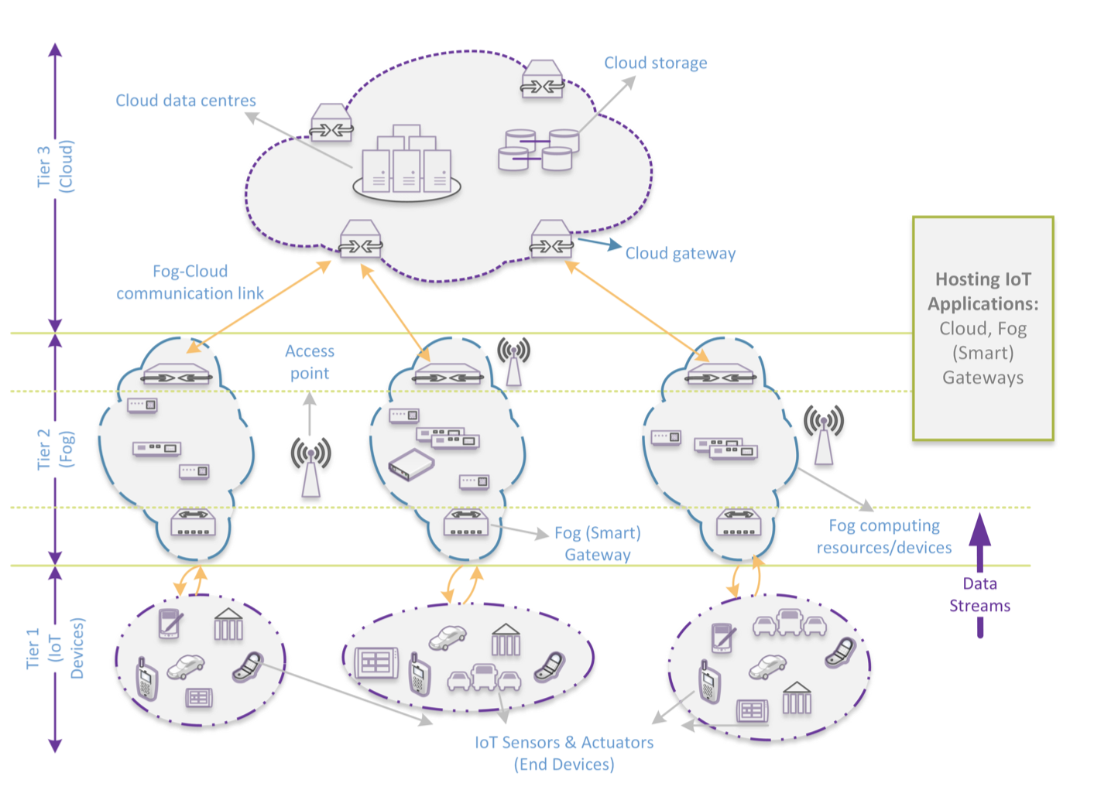
Introduction
Cloud Computing
Fog Computing
Sensor Layer
Edge Layer
Cloud Layer
Traditional Cloud Paradigms
Computation power
Network communication (Latency)
Lambda Architecture
Speed Layer
Batch Layer
Serving Layer
https://www.researchgate.net/figure/Pilot-system-architecture-of-A-Cloud-Computing-site-at-NCHC-Taiwan-and-B-Fog_fig2_263014236
Taneja, M. and Davy, A., 2017, May. Resource aware placement of IoT application modules in Fog-Cloud Computing Paradigm. In Integrated Network and Service Management (IM), 2017 IFIP/IEEE Symposium on (pp. 1222-1228). IEEE.

Slide 4
Problem Statement
Design a system to monitor and predict the temperature of a CPU
End device is assumed to have minimal compute power
Monitoring device is assumed to have minimal compute power
Edge device has a small amount of compute power and storage
Monitoring device is connected to the same edge device as the end device
Cloud has a large amount of compute power

Slide 5
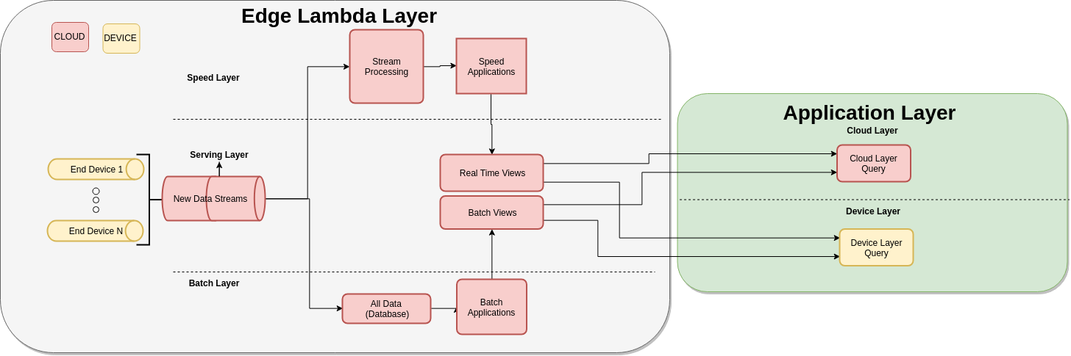
Original Lambda
Lambda Layer

Slide 6
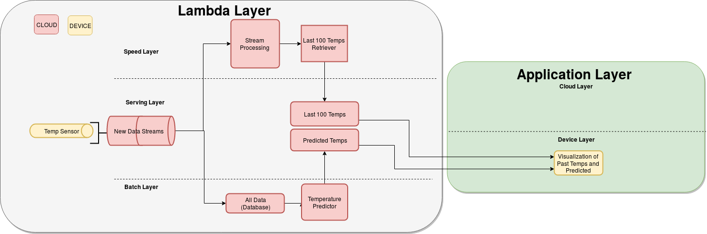
Original Lambda

Slide 7
Edge-Lambda
Slight modification to the original Lambda Architecture
Speed Layer is moved to the edge device
Serving layer can now exist in the cloud, edge or end device layers

Slide 8
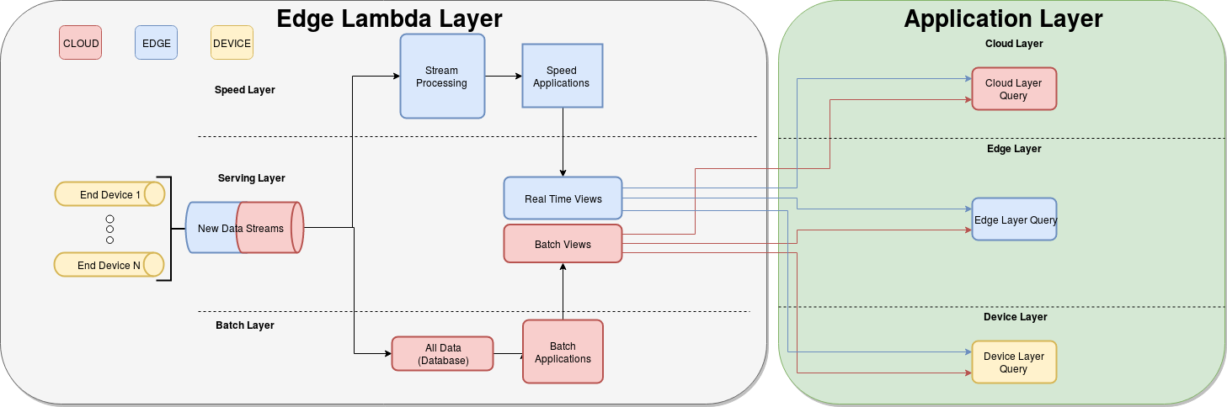
Edge-Lambda

Slide 9
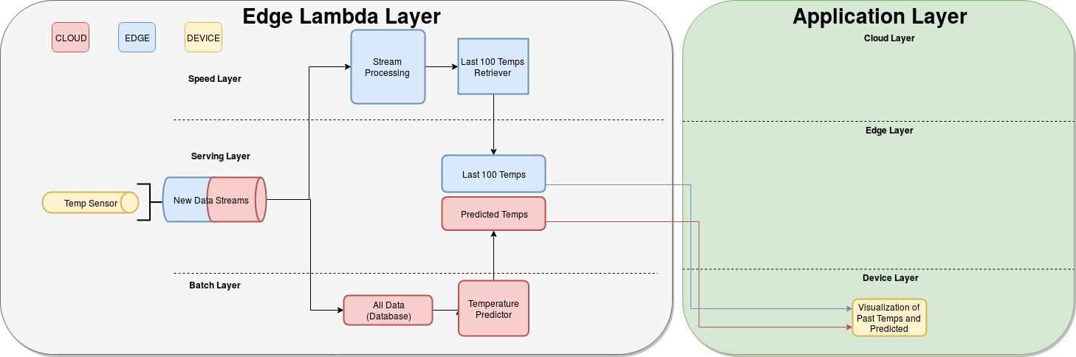
Edge-Lambda

Slide 10
Implementation Details
Setup End Device
Read CPU temperature
Send temperatures to Edge and Cloud via RabbitMQ
Setup Edge device
Install RabbitMQ
Install MySQL
Install hostapd to host wifi network
Setup iptables to forward packets from wireless to ethernet
Setup Cloud
Install RabbitMQ
Install MySQL
Read and store temperature data from RabbitMQ to MySQL
Predict future temperatures and store into MySQL
ARIMA prediction

Slide 11
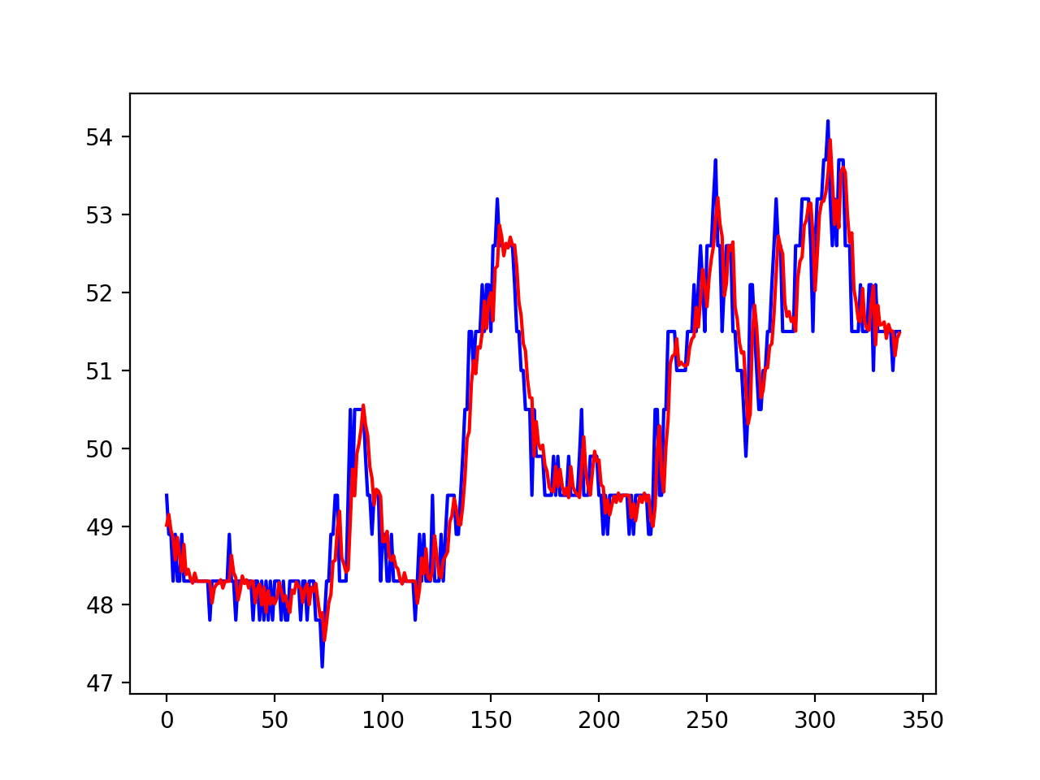
Results (Time series Prediction)
Auto-regressive Integrated Moving Average Model
Number of time lags
Number of differencing
Order of moving-average
Temp recorded data-points (total 1000)
66% for training
34% for evaluation/test
RSME = 0.386712

Slide 12
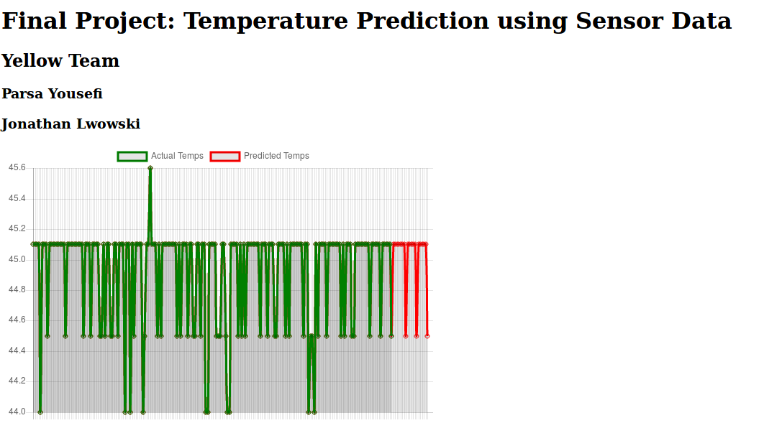
Results (Real-time prediction)

Slide 13
Conclusion
Fog Cloud Challenges
Network Communication (Latency)
Computation Power
Distribution of work loads between sensor level, edge level, and cloud level
Modified Lambda Architecture
Speed Layer in edge device (router)
Serving layer in the cloud, edge, and end devices
Batch layer includes temperature Prediction using ARIMA time-series forecasting method
Minimizing the latency
Optimizing the computation in both edge and cloud layers

Slide 14
References
A. Munir, P. Kansakar and S. U. Khan, "IFCIoT: Integrated Fog Cloud IoT: A novel architectural paradigm for the future Internet of Things.," in IEEE Consumer Electronics Magazine, vol. 6, no. 3, pp. 74-82, July 2017. doi: 10.1109/MCE.2017.2684981
M. Taneja and A. Davy, "Resource aware placement of IoT application modules in Fog-Cloud Computing Paradigm," 2017 IFIP/IEEE Symposium on Integrated Network and Service Management (IM), Lisbon, 2017, pp. 1222-1228.
doi: 10.23919/INM.2017.7987464
http://lambda-architecture.net
https://www.datascience.com/blog/introduction-to-forecasting-with-arima-in-r-learn-data-science-tutorials
https://www.analyticsvidhya.com/blog/2018/02/time-series-forecasting-methods/

